Slide 1


BMA Collective Action Update
Presented by Dr Clare Bannon

Slide 2

BMA Actions
Limit daily patient contacts per clinician to the UEMO recommended safe maximum of 25
Serving notice on voluntary services that plug local commissioning gaps
Cost up the value of providing locally commissioned services and serve notice on contracts which are undermining practices’ ability to sustain a service
Withdraw permission from secondary-use data sharing agreements
Freeze sign-up to new data sharing platforms
Stop engaging with the e-Referral Advice & Guidance pathway
Stop rationing referrals, investigations, and admissions
Switch off GP Connect Update Record Functionality
Ignore medicine optimisation software which diminishes patient choice in return for system savings never seen by GP practices
Defer your PCN declaration regarding online triage to 2025
Presented by Dr C Bannon

Slide 3
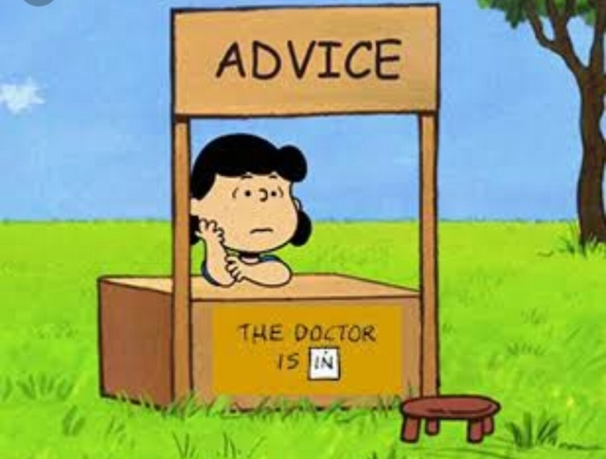
2. Advice and Guidance
Advice and Guidance, see BMA guidance
Only use if genuinely want brief advice.
Long list of actions for the GP is not appropriate.
Please bear in mind the number of consultants continues to rise but the number of fully qualified full time GPs is over 800 fewer fully qualified FTE GPs since 2019.
Over that same time period we are seeing 20% more patients
We should not take on further hospital work.
Presented by Dr C Bannon

Slide 4

3. Serve notice on commissioning Gaps
In Barnsley there are a number of services that are unfunded.
Phlebotomy – this is only funded for shared care drugs. We are not funded to provide blood tests for any other reasons.
Spirometry - New service to be launched supported by LMC
ECGs - these do not form part of essential services, patients should be referred.
PSA Call and Recall - LMC Template letter
MGUS call and recall - LMC Template letter
Presented by Dr C Bannon
Notes:
Where possible these patients should be referred to the phlebotomy service at the glassworks or hospital. We are often asked about bloods for QOF – the requirement here is to organise the test not perform it.
There is very clear guidance from NHSE that is clear this should be available for GPs to book via eRS. The hospital is accepting referrals for spirometry and we would encourage practices to use this
many areas have an ECG locally commissioned service, providing ECGs does not form part of essential services and where possible these patients should be referred
Providing recall for PSA testing under the direction of the hospital should have a formal, funded shared care arrangement. There are not robust mechanisms in place to manage these patients in General Practice. The LMC has been made aware of a number of significant events concerning the follow up of PSA results, which may require actioning even when in the normal range. We do not have the infrastructure in place or the knowledge to independently decide how to manage these results. GMC guidance ‘Good medical practice’ is clear that Drs should ‘provide a good standard of practice and care and work within competence’. Please see attached letter to serve notice to urology about accepting the care back.
There is a significant level of risk in managing patients with Monoclonal gammopathy of undetermined significance. Patients are monitored due the increased risk of malignancy. Monitoring of these patients does not fall into the GMS/PMS definition of essential services, and legal advice taken by the BMA suggested GPs treating such patients are putting themselves at risk, due to their limited knowledge of the condition. All patients with MGUS should be returned to haematology for the appropriate specialist follow up. There are several examples across England of good practice such as University college London MGUS , nurse led telephone follow up clinic that utilises Nurse specialists to follow up these patients. Please see attached letter to return all patients currently under follow up for

Slide 5

Shared care
Some funding for shared care but it is not enough for the work involved
Raised with Medicines Management team that PSSRU figures should be used
We have written to the ICB and Acute Trusts that the majority of practices intend to stop signing new patients up to shared care without changes from April 1st.
Presented by Dr C Bannon
Notes:
Personal Social Services Research UnitUniversity of Kent and University of York Research

Slide 6

Data Sharing Agreements
We recommend practices do not sign any new data sharing agreements
ICB Connecting GP data
Whilst could be beneficial in long term must have the funding to underpin plan is to use for service redesign.
We are not recommending Scriptswitch or Eclipse are switched off as feel this have important safety uses
Presented by Dr C Bannon

Slide 7
Thank you for listening.
Questions?
01226 355 824
barnsley.lmc@nhs.net
www.barnsleylmc.co.uk

