Slide 1
TUBERCULOSIS
AWARENESS

Slide 2
Aims of session:
To have a basic understanding of Tuberculosis (TB)
The signs and symptoms of TB and how it is transmitted
The risk factors for TB
Active disease versus latent infection
Who to contact if any concerns

Slide 3
What is TB ?

Slide 4
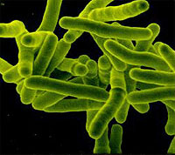
Human Tubercle Bacillus – Mycobacterium Tuberculosis is the main cause of Tuberculosis
Its a rod shaped microbacteria
Slow growing doubles 18-24 hours
Passed by inhalation from an infected person
Notifiable disease
3 types of Notifiable TB
M. Tuberculosis
M. Bovine - infection previously passed on in infected milk- usually Pyrazinamide resistant.
M. Africanum as the name suggests in Africa

Slide 5
Clinical Symptoms of TB
Cough for over 3 weeks
Drenching night sweats
Fever
No appetite
Unexplained weight loss can be quite rapid
Extreme tiredness / lethargy

Slide 6
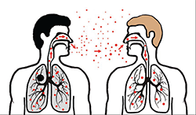
How is TB transmitted?

Slide 7
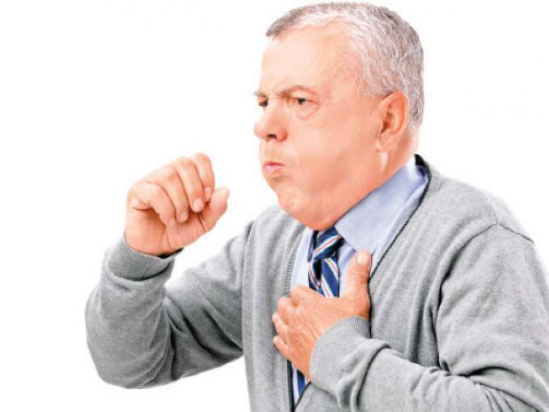
Coughing
Sneezing
Singing
Laughing

Slide 8
What are the Risk factors for TB?
High risk countries
Travel to high risk countries
Prison / Detention
Homelessness / refugee camps
Alcohol dependence
Drug use

Slide 9
Treatment for active TB
Standard Quadruple therapy for a period of 6 months – this time frame can be variable depending on site of disease and any results received for example any resistance.
Following 2 weeks of treatment a person is deemed non infectious.

Slide 10
What is Latent TB infection
Dormant / Latent infection
Identified by screening
Individual clinically well no signs or symptoms to active TB disease
No risk of transmission to others
Treatable 3 months of dual therapy or 6 months of mono therapy

Slide 11
Barnsley / Wakefield Community TB service
01226 – 731686
01924 - 252873
Bev Jones Lead TB Clinical Nurse Specialist TB Barnsley & Wakefield
Ruth Maclean – TB Specialist Nurse - Wakefield
Faa Songelani Community TB Staff Nurse - Wakefield

