Slide 1
Pulmonary Rehabilitation
Ursula Freeman
SYICB PR Transformation Lead
@SYPRehab
ursula.freeman@nhs.net
Rachel Clayton
Clinical Team Leader - SWYFT
@allofusinmind
Rachel.clayton@swyt.nhs.uk

Slide 2
What is PR?
A programme of physical activity and education for people
who have chronic lung disease, who are limited by breathlessness.
Highly evidenced based
PR guidelines BTS 2013 & 2023 update
COPD NICE 2018/19, Cochrane 2015, GOLD 2024
Pulmonary Fibrosis NICE 2013/17, Cochrane 2021
Bronchiectasis BTS 2019
Notes:
We often only talk about COPD in relation to PR but it is the biggest disease group that access PR and what the original evidence was built around. Now ILD Bronchiectasis guidelines also include PR – smaller numbers though.

Slide 3
What PR isn't!
Airways Clearance sessions
Dysfunctional breathing sessions
Weight loss programme
Sheffield Alternative Options:
ICTT – housebound patients
NGH resp physio clinics (consultant referrals only)
Live Lighter

Slide 4
Aims of PR
Reduce exacerbations
Reduce hospital admissions (LOS reduced significantly)
Reduce readmission following AECOPD admission
Reduced dyspnoea
Increase QoL
Increase walking distance
Self-management
Reduce anxiety associated with breathlessness
Notes:
90% people who do PR report an improvement in QoL

Slide 5
PR National Programme
High Priority – NHSE LTP, NHSE 5-year PR vision, CORE20PLUS5, RightCare COPD pathway, NHSE PR commissioning standards
NHSE Funding till March 2027
NRAP (RCP) nrap.org.uk
PRSAS (RCP) prsas.org
NHSE Commissioning standards 2024
BTS PR guidelines (updated 2023)
Notes:
LTP – Resp high priority - increase access to PR over 10 years
5 year vision quality access and sustainable
Core20 HI approach - There are five clinical areas of focus which require accelerated improvement.
Rigthcare COPD pathway – timely access to PR

Slide 6
How is PR being addressed in SY?
SYICB Joint forward plan
SY PR subgroup 2022 (Commissioners and Providers)
SY PR Transformation Lead 2024 (12months)
SY PR 5-year vision
6 priority areas
Access and HI
Service delivery and waiting times
Service specification
High quality service
Integrated approach
Workforce

Slide 7
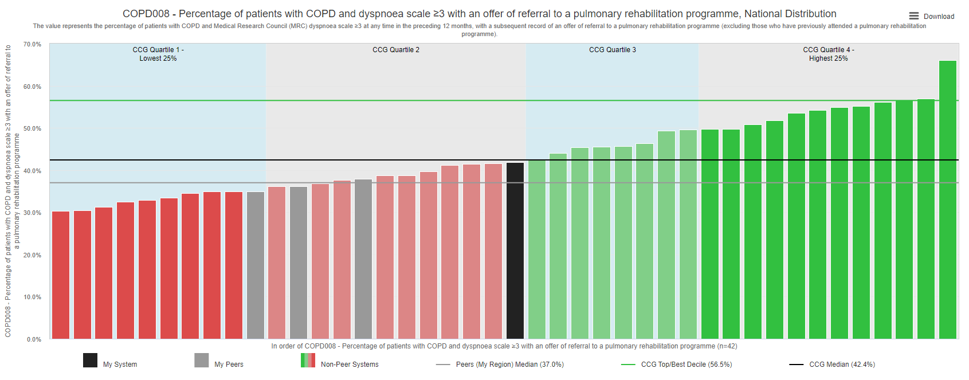
What do we know about PR in SY?
Prevalence of COPD in South Yorkshire is 2.6% (or 38,000 people) v 2.1% Nationally¹​
41.8% COPD patients with MRC 3+ were offered a referral to a pulmonary rehabilitation (22/23)¹​
1 Model Health System

Slide 8
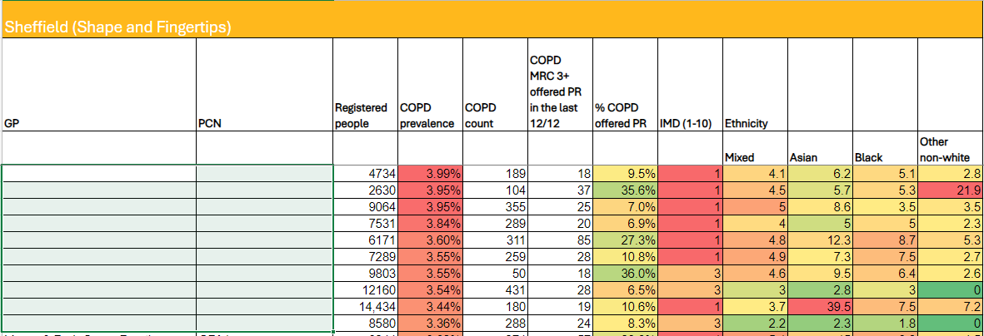
What do we know about PR in Primary Care?

Slide 9
The Right Patient at the Right Time
"Intervention Decay" - example n=100
20% Opt out before assessment – Not a priority/ lack of understanding
5% Decline at assessment – Can't commitment / transports / cost
10% Drop out during the programme – Exac. / other commitments / transport / comorbidities / cost
65% complete programme
Do not continue PA post PR
Re-referred to PR
*numbers are hypothetical / anecdotal

Slide 10
The Right patients at The Right time –
What's the criteria?
COPD / ILD / Bronchiectasis
Limited by breathlessness
MRC 3+
Contraindications – Sev. AS, unstable angina & AAA > 4.0cm
Resp. meds optimised
Stable comorbidities (CVS & MSK particularly)
Resolved investigations i.e. ECHO, Oxygen
Motivated - #WMTY
Committed – 2 x week 6/52
Informed consent
Notes:
The point of referral to pulmonary rehabilitation should be used as an opportunity to explore the patient’s understanding of pulmonary rehabilitation, address concerns and to educate patients about the benefits of a pulmonary rehabilitation programme.
We want Healthcare professionals making referrals to pulmonary rehabilitation to have basic knowledge about what a programme entails and effectiveness.
A pulmonary rehabilitation programme should be presented by the referrer as a fundamental treatment for CO
What we want to avoid is other conditions / symptoms other than breathlessness limiting their ability to do PA. - i.s. MSK pain. Angina,

Slide 11
PR in Barnsley
You first:
Referral via email form to: RightCareBarnsleyIntegratedSPA@swyt.nhs.uk
Need medical summary
Meds. need optimising
BP stable
Consent and aware of commitment
Then Us:
Triaged by clinical staff
Telephone to introduce service
Assessment on phone, home or at a venue
Walk test and Questionnaires
Start PR – 6/52
D/C assessment repeat walk test and Questionnaires

Slide 12
PR in Barnsley – assessment & groups
Assessment – phone
Walk test and Observations
Invited to group
Up to 15 patient in 1 group
Rolling programme
Circuit based – resistance and CV
Individual programme
Use breathlessness Borg scale to progress.
PR groups:
12 sessions over 6 weeks
2 x exercise / wk
1 x education / wk
1-2 hrs per session
Education sessions:
Respiratory conditions
Exacerbations
Self management
Breathing control
Inhalers/Medication
Talking Therapies – Stress management
Face to face with additional online resources

Slide 13
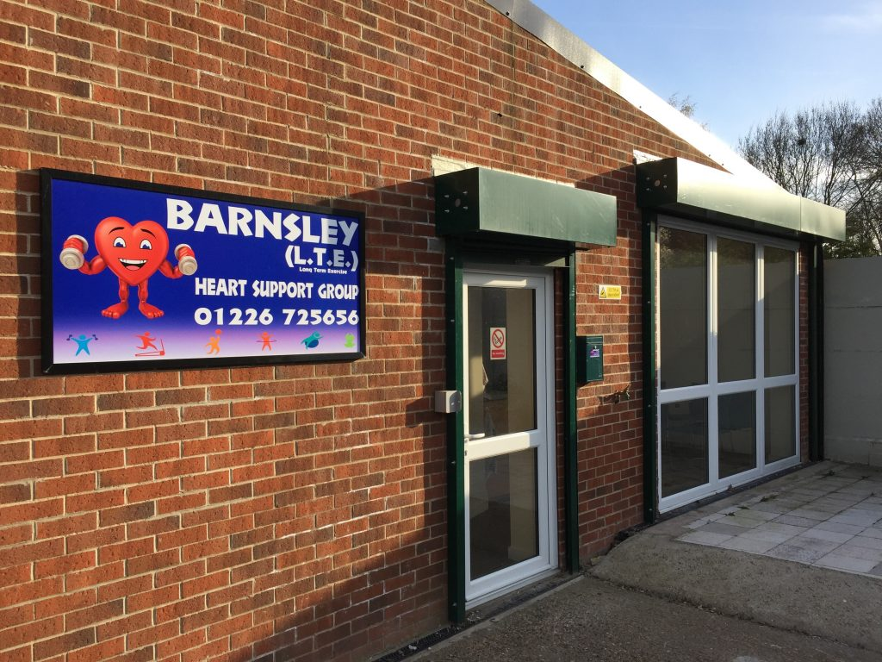
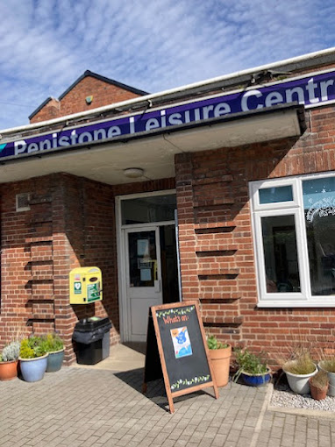
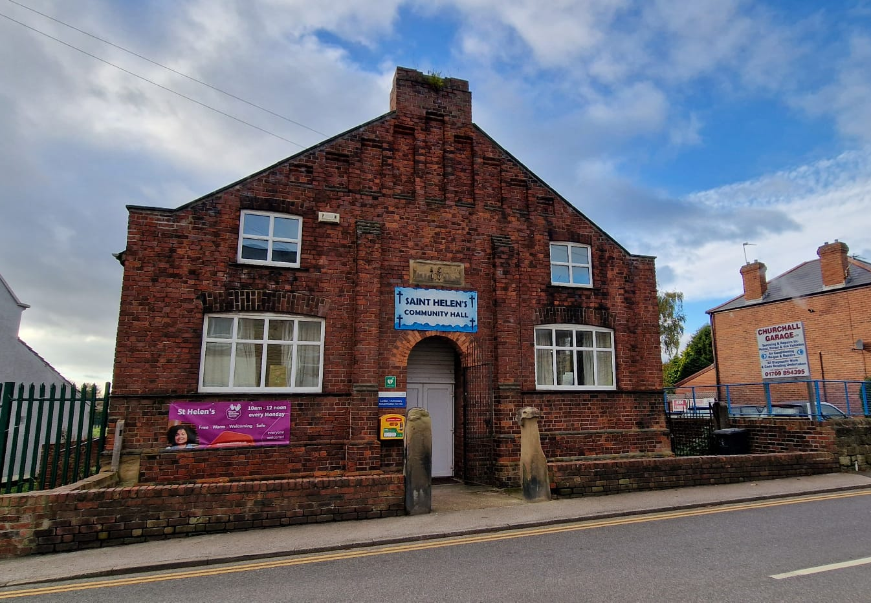
PR in Barnsley - Venues
Healthy Hearts Gym. Royston S71
Penistone Leisure Centre. S36
The Rockingham Centre.
Hoyland S74
St. Helen’s Church Community Hall. Thurnscoe S74

Slide 14
What is Barnsley PR doing to improve access?
Increase number of venues
Reduce waiting times
Make the referral process easier
Triage patients
Suggest transport options i.e. door-2-door
Offer home rehab as an alternative
Use data to target support for GP
Offer support / education to referrers
basic understanding of PR
who to refer and when

Slide 15
What can Primary Care do to help?
Consider PR referral for all COPD / ILD / Bronchiectasis with MRC 3+ (@ Annual Review?)
Plant the PR seed early after diagnosis
Fundamental treatment - not an add-on if nothing else works
Work with patients who decline – health coaching
Case finding
Tell us what you need to help your patients access PR

Slide 16
Elevator pitch
How would you introduce PR to patients?
A short memorable description
What are the key points?
Earn a second conversation
Focus on the positives
Be clear about commitment
Finish with a question

Slide 17
Pulmonary Rehab Elevator pitch
How introduce PR to your patients
_______________________________________________________________________________________________________________________________________________________________________________________________________________________________________________________________________________________
Key words:
Physical activity
Education
Evidence-based
Effective
Self-management
Confidence
Quality of life
Less breathless
Safe
Stronger
Fewer flare ups

Slide 18
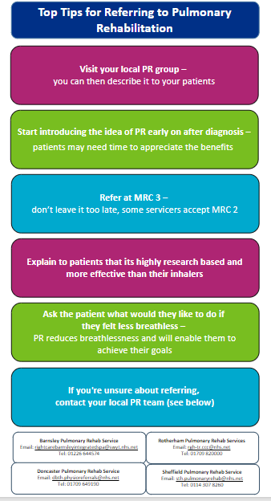
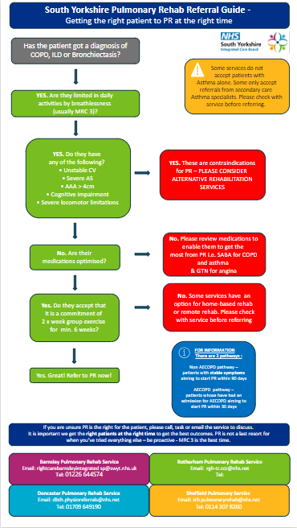
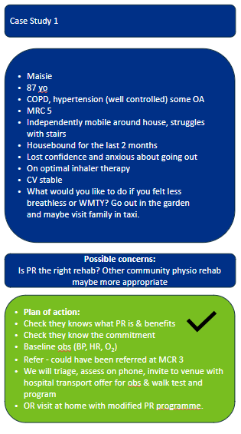
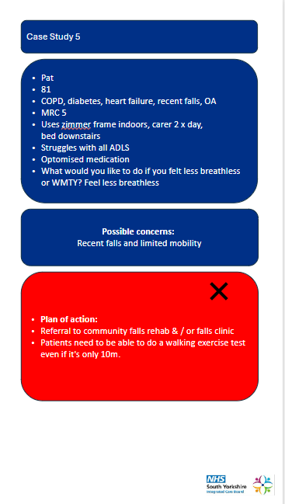
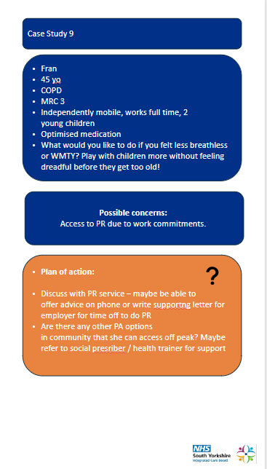
Resources
Top Tips
Referral Flow Chart
Case Studies

Slide 19
How else can PR help you?
PCN, Practice & 1:1 education / support sessions
Online education resource (short 10 min webinar intro) - good for new staff
Anything else?

Slide 20
Questions?

