Slide 1
Menopause
Dr Philippa Green
Notes:
Image credit: https://www.yesmagazine.org/opinion/2022/02/15/menopause-shape-shifting-power

Slide 2
What will we cover
What is it?
Why is it a problem?
What can we do about it?
Notes:
Image credit:
https://www.newstatesman.com/comment/2024/10/the-menopause-industry-is-a-murky-area-of-womens-healthcare

Slide 3
What is it?
Menopause: 1 year after last menses
Perimenopause: lowering or fluctuating levels of oestrogen before the menopause, often causing a collection of symptoms
Premature ovarian insufficiency: perimenopausal symptoms including change in period cycle before the age of 40
Notes:
Image credit :
https://en.wikipedia.org/wiki/Menopause
https://livehealthy.muhealth.org/stories/8-surprising-facts-about-menopause-and-perimenopause

Slide 4
Is it a medical problem?
Why is it a problem?
Notes:
Image credit:
https://www.motherhoodindia.com/perimenopause-symptoms-causes-treatment/

Slide 5
Health risks of menopause
Bone health
Osteoarthritis
Other MSK conditions
CVD
Stroke
HTN
Obesity
T2DM
Dementia
Depression
Anxiety
Immunity
Worsening of pre-existing conditions
Misdiagnoses

Slide 6
Symptoms
Anxiety
Low or fluctuating mood
Poor concentration, focus, memory
Change in periods
Hot flushes and night sweats
Sleep disturbance
Headaches
Irritability
Joint and muscle pains
Reduced libido, dyspareunia
Vaginal dryness, itching, discomfort
Urinary frequency, urgency, UTIs
RED FLAGS - abnormal bleeding– new persistent, intermenstrual, post coital
- weight loss, persistent bloating,

Slide 7
If under 40- consider POI
If 40-45 – consider bloods to exclude other causes
If over 45 – establish diagnosis on the basis of one or more symptoms, no need for FSH
FSH testing
There is no diagnostic test for perimenopause
FSH can be useful in women under 40, but is not reliable esp if they have had a period in the last year.
Is affected by COCP and high dose progesterone-based contraception
Notes:
Image credit
https://www.askyoursisters.com/episodes/menopausalmindshift

Slide 8
What can we do about it?
Notes:
Image credit
https://easy-peasy.ai/ai-image-generator/images/empowering-portrait-diverse-women-vibrant-bold-artwork

Slide 9
Exercise advice – esp muscle building
Dietary advice
Smoking cessation
Alcohol intake
Sleep

Slide 10
What can we do about it?
HRT
Notes:
Image credit
https://www.forbes.com/sites/cherylrobinson/2024/01/22/womens-empowerment-isnt-enough-activating-women-is-more-powerful/

Slide 11
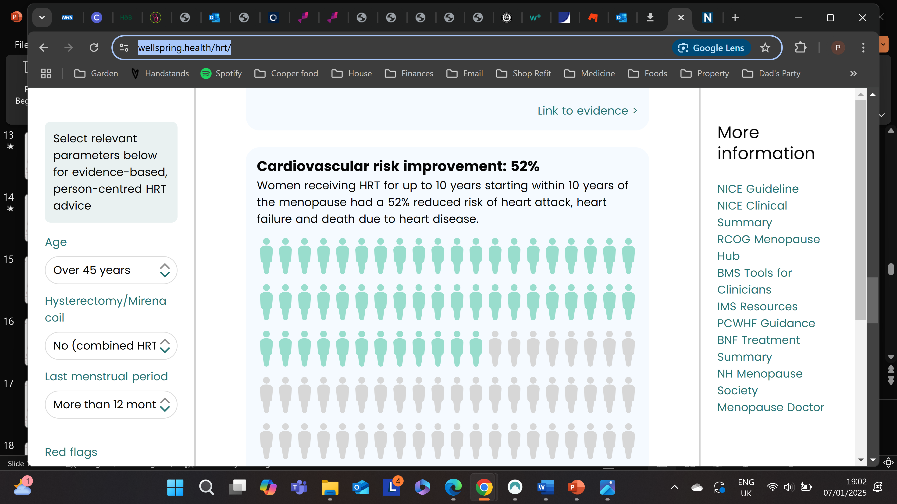
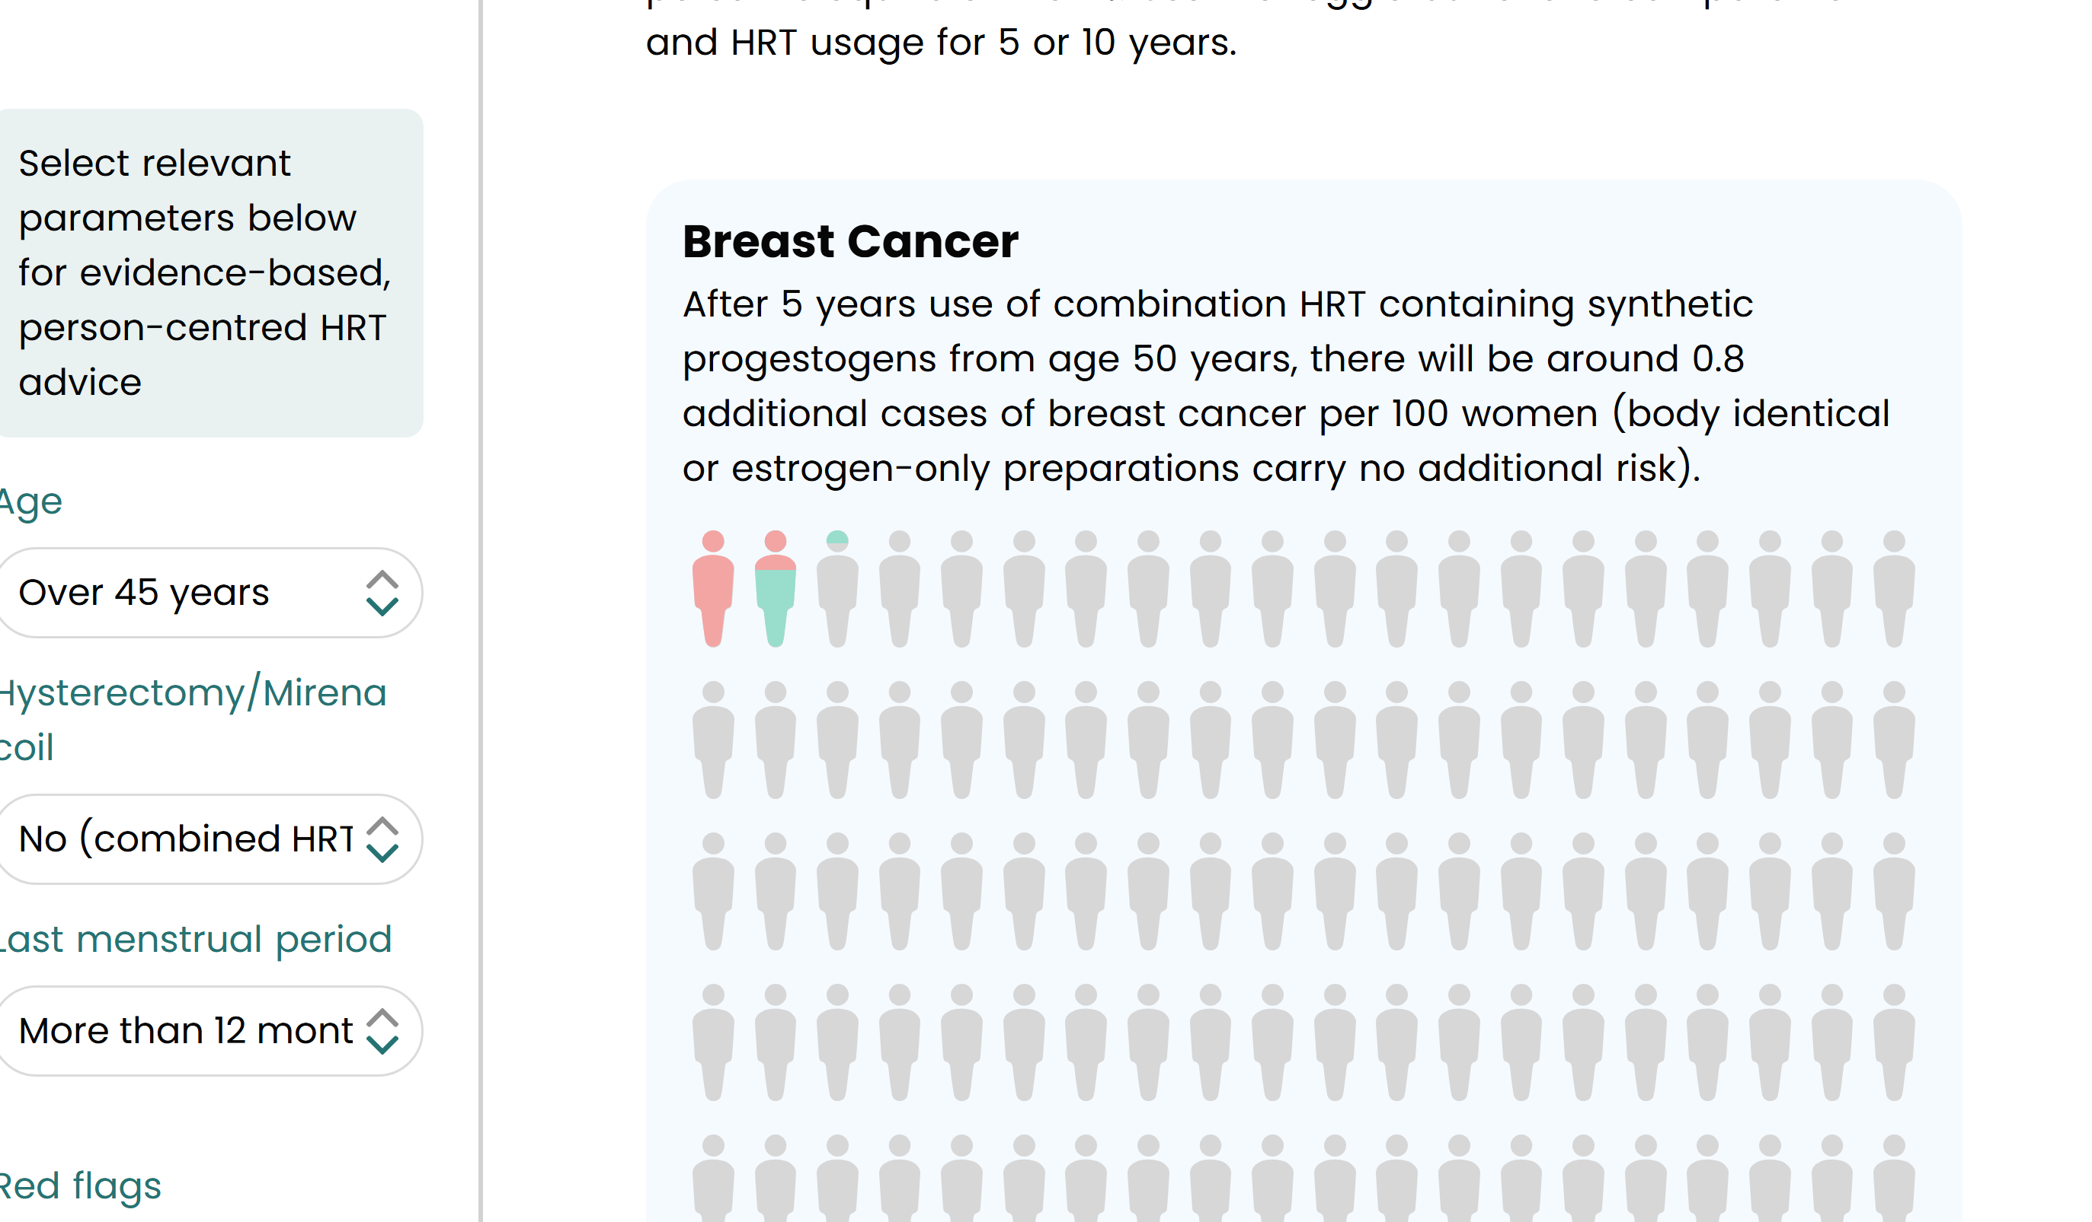
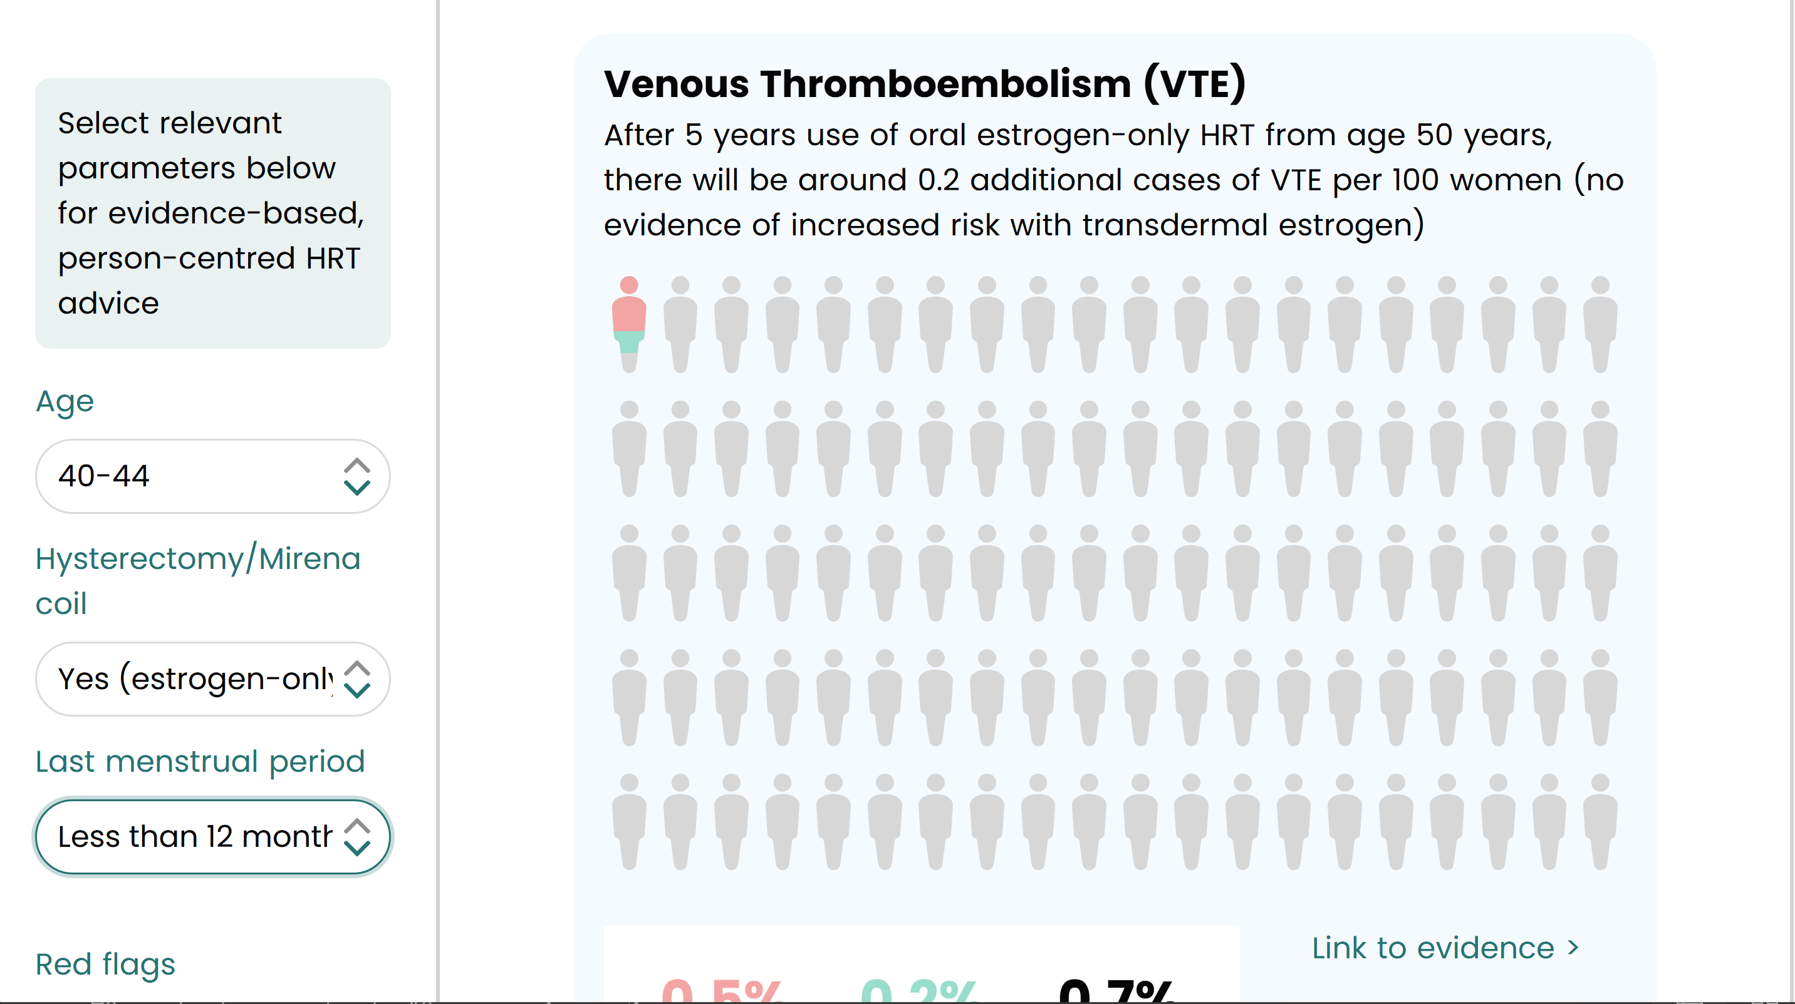
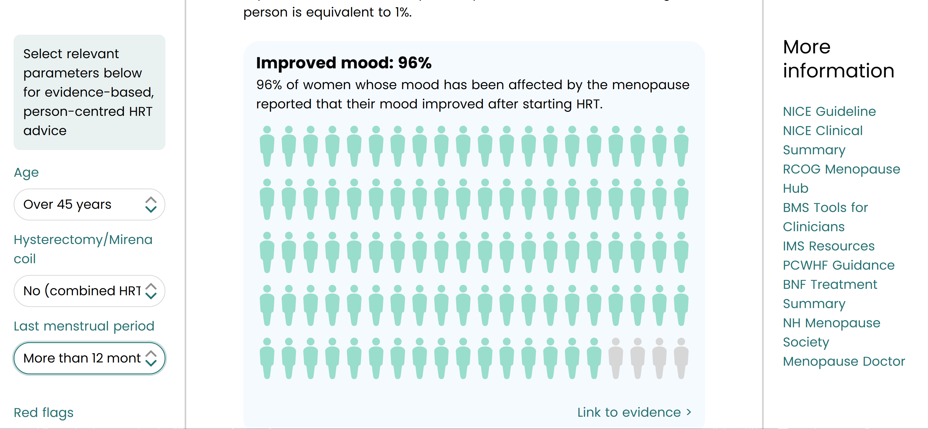
https://wellspring.health/hrt/

Slide 12
Risks by type of hrt
Risk | Oral HRT | Transdermal combined | Transdermal oestrogen only | Micronised progesterone
Breast cancer | 0.8% ↑ | 0.8% ↑ | ↓ Reduced risk | 0
VTE | 0.7% ↑ | 0 | 0 | 0
Stroke | 0.1% ↑ | ↓ 0.7% | ↓ 0.7% | 0

Slide 13
Benefits | Oral HRT | Transdermal combined
CVD | ↓ 50% | ↓ 50%
Stroke |  | ↓ 40%
Diabetes | ↓ 30% | ↓ 30%
Fragility fracture | ↓ 22% | ↓ 22%
Dementia | 0 | ↓ 34%
Mortality | 0 | ↓ 30%
Vaginal symptoms | ↓85% | ↓85%

Slide 14
Additional benefits
Mental health – improved mood – 96%
OA
Sleep quality – 56% improved

Slide 15
prescribing guide
Notes:
Image credit:
https://www.gponline.com/ensure-safe-online-prescribing/article/1488493

Slide 16
Treatment principles
-have a low threshold to try treatment
-there is no lower or upper age limit
-there is no duration limit – HRT can be taken for as long as a woman wants
-for the majority of women under 60yrs, HRT benefits outweighs the risks
-use transdermal oestrogen and micronized progesterone as first line

Slide 18
TRANSDERMAL

Slide 19
Which HRT regime
Without womb:
Continuous oestrogen only therapy
With womb or hx of untreated endometriosis:
Combined therapy
LMP within 12/12
sequential - transdermal oestrogen all the time, and progesterone for 2 weeks on then 2 weeks off,
200mg utrogestan at night
LMP beyond 12/12
continuous – transdermal oestrogen all the time, and progesterone continuously
100mg utrogestan
Progesterone challenge – 3/12 oestrogen, then 2 weeks utrogestan 200mg, then stop and review if bleeding

Slide 20
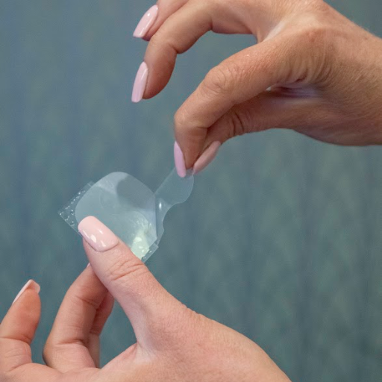
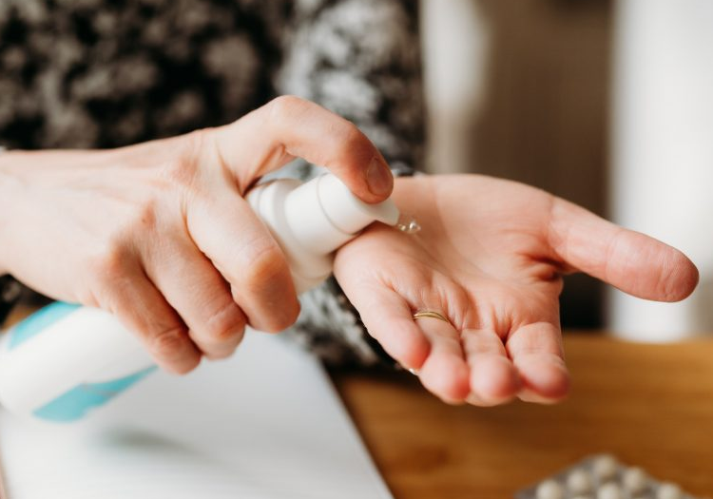
Notes:
https://best.barnsleyccg.nhs.uk/media/0kyb31ir/hrt-formulary-treatment-options-guideline.pdf

Slide 21
Contraception

Slide 22
contraception
FN29ATR
COCP
POP
Mirena – only one that is licensed for use as HRT and contraception
Implant, barrier methods or copper coil
Depo
When to stop contraception:
not on HRT or contraception
– and over 50yrs and amenorrhoea >12/12 can be stopped
– and over 50yrs, amenorrhoea <12/12 and FSH over 30, contraception can be stopped after 1 year
- and 46-50yrs and amenorrhoea >2 yrs then can be stopped

Slide 23
Testosterone
What?
symptoms
Monitoring
Normal female hormone
Replace oestrogen first
Use transdermal HRT
Not licensed …yet
Can take 6/12 to effect symptoms
Low libido, hypoactive sexual desire disorder
Low energy
Low motivation
Low mood
Reduced strength
Brain fog
Anxiety
Headaches
Vaginal dryness
FAI levels
3/12
12/12
Side effects
Hair growth
Acne, hair loss – uncommon
Voice lowering, clitoral enlargement (rare)
No long-term health risks

Slide 24
Non-hormonal treatments
Non-pharmacological – CBT, mindfulness,
Pharmacological - SSRIs/ SNRIs , Gabapentin

Slide 25
Menopause mental health
Helen Lavender
Notes:
Image credit: https://www.yesmagazine.org/opinion/2022/02/15/menopause-shape-shifting-power

Slide 26
Menopausal Mental Health: Challenges and Interventions
Why It Matters: High prevalence of depression and anxiety in peri and menopausal women. Impact on quality of life, productivity, and long-term health risks. Key Statistics: 45–64 age group has the highest female suicide rates (ONS, 2023). 60% of women experience moderate to severe symptoms during this transition. Worsley et al. (2014) and Bariola et al. (2017)

Slide 27
Managing Symptoms
Pharmacological Interventions:
Hormone Replacement Therapy (HRT): Addresses root hormonal causes but has safety concerns.
Antidepressants (SSRIs/SNRIs): Effective for mood but not underlying hormonal issues.
Non-Pharmacological Interventions:
Cognitive Behavioural Therapy (CBT): Reduces depression and anxiety by 35%.
Mindfulness-Based Interventions (MBIs): Stress and emotional resilience improvements.
Barriers:
Underutilisation due to systemic gaps and stigma.

Slide 28
NICE Guidelines 2024
Cognitive Behavioural Therapy (CBT):
Recommended as the first choice for managing low mood, anxiety, and depression linked to menopause.
Helps with coping strategies and improving emotional well-being.
Hormone Replacement Therapy (HRT):
Advised if symptoms are caused by hormonal changes.
Tackles the root hormonal causes of mood issues.
Antidepressants:
Not recommended as a first option unless the depression is not related to menopause.
Should only be used for severe or diagnosed mood disorders.
Lifestyle Changes:
Encouraged to improve mental health, including regular physical activity, mindfulness, and stress management.
Personalised Care:
Treatment should be tailored to individual symptoms and preferences,
with regular reviews to ensure it remains suitable.

Slide 29
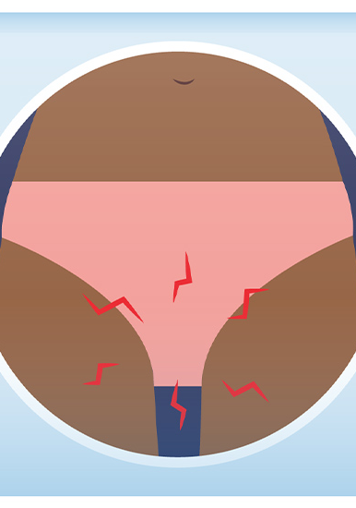
Genitourinary syndrome of the menopause
Notes:
Image credit: https://www.yesmagazine.org/opinion/2022/02/15/menopause-shape-shifting-power

Slide 30
Genitourinary syndrome of the menopause
Symptoms
examination
Treatment
Vaginal: dryness, itching, burning, stinging,
Urinary: frequency, urgency, incontinence,
Sexual: dyspareunia, PCB, low libido,
Vulval atrophy,
Atrophy of clitoral hood,
Loss of elasticity and rugae within the vagina
Normal appearance
Avoid irritants
Vaginal moisturisers
Vaginal lubricants
Topical oestrogen

Slide 31
Topical treatments
Pessaries | Vagirux | Oestradiol | 10mcg, One daily for two weeks then twice weekly | Can be used more frequently depending on need
 | Vagifem
 | Imvaggis | Estriol | 30mcg estriol, one daily for three weeks then twice weekly | Can be used more frequently depending on need Can damage latex condoms
 | Intrarosa | Prasterone (DHEA) | 6.5mg, one daily | Converts into oestrogen and testosterone Can damage latex condoms Use if no response to oestrogen alone
Cream | Gynest | Estriol | 0.01%, once daily until improvement then twice weekly | More dilute, but can be helpful if stronger preps irritating. Contains peanut oil
 | Ovestin | Estriol | 0.1%, Once daily for two weeks then twice weekly | Can be used more frequently depending on need
Gel | Blissel | Estriol | 50mcg, one daily for 3 weeks, then twice weekly
Ring | Estring | Estradiol | 7.5mcg/24hr, worn continuously for 3/12 | Flexible, silicone ring,
Oral | Senshio | Ospemifene | 60mg daily, | SERM, useful for those who can’t use vaginal treatments, cannot be used with HRT,

Slide 32
Troubleshooting
Switching between preparations – not available or patient choice
Not working …
Abnormal bleeding – review what this means
Migraines with aura – not contraindication to transdermal HRT – as no increased clot risk
High BP - as above
Endometriosis /subtotal hysterectomy
HRT certificate
Breast cancer
Equivalent doses | Evorel 50 | Lenzetto 3 sprays | Oestrogel 2 pumps | Sandrena 1mg sachet

Slide 33
3 month review
Symptoms poorly controlled or not changed
Symptoms well controlled
Symptoms improved
Move to annual reviews
Increase dose and review in a further 3/12
Compliance
Consider absorption
Consider alterative diagnosis
Side effects
Review lifestyle
Contraception review

Slide 34
Progesterone intolerance
If coping with symptoms continue for another 3/12 to see if settles
Change progesterone type or route:
- use utrogestan vaginally - off license
- mirena
If symptoms ongoing – consider use without progesterone for 3/12
If improves consider:
- cyclogest
-lutigest

Slide 35
Bleeding on hrt
HRT does not need to be stopped when referring for abnormal bleeding.
Exclude pregnancy and red flags – persistent, heavy bleeding, pcb, persistent bloating, weight loss,
Risk factors for endometrial cancer – nulliparity, PCOS, poor compliance with progesterone, high BMI, early menarche, late menopause, tamoxifen use,
Bleeding outside of normal period pattern needs examination and onward referral if necessary.
Bleeding after 6/12 or ongoing bleeding beyond 6/12 - needs further ix
Bleeding after 12/12 of amenorrhoea is PMB and should be referred as such.

Slide 36
Bleeding within 6/12
Change the regime
Change the dose
Go back to sequential regime for 6/12
CC – 200mg every night
SC – 300mg 2/52
Change the route
Change the type
Utrogestan capsules vaginally
CC – 100mg every other night
SC – 100mg every night 2/52
Mirena
Combined patch
Norethisterone - cc 5mg PO OD, sc 5mg PO BD
Medroxyprogesterone - cc 5mg PO OD,
- sc 10mg PO OD 2/52
Progestogens and endometrial protection
https://thebms.org.uk/wp-content/uploads/2023/04/14-BMS-TfC-Progestogens-and-endometrial-protection-APR2023-A.pdf

Slide 37
SUmmary
Menopause is an opportunity to make timely health interventions
We have lots of good data about risks
And lots of good data about long term benefits
Low threshold to trial treatment
Wide range of prescribing options
Face inequalities
Notes:
https://www.morrama.com/lab/menopause

Slide 38
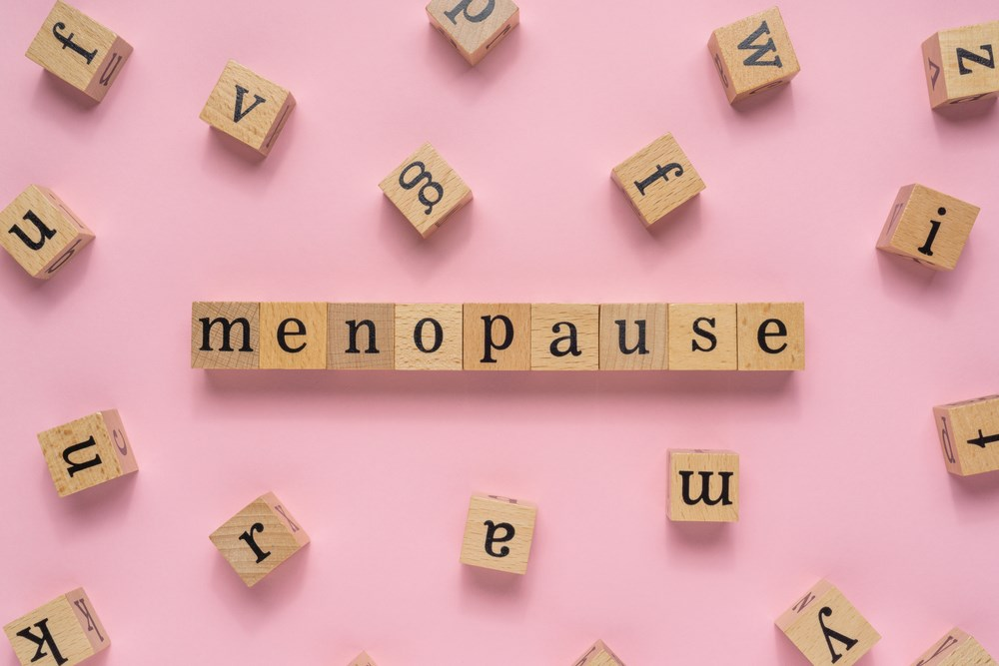
Thank you
ANY QUESTIONS?
Notes:
Image credit
https://talkingtherapies.berkshirehealthcare.nhs.uk/therapy-in-focus-blogs/mental-health-and-the-menopause/

