Slide 1
Implementing Good medical practice 2024
Notes:
Launched on 22nd August 2023, the new Good Medical Practice standards will come (or came if after the “live” date) into effect on 30th January 2024.

Slide 2
Rachel Ball
Regional Liaison Adviser – Yorkshire & Humber
https://www.hellomynameis.org.uk/
Notes:
A good example of a small project that became a major intervention.
Culture change needn’t be expensive.
Good ideas take fire.

Slide 3
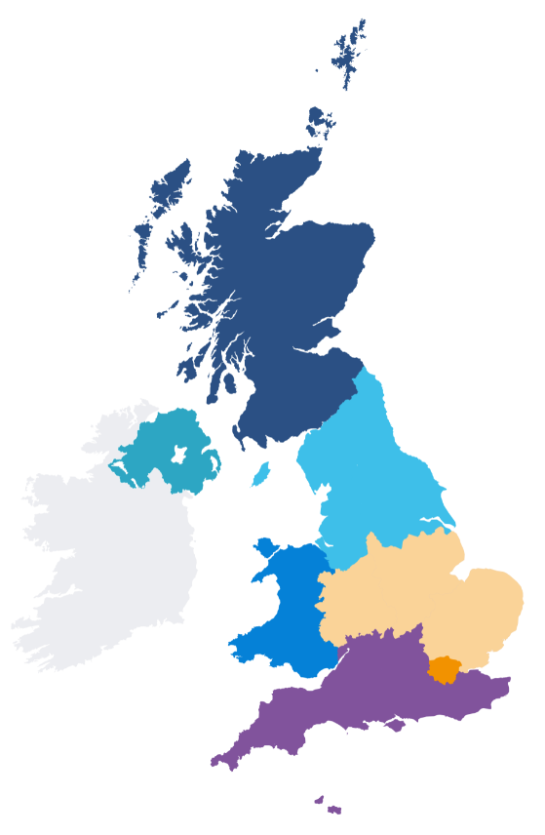
GMC Outreach
Regional and national
Improve understanding
Promote and support excellence
Teaching and engagement workshops
In person and online
Gather and share insight
Notes:
Hi, I am XXX and I am a Regional/Liaison Adviser – part of national team of advisers at GMC Outreach. We collaborate with doctors, healthcare providers, educators and other regulators to:
improve understanding of the role and value of the GMC
promote and support excellence in medical education, training and practice
learn about the environments in which doctors practice to identify and address risks to patients and doctors before harm occurs

Slide 4
What do we do?
What do we do?
Notes:
But to give you a full background of the main areas of our work…
We have an Education teams who set standards in undergraduate and postgraduate education and training. They quality assure medical schools to make sure they are meeting our standards and they also approve postgraduate medical education and training in the UK, working with Royal Colleges.
Our Registration teams ensure that we only register those doctors with the right qualifications and who are fit to practise. Every year we deal with thousands of applications from doctors all over the world.
In the last few years we introduced a huge change in medical regulation - Revalidation. Every five years, we now get confirmation that each doctor is following the standards of Good medical practice from their employer.
We are sometimes most well known for our role with dealing with complaints about doctors and how we investigate these. In protecting the public, this is a very role important, but to highlight to you, the proportion of doctors who are formally investigated is very small ( )and those removed from the register following concerns is less than approx. 50 per year
So the majority of doctors are doing a great job and we want to keep supporting them to do this by providing high standards in our guidance. This is why the diagram shows the work of our standards team being at the core of everything we do.

Slide 5
Good medical practice
Protecting children and young people
Confidentiality
0-18
Decision making and consent
Leadership and management
Raising and acting on concerns
Notes:
One of the key aspects of my role is to discuss our standards as laid out in Good Medical Practice and additional explanatory guidance. Today I will be talking with you about the new GMP 2024, which was launched on 22nd August 2023 and comes (or came if later than) into effect on 30th Jan 2024.

Slide 6
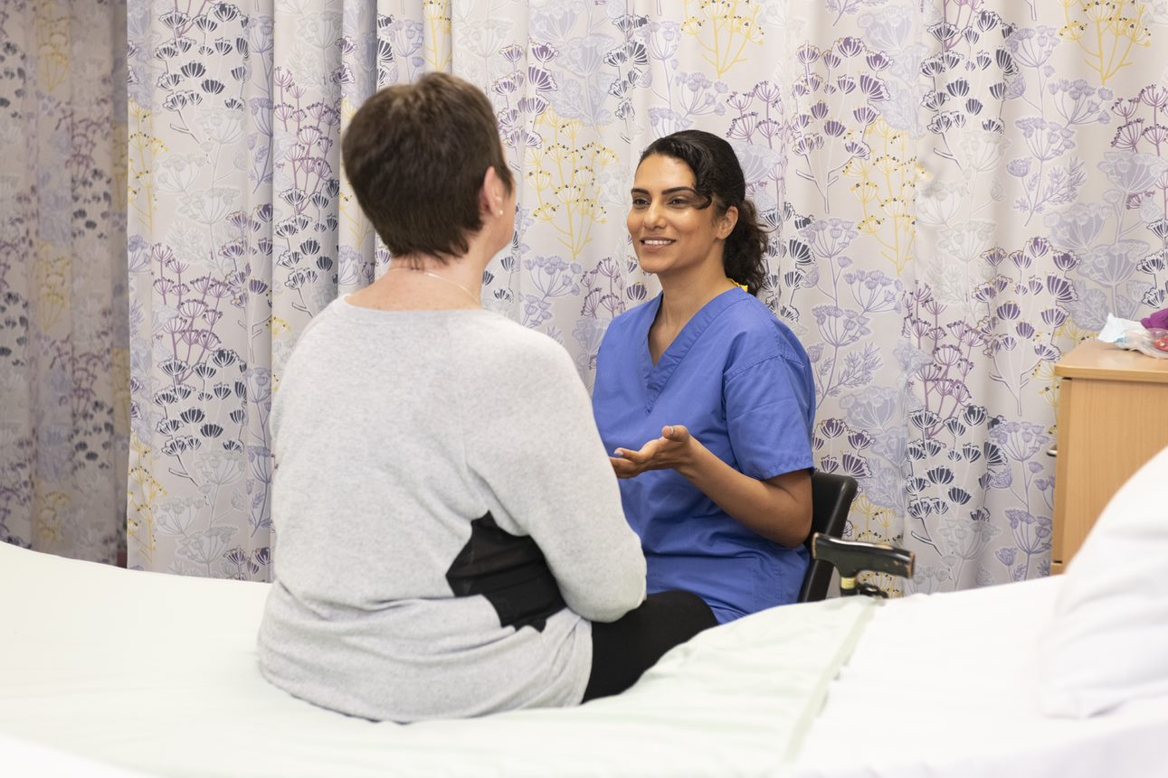
Good medical practice is at the heart of UK healthcare. It sets the standards of care and professional behaviour expected of all medical professionals registered with us.
Notes:
A reminder: Good medical practice sets out the standards of care and professional behaviour expected of all doctors, across all specialties, career stages and sectors.
It’s a supportive framework to guide doctors when caring for patients and working with colleagues.
As the name suggests it describes good practice, not minimum standards or an aspirational council of excellence - not every departure from them will be considered serious. In response to feedback, the updated version includes more information about how the standards relate to fitness to practice procedures
Key message for EDUCATORS: The standards are at the core of medical education and training, appraisals and revalidation. They are for all doctors on our register, whatever their specialty or field of practice, whether they work in the NHS or an independent care setting. So, they underpin the care we all receive throughout our lives.

Slide 7
The consultation
Notes:
During May, June and July 2022 we ran our largest consultation to date to gather feedback from stakeholders, medical professionals and the public about the future of Good Medical Practice.
We heard from over 4,600 individuals across the UK via outreach workshops, online feedback and meetings.
We’ve listened and acted on feedback from thousands of medical professionals, patients and others supporting the UK’s health services.
We’ve carefully considered the collective impact of the updated standards on the UK’s health services and patient care. The diverse views we’ve heard have helped make sure they are reasonable to deliver in high-pressure environments.
Our independent advisory forum have also shaped our thinking throughout every step of the review. This group of 12 experts from outside of the GMC have given us a range of perspectives from across the UK and from a range of specialist areas, including medical ethics, human rights and equality, diversity and inclusion.
We’re really pleased with the diversity of responses from our survey of healthcare professionals and this is important as it helps to give the guidance credibility among medical professionals from different backgrounds and personal characteristics. This didn’t happen by accident – we actively monitored EDI stats against response rates while the consultation was live and took intervention action to encourage responses from underrepresented groups (such as partnership work with organisations and targeted mailouts)
We also commissioned independent research from a behavioural insights agency to conduct focus groups and paired interviews with seldom heard groups such as carers, older people, school children, parents and expectant parents, people identifying as LGBTQ+, homeless people, asylum seekers and refugees.
consultation
3 surveys – stakeholders, medical professionals, patients
200 workshops with 2,800 doctors and medical students across the UK
Commissioned research with patients
Meetings with key stakeholders across the UK
Specialist round tables on sustainability, patient rights, AI and tech
Drafting
Internal steering groups – case examiners, legal, ftp policy
GMP advisory forum – doctors, AAs, PAs, patients, other professions
Clinical fellows and alumni
Audience testing
We are proud that e received contributions from individuals from all backgrounds during the consultation.
During the consultation;
44% of medical professional respondents identified as an ethnic minority.
41% of medical professional respondents identified as female.
7% of medical professional respondents identified as having a disability.
7% of medical professional respondents identified as lesbian, gay or bisexual.

Slide 8
To explore the key updates to our standards
To consider responsibilities of all doctors in the implementation of Good medical practice
Aims of the session:
Notes:
During this workshop we will take a look at some of the key changes on the back of our review consultation. We will also consider what your role, as educators, doctors and leaders, is in successfully implementing the new standards.

Slide 9
The four domains
Notes:
On a practical level, we’ve restructured GMP to make it easier for busy medical professionals to find the information they’re looking for. For example, we’ve changed the names of the four sections of the guidance to clearly reflect the content.
Old Domain name/structure New domain name/structure
Domain 1: Knowledge, skills and performance Domain 1: Knowledge, skills and development
Domain 2: Safety and quality Domain 2: Patients, partnership and communication
Domain 3: Communication, partnership and teamwork Domain 3: Colleagues, culture and safety
Domain 4: Maintaining trust Domain 4: Trust and professionalism

Slide 10
Fairness
Remote consultations
Making sustainable decisions
Research
Notes:
Domain 1: Knowledge, skills and development
Paragraph 1: You must be competent in all aspects of your work including, where applicable, formal leadership or management roles, research and teaching.
Key updates to highlight. These are not all new paragraphs and you may want to review this and highlight different areas dependent on the cohort you are delivering to.
Fairness
Expansion of reflective practice: consider how your life experience, culture and beliefs influence your interactions and may impact on the decisions you make about care.
New expectation to consider relevant socio-economic factors when assessing a patient’s needs.
Remote consultations
Expectation to make sure the mode of consultation is safe, offering alternatives if it isn’t.
NB this was already in the prescribing guidance.
We listened to feedback and said that the deciding factor should be whether or not it was safe, rather than what the patient requested.
Sustainable healthcare
A new duty to choose sustainable solutions when you’re able to, provided care standards aren’t compromised.
A new duty to consider supporting initiatives reducing the environmental impact of healthcare.
Research
A new duty to tell patients about opportunities to participate in research, where you are aware these exist.
Guidance extracts
Offering remote consultations
9 You must provide safe and effective clinical care whether face to face, or through remote
consultations via telephone, video link, or other online services. If you can’t provide safe
care through the mode of consultation you’re using, you should offer an alternative if
available, or signpost to other services.
Considering research opportunities
10 Research is vital in improving our understanding of health conditions, and increasing the
availability of options for effective prevention, treatment, and care. You should consider
opportunities to conduct or participate in research that may benefit current and/or future
patients, and help to improve the health of the population. You should tell patients if
you’re aware of opportunities for them to participate in appropriate research.
Sustainability
15 You should choose sustainable solutions when you’re able to, provided these don’t
compromise care standards. You should consider supporting initiatives to reduce the
environmental impact of healthcare.
New wording in paragraph 7b:
7. In providing clinical care you must:
adequately assess a patient’s condition(s), taking account of their history, including;
symptoms
relevant psychological, spiritual, social, economic, and cultural factors
the patient’s views, needs, and values
NB "social, economic" is new – a new duty to take these things into consideration when assessing a patient's needs. There's a tool developed by the Personalised Care Institute - https://www.personalisedcareinstitute.org.uk/money-talk/ and the Money & Pensions Authority which can help doctors start conversations with patients about economic circumstances.

Slide 11
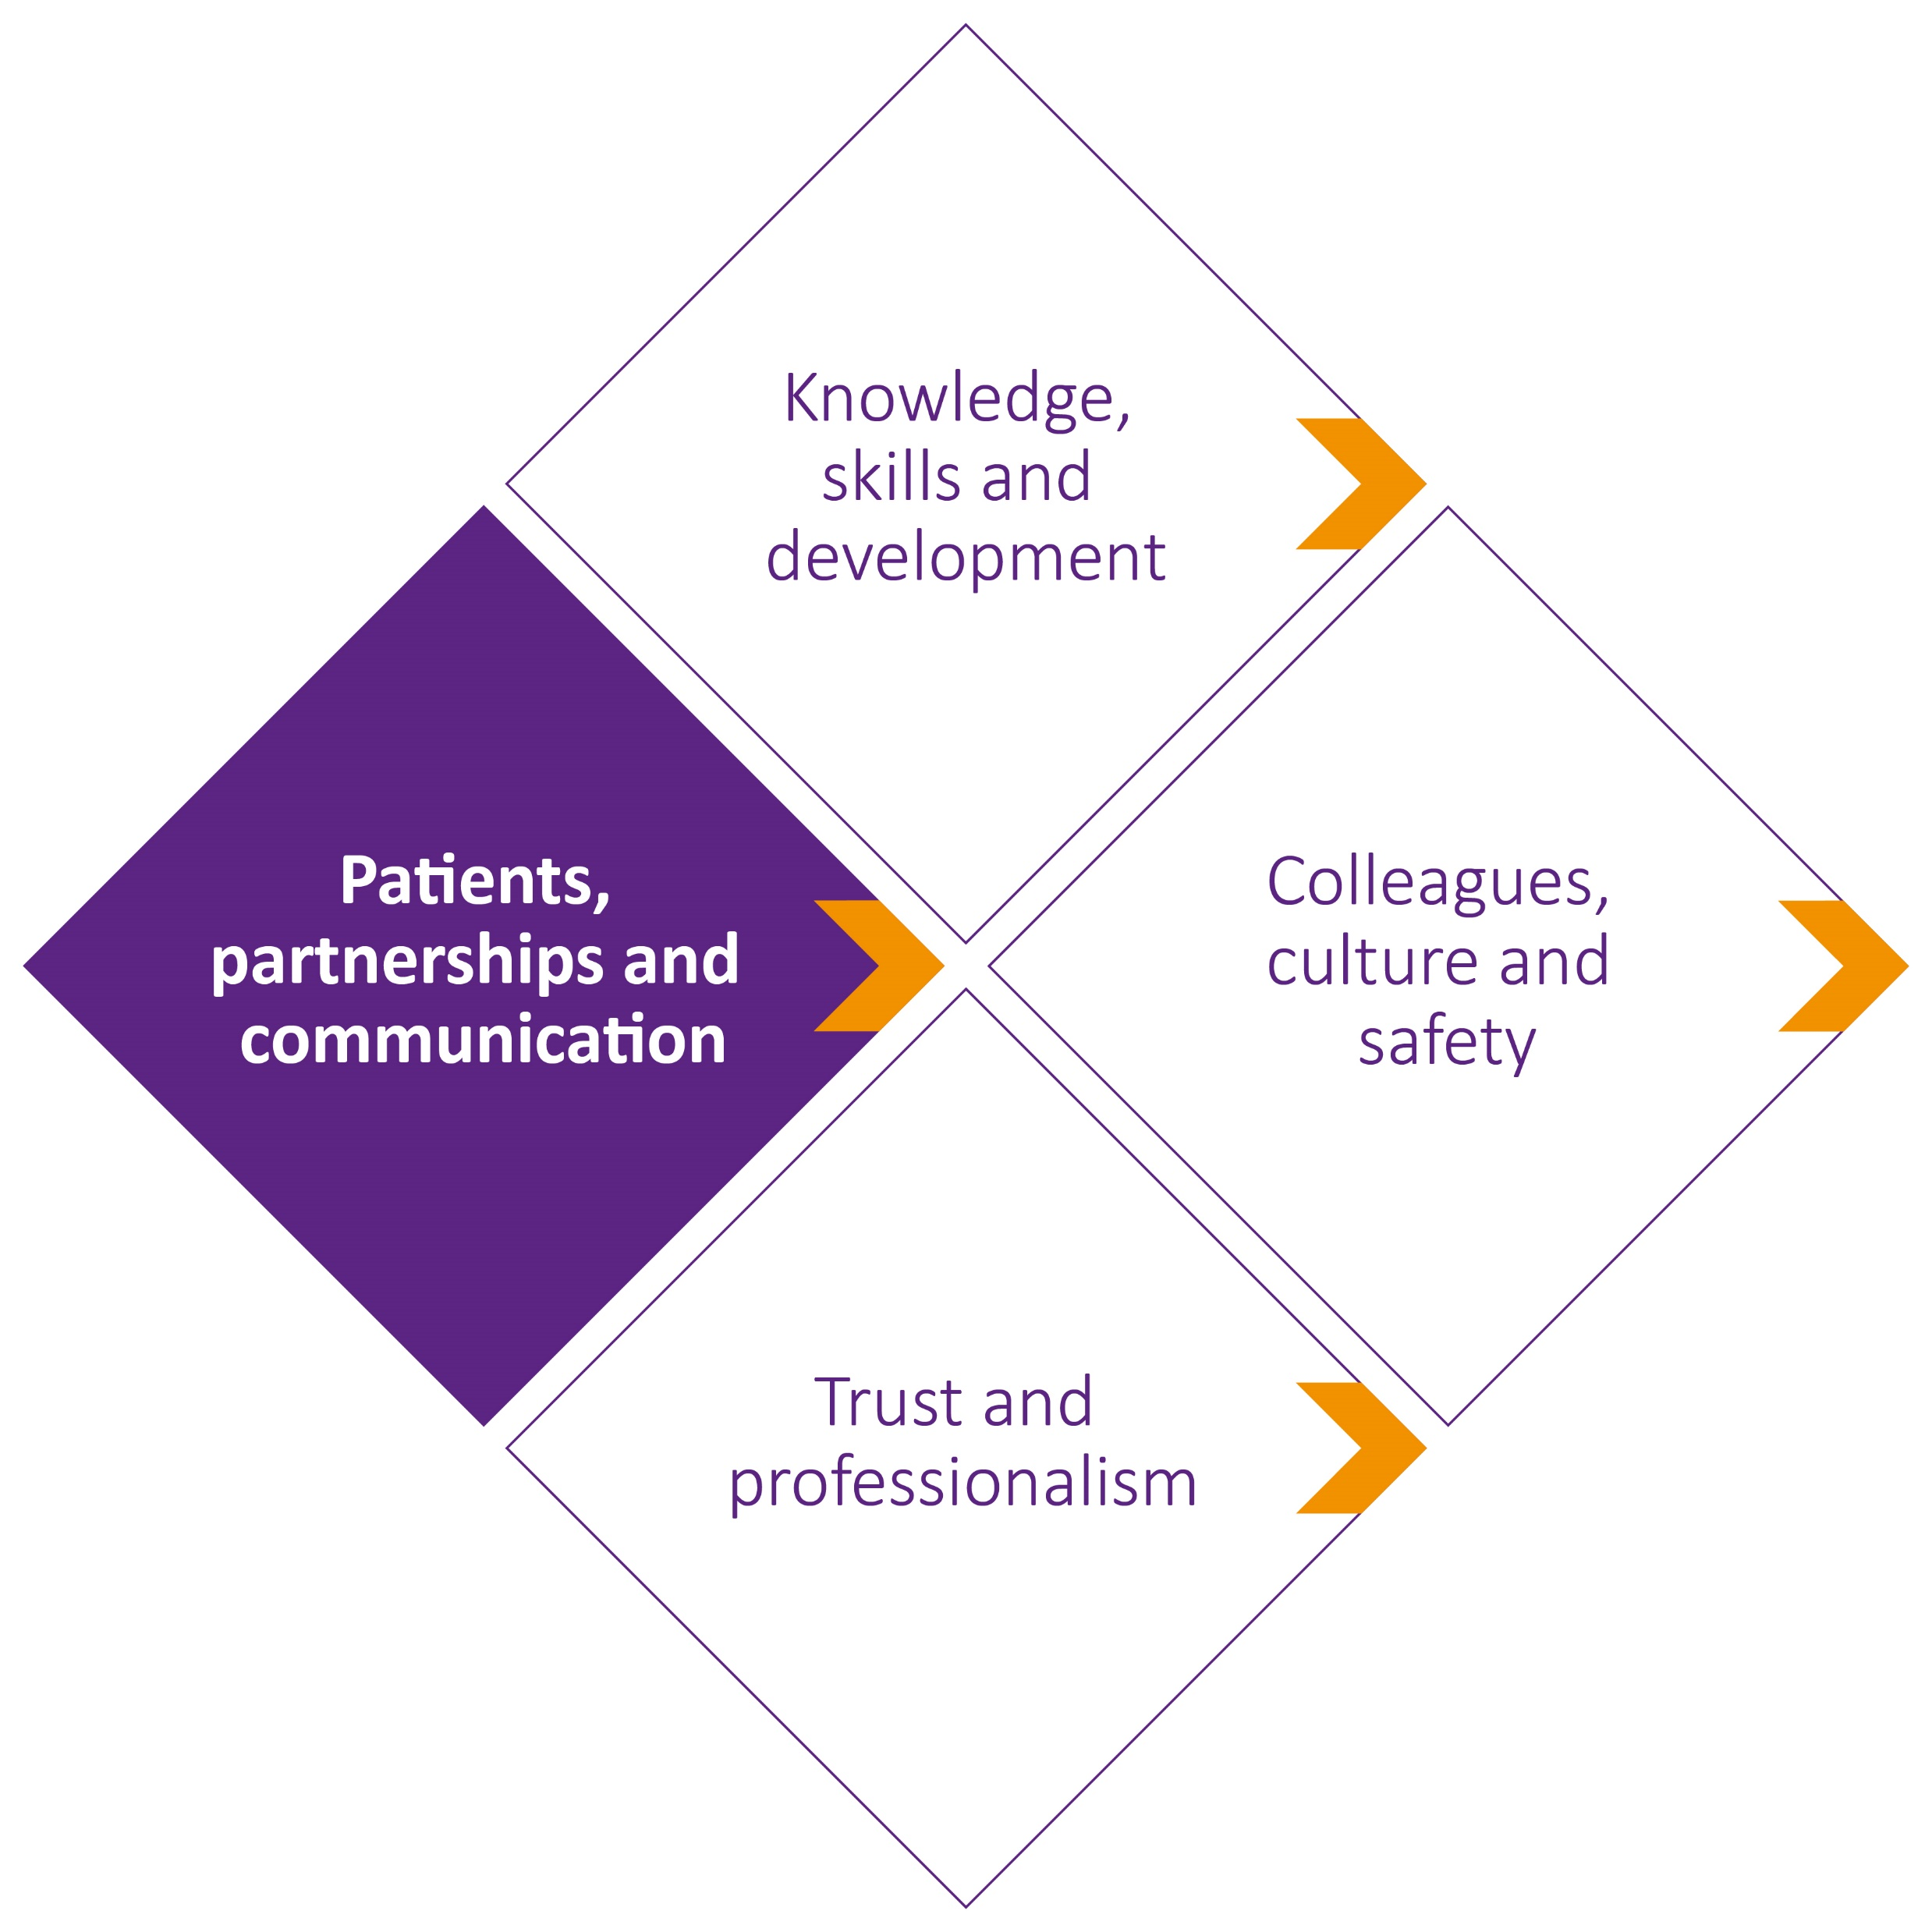
Treating patients with kindness, courtesy and respect
Partnership working
Meeting communication needs
Safeguarding
Notes:
Domain 2: Patients, partnerships and communication
Treating patients with kindness, courtesy and respect
Emphasis on the importance of kindness in healthcare, which includes communicating sensitively and considerately, recognising vulnerability and being alert to signs of pain and distress.
This doesn’t mean agreeing to every request, or withholding information that may be upsetting or unwelcome.
Partnership working (Strengthened links with our consent guidance)
Greater focus on patients’ roles in making decisions about their health, with expectations about listening to patients, not making assumptions, explaining options and checking understanding, and understanding capacity law.
Meeting communication needs
Greater emphasis on meeting patients’ communication needs, helping them to engage in meaningful dialogue and make informed decisions.
Safeguarding
New expectation to take action if a patient, or someone close to them, may be at risk of, or suffering, abuse or neglect.
Guidance extracts
Kindness (see also Internal briefing doc for updated lines to take – also Daniel Sokol article in the BMJ Do doctors need to be told to be kind? | The BMJ)
23 You must treat patients with kindness, courtesy and respect. This doesn’t mean agreeing to every request (see paragraph 7d) or withholding relevant information that may be upsetting or unwelcome (see paragraph 28). It means:
a communicating sensitively and considerately, particularly when you’re sharing potentially distressing issues about the patient’s prognosis and care
b listening to patients, recognising their knowledge and experience of their health, and acknowledging their concerns
c trying not to make assumptions about what a patient will consider significant or the importance they will attach to different outcomes
d being willing to explain your reasons for the options you offer (and the options you don’t) and any recommendations you make
e recognising that patients may be vulnerable, even if they don’t seem it
f being alert to signs of pain or distress, and taking steps to alleviate pain and distress whether or not a cure may be possible.
Partnership working
Sharing information with patients
Paragraphs 28-31 not new but strengthened in line with Decision making and consent guidance (updated 2020)
Meeting communication needs
32 You must take steps to meet patients’ language and communication needs, so you can support them to engage in meaningful dialogue and make informed decisions about their care. The steps you take should be proportionate to the circumstances, including the patient’s needs and the seriousness of their condition(s), the urgency of the situation and the availability of resources.
33 You must consider and respond to the needs of patients with impairments or disabilities. Not all impairments and disabilities are easy to identify so you should ask patients what support they need, and offer reasonable adjustments that are proportionate to the circumstances.
Caring for the whole patient
40 If a patient is taking multiple medications, you should discuss the importance of regularreviews to check that the medications continue to meet the patient’s needs and are optimised for them. You should consider the overall impact of the patient’s treatments, and whether the benefits outweigh any risk of harm.
Safeguarding children and adults who are at risk of harm
42 You must act promptly2 on any concerns you have about a patient – or someone close to them – who may be at risk of abuse or neglect, or is being abused or neglected.
Footnote 2 is a link to our ethical hub advice on Adult safeguarding : https://www.gmc-uk.org/ethical-guidance/ethical-hub/adult-safeguarding

Slide 12
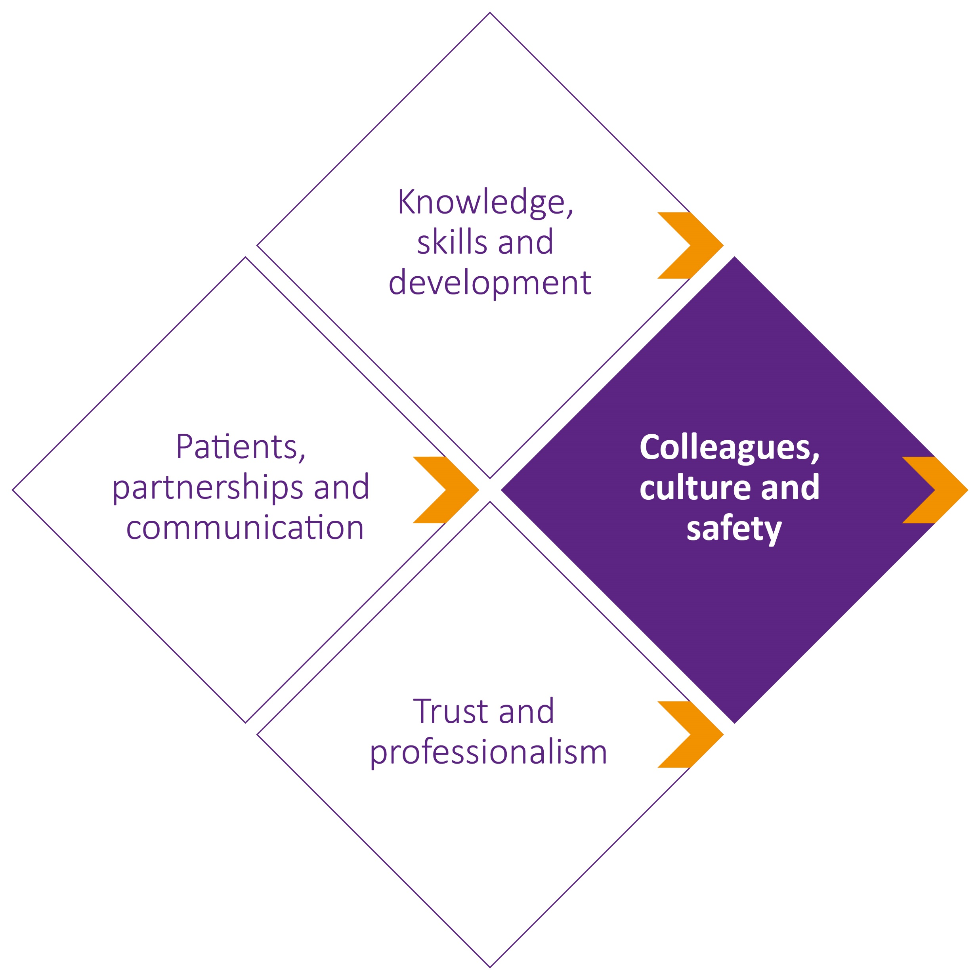
Contributing to a positive environment
Tackling discrimination
Team working and delegation
Leadership
Notes:
Domain 3: Colleagues, culture and safety
A key theme emerging from our initial scoping, research and engagement was that a good workplace culture is the foundation for good healthcare. That starts with how medical professionals treat each other, and how teams work together in the interests of patients.
Contributing to a positive environment
New expectation to help create cultures that are respectful, fair, supportive and compassionate. This includes showing respect for, and sensitivity towards others’ life experience, cultures and beliefs.
New duty not to act in a sexual way towards colleagues with the effect or purpose of causing offence, embarrassment, humiliation or distress.
Tackling discrimination
New duty to take action in response to discrimination, bullying or harassment, such as calling out or reporting the behaviour.
Team working and delegation
Expansion of existing guidance to include communicating, listening, leadership and followership as elements of effective teamworking.
Duty to seek support if you’re not confident with work you’ve been delegated.
Leadership
New expectation for leaders to role model positive behaviours and create an environment in which people can talk about errors and concerns safely.
Extracts from guidance
Treating colleagues with kindness, courtesy and respect
48. You must treat colleagues with kindness, courtesy and respect. (see Internal briefing doc for latest lines)
50. When you are on duty you must be accessible to colleagues seeking information, advice, or support.
[NB – depending on your audience you could say that this standard has been made more achievable from “when you are on duty you must be readily accessible to patients and colleagues seeking information, advice or support” in GMP2013 in recognition of the pressures drs are under – the previous duty is unreasonable for doctors responsible for hundreds of patients at any time]
51. You must be compassionate towards colleagues who have problems with their performance or health. But you must put patient safety first at all times.
Contributing to a positive working and training environment AND Tackling discrimination
52 You must help to create a culture that is respectful, fair, supportive, and compassionate by role modelling behaviours consistent with these values.
53. You should be aware of how your behaviour may influence others within and outside the team. [NB it’s a ‘should’ because we can’t require that everyone is aware, but we would hope everyone would reflect on this as part of reflective practice – as per paragraph 13.d.ii]
54 You should be aware of the risk of bias, and consider how your own life experience, culture and beliefs influence your interactions with others, and may impact on your decisions and actions.
55 You must show respect for, and sensitivity towards, others’ life experience, cultures and beliefs.
56. You must not abuse, discriminate against, bully, or harass anyone based on their personal characteristics, or for any other reason. By ‘personal characteristics’ we mean someone’s appearance, lifestyle, culture, their social or economic status, or any of the characteristics protected by legislation – age, disability, gender reassignment, race, marriage and civil partnership, pregnancy and maternity, religion or belief, sex and sexual orientation.
57. You must not act in a sexual way towards colleagues with the effect or purpose of causing offence, embarrassment, humiliation or distress. What we mean by acting ‘in a sexual way’ can include – but isn’t limited to – verbal or written comments, displaying or sharing images, as well as unwelcome physical contact. You must follow our more detailed guidance on Maintaining personal and professional boundaries.
59 If you have a formal leadership or management role and you witness – or are made aware of – any of the behaviours described in paragraphs 56 or 57, you must act. You must:
a make sure such behaviours are adequately addressed
b make sure people are supported where necessary, and
c make sure concerns are dealt with promptly, being escalated where necessary63. You should be willing to offer professional support to colleagues, including students, for example through mentoring, coaching, teaching or training. This type of support is especially important for those new to practice in the UK, those returning from a period away from practice, and those who cannot easily access support.
NB the duty for leaders/managers is higher – a ‘you must’ – than for all doctors (‘you should’) in recognition that we’re not going to use this duty to pursue junior staff members who don’t take action in response to toxic behaviours; we just want to encourage a psychologically safe environment. Leaders on the other hand are absolutely expected to deal with the behaviours, report etc and actively contribute to a positive working environment
Demonstrating leadership behaviours
64 If part of your role is helping staff access training, development and employment opportunities, you should do this fairly (new – we heard that this isn’t done fairly at the moment and “the usual suspects” get the opportunities with others – often those with protected characteristics – getting passed over)
Teamworking and delegation
66 You must be confident that any person you delegate to has the necessary knowledge, skillsand training to carry out the task you’re delegating. You must give them clear instructions and encourage them to ask questions and seek support or supervision if they need it.
67. If a task is delegated to you by a colleague but you’re not confident you have the necessary knowledge, skills or training to carry it out safely, you must prioritise patient safety and seek help, even if you’ve already agreed to carry out the task independently. [the aim is to empower junior doctors to speak up if they don’t feel competent – and the duty to ‘seek help’ doesn’t require them to say to the person who is delegating that they don’t feel competent – in case that person is intimidating or very senior – they must just seek help from someone, either to carry out the task for them, or supervise them doing it. The key message is not to do something they don’t feel competent to do.]
Keeping patients safe
72. You should be familiar with, and use, the clinical governance and risk management structures and processes in any organisation that you work for or are contracted to.
Responding to safety risks
Paras 75-76 on raising concerns. Again the duty is stronger for those in formal leadership or management roles.
Managing risks posed by your health
78. You should try to take care of your own health and wellbeing, recognising if you may not be fit for work. You should seek independent professional advice about your fitness for work, rather than relying on your own assessment.
Another example of where GMP is modelling good behaviour rather than calling out bad, ie we’re not interested in punishing drs who don’t take care of their own health, but by including this new duty we’re acknowledging the importance of drs own health and wellbeing if they’re to practise effectively. Hope to empower drs to be able to say to unreasonable employers – look, the GMC tells me to look after myself.

Slide 13
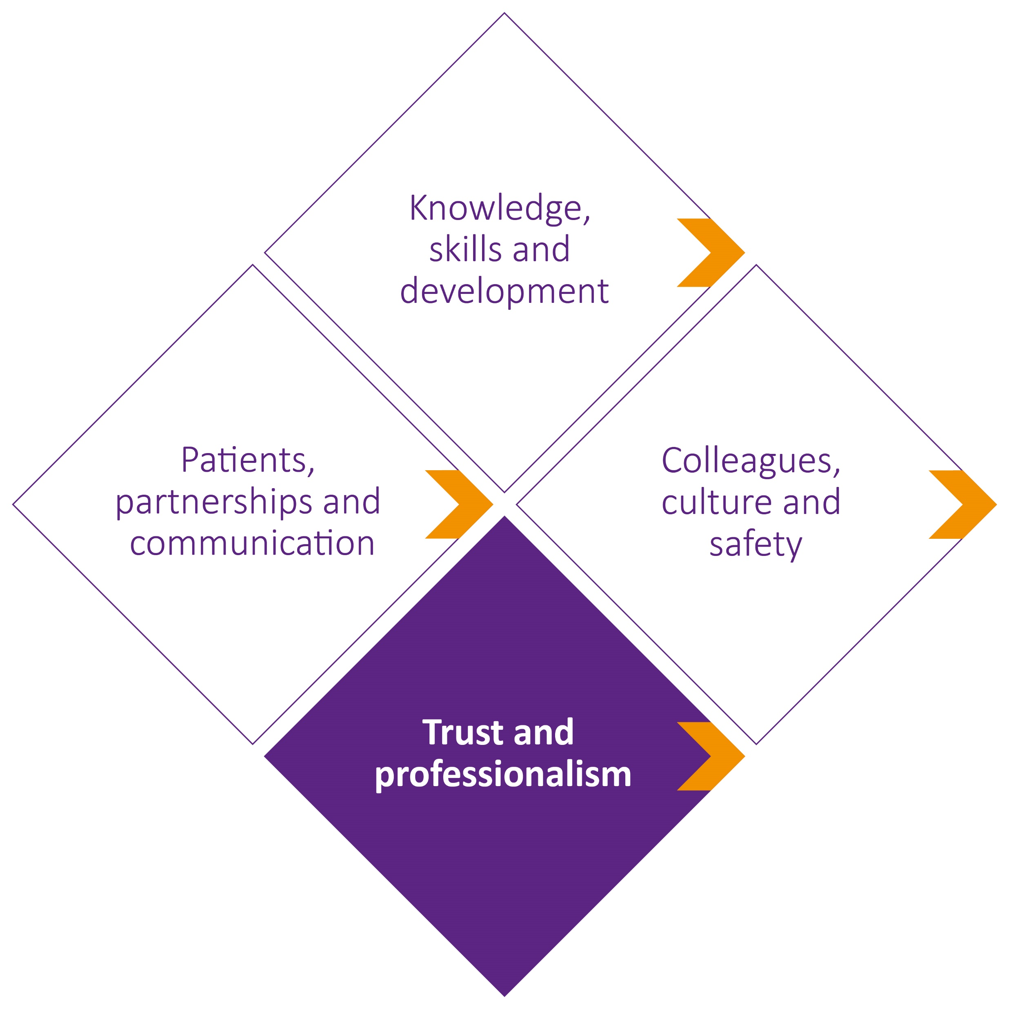
Maintaining professional boundaries
Communicating as a professional
Managing conflicts of interest
Acting with honesty and integrity
Notes:
Domain 4: Trust and professionalism
Maintaining professional boundaries
Expansion of current guidance on relationships with patients to say that medical professionals must not act in a sexual way towards patients.
Communicating as a professional
Expansion of current guidance to emphasise that any information communicated by a medical professional must be accurate, not false or misleading.
Information communicated must not exploit people’s vulnerability or lack of medical knowledge.
This guidance also applies on social media and when advertising or endorsing products.
New reminder that private communications may become public.
Managing conflicts of interest
Greater emphasis on identifying and managing conflicts of interest, including being open with patients and employers.
81. You must make sure that your conduct justifies patients’ trust in you and the public’s trust in your profession.
86. You must not act in a sexual way towards patients or use your professional position to pursue a sexual or improper emotional relationship with a patient or someone close to them. You must follow our more detailed guidance on Maintaining personal and professional boundaries.
90. When communicating publicly as a medical professional – including using social media, advertising your services, and promoting or endorsing any services or products:
you must follow the guidance in paragraph 89 and 90
you must declare any conflicts of interest
you must not exploit people’s vulnerability or lack of medical knowledge
you must make sure what you communicate is in line with your duty to promote and protect the health of patients and the public.
98. To maintain patient safety, you must cooperate with formal inquiries, patient safety investigations, and complaints procedures. You must provide all relevant information and be open and honest.

Slide 14
The professional standards, revalidation and fitness to practise
The professional standards describe good practice, and not every departure from them will be considered serious.
Notes:
GMP introductory pages have been expanded to include:
How the standards relate to revalidation [Go into detail where relevant]
Revalidation supports you to develop your practice, drives improvements in clinical governance, and gives your patients confidence that you’re up to date.
To maintain your licence to practise, you must continuously engage with local clinical governance systems, including annual appraisal. This will demonstrate that you are working in line with the principles, values and standards of care, and behaviour, set out in the professional standards
How the standards relate to fitness to practise [Go into detail where relevant]
The professional standards describe good practice, and not every departure from them will be considered serious.
When a concern is raised with us about a medical professional, we must assess if that medical professional poses any current and ongoing risk to one or more of the three parts of public protection:
protecting, promoting and maintaining the health, safety and wellbeing of the public
promoting and maintaining public confidence in the medical professions, and
promoting and maintaining proper professional standards and conduct for members of those professions.
We do this by considering the following.
How serious the concern is. This includes looking at the extent of the medical professional’s departure from the professional standards and/or the impact of a health condition on their behaviour or performance. It also includes other factors that may impact on seriousness, such as premeditated or persistent behaviour, abuse of power, and whether the behaviour or poor performance the concern relates to is an isolated incident or has been repeated.
Any relevant context that may impact on risk, for example systems factors and interpersonal factors in the medical professional’s working environment or their role and level of experience.
How the medical professional responded to the concern, including evidence of insight and remediation.
Once we’ve assessed the risk, we’ll need to consider if regulatory action may be required in response to the concern. You can read more about our processes and the types of action we might need to take on our fitness to practise webpages.
Only a small number of doctors have a fitness to practise investigation opened each year – around 3% of doctors on the register, with around 150 doctors having their registration erased or suspended (Fitness to practise annual statistics: 2021).

Slide 15
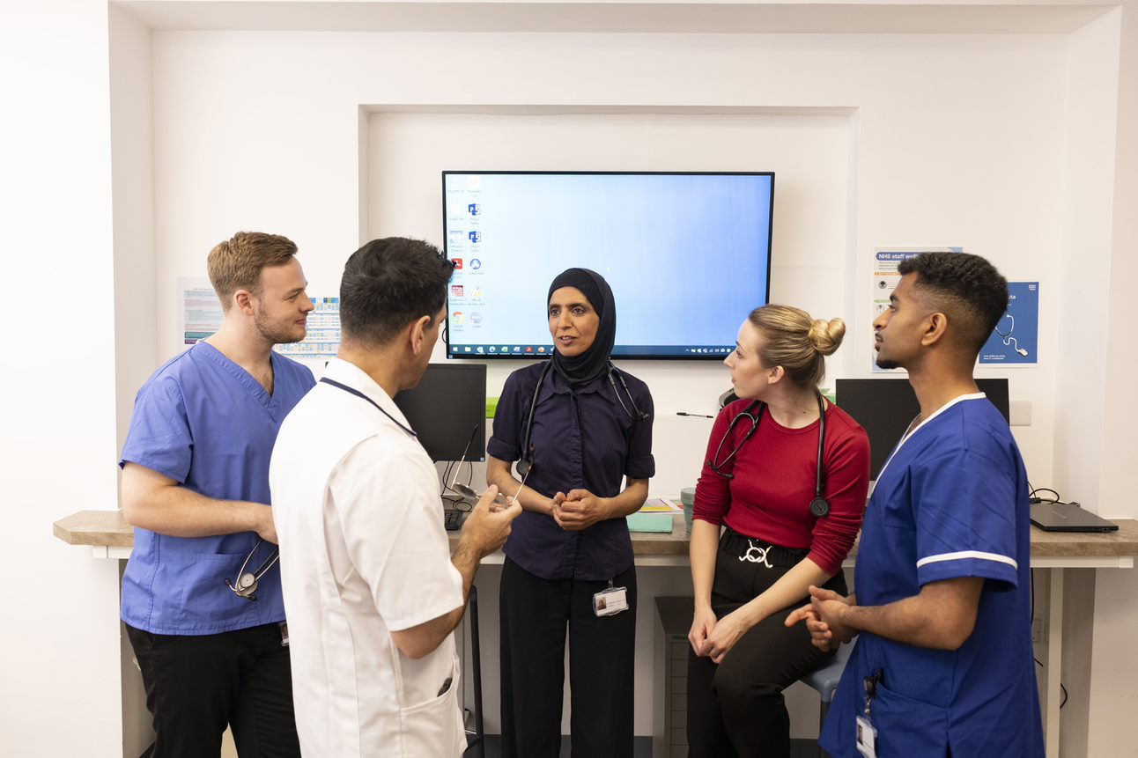
The five key themes:
A new approach?
Notes:
The updated standards have a stronger focus on behaviours and values which create respectful, fair and supportive workplaces. These type of environments enable good team work, they make everyone feel safe to speak up, and they empower doctors to provide quality patient care. Crucially, these type of environments help to retain doctors working in the UK.
Key point: This is a “cultural” GMP. The emphasis on culture and behaviours in our standards calls for a new approach. The GMP is an enabler to creating a better culture in the NHS. It helps nudge doctors towards role-modelling and playing their part in creating more inclusive, fairer cultures.
We are now going to take a look at 3 of the five themes to consider how you, as educators, leaders and doctors will use the standards to help create and maintain those fairer working environments, ensuring the care and support for doctors that is required to ensure compassionate and safe care for patients.
[You don’t need to mention them now but below are the three themes that will be discussed in this session]
creating respectful, fair and compassionate workplaces for colleagues and patients
helping to tackle discrimination
championing fair and inclusive leadership

Slide 16
Five key themes of Good medical practice 2024
Creating respectful, fair and compassionate workplaces
Promoting patient centred care
Helping to tackle discrimination
Championing fair and inclusive leadership
Supporting continuity of care and safe delegation

Slide 17
Implementing the standards

Slide 18
Creating respectful, fair and compassionate workplaces
48. You must treat colleagues with kindness, courtesy and respect.
51. You must be compassionate towards colleagues who have problems with their performance or health. But you must put patient safety first at all times.
52. You must help to create a culture that is respectful, fair, supportive, and compassionate by role modelling behaviours consistent with these values.
53. You should be aware of how your behaviour may influence others within and outside the team.
Notes:
A key theme emerging from our research and engagement was that a good workplace culture is the foundation for good healthcare. That starts with how medical professionals treat each other, and how teams work together in the interests of patients. We’ve strengthened duties under this theme to highlight the importance of medical professionals working effectively with colleagues – within and between teams – to help shape respectful, fair, supportive and compassionate cultures for medical professionals and patients.
For example we’ve expanded existing guidance to include communicating, listening, leadership and followership as elements of effective teamworking. And we’ve made some changes to highlight the importance of leadership, and not just for those in formal leadership and management roles. Medical professionals don’t always recognise that behaviours and skills they demonstrate daily are examples of everyday leadership so we’ve tried to make that clearer. We’ve also acknowledged the importance of medical professionals taking care of their own wellbeing.
Para 48: You must treat colleagues with kindness, courtesy and respect.
Para 49: To develop and maintain effective teamworking and interpersonal relationships you must: listen to colleagues, communicate clearly, politely and considerately, recognise and show respect for colleagues’ skills and contributions, work collaboratively with colleagues, being willing to lead or follow as the circumstances require.
Para 52: You must help to create a culture that is respectful, fair, supportive, and compassionate by role modelling behaviours consistent with these values.
Para 78: You should try to take care of your own health and wellbeing, recognising if you may not be fit for work.
If you have a formal leadership or management role, must take active steps towards creating such a culture including role modelling these behaviours.
Medical professionals should be willing to offer professional support to colleagues and students including mentoring, coaching, teaching or training (new to UK practice, returning from break in practice, or find it difficult to access support)
Clear expectation that those with a role in helping staff access training, development and employment opportunities should do this fairly.
Shaping organisational culture – should be aware of impact of behaviours such as talking openly about errors, asking questions and encouraging questions..
These updated standards are needed in UK practice now more than ever. Public inquiries, research and data repeatedly highlight the negative impact that poor workplaces and cultures have on patient safety and doctors’ wellbeing.
That’s why we’ve included duties to help address the impacts of biases and the impact that these have on colleagues (as potential contributors to differential outcomes in education and career development
Domain 3 also includes new duties to tackle abuse, discrimination, bullying or harassment; and to take action if a medical professional witnesses discriminatory behaviour, such as calling out the behaviour if safe to do so or reporting the behaviour.
And a new duty on sexual behaviour between colleagues, intended to address the pernicious low level behaviours that can be dismissed as banter or miscommunication but can, and often will, escalate into something more serious if left unchecked
___________________
Other areas you may wish to highlight;
Para 50: When you are on duty, you must be accessible to colleagues seeking information, advice, or support.
Para 53: You should be aware of how your behaviour may influence others within and outside the team.
Para 61: You must make sure that all colleagues whose work you are overseeing have appropriate supervision.
Para 63: You should be willing to offer professional support to colleagues, including students, for example through mentoring, coaching, teaching or training. This type of support is especially important for those new to practice in the UK, those returning from a period away from practice, and those who cannot easily access support.
Para 64: If part of your role is helping staff access training, development and employment opportunities, you should do this fairly.
Para 76: If you have a formal leadership or management role, you must take active steps to create an environment in which people can talk about errors and concerns safely. This includes making sure that any concerns raised with you are dealt with promptly and adequately, in line with your workplace policy and our more detailed guidance on Raising and acting on concerns about patient safety.

Slide 19
What are you doing in your workplace that contributes to a positive culture?

Slide 20
Promoting patient centred care
Notes:
A key theme emerging from our research and engagement was that a good workplace culture is the foundation for good healthcare. That starts with how medical professionals treat each other, and how teams work together in the interests of patients. We’ve strengthened duties under this theme to highlight the importance of medical professionals working effectively with colleagues – within and between teams – to help shape respectful, fair, supportive and compassionate cultures for medical professionals and patients.
For example we’ve expanded existing guidance to include communicating, listening, leadership and followership as elements of effective teamworking. And we’ve made some changes to highlight the importance of leadership, and not just for those in formal leadership and management roles. Medical professionals don’t always recognise that behaviours and skills they demonstrate daily are examples of everyday leadership so we’ve tried to make that clearer. We’ve also acknowledged the importance of medical professionals taking care of their own wellbeing.
Para 48: You must treat colleagues with kindness, courtesy and respect.
Para 49: To develop and maintain effective teamworking and interpersonal relationships you must: listen to colleagues, communicate clearly, politely and considerately, recognise and show respect for colleagues’ skills and contributions, work collaboratively with colleagues, being willing to lead or follow as the circumstances require.
Para 52: You must help to create a culture that is respectful, fair, supportive, and compassionate by role modelling behaviours consistent with these values.
Para 78: You should try to take care of your own health and wellbeing, recognising if you may not be fit for work.
If you have a formal leadership or management role, must take active steps towards creating such a culture including role modelling these behaviours.
Medical professionals should be willing to offer professional support to colleagues and students including mentoring, coaching, teaching or training (new to UK practice, returning from break in practice, or find it difficult to access support)
Clear expectation that those with a role in helping staff access training, development and employment opportunities should do this fairly.
Shaping organisational culture – should be aware of impact of behaviours such as talking openly about errors, asking questions and encouraging questions..
These updated standards are needed in UK practice now more than ever. Public inquiries, research and data repeatedly highlight the negative impact that poor workplaces and cultures have on patient safety and doctors’ wellbeing.
That’s why we’ve included duties to help address the impacts of biases and the impact that these have on colleagues (as potential contributors to differential outcomes in education and career development
Domain 3 also includes new duties to tackle abuse, discrimination, bullying or harassment; and to take action if a medical professional witnesses discriminatory behaviour, such as calling out the behaviour if safe to do so or reporting the behaviour.
And a new duty on sexual behaviour between colleagues, intended to address the pernicious low level behaviours that can be dismissed as banter or miscommunication but can, and often will, escalate into something more serious if left unchecked
___________________
Other areas you may wish to highlight;
Para 50: When you are on duty, you must be accessible to colleagues seeking information, advice, or support.
Para 53: You should be aware of how your behaviour may influence others within and outside the team.
Para 61: You must make sure that all colleagues whose work you are overseeing have appropriate supervision.
Para 63: You should be willing to offer professional support to colleagues, including students, for example through mentoring, coaching, teaching or training. This type of support is especially important for those new to practice in the UK, those returning from a period away from practice, and those who cannot easily access support.
Para 64: If part of your role is helping staff access training, development and employment opportunities, you should do this fairly.
Para 76: If you have a formal leadership or management role, you must take active steps to create an environment in which people can talk about errors and concerns safely. This includes making sure that any concerns raised with you are dealt with promptly and adequately, in line with your workplace policy and our more detailed guidance on Raising and acting on concerns about patient safety.

Slide 21
Promoting patient centred care
32 You must take steps to meet patients’ language and communication needs, so you can support them to engage in meaningful dialogue and make informed decisions about their care. The steps you take should be proportionate to the circumstances, including the patient’s needs and the seriousness of their condition(s), the urgency of the situation and the availability of resources.
40 If a patient is taking multiple medications, you should discuss the importance of regular reviews to check that the medications continue to meet the patient’s needs and are optimised for them. You should consider the overall impact of the patient’s treatments, and whether the benefits outweigh any risk of harm.
Notes:
Decision making and consent
Greater focus on patients’ roles in making decisions about their health , with expectations brought in from Decision making and consent about listening to patients, not making assumptions, explaining options and checking understanding, and understanding capacity law.
One new addition to the guidance is treating colleagues and patients with kindness. This word attracted significant debate during the consultation period, with most bodies representing medical professionals opposing its inclusion in the professional standards, and divided views among patient respondents. The publication of the Reading the Signals report on maternity and neonatal services led by Dr Bill Kirkup, with its emphasis on the importance of kindness and compassion, has helped shaped our thinking on the issue. We have therefore kept the term kindness in the draft with emphasis on the practical behaviours that underpin this. We also felt it was important to include this to provide parity of expectations across multidisciplinary teams (NMC ask registrants to treat patients with kindness). The definition we’ve provided here is based on the responses we heard from healthcare professionals and patients who described what kindness means to them in this context.
Other paragraphs to highlight if needed;
Para 23: You must treat patients with kindness, courtesy and respect. This doesn’t mean agreeing to every request (see paragraph 7d) or withholding relevant information that may be upsetting or unwelcome (see paragraph 28). It means:
communicating sensitively and considerately, particularly when you’re sharing potentially distressing issues about the patient’s prognosis and care
listening to patients, recognising their knowledge and experience of their health, and acknowledging their concerns
trying not to make assumptions about what a patient will consider significant or the importance they will attach to different outcomes
being willing to explain your reasons for the options you offer (and the options you don’t) and any recommendations you make
recognising that patients may be vulnerable, even if they don’t seem it
being alert to signs of pain or distress, and taking steps to alleviate pain and distress whether or not a cure may be possible.
Para 24: All patients have the right to be involved in decisions about their treatment and care, and be supported to make informed decisions if they are able to. You must start from the presumption that all adult patients have capacity to make decisions about their treatment and care.
Para 32: You must take steps to meet patients’ language and communication needs, so you can support them to engage in meaningful dialogue and make informed decisions about their care. The steps you take should be proportionate to the circumstances, including the patient’s needs and the seriousness of their condition(s), the urgency of the situation and the availability of resources.
Para 40: If a patient is taking multiple medications, you should discuss the importance of regular reviews to check that the medications continue to meet the patient’s needs and are optimised for them. You should consider the overall impact of the patient’s treatments, and whether the benefits outweigh any risk of harm.

Slide 22
What helps create a patient centred approach where you work?

Slide 23
Tackling discrimination
Notes:
A key theme emerging from our research and engagement was that a good workplace culture is the foundation for good healthcare. That starts with how medical professionals treat each other, and how teams work together in the interests of patients. We’ve strengthened duties under this theme to highlight the importance of medical professionals working effectively with colleagues – within and between teams – to help shape respectful, fair, supportive and compassionate cultures for medical professionals and patients.
For example we’ve expanded existing guidance to include communicating, listening, leadership and followership as elements of effective teamworking. And we’ve made some changes to highlight the importance of leadership, and not just for those in formal leadership and management roles. Medical professionals don’t always recognise that behaviours and skills they demonstrate daily are examples of everyday leadership so we’ve tried to make that clearer. We’ve also acknowledged the importance of medical professionals taking care of their own wellbeing.
Para 48: You must treat colleagues with kindness, courtesy and respect.
Para 49: To develop and maintain effective teamworking and interpersonal relationships you must: listen to colleagues, communicate clearly, politely and considerately, recognise and show respect for colleagues’ skills and contributions, work collaboratively with colleagues, being willing to lead or follow as the circumstances require.
Para 52: You must help to create a culture that is respectful, fair, supportive, and compassionate by role modelling behaviours consistent with these values.
Para 78: You should try to take care of your own health and wellbeing, recognising if you may not be fit for work.
If you have a formal leadership or management role, must take active steps towards creating such a culture including role modelling these behaviours.
Medical professionals should be willing to offer professional support to colleagues and students including mentoring, coaching, teaching or training (new to UK practice, returning from break in practice, or find it difficult to access support)
Clear expectation that those with a role in helping staff access training, development and employment opportunities should do this fairly.
Shaping organisational culture – should be aware of impact of behaviours such as talking openly about errors, asking questions and encouraging questions..
These updated standards are needed in UK practice now more than ever. Public inquiries, research and data repeatedly highlight the negative impact that poor workplaces and cultures have on patient safety and doctors’ wellbeing.
That’s why we’ve included duties to help address the impacts of biases and the impact that these have on colleagues (as potential contributors to differential outcomes in education and career development
Domain 3 also includes new duties to tackle abuse, discrimination, bullying or harassment; and to take action if a medical professional witnesses discriminatory behaviour, such as calling out the behaviour if safe to do so or reporting the behaviour.
And a new duty on sexual behaviour between colleagues, intended to address the pernicious low level behaviours that can be dismissed as banter or miscommunication but can, and often will, escalate into something more serious if left unchecked
___________________
Other areas you may wish to highlight;
Para 50: When you are on duty, you must be accessible to colleagues seeking information, advice, or support.
Para 53: You should be aware of how your behaviour may influence others within and outside the team.
Para 61: You must make sure that all colleagues whose work you are overseeing have appropriate supervision.
Para 63: You should be willing to offer professional support to colleagues, including students, for example through mentoring, coaching, teaching or training. This type of support is especially important for those new to practice in the UK, those returning from a period away from practice, and those who cannot easily access support.
Para 64: If part of your role is helping staff access training, development and employment opportunities, you should do this fairly.
Para 76: If you have a formal leadership or management role, you must take active steps to create an environment in which people can talk about errors and concerns safely. This includes making sure that any concerns raised with you are dealt with promptly and adequately, in line with your workplace policy and our more detailed guidance on Raising and acting on concerns about patient safety.

Slide 24
Helping to tackle discrimination
56. You must not abuse, discriminate against, bully, or harass anyone based on their personal characteristics, or for any other reason. By ‘personal characteristics’ we mean someone’s appearance, lifestyle, culture, their social or economic status, or any of the characteristics protected by legislation – age, disability, gender reassignment, race, marriage and civil partnership, pregnancy and maternity, religion or belief, sex and sexual orientation
57. You must not act in a sexual way towards colleagues with the effect or purpose of causing offence, embarrassment, humiliation or distress. What we mean by acting ‘in a sexual way’ can include – but isn’t limited to – verbal or written comments, displaying or sharing images, as well as unwelcome physical contact.
Notes:
Fairness – a key ambition for this review has been for GMP to support medical professionals and health service leaders in their work to tackle wider societal issues, including racism, sexual harassment, and discrimination. We are absolutely committed to delivering fairer, safer workplaces for everyone. In the new duty, personal characteristics refers to..
We are aware that sexual harassment in healthcare settings is in the media spotlight at present. Of course this has always been unacceptable, but this is the first time our guidance has explicitly addressed the issue. The new duty on sexual behaviour between colleagues is intended to address the pernicious low level behaviours that can be dismissed as banter or miscommunication but can, and often will, escalate into something more serious if left unchecked
The updated guidance is not intended to preclude relationships developing between colleagues who work together, but it we hope this will be useful in giving people the confidence to speak up when they are the subject of actions with the effect or purpose of causing offence, embarrassment, humiliation or distress. (NB effect is as important or more important than purpose – “it was just banter I didn’t mean to cause offence” is NOT an excuse)
Must not abuse, discriminate against, bully, or harass anyone based on their personal characteristics, or for any other reason.
Must not act in a sexual way towards colleagues with the effect or purpose of causing offence, embarrassment, humiliation or distress. What we mean by acting ‘in a sexual way’ can include – but isn’t limited to – verbal or written comments, displaying or sharing images, as well as unwelcome physical contact.

Slide 25
The bystander duty
Everyone should act…
For example you could:
Leaders must act….
address behaviours
challenge the behaviour
consider reporting
offer support
support people
deal with concerns promptly, escalating if necessary
Notes:
The bystander duty cuts across both theme 1 relating to culture and theme 3 tackling discrimination.
And it’s one of the areas where the expectations are strengthened for those in leadership of management roles.
The bystander duty is not entirely new – there is already a duty in GMP to challenge colleagues if their behaviour is discriminatory.
But we’ve given more information about how you might do that. Changed significantly from the consultation draft as well, to give more detail - suggestions about what action people can take in response to witnessing harassment or discrimination – bearing in mind that many of those who witness such behaviour may well be junior members of staff and we don’t want them to put their careers on the line or damage relationships with senior colleagues.
the duty for everyone is a should – we recognise that this won’t always be possible.
While the duty for leaders is a “you must”. Those with a formal leadership or management roles must make sure that bullying, harassment or discrimination is adequately addressed, people involved are supported, and that concerns are dealt with promptly and escalated where necessary.
You must not…
…abuse, discriminate against, bully, or harass anyone based on their personal characteristics, or for any other reason. By ‘personal characteristics’ we mean someone’s appearance, lifestyle, culture, their social or economic status, or any of the characteristics protected by legislation – age, disability, gender reassignment, race, marriage and civil partnership, pregnancy and maternity, religion or belief, sex and sexual orientation.
…act in a sexual way towards colleagues with the effect or purpose of causing offence, embarrassment, humiliation or distress. What we mean by acting ‘in a sexual way’ can include – but isn’t limited to – verbal or written comments, displaying or sharing images, as well as unwelcome physical contact. You must follow our more detailed guidance on Maintaining personal and professional boundaries.
From the internal briefing doc:
The updated Good medical practice includes a duty to act if a doctor witnesses discriminatory or bullying behaviour. Won’t some doctors find that more difficult, such as those in the early stages of their career?
We recognise some people may find it harder than others to speak up, but everyone has a responsibility – to themselves and their colleagues – to do something to prevent these behaviours continuing and contributing to a negative, unsafe environment. Inaction risks allowing such behaviour to be normalised, contributing to a toxic culture and environment.
The new duty to act if you witness discriminatory or bullying behaviour is applicable to all doctors. It is a ‘should’ duty, recognising that there may be circumstances where taking action may be too difficult for some doctors, including more junior members of staff. The action we expect doctors to take is not set out prescriptively - it depends on the context of the particular situation.
However, for those in formal leadership or management positions, the duty to act if you witness discrimination or bullying is a ‘must’ duty. We set out three expected actions in these circumstances and doctors in these roles must:
make sure such behaviours are adequately addressed
make sure people are supported where necessary, and
make sure concerns are dealt with promptly, being escalated where necessary.

Slide 26
3. Helping tackle discrimination
Life experience, culture, beliefs
Interactions
Patient care
Decisions
Notes:
Also trying to tackle discrimination in a preventative way. Encouraging drs to reflect, seek to understand, not judge, treat colleagues with compassion etc
Relevant paragraphs:
Para 13
You must take steps to monitor, maintain, develop, and improve your performance and the quality of your work…This includes…regularly reflecting on your standards of practice and the care you provide, including…considering how your life experience, culture and beliefs influence your interactions with others and may impact on the decisions you make and the care you provide.
Para 54
You should be aware of the risk of bias, and consider how your own life experience, culture and beliefs influence your interactions with others, and may impact on your decisions and actions.
Para 55
You must show respect for, and sensitivity towards, others’ life experience, cultures and beliefs.

Slide 27
How do you raise awareness about discrimination where you work?

Slide 28
Championing fair, inclusive leadership
Notes:
54. You should be aware of the risk of bias, and consider how your own life experience, culture and beliefs influence your interactions with others, and may impact on your decisions and actions.
55. You must show respect for, and sensitivity towards, others’ life experience, cultures and beliefs.
59. If you have a formal leadership or management role and you witness – or are made aware of – any of the behaviours described in paragraphs 56 or 57, you must act. You must:
make sure such behaviours are adequately addressed
make sure people are supported where necessary, and make sure concerns are dealt with promptly, being escalated where necessary.

Slide 29
4. Championing fair and inclusive leadership
Support colleagues through mentoring, coaching, teaching or training
Fair access to training, development and employment opportunities
Taking active steps to create environment where it’s safe to
Talk about errors
Raise concerns
Ask questions
Dealing promptly and adequately with concerns
Notes:
These are the strengthened duties for leaders
Para 59
If you have a formal leadership or management role and you witness – or are made aware of – any of the behaviours described in paragraphs 56 or 57, you must act.
You must:
Make sure such behaviours are adequately addressed
Make sure people are supported where necessary, and
Make sure concerns are dealt with promptly, being escalated where necessary.
Para 63 (for everyone)
You should be willing to offer professional support to colleagues, including students, for example through mentoring, coaching, teaching or training. This type of support is especially important for those new to practice in the UK, those returning from a period away from practice, and those who cannot easily access support.
Para 64
If part of your role is helping staff access training, development and employment opportunities, you should do this fairly.
Para 76
If you have a formal leadership or management role, you must take active steps to create an environment in which people can talk about errors and concerns safely. This includes making sure that any concerns raised with you are dealt with promptly and adequately, in line with your workplace policy and our more detailed guidance on Raising and acting on concerns about patient safety.
NB the duty for everyone is a ‘you should act’ whereas for those with formal leadership or management roles it’s a ‘you must act’.

Slide 30
What can support Doctors to be more confident to raise concerns and talk about errors to support learning?

Slide 31
Supporting continuity of care and safe delegation
66. You must be confident that any person you delegate to has the necessary knowledge, skills and training to carry out the task you’re delegating. You must give them clear instructions and encourage them to ask questions and seek support or supervision if they need it.
67. If a task is delegated to you by a colleague but you’re not confident you have the necessary knowledge, skills or training to carry it out safely, you must prioritise patient safety and seek help, even if you’ve already agreed to carry out the task independently.
Notes:
Continuity of care and safe delegation is at the heart of improving care for all patients, particularly those with complex or long term conditions or language and support needs. We’ve been careful to distinguish between individual and system responsibilities as we’ve finessed how we’ve expressed this, for example making clear doctors should make best use of the resources available to them, and urgency of the situation. It’s not intended to preclude use of staff as interpreters for example.
It’s also important to create an environment where colleagues feel able to say so and seek support if they’ve agreed to help with something and later find they don’t understand or lack the confidence or skills and we think our new advice on delegation makes this clear.
We’ve also clarified our expectations on safeguarding in line with other advice we’ve published on our website.

Slide 32
5. Supporting continuity of care and safe delegation
Be accessible to advise & support colleagues
Keep patients informed
Named clinician or team
Share information promptly
Clear instructions
Prioritise patient safety – seek help or supervision
Notes:
Relevant paragraphs
Para 50 When you are on duty, you must be accessible to colleagues seeking information, advice, or support.
Para 61 You must make sure that all colleagues whose work you are overseeing have appropriate supervision.
Para 65 Continuity of care is important for all patients, but especially those who may struggle to navigate their healthcare journey or advocate for themselves. Continuity is particularly important when care is shared between teams, between different members of the same team, or when patients are transferred between care providers.
You must promptly share all relevant information about patients (including any reasonable adjustments and communication support preferences) with others involved in their care, within and across teams, as required.
You must share information with patients [and those close to them where necessary] about:
the progress of their care
who is responsible for which aspect of their care
the name of the lead clinician or team with overall responsibility for their care
You must be confident that information necessary for ongoing care has been shared:
before you go off duty
before you delegate care, or
before you refer the patients to another health or social care provider.
You must check, where practical, that a named clinician or team has taken over responsibility when your role in a patient’s care has ended.
Para 66 You must be confident that any person you delegate to has the necessary knowledge, skills and training to carry out the task you’re delegating. You must give them clear instructions and encourage them to ask questions and seek support or supervision if they need it.
Para 67 If a task is delegated to you by a colleague but you’re not confident you have the necessary knowledge, skills or training to carry it out safely, you must prioritise patient safety and seek help, even if you’ve already agreed to carry out the task independently.
Paras 69-70 on record keeping – also important for continuity of care
69 You must make sure that formal records of your work (including patients’ records) are clear, accurate, contemporaneous6 and legible.
70 You should take a proportionate approach to the level of detail but patients’ records should usually include:
relevant clinical findings
drugs, investigations or treatments proposed, provided or prescribed
the information shared with patients
concerns or preferences expressed by the patient that might be relevant to their ongoing care, and whether these were addressed
information about any reasonable adjustments and communication support preferences
decisions made, actions agreed (including decisions to take no action) and when/whether decisions should be reviewed
who is creating the record and when.

Slide 33
How Good medical practice relates to GMC investigations
The professional standards describe good practice, and not every departure from them will be considered serious.
When a concern is raised, the GMC must assess if there is a current and ongoing risk to one or more of the three parts of public protection.
To assess risk the GMC consider:
- how serious the concern is
- relevant context including system factors
- the doctor’s response including evidence of insight and remediation
Notes:
First thing to say is that GMP is not a FtP document. When it was first developed in 1995 it was a conscious move away from the blue book which listed…offences that would get you struck off the medical register. GMP has always been a description of a good doctor, what all drs want to be able to do and what the majority of doctors do the majority of the time.
But because it describes the professional standards by which a dr will be judged if their registration is called into question…it does have a relationship with ftp. And we’ve had several attempts to describe that relationship as succinctly and accurately as possible.
The latest iteration is in the introduction, and it’s a few paragraphs long but it essentially boils down to these 3 factors (on slide)
Professional standadrs – GMP and MDG – describe good practice and not every departure will be considered serious.
FtP angle. We must assess whether there’s a current and ongoing risk
We do that by considering:
How serious (that’s where the prof standards come in – how far departure and whether it’s repeated/persistent behaviour)
Also considered when assessing risk is context and drs response.
current wording only serious and persistent etc is very familiar to us all, and medical professionals and stakeholders ….But not always true – you can get non persistent breaches that are referred to hearing
our first attempt (in the consultation) concerned stakeholders as they saw it as an attempt to change the threshold -so more cases would be referred – not our intention.
MDOs and BMA called for a clear, concise statement to help medical professionals understand the relationship between standards guidance and fitness to practise procedures.
We worked closely with them – and with FtP policy - on this new text which will link to the forthcoming Guidance for all Decision Makers (yet to be published but we do have a new web page: Fitness to practise explained - GMC (gmc-uk.org)
We’re launching Chapters 1 & 2 of the guidance alongside GMP because it provides relevant context on a number of areas.
Chapter 1 explains what we mean by: protecting the public, being proportionate, being transparent, being fair. It establishes the good decision-making principles that apply to all decision made about a medical professional’s fitness to practise.
Chapter 2 aims to promote common understanding of concepts that are key to the assessment of an individual’s fitness to practise: seriousness of an allegation, relevant context, insight and remediation. It sets the context of our regulatory remit and describes what we mean by ‘fitness to practise’. It explains what may amount to a fitness to practise concern and why.
There are considerable benefits to supporting the publication of GMP with this guidance. It answers questions about relevant context and provides an explanation of what we mean by protection of the public – both areas where we receive a lot of questions!
We will provide more information on the guidance and how it should be used by FtP decision makers ahead of its publication - keep an eye out for a video from our Policy colleagues in the near future! If you have any questions in the meantime, please email FTPRegulatoryReform@gmc-uk.org

Slide 34
How we can support you
Notes:
We can offer Respect protects - tools to help you tackle unprofessional behaviour - speaking up - ethical topic - GMC (gmc-uk.org)

Slide 35
GMC ethical hub content
Racism in the workplace - GMC (gmc-uk.org)
Speaking up - ethical topic - GMC (gmc-uk.org)
Identifying and tackling sexual misconduct - ethical topic - GMC (gmc-uk.org)
Home - GMC (gmc-uk.org)

Slide 36
Questions / comments
professionalstandards@gmc-uk.org

Slide 37
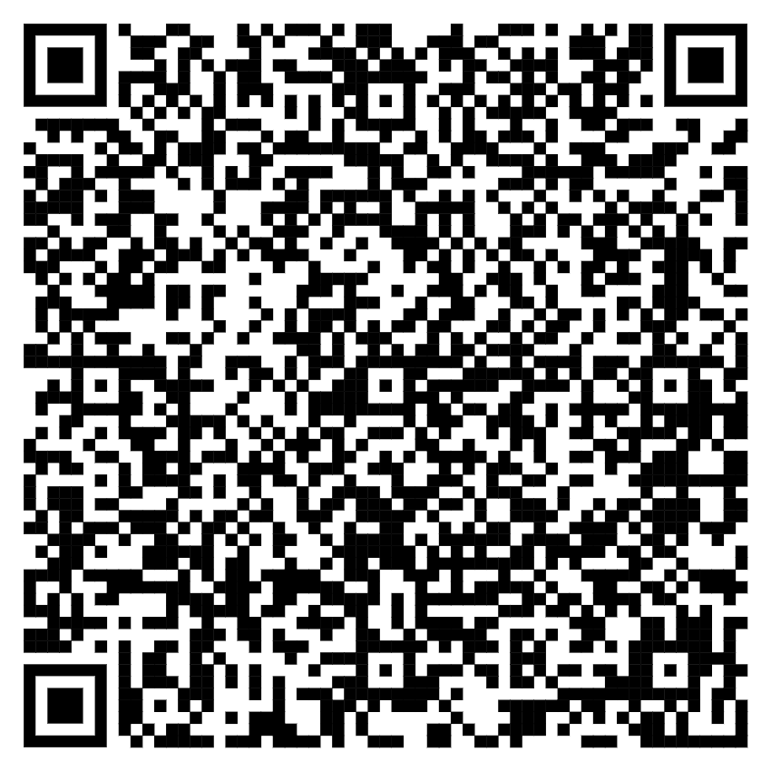

Slide 38
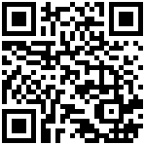
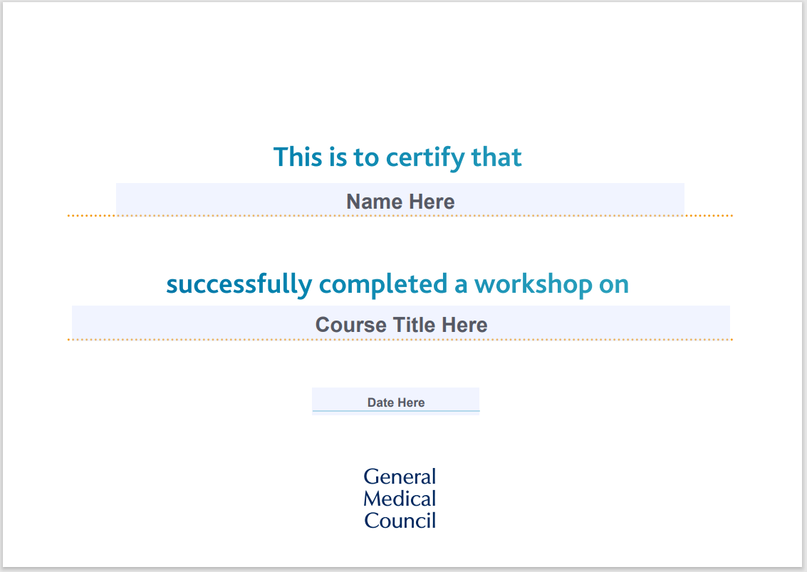
Evaluation and session certificate
https://www.smartsurvey.co.uk/s/N1IWPU/
Session delivered by: Rachel Ball

Slide 39
Regional Liaison Adviser
Rachel.Ball@gmc-uk.org
@gmcuk
0161 923 6602: GMC Contact Centre
0161 923 6399: GMC Confidential Helpline

