Slide 1
T2DAY: Type 2 Diabetes in the young (18-39)
Aim: To Improve outcomes for younger adults with type 2 diabetes.
Katie Whitehead: Practice Nurse Educator/Practice Nurse

Slide 2
Training outline:
The T2Day programme and the current situation in South Yorkshire.
Preconception and pregnancy care for young adults with T2D.
Improving access to prevention and remission programmes.
Foundry pilot project – improving care for young adults with T2D.
What you can do to improve care for young adults with T2D.

Slide 3
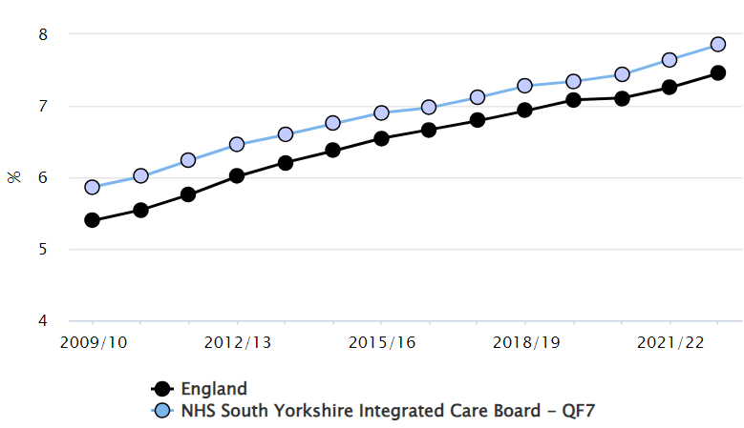
Increase in Diabetes - Major Challenge for Health, HIs and SY’s Economy
More children being diagnosed with type one diabetes since covid (7,000 total T1D)
Since 2010, SY QOF registers increased by 72%
From 5.9% of the population to 7.9%
Higher than the national average of 7.5%
A thousand more SY people are being newly diagnosed
with T2D each year compared to 10 years ago
a 78% increase, 1,326 to 2,365 / yr
Total 91,300 have type two
126,000 (11.5%) aged 16 and over non-diabetic hyperglycaemia.
1,400 women have gestational diabetes each year. Increasing - obesity & pregnancies in older women.

Slide 4
EOT2D - Key Facts
T2DaY is the Type 2 Diabetes in the Young programme, an NHSE 2-year initiative to improve care for people with Early Onset Type 2 Diabetes (EOT2D) affecting those aged between 18-39 yrs.
Early onset Type 2 diabetes (EOT2D) is defined as the development of Type 2 diabetes below the age of 40 years.
It is more common in people from ethnic minorities (particularly in people with South Asian ethnicity) and people living in the most socio-economically deprived areas.
A high proportion of people with EOT2D are living with obesity and may also have concurrent unmet psychological and social needs.

Slide 5
T2 Day Team
Natalie Johnson - Diabetes Specialist Midwife
Natalie.Johnson56@nhs.net
Support: Preconception Care and Pregnancy
Katie Whitehead - Diabetes Practice Nurse Educator
Katie.Whitehead@nhs.net
Support: Raising Awareness & Training
James Ball - Health and Wellbeing Coach
James.Ball12@nhs.net
Support: Florey Questionnaires & Searches
Farah Akhtar - Health and Wellbeing Coach
Foundry PCN
Farah.Akhtar4@nhs.net
Support: Target Approach to increase 9 care
Ani Kumar - SY, ICB, Programme Manager
Ani.Kumar@nhs.net
Amy Moore - Diabetes Project Implementation Officer. Amy.Moore56@nhs.net
Most women with Type 2 diabetes who become pregnant are not prepared for pregnancy, and where blood glucose is not less than 48mmol/mol they are at increased risk of adverse maternal and neonatal outcomes.
Notes:
Source NHSENGLAND

Slide 6
WHY DO WE NEED TO FOCUS ON YOUNGER ADULTS WITH TYPE 2 DIABETES?

Slide 7
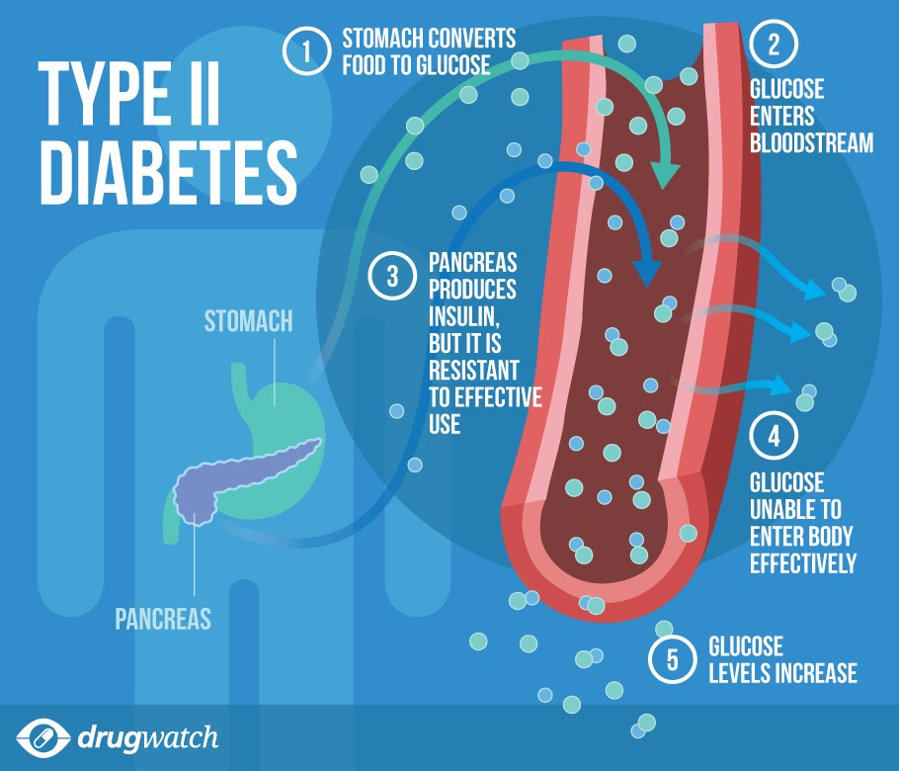
Early Onset T2D (OET2D) is associated with:
More aggressive diabetes phenotype than older-onset Type 2 diabetes.
2. More rapid progression of glycaemia.
3. Early development of diabetes-related microvascular and macrovascular complications and premature mortality.
4. Significant reduction in life expectancy
5. Increased risk of adverse maternal and neonatal outcomes in the cohort that are not prepared for pregnancy.
This Photo by Unknown Author is licensed under CC BY-SA-NC

Slide 8
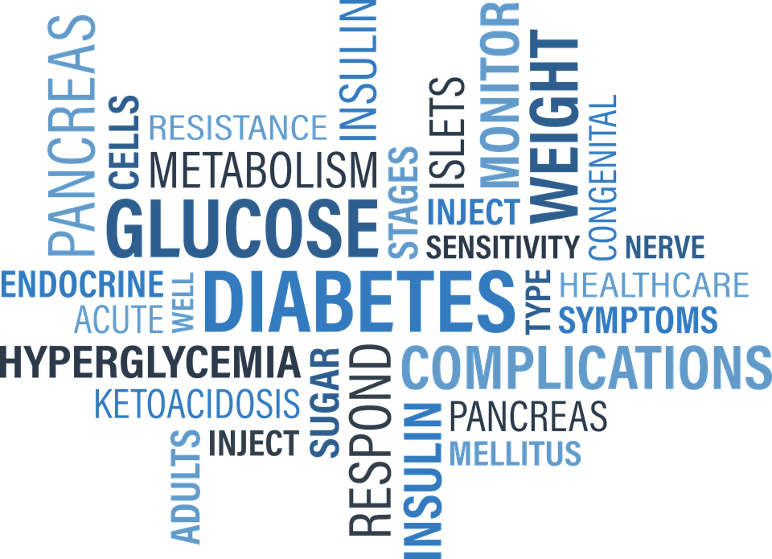
Significant Reduction in Life Expectancy
12 years when T2DM was diagnosed at ≈15 years of age
6 years when diagnosed at 45 years of age
c. 2 years when diagnosed at 65 years of age

Slide 9
Pregnancy
54% of pregnancies in people with diabetes in 2020 related to those affected by Type 2 diabetes, representing a doubling in proportion since 2002.
Attaining HbA1c < 48 mmol/mol is associated with better neonatal outcomes; however, in 2020 only 11% of women with Type 2 diabetes who became pregnant had evidence of adequate preparation for pregnancy, reducing to only 6% of those living in the most deprived areas.
NHS England (2023b) National Pregnancy in Diabetes Audit 2021 and 2022 (01 January 2021 to 31 December 2022). https://bit.ly/47JUeJf
Notes:
Healthier_You_GDM_leaflet_FINAL_v2.pdf (assets.nhs.uk)

Slide 10
9 Key Care Process
HbA1c your average blood sugar levels for the past three months
Cholesterol levels how much fat is in your blood
Kidney function how well your kidneys are working.
You should be asked to provide a urine sample that is sent to the lab to check for signs of kidney disease.
Your healthcare professional will also check your feet to make sure blood is flowing to your feet properly and to check for nerve damage
Your weight and height are measured to work out your Body Mass Index (BMI)
Your blood pressure is measured.
Smoking status
Retinal Eye Screening

Slide 11
The Situation in South Yorkshire

Slide 12
South Yorkshire Data
9th July 2024 (12 months) | Age 18-39 with Type 2 | % 8 Care | 9 care % | 3 Treatment Target
Barnsley | 575 | 25.57% | 15.13% | 17.91%
Doncaster | 871 | 24% | 13.20% | 16.07%
Rotherham | 769 | 18.47% | 7.93% | 15.73%
Sheffield | 1542 | 30.03% | 19.52% | 14.53%
South Yorkshire | 3757 | 25.58% | 15.01% | 15.65%
July 2024, GP Clinical System Search SY.
Notes:
Data searches ran on 9th July 2024 for the last 12 months across South Yorkshire. The table shows % and the graph shows the current number of T2 patients against the number of completed all 8 care process across SY.

Slide 13
National Diabetes Audit Data Q4 2022-23 indicates the prevalence of EOT2D within our total T2 population of 85,355 is 3600 individuals, the majority of whom are cared for exclusively in General Practice.
The National Diabetes Audit (NDA) shows that prevalence is increasing yearly.
Patients with EOT2D In South Yorkshire have increased by 148 within 4 months.

Slide 14
THE T2DAY TSUNAMI IN SOUTH YORKSHIRE
NHS Digital. National diabetes audit. https://digital.nhs.uk/data-and-information/publications/statistical/national-diabetes-audit

Slide 15
THE T2DAY TSUNAMI IN SOUTH YORKSHIRE
The proportion of people with type 2 diabetes is rising most quickly in under 40s—about an 18% rise in cross-sectional prevalence in the past five years, which compares with 11% in older age groups.
NHS Digital. National diabetes audit. https://digital.nhs.uk/data-and-information/publications/statistical/national-diabetes-audit

Slide 16
Despite all the risks, people with EOT2D are:
less likely to receive all NICE-recommended care processes
tend to have higher HbA1c
….than older people with Type 2 diabetes.

Slide 17
SY T2Day Model of care and our strategy
… What are we going to do and how?
Remission
Prevention
Integration
Engagement
Education

Slide 18
T2Day workstreams:
Communication and Engagement.
Clinical Guidance.
Preconception and Pregnancy.
Data Collection.
Structured Education.
T2Day Clinical Template.

Slide 19
T2 Day Type 2 Diabetes in the Young (18-39)
Preconception Care
Natalie Johnson – Diabetes Specialist Midwife. Natalie.Johnson56@nhs.net

Slide 20
Preconception Care & Type 2 Diabetes
Why are we concerned about preconception Care?
How should we prepare for Pregnancy & what are the risks of not being prepared?
How is preconception care provided?

Slide 21
How to prepare for pregnancy.
How does this differ from routine care?
Routine 9 Key care processes
Hba1c (< or 48mmol/mol ideal)
Cholesterol
Creatine
Kidney Function (Urine) ACR
Blood Pressure 140/90mmhg
Foot Check
BMI
Smoking Status
Diabetic Eye Check/Retinal Screening
Pre Conception-Checks
All 9 Key care processes
Monthly Hba1c
Contraception advice and initiation
5MG Folic Acid
Vitamin D
Offer Glucose Monitoring

Slide 22
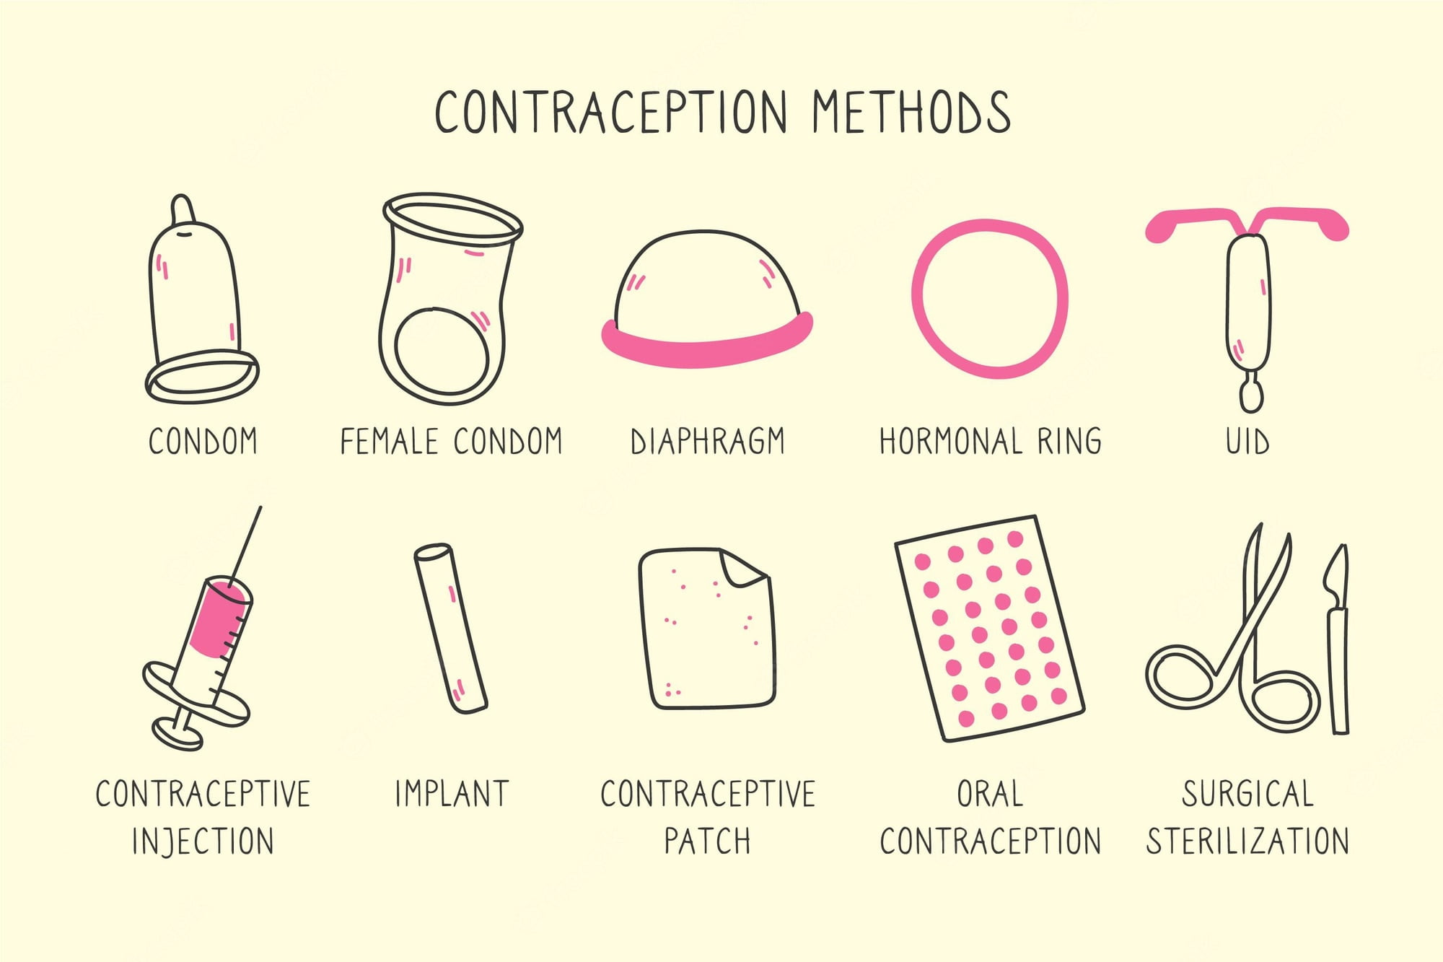
Contraception Choices

Slide 23
Concerns of Diabetes & Pregnancy
Risk to Mum:
Existing condition and symptoms worsening
Pre-eclampsia
Polyhydramnios (increased liquor volume)
Increased risk of DKA in 3rd trimester or after steroid use
Hypoglycaemia unawareness
Perineal trauma
Early IOL/LSCS
Risk to Baby:
Increased chance of SCBU admission
Heart defects
Spinal Defects
Miscarriage
Macrosomia / Large for gestational age
Birth injury related to shoulder dystocia
Still birth
Hypoglycaemia
Obesity and diabetes later in life

Slide 24
Percentage of pregnancies per audit year in England & Wales
Audit year | All pregnancies | Type 1 | Type 1 (%) | Type 2 | Type 2 (%) | Other diabetes | Other diabetes (%) | Not known diabetes | Not known diabetes (%)
2014 | 2,595 | 1,330 | 51.3 | 1,220 | 47.0 | 20 | 0.8 | 20 | 0.8
2015 | 3,100 | 1,585 | 51.1 | 1,475 | 47.6 | 30 | 1.0 | 15 | 0.5
2016 | 3,475 | 1,735 | 49.9 | 1,700 | 48.9 | 35 | 1.0 | 15 | 0.4
2017 | 3,865 | 1,870 | 48.4 | 1,960 | 50.7 | 30 | 0.8 | 5 | 0.1
2018 | 4,620 | 2,180 | 47.2 | 2,385 | 51.6 | 40 | 0.9 | 15 | 0.3
2019 | 4,870 | 2,170 | 44.6 | 2,625 | 53.9 | 60 | 1.2 | 20 | 0.4
2020 | 4,730 | 2,115 | 44.7 | 2,555 | 54.0 | 50 | 1.1 | 10 | 0.2
2021 | 4,880 | 2,190 | 44.9 | 2,610 | 53.5 | 55 | 1.1 | 25 | 0.5
2022 | 5,345 | 2,280 | 42.7 | 2,975 | 55.7 | 50 | 0.9 | 40 | 0.7

Slide 25
Preconception Care & Type 2 Diabetes
Table 3: Number of pregnancy outcomes (live births, stillbirths, miscarriages) by diabetes type (2021 and 2022)
Audit year | Diabetes type | Live births | Stillbirths | Miscarriages
2021 | Type 1 | 1,975 | 25 | 160
 | Type 2 | 2,325 | 20 | 280
 | Other | 75 | 0 | 5
2022 | Type 1 | 2,095 | 20 | 155
 | Type 2 | 2,670 | 35 | 280
 | Other | 80 | 0 | 10

Slide 26
Who should provide Care?
How can we support people?
People with Type 2 Diabetes may not have a Diabetes Specialist Nurse – we must remember this.
Primary care provides initial Diabetes Care.
All women with Type 2 Diabetes are entitled to Pre-conception care to the same standard as Type 1.
Initiation will be with primary care and the practice nurses.
Once women are within range to have a safe pregnancy, they can then be referred to secondary care.
Women with additional medical conditions may need early referral to secondary care

Slide 27
Previous GDMs
Women who have had previous pregnancies and have been diagnosed with Gestational Diabetes Mellitus (GDM) are at higher risk of developing Type 2 Diabetes within 5 years of diagnosis.
To help reduce the chance of this happening we can offer further care through advising GPs of the initial GDM diagnosis and on discharge from midwifery services.
Advising primary care of the correct coding can then facilitate ongoing care pathways such as annual hba1c checks, referral to the prevention program, and early identification of diabetes should this occur.

Slide 28
CODING FOR GESTATIONAL DIABETES
Gestational Diabetes Mellitus - SNOMED CT 11687002
This code should then highlight that they are entitled to annual screening for diabetes.
Hba1c readings should be scheduled for -
3 months postpartum (Please add a diary date 3 months from their expected delivery date)
Annually (Please add a recall)
Prior to future pregnancy
Referral to Diabetes prevention program -SNOMED 1025251000000107
•This is vital for providing support to reduce their high risk of developing Type 2 Diabetes
•The patient should be given information on self-referral to ‘Healthier You: NHS Diabetes Prevention Programme’

Slide 29
Referrals
Sheffield
Patient booking hub – 01142712866
Sth.referralstosth@nhs.net
Barnsley
Barnsleydiabetes@spa.nhs.net or via the BEST website
Rotherham
Rgh-tr.diabetesinpregnancyteam@nhs.net
Rgh-tr.greenoaksantenatalreferrals@nhs.net
Doncaster and Bassetlaw
https://www.mypregnancynotes.com/

Slide 30
James Ball Diabetes Health and Wellbeing Coach
James.Ball12@nhs.net

Slide 31
Delivery Option:
Face to Face
Remote (Four Priority Groups)
Digital (App)
https://healthieryou.reedwellbeing.com/
Notes:
4 priority, visualyl impaired, hearing , Bangladeshis, Pakistani and women GDM.

Slide 32
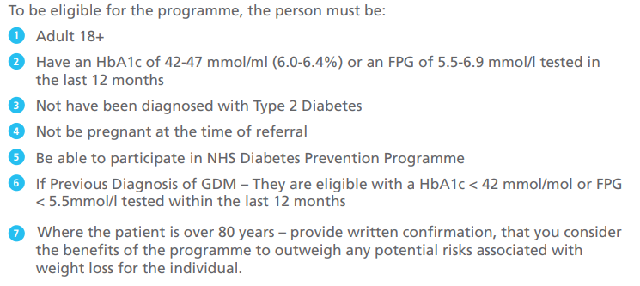
Eligibility Criteria

Slide 33
How to Refer?
Refer securely by:
Completing our electronic referral form through the Primary Care System.
Completing referral form and returning to healthieryou.syandb@nhs.net
Sending eligible patients, a letter suggesting they call us.
Previous GDM patients can self-refer online using the following link:
Gestational Diabetes | Healthier You | Diabetes Prevention (reedwellbeing.com)

Slide 34
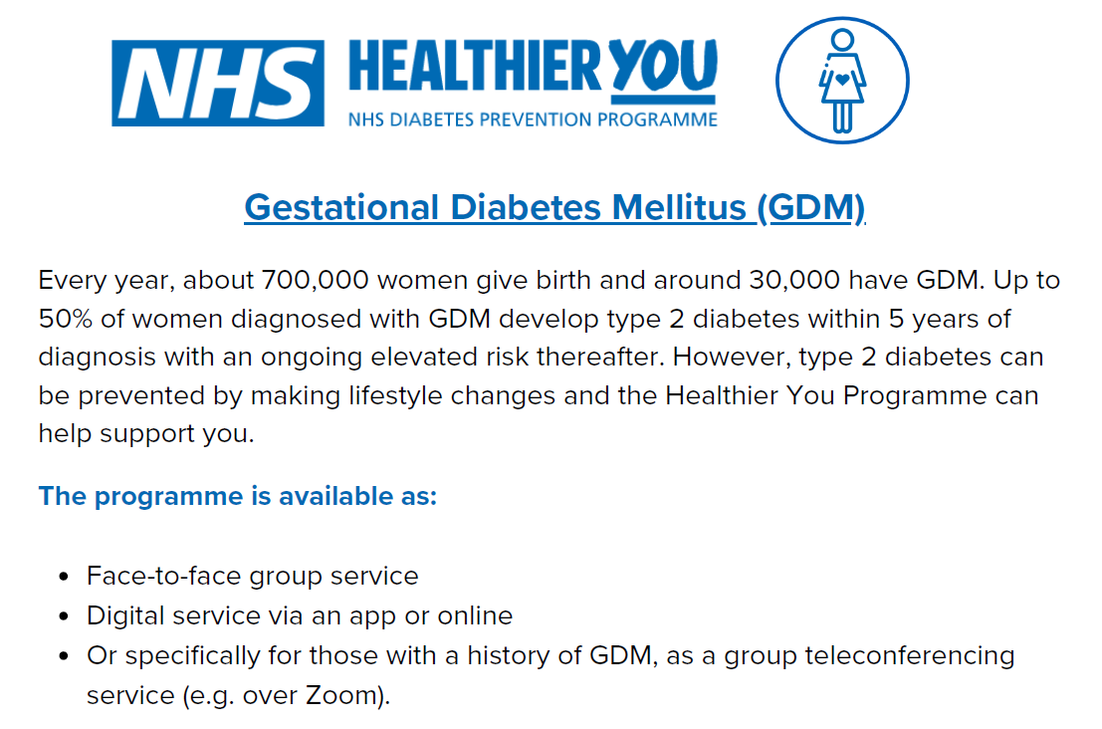
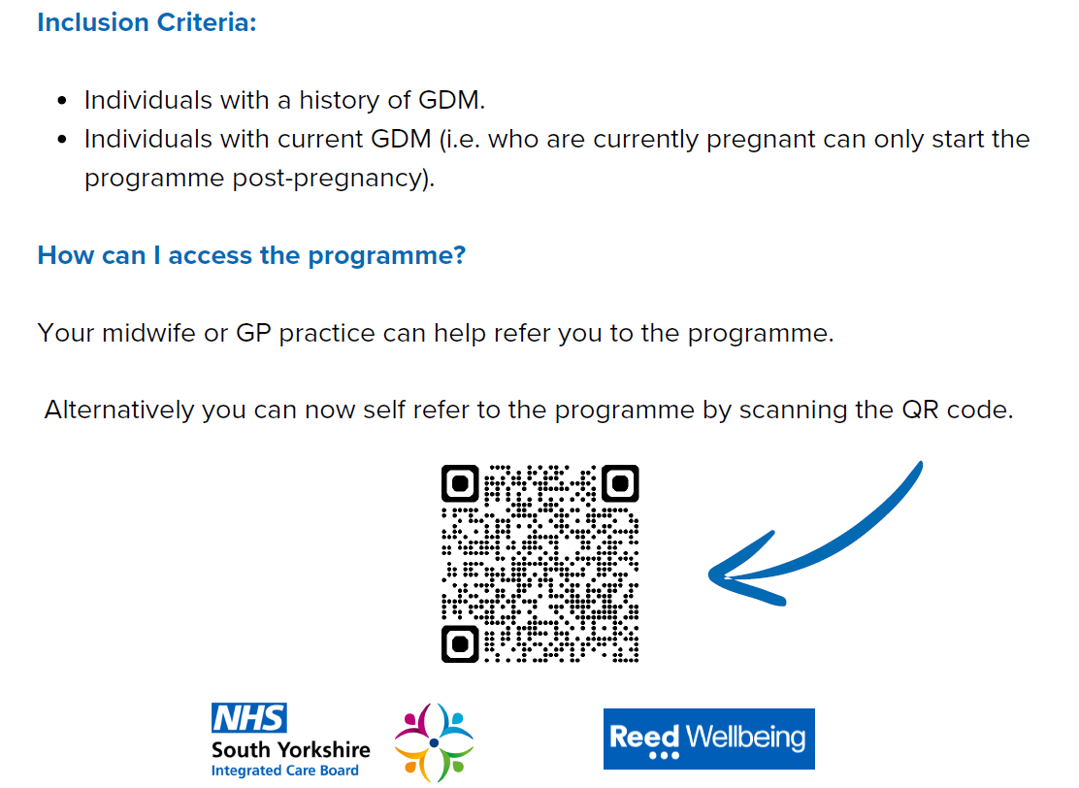
GDM Self-Referral
Previous GDM patients can self-refer online using the following link:​
Gestational Diabetes | Healthier You | Diabetes Prevention (reedwellbeing.com)
Notes:
Healthier_You_GDM_leaflet_FINAL_v2.pdf (assets.nhs.uk)

Slide 35
NHS Type 2 Diabetes Path to Remission Programme (T2DR)
Previously known as ‘NHS Low Calorie Diet’
Eligibility, content, and Coach support for 12-months
For patients diagnosed with Type 2 diabetes in last 6 years
Based on DiRECT and DROPLET studies
Three phases (not just ‘soups and shakes’):
Total Diet Replacement (12 weeks) Total Diet Replacement: For Diabetes Reversal & Weight Loss - Habitual (tryhabitual.com)
Food Reintroduction (6 weeks)
Weight Maintenance (to 12 months, incl. Rescue packages)
NO COST to patients
Delivery format: participant choice of 1:1 in-person or digital
Service provided by
NEWCASTLE

Slide 36
Participant Resources

Slide 37
Eligibility criteria (summary)
Inclusion
Exclusion
Aged 18-65
T2D diagnosis within last 6 years
BMI >=27kg/m² (>=25kg/m² if BAME origin)
Attended monitoring and diabetes review in last 12 months
HbA1c within 12 months:
If on diabetes medication, HbA1c >=43 mmol/mol (6.1%)
If not on diabetes medication, HbA1c >=48 mmol/mol (6.5%)
In all cases, HbA1c must be <=87 mmol/mol (10.1%)
Current insulin user
Currently breastfeeding
Pregnant or planning pregnancy within 6 mths
Heart attack or stroke in last 6 months; severe heart failure (New York Heart Association grade 3 or 4); severe renal impairment (most recent eGFR <30mls/min/1.73m2); active liver disease (not including NAFLD); active substance use disorder; active eating disorder; porphyria; or known proliferative retinopathy that has not been treated
Had bariatric surgery
Health professional assessment; or for whom safe and robust medications adjustment is not practical in a primary care setting
Notes:
Aged between 18-65
BMI reading of a minimum of 27 unless from a BAME ethnicity and this would reduce to 25.
Regarding the HbA1c scores, must be taken within the last 12 months:
If on diabetes medication we would require a score of 43 or greater, if not on diabetes medication we would require a score of 48mmol or greater.
In both instances HbA1c needs to be less than 87.
So, the exclusion criteria … No one who is currently using insulin, breastfeeding, pregnant. The EMIS search wouldn’t pick up on if an individual is planning on becoming pregnant so that would be picked up in the assessment.

Slide 38
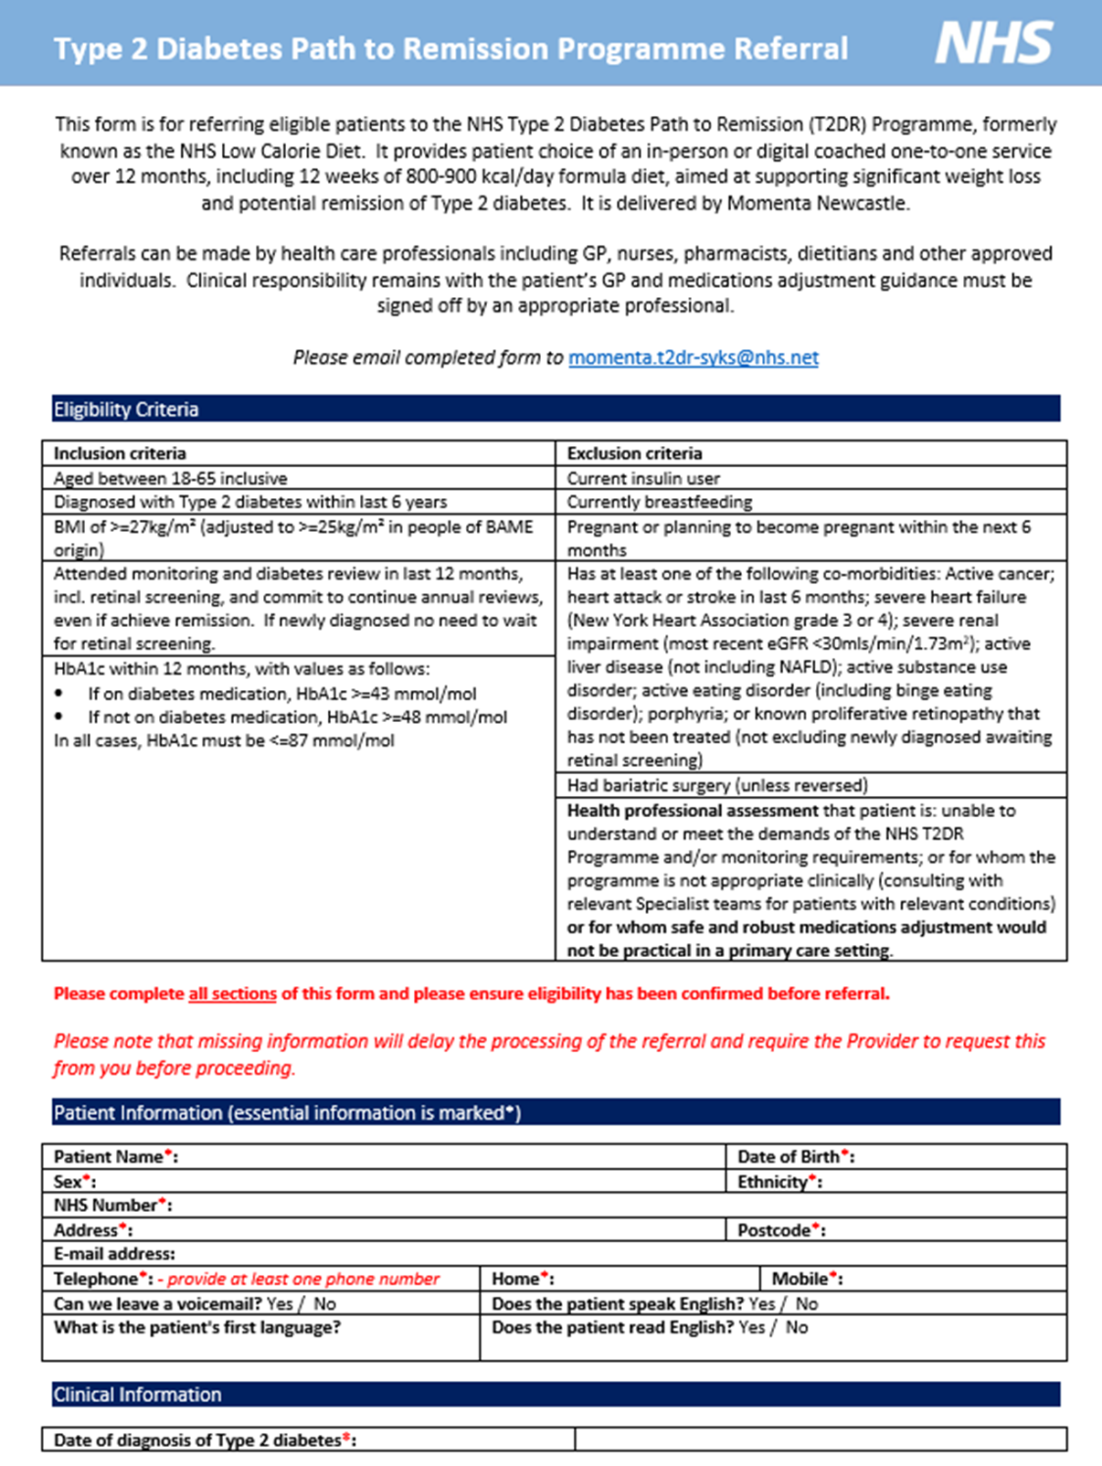
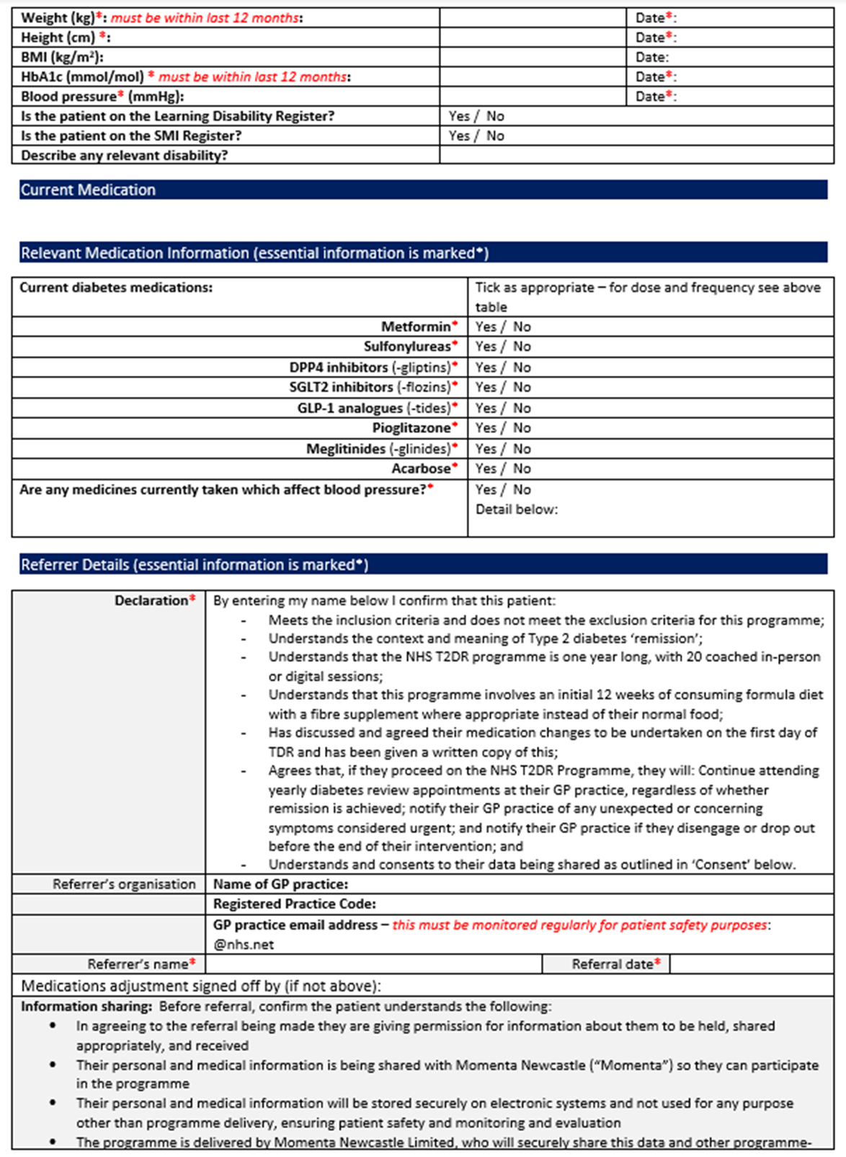
How to Refer?

Slide 39
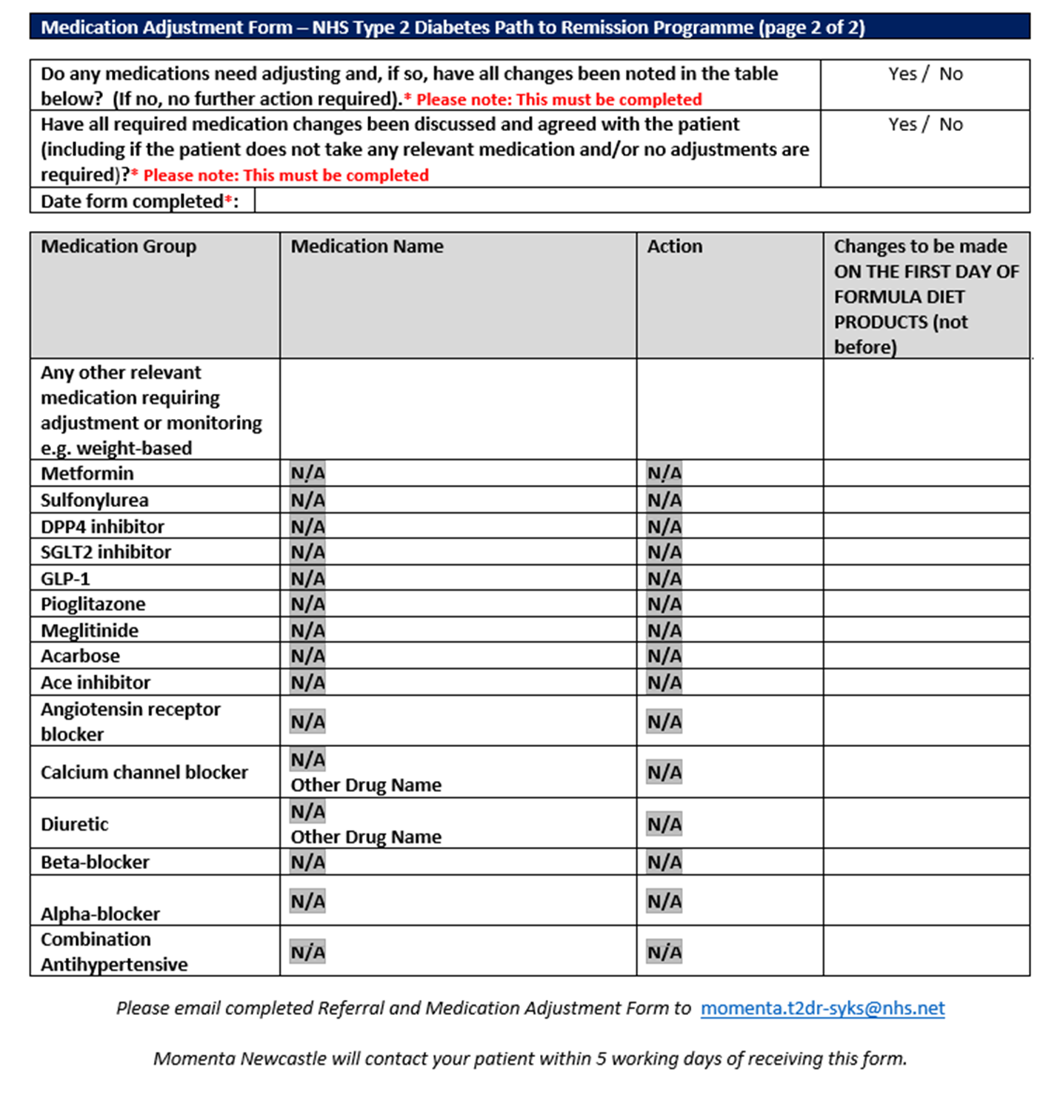

Slide 40
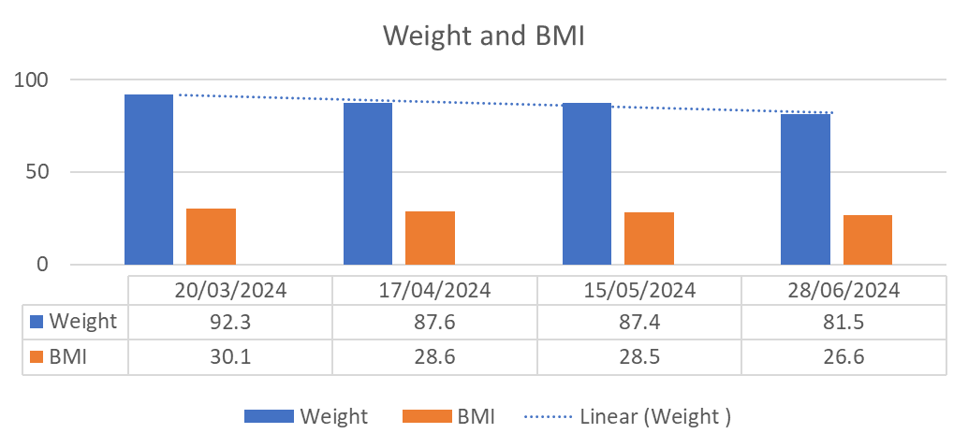
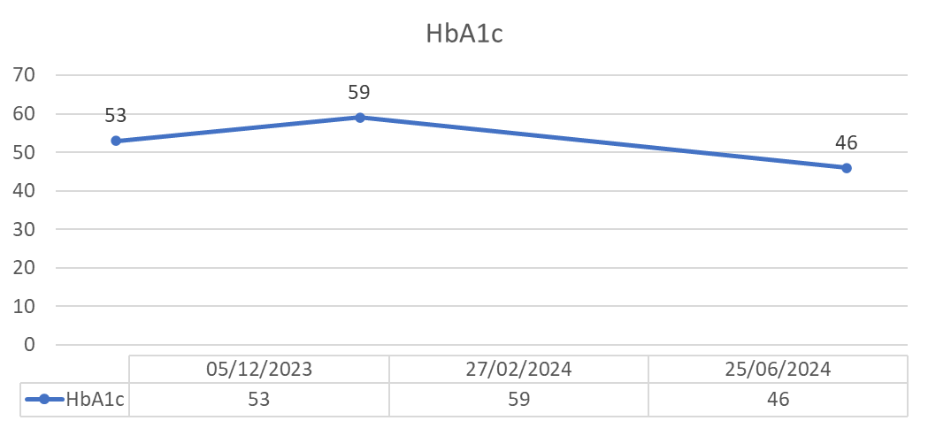
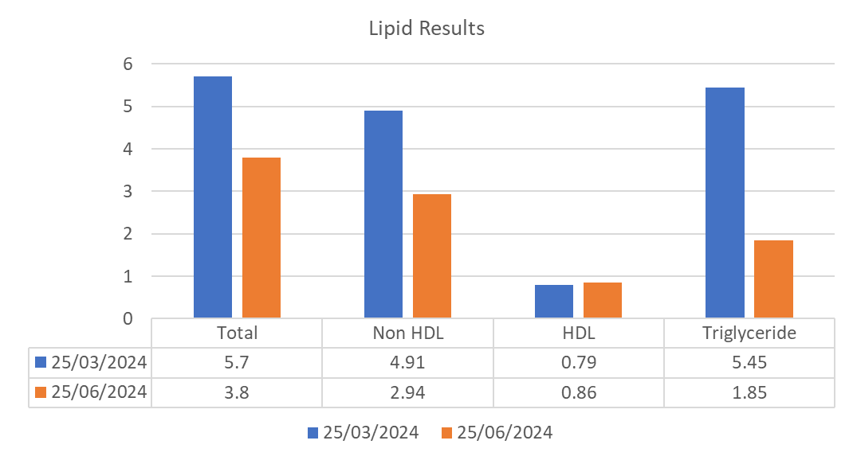
T2DR Case Study- Male 40
Results after 12 weeks of being on the programme
Patient stopped Metformin on day one of the programme
Weight reduced by 10.8kg
BMI reduced by 3.5
HbA1c reduced by 13mmol/L
Total cholesterol reduced by 1.9 mmol/L
Non-HDL reduced by 1.97 mmol/L
HDL increased by 0.07 mmol/L
Triglyceride reduced by 3.6 mmol/L

Slide 41
How to run a search?
Reporting
Population Reporting
Clinical Reporting
Please review each patient before considering referring them into a programme to prevent disappointment and referrals being rejected
Ardens Folder
Ardens Ltd Folder
4.12 Conditions - Diabetes
Conditions | Diabetes
National Diabetes Prevention Programme (NDPP)
LCD or Pathway to Remission – Potentially Eligible
NDPP | For Review | Referral
LCD|T2DR| For Review | Referral

Slide 42
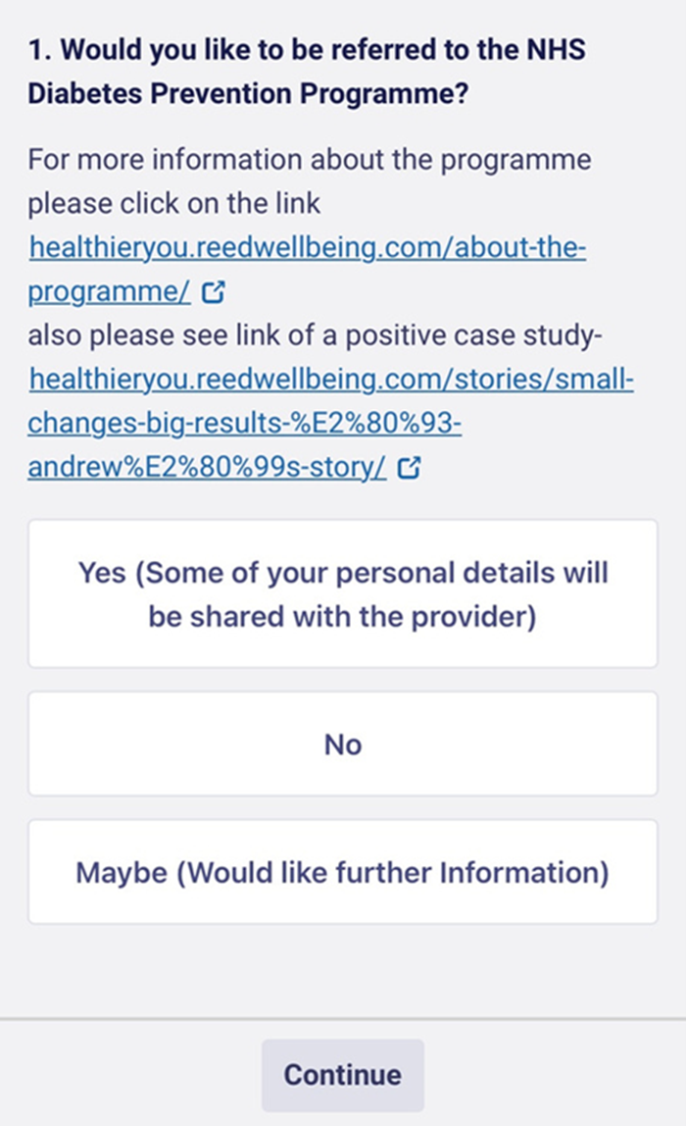
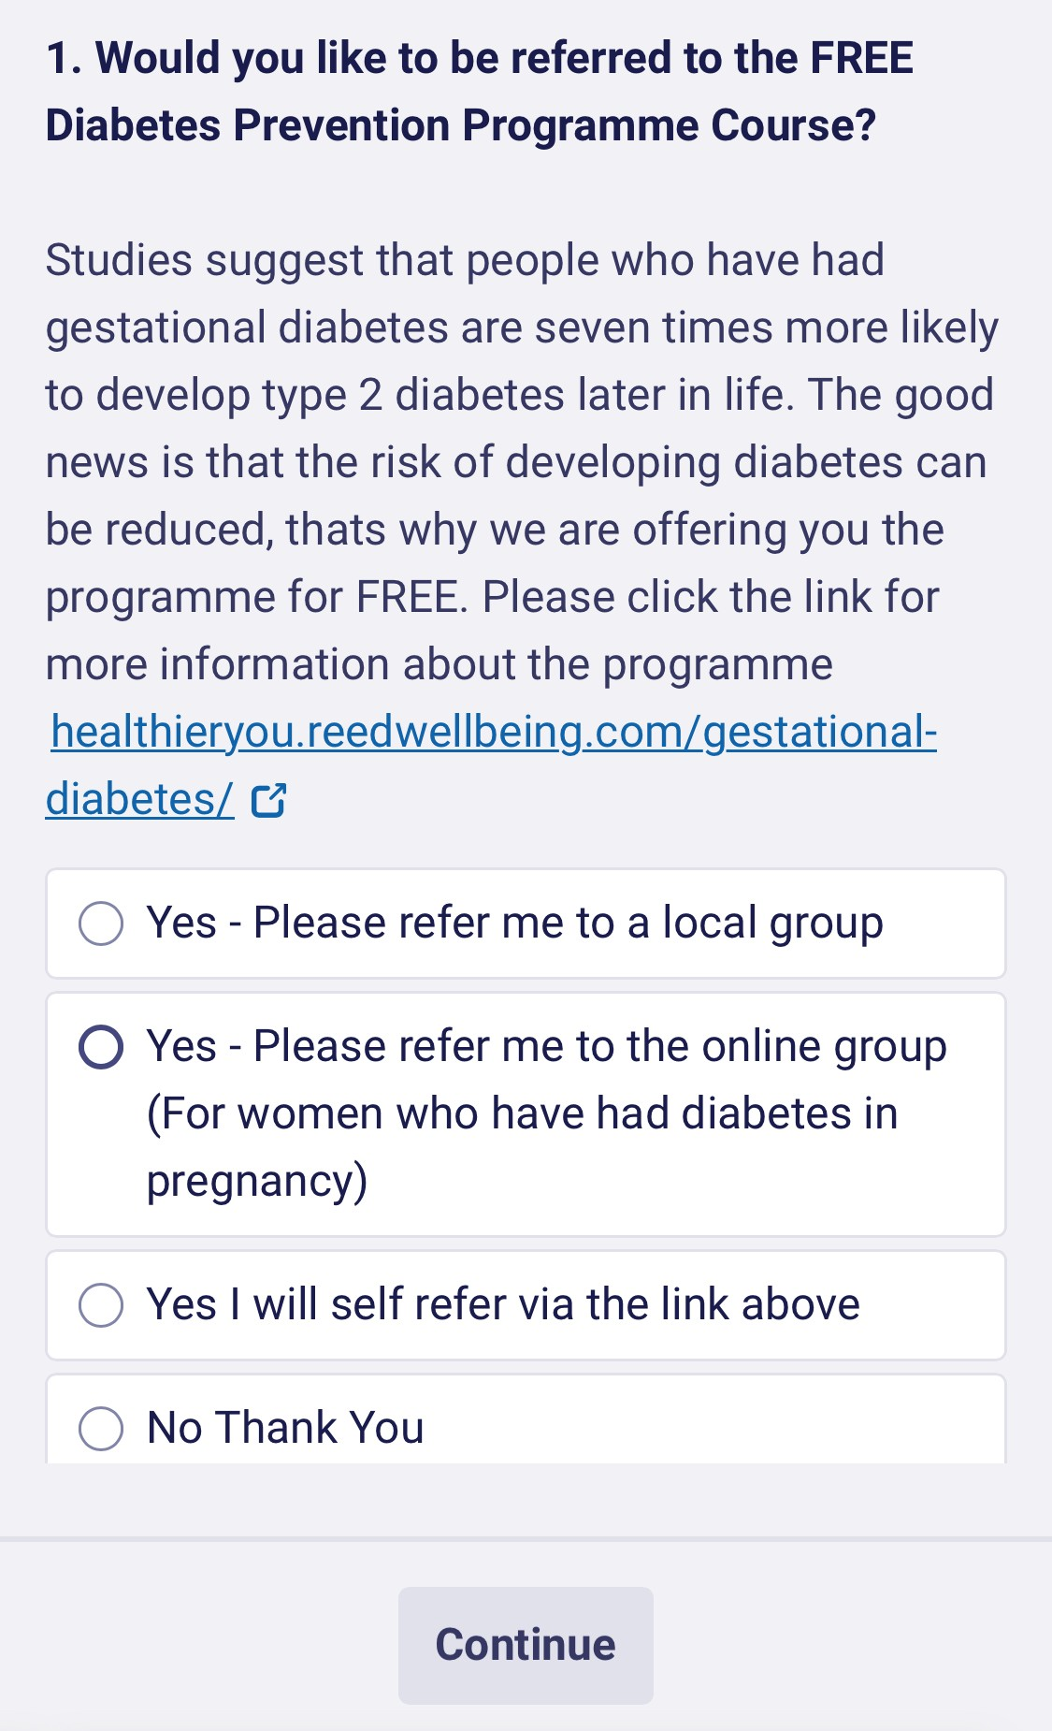
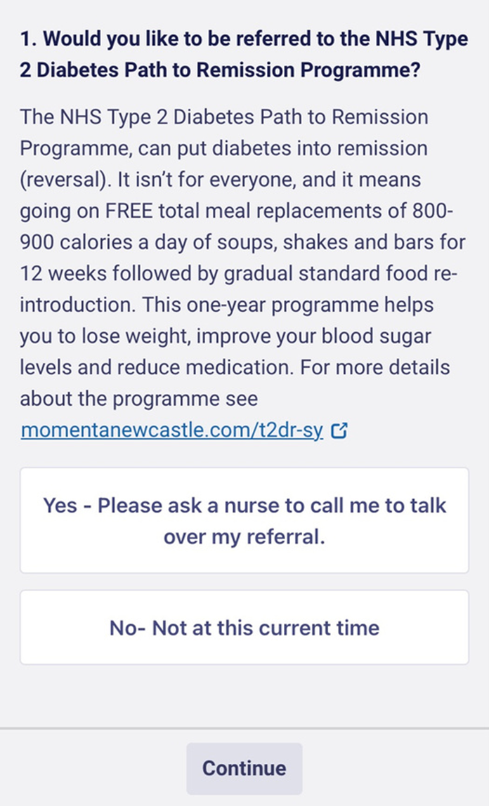
Florey Questionnaires
NHS Diabetes Prevention Programme Florey​
​
https://web.accurx.com/import/gybd2x7mw8​
​
​
NHS Diabetes Prevention Programme GDM Florey
https://web.accurx.com/import/8nmj6p62aw
​
​
Type 2 Path To Remission Programme Florey
https://web.accurx.com/import/x4wc7wtvh8
​
​

Slide 43
Floreys Outcomes
NHS Diabetes Prevention Programme
Hollygreen Referrals to the NDPP Prior to sending out the Florey (July 2023 - Total Referrals- 35).
89 referrals from sending the Florey with the practice getting £11.50 for each referral = £1,023.50
Since starting:
75% of referrals had a follow-up Hba1c
30% reduced Hba1c to <42 mmol/mol (nondiabetic range)
27% reduced but still pre-diabetic
NHS Type 2 Diabetes Path to Remission
Programme
Identified 28 simple referrals and sent them the Florey questionnaire.
9 replied
6 asked to be referred
3 declined

Slide 44
Top Tips NDPP and T2DR Programmes
NHS Diabetes Prevention Programme
Search will pick up GDM patients​
Check they have had a HbA1c within the last 12 months. ​
Make sure you tick GDM on the referral form​
​
Any patients Aged 80+ need additional confirmation from GP and made aware the programme is classed as a weight management programme. ​
Send the Florey to patients once they have had a blood test and it has come back as pre-diabetes 42-47 mmol/L
Link below about the programme​
​
https://healthieryou.reedwellbeing.com/about-the-programme/​
​
Link below for self-referral for Gestational Diabetes​
​
https://healthieryou.reedwellbeing.com/gestational-diabetes/​
NHS Type 2 Diabetes Path to Remission
Programme
Identify simple referrals first
On no medication (Newly Diagnosed Patients)
1 or 2 DM medication
Not on BP medication (Solely for BP)
Resource for referrers
https://momentanewcastle.com/hcp-t2dr-sy
Resource for patients
https://momentanewcastle.com/t2dr-sy​

Slide 45
T2 Day Type 2 Diabetes in the Young (18-39)
Foundry PCN Pilot
Farah Akhtar – Health and Wellbeing Coach
Farah.Akhtar4@nhs.net

Slide 46
Foundry PCN
Foundry PCN has a total population of 59,614 The PCN has a widely diverse population, and seven out of eight practices are in the most deprived decile 1, the eighth being in decile 3.
There is a high number of Type 2 Patients across Foundry compared to Sheffield with low engagement with primary care.
167 different languages spoken within the network
Practice Name | 1 Aged 18-39 with T2DM | 1a All 8 care processes 12m | % TYP2/ 8 Care | 1b All 9 care processes 12m | % with T2 9 care | 1c All 3 treatment targets 12m | % with T2 With 3 TT
FIRTH PARK SURGERY | 42 | 16 | 33.33% | 0 | 0.00% | 2 | 44.44%
SOUTHEY GREEN MEDICAL CTR | 5 | 0 | 23.33% | 0 | 3.33% | 1 | 13.33%
FORGE HEALTH GROUP | 64 | 23 | 7.14% | 1 | 7.14% | 6 | 21.43%
WINCOBANK MEDICAL CENTRE | 25 | 10 | 25.00% | 4 | 12.50% | 2 | 4.17%
BURNGREAVE SURGERY | 38 | 9 | 18.18% | 7 | 18.18% | 6 | 18.18%
PAGE HALL MEDICAL CENTRE | 46 | 15 | 30.00% | 10 | 20.00% | 5 | 20.00%
SHEFFIELD MEDICAL CENTRE | 17 | 8 | 32.35% | 4 | 20.59% | 2 | 8.82%
UPWELL STREET SURGERY | 25 | 12 | 11.11% | 9 | 5.56% | 3 | 5.56%
 | 262 | 93 | 35.50% | 35 | 13.36% | 27 | 10.31%
Data Source Local Searches SY: February 2023 – February 2024.
Notes:
3609 in SY and 1475 in Sheffield, 17.76% of Sheffield T2 are from the Foundry area
(Source. April 2024 Fingertips|PublichHealthData).

Slide 47
Pilot Burngreave Surgery
When?
3 Thursday Morning at BG Practice (8 available appointments a day)
Protected Clinic Time
How?
Pre-booked Appointments
Targeted Approach – Telephone Calls
Who?
Practice Nurse
Practice Manager
Farah Akhtar Admin Support
What Worked Well?
Coaching and Education – reduce DNA
Allowing time to ask questions/address any concerns.
Holistic Approach
Utilise other appointments for any elements missed
Identifying areas of priority that are missing
Lessons Learnt?
Key to know what services are available in local areas for example Weight Management, Carb Smart
Structured Approach to Appointments
Outcome
Out of 24 appointments 21 were used. - 87.5% uptake
Almost 53% increase 8 care
43% increase 9 care
Notes:
Time
Conversations started end of April 2024, Clinics started in May, followed by 2 weeks of mop-up work.
BURNGREAVE was the first Plot Site. Patients were identified on System 1 reporting.
Discussed with the practice and nurse to review capacity. Had done prior text for engagement with no success.
Agree to start with 0 out 9 care elements. Hardest to engage
Three Weekly Clinics ran with 8 appointments available
Telephone Call – provided a direct appointment for the clinics. Discussed Diabetes reviews and all care elements and the opportunity to ask any questions before appointment. Text sent of appointment. – KEY TO REDUCE DNA knew why attending.
A reminder call the day before.
Out of 24 appointments 21 attended. 87.5% attended.
DNA followed up and was booked back into either the next clinic and or Ad Hoc appointments with the nurse or HCA (as appropriate)
Out of the 3 clinics, not all 8 care elements were completed due to a number of reasons, these patients were followed up and offered an additional appointment. For example, some patients forgot or didn’t wish t complete there urine sample on the day.
On the day Nurse, discussed retinal screening and encouraged to book and or Farah supported

Slide 48
Case Study
32 years old, moved to the UK 4 years ago (2020) and changed address 4 times.
Diagnosed with Type 2 Diabetes in 2021. 0 out of 9 Key Care Processes.
Reluctant to accepted diagnosis of Type 2 Diabetes.
Problem
- Incorrect address on System one
- Fractured Relationship with GP
- Works nights – Zero Hour Contract – Poor eating patterns
- Doesn’t Answer private calls
- Complex Social Issues –Housing Priority
- Living in private shared accommodation with 10 people – limited kitchen access
- Concerns regarding vision
Outcome
- Patient attended the appointment
- Support was provided for housing
- Address was updated
- All 8 Care processes completed
- Booked Retinal Screening Appointment at the end of the day (before starts work)
- Discussed local services and online platforms.
Approach
- Called patient several times at different times of the day – updated system with working pattern
- Provided awareness T2 and the importance of Annual Reviews
- Patient ‘didn’t care about Diabetes’ the only support they wanted was with housing.
- Agreed to book an appointment at a time that suits
- Appointment booked with Farah, Care Coordinator and GP
Took 3 years to attend, but only took 30 minutes to book.
Notes:
Lack of acceptance of T2 Diagnosis
23rd July appointment retinal

Slide 49
Tops Tips
Identify patients and review the missing care elements- To support conversations
Know what works for your patients.
Use Interpreters
Know what services are available locally
Split Appointments where possible
Coding
Retinal Screening. Support making appointments.
Location options.
Utilise any existing appointments.
Notes:
Split appointments where possible. I.E. 1st appointment with HCA to do clinical elements such as Blood Pressure and 2nd appointment with the nurse to discuss medication, and other clinical queries and discuss/refer to Remission/Prevention Programme etc.

Slide 50
What could we be doing differently?

Slide 51
Seek out
Actively seek out your younger T2D patients. They probably won’t seek you out.
Think
Think differently when consulting with a younger person with T2D.
Individually assess
Do not assess their CV risk using QRISK tool. This will underestimate their CV risk. EOT2D plus any one additional risk factor = high CV risk
Talk
Talk to women of childbearing age and T2D about their contraception and their risks if not prepared for pregnancy. No contraception = aiming for conception.
Question
Question a diagnosis if it doesn’t feel right. Is the patient failing to respond to treatment as expected? Are there clinical features which don’t fit with type 2D? Ask for advice or refer.
Promote self management and remission
Promote the T2D remission programme to anyone eligible and interested. Also utilize the structured education programmes e.g. DESMOND, Healthy Living for People with Type 2 Diabetes, X-PERT programme, etc.
Promote the DPP (Prevention programme) to anyone eligible and interested. HbA1c of 42-47 in last 12mths. All women with history of GDM are eligible whatever their HbA1c in last 12mths.
Prevent

Slide 52
First Steps in Supporting the T2 Day Programme
KEY TAKE HOME MESSAGES
Run a search and identify your patient cohort
1
Ensure all 9 care processes are completed annually
2
Talk to women of childbearing age about the risks of, and preparing for, pregnancy. (FOLIC ACID 5MG)
3
Discuss and consider referring to the remission programme.
4
Refer to structured education programmes e.g. DESMOND/X-PERT or Healthy Living and/or offer locally available programmes.
5
Identify a T2Day Diabetes Champion for the practice.
Can we make T2 Day part of the agenda.
6
Notes:
Can you be our Diabetes Champion for the practice?
How will T2Day/DPP/T2DR stay on your practice’s/PCN’s agenda?

Slide 53
What support is available?
SY & WY T2 DAY Monthly Education Lunch and Learn
April 2024-April 2025
SY Diabetes Share Point
Diabetes
Online Training
This session, 1.1 support. Diabetes UK, CDEP
SY Diabetes Quarterly Newsletter

Slide 54
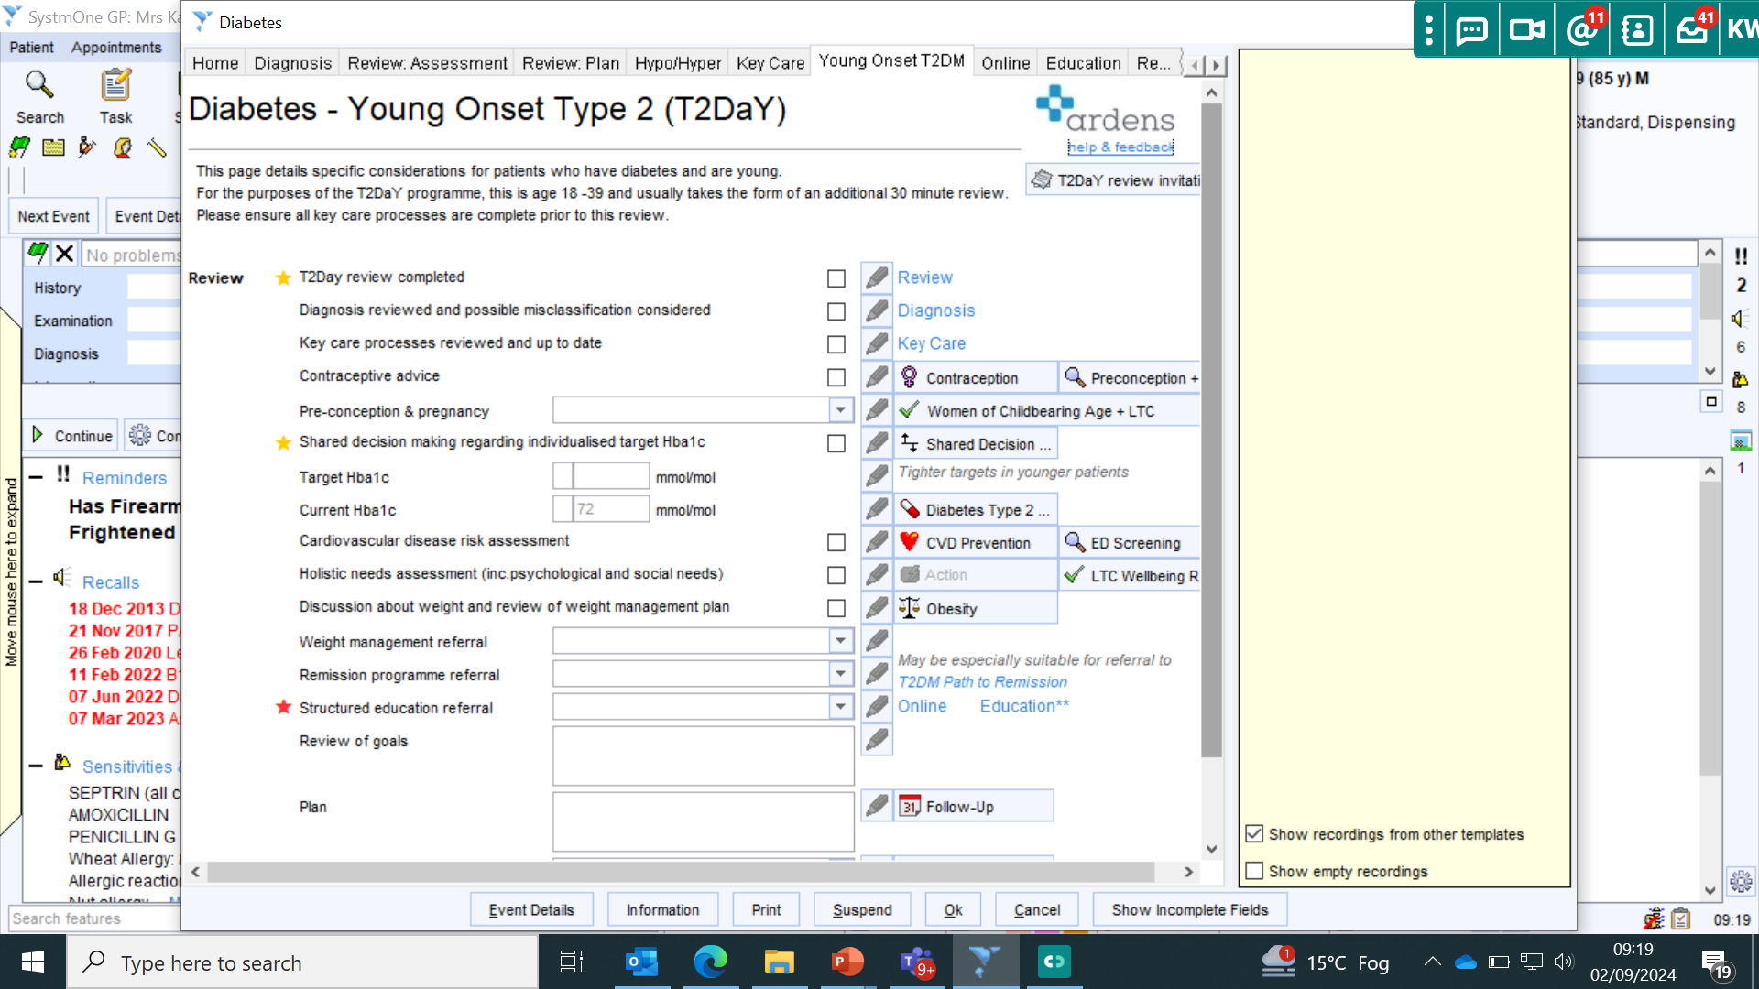
Ardens template - diabetes
Clinical Guidance.

Slide 55
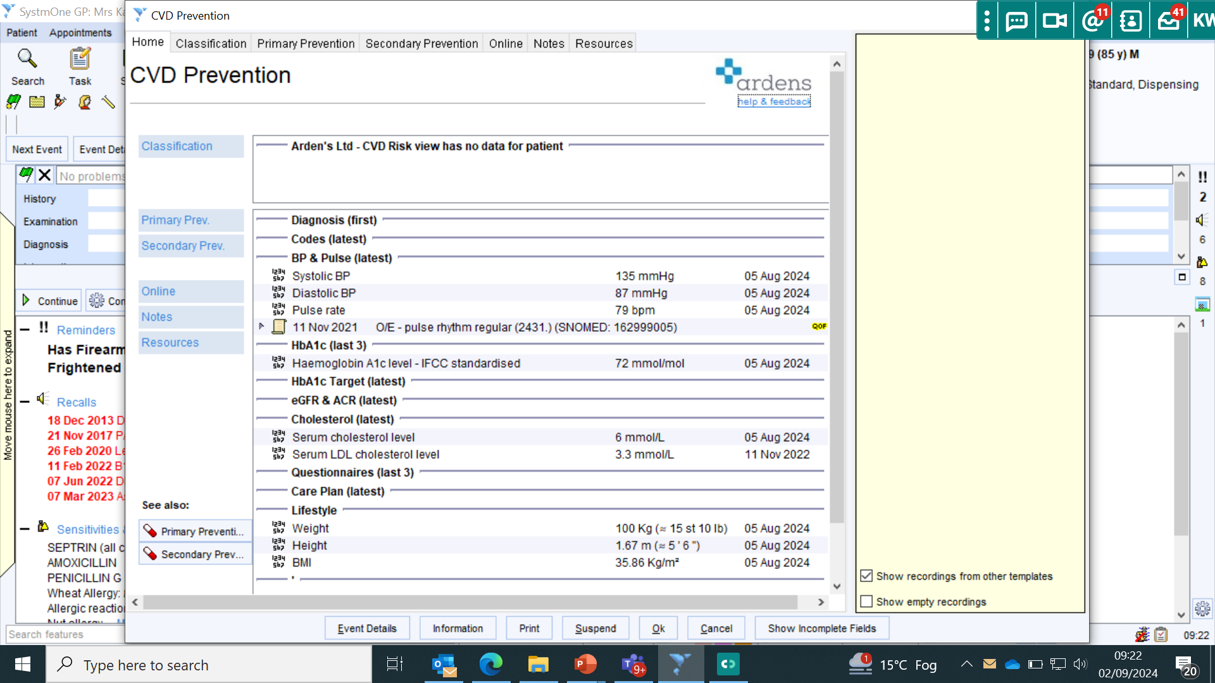
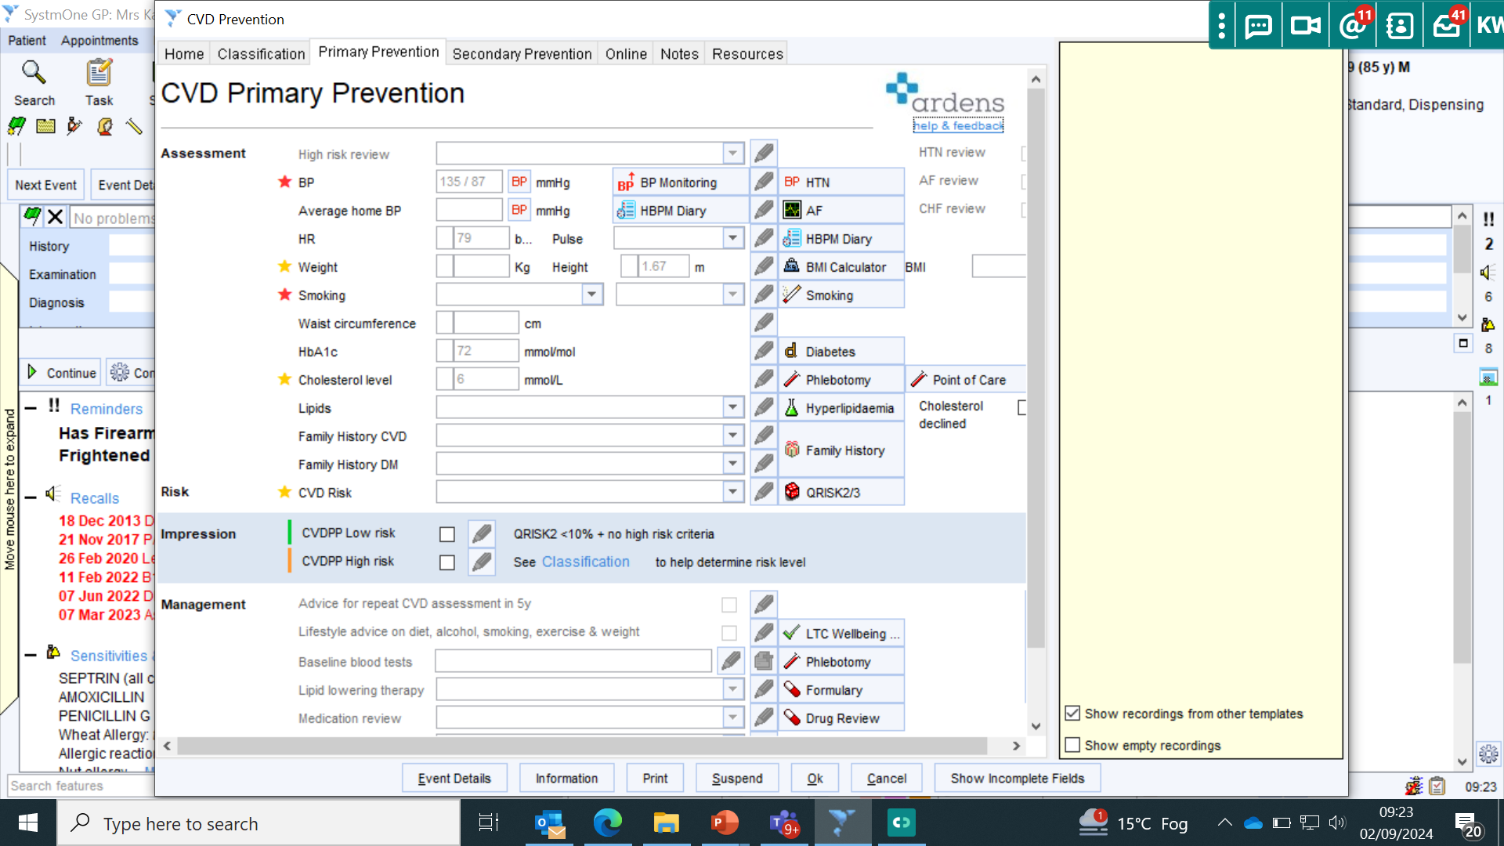
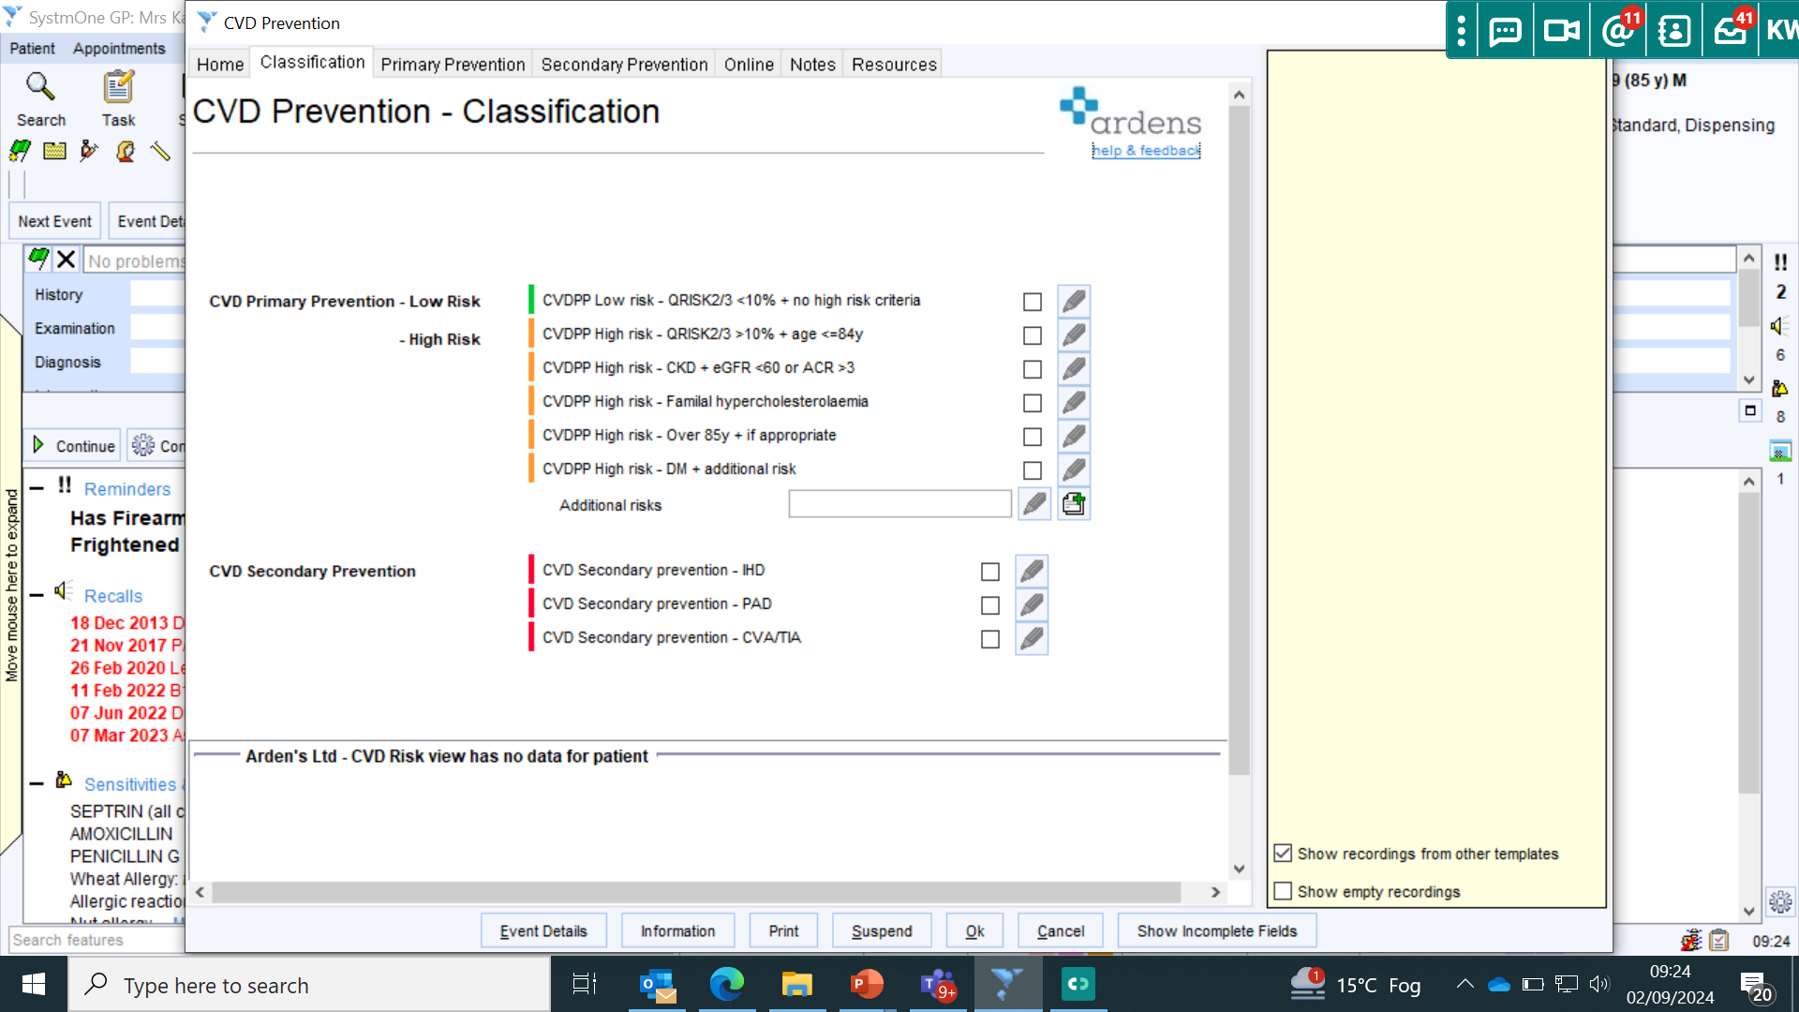
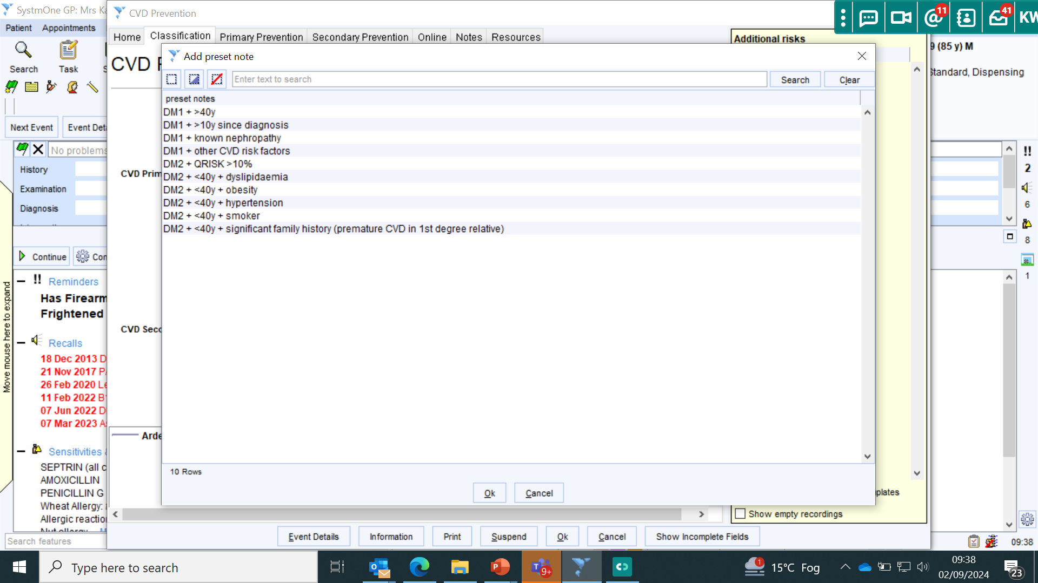

Slide 56
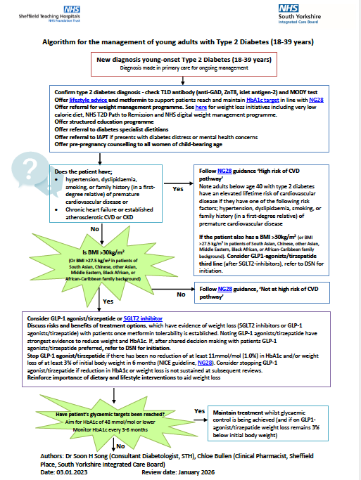
SY ICB young type 2 diabetes care pathway for primary care
Confirm type 2 diabetes diagnosis - check T1D antibody (anti-GAD, ZnT8, islet antigen-2) and MODY test
Offer lifestyle advice and metformin to support patients reach and maintain HbA1c target in line with NG28 Offer referral for weight management programme. See here for weight loss initiatives including very low calorie diet, NHS T2D Path to Remission and NHS digital weight management programme. Offer structured education programme Offer referral to diabetes specialist dietitians Offer referral to IAPT if presents with diabetes distress or mental health concerns
Offer pre-pregnancy counselling to all women of child-bearing age
COMING SOON!!
CVD risk assessment
Glycaemic treatment options
HbA1c target and monitoring frequency

Slide 57
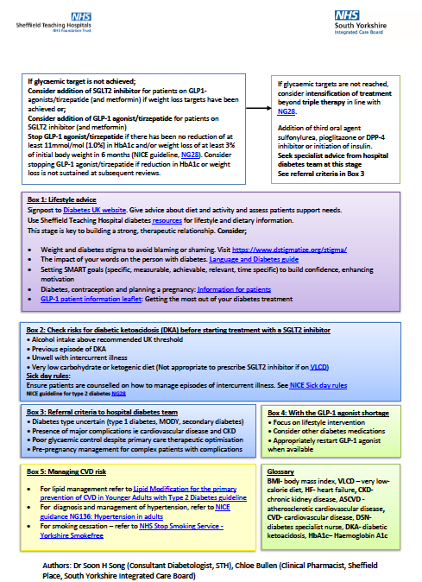
Lifestyle advice
Weight and diabetes stigma
Language Matters
Contraception and pregnancy
COMING SOON!!
SGLT2-Inhibitors and DKA
Sick day rules
Referral criteria to secondary care
GLP-1 agonist shortage
Clinical priority to focus on
CVD risk management
Resources for hypertension, lipid and smoking cessation

Slide 58
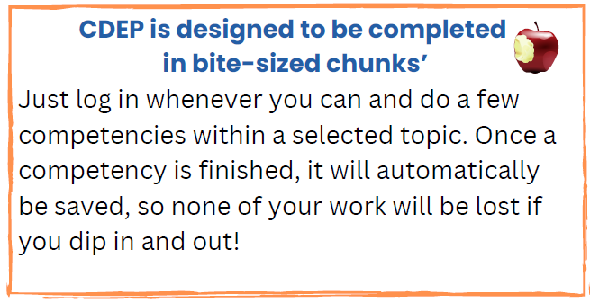
Cambridge Diabetes Education Programme (CDEP)
FREE for staff across South Yorkshire.
CDEP is an online diabetes training platform which can be accessed by all levels of staff, both registered and unregistered at any time.
CDEP is designed to: boost people's knowledge, confidence and guideline familiarity. Be done in bite-sized chunks that fit into your busy life and are accessed from a computer, mobile phone, or tablet.
To register click here. Or scan the QR Code.
Go to “Sign IN/Register”
Under new candidate registration enter your email address & click ‘Create My Account’
Complete registration form
Under “Registration Key Code” enter “SOUTHYORKSHIRE”.
This will provide you with free access for 12 months.
https://www.cdep.org.uk/
Most women with Type 2 diabetes who become pregnant are not prepared for pregnancy, and where blood glucose is not less than 48mmol/mol they are at increased risk of adverse maternal and neonatal outcomes.
Notes:
Source NHSENGLAND

Slide 59
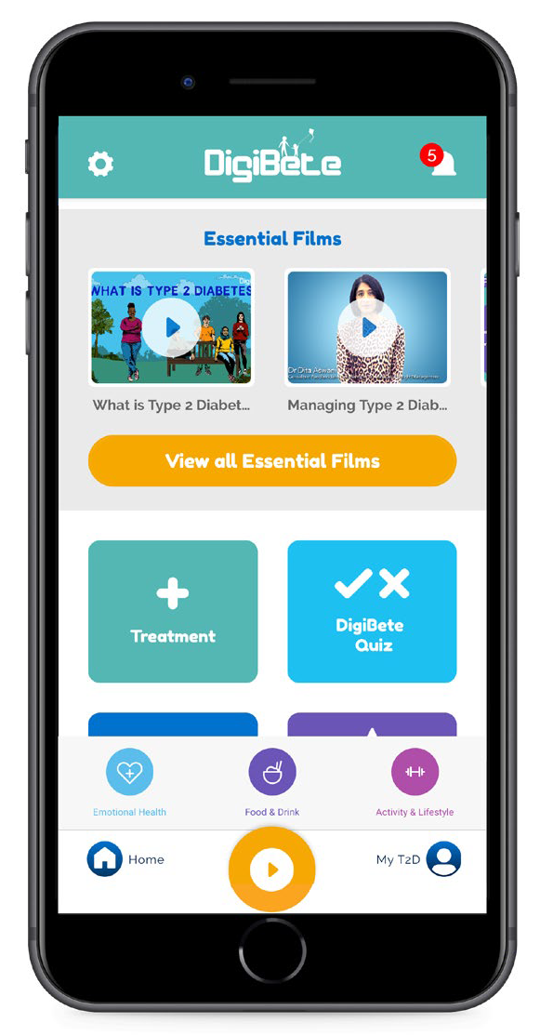
www.youngtype2.org
Download instructions
On downloading the DigiBete App, you will be asked to either
‘log in’ or ‘sign up’.
You will need to press ‘sign up’ on your first visit.
You will then create an account and enter your unique clinic code.
Your Clinic Code is: DVIKG (all letters)
3 reasons for you to download and use the DigiBete App today from either the App Store or Google Play:
Essential films, Support & Resources
You will have direct access to lots of Type 2 diabetes films & resources, including sick day rules, healthy eating, how to films and lots of written resources to support self-management, such as managing exercise, meal planning, healthy swaps, lifestyle, & motivation support.
Communication
DigiBete can send you relevant information and resources to support your diabetes at home. DigiBete will also send out regular communications.
Store Appointments, Notes, Goals & Keep a Photographic Food Diary
The My T2D area in the App allows you to record and access all your own personal management information, such as medication, appointments, food diary, goals & HbA1c. It is so handy to have everything you need all in the one place on your phone or tablet.
You can find a guide on how to register and how best to use the App here:
https://www.youngtype2.org/type-2-information/app-training-and-support
Each family can sign up with one email address and a password that can be shared with carers. Up to 6 devices can access the App using the same login. We hope you find this helpful.
Our Type 2 website is also available: https://www.youngtype2.org/
Any questions: app@digibete.org

Slide 60
T2 Day Team
Natalie Johnson - Diabetes Specialist Midwife
Natalie.Johnson56@nhs.net
Support: Preconception Care and Pregnancy
Katie Whitehead - Diabetes Practice Nurse Educator
Katie.Whitehead@nhs.net
Support: Raising Awareness & Training
James Ball - Health and Wellbeing Coach
James.Ball12@nhs.net
Support: Florey Questionnaires & Searches
Farah Akhtar - Health and Wellbeing Coach
Foundry PCN
Farah.Akhtar4@nhs.net
Support: Target Approach to increase 9 care
Ani Kumar - SY, ICB, Programme Manager
Ani.Kumar@nhs.net
Amy Moore - Diabetes Project Implementation Officer. Amy.Moore56@nhs.net
Most women with Type 2 diabetes who become pregnant are not prepared for pregnancy, and where blood glucose is not less than 48mmol/mol they are at increased risk of adverse maternal and neonatal outcomes.
Notes:
Source NHSENGLAND

Slide 61
WHAT CAN YOU DO THIS WEEK?
WHEN CAN YOU SEARCH FOR THESE PATIENTS?
WHO CAN HELP YOU?
ARE THERE COLLEAGUES WHO SHOULD KNOW ABOUT THIS?
WHEN COULD YOU SHARE THIS INFO WITH THEM?
(TEACHING SOMEONE ELSE IS A GREAT WAY TO EMBED IN YOUR MEMORY!)
WE NEED YOU TO BE A T2DAY CHAMPION!!
EMAIL: KATIE.WHITEHEAD@NHS.NET

Slide 62
Questions & Answers

Slide 63
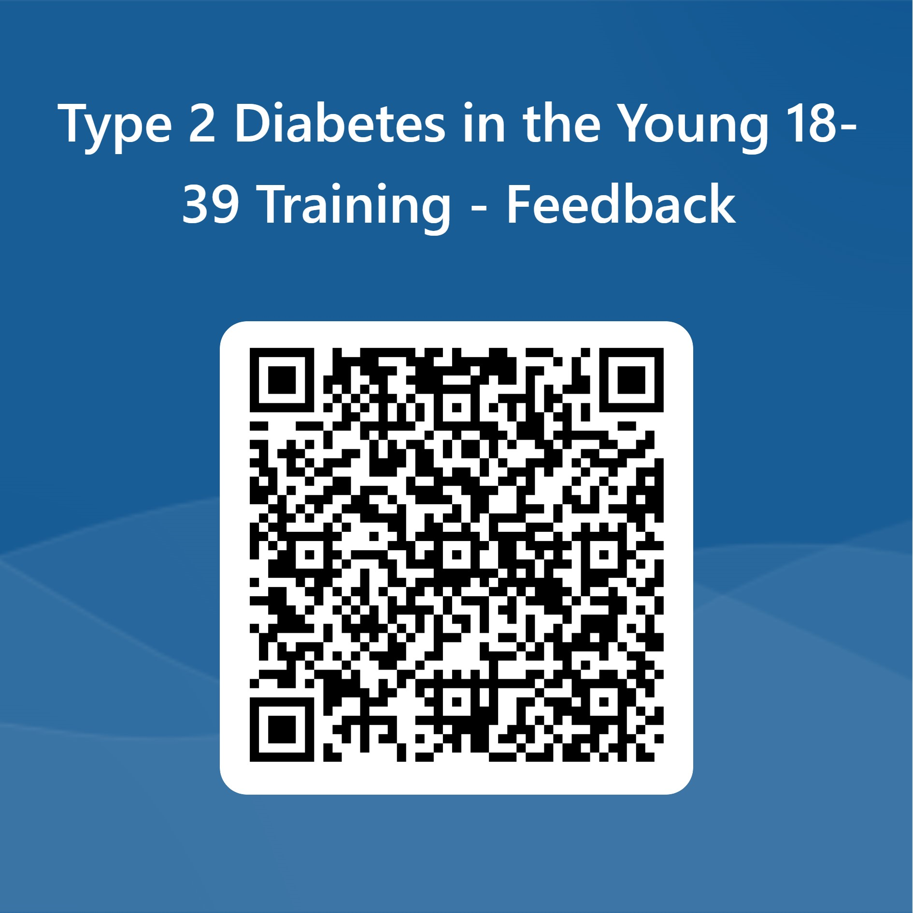
Feedback
Notes:
https://forms.microsoft.com/e/B6kssJUJQc - link for adding to chat.

