Slide 1

Pleural Effusion
Dr Muhammad Hussain
Consultant Respiratory Medicine
Barnsley Hospital

Slide 2
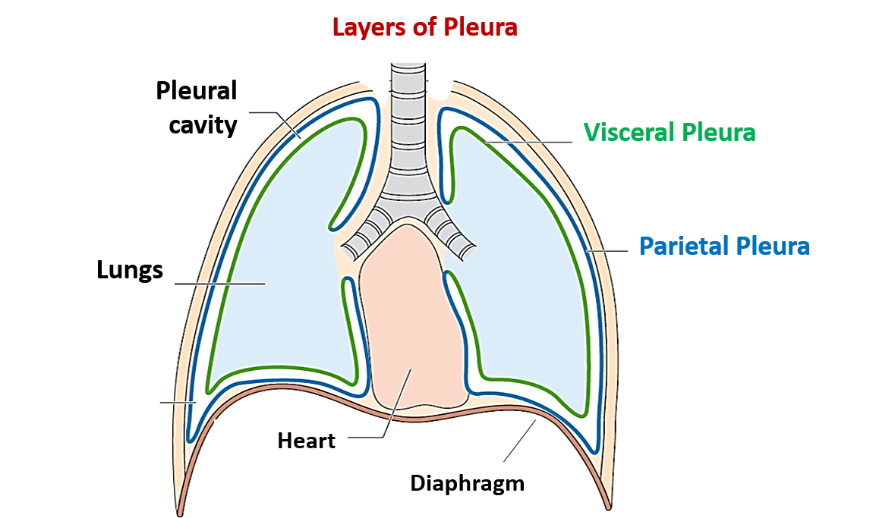
Pleural effusion (PE) is a common clinical problem with >60 recognized causes, including local pleural processes, underlying lung, systemic and multi-organ dysfunction, and drug-induced disease.
Its prevalence is around 400 cases/100 000 inhabitants.
Notes:
This means that most clinicians will have to manage cases of PE in the course of their careers.

Slide 3
Physiology of PF movement
Under normal conditions, the volume of PF in the pleural space is the result of a dynamic equilibrium between fluid inflow and outflow.
The fluid in the pleural space is continuously exchanged and forms a small film about 10 μm thick between the parietal and the visceral pleura that allows one membrane to slide over the other.
The PF filtered through the parietal pleura generates a higher pressure gradient than that coming from the visceral pleura. The reason for this difference is that the capillaries of the parietal pleura receive blood from the systemic circulation, whereas those of the visceral pleura receive it from the pulmonary circulation. In other words, in a normal situation, the parietal pleura plays a more relevant role in the filtration of fluid into the pleural space than the visceral pleura.

Slide 4
Under normal conditions, the net rate of PF formation is ≈0.01 mL·kg−1·h−1, hence, in a 60-kg person, about 15 mL·day−1 would enter.
For a PE to develop, one of the following situations must occur: the amount of fluid passing into the pleural space must be 30 times greater than normal to exceed the rate of lymphatic reabsorption; or lymphatic reabsorption is significantly decreased.

Slide 5
Increased hydrostatic pressure in the capillaries of the visceral pleura
Heart failure are a typical case in which increases in systolic and diastolic pressures of the left ventricle result in increased wedge pressures of the pulmonary capillaries and therefore an increase in hydrostatic pressures within the capillaries of the visceral pleura that causes fluid to move into the pleural space.
Determination of natriuretic peptides secreted by the cardiac ventricles in response to their acute distension may be useful in the diagnosis of these effusions

Slide 6
Decrease in oncotic pressure in pleural capillaries
This phenomenon occurs in patients with hypoalbuminaemia, or with excessive protein loss from the renal glomerulus (in nephrotic syndrome, for example). In these cases, the small amount of solutes in the pleural capillaries causes a decrease in oncotic pressure, which reduces the attraction of fluids into the capillaries. As a result, fluid accumulates in the pleural space. This fluid mainly comes from the parietal pleura, although the visceral pleura may also contribute. Clinically, this mechanism is a rare cause of large PE, probably due to residual lymphatic reabsorption.

Slide 7
Decrease in hydrostatic pressure in the pleural space
This type of PE occurs in the trapped lung. The hydrostatic gradient between the pleural space and the parietal pleura rises due to the increased negative pressure in the pleural space; as a result, the net flow of fluid into the pleural space increases to reduce the hydrostatic gradient. In this type of PE, as fluid is removed by thoracentesis, intrapleural hydrostatic pressure becomes even more negative and fluid builds up again in the pleural space.

Slide 8
Increased permeability of pleural capillaries
This enables a greater amount of fluid and solutes to enter the pleural space, it is the inflow and outflow that are altered, not pressures.
Microvascular permeability may increase by the action of two mechanisms: the opening of new spaces between cells (where permeability to water and small solutes increases, but macromolecule filtration is still restricted) or the opening of transcellular pathways (in this case, permeability to macromolecules also increases.
A variety of stimuli and mediators can cause these effects on the endothelium

Slide 9
Impaired lymphatic drainage of the pleural space
It is caused by an obstruction somewhere in the lymphatic system, including the stomas and mediastinal lymph nodes, caused by fibrosis, a tumour (usually lymphoma or a mediastinal mass) or lymphatic dysfunction, as in yellow nail syndrome.
Both situations will cause a retrograde accumulation of fluid into the pleural space.

Slide 10
Movement of fluid from the peritoneal space
Any disease involving the presence of fluid in the abdominal cavity can cause PE. Fluid may accumulate in the pleural space due to the pressure gradient between the peritoneal and pleural spaces (greater in the former as the latter has a negative pressure). This facilitates the unidirectional passage of fluid into the thoracic cavity and not the other way round.
Fluid also filtrates through diaphragmatic defects, generally smaller than 1 cm, usually found in the tendinous part of the right diaphragm. In this case, the type of effusion (transudate or exudate) will depend on the disease that caused the accumulation of free fluid in the abdominal cavity.

Slide 11
Signs and Symptoms
Dyspnea
Cough, usually non-productive
Pleuritic chest pain
Chest pressure
Hypoxemia
Decreased breath sounds on the affected side
Some people may exhibit no symptoms!

Slide 12
Investigation of the undiagnosed unilateral pleural effusion.
Imaging findings of a unilateral pleural effusion should be interpreted in the context of clinical history and knowledge of pleural fluid characteristics.
CT follow-up should be considered for patients presenting with pleural infection to exclude occult malignancy if there are ongoing symptoms, or other clinically concerning features.
PET-CT can be considered to support a diagnosis of pleural malignancy in adults when there are suspicious CT or clinical features and negative histological results, or when invasive sampling is not an option.

Slide 13
Diagnosis
Chest radiograph (x-ray)
Distinguish >200ml of fluid
Chest ultrasound
Locates small amounts or isolated loculated
pockets of fluid
Gives precise position of accumulation
Computed Tomography (CT) scan
Differentiates between fluid collection, lung
abcess, or tumor

Slide 14
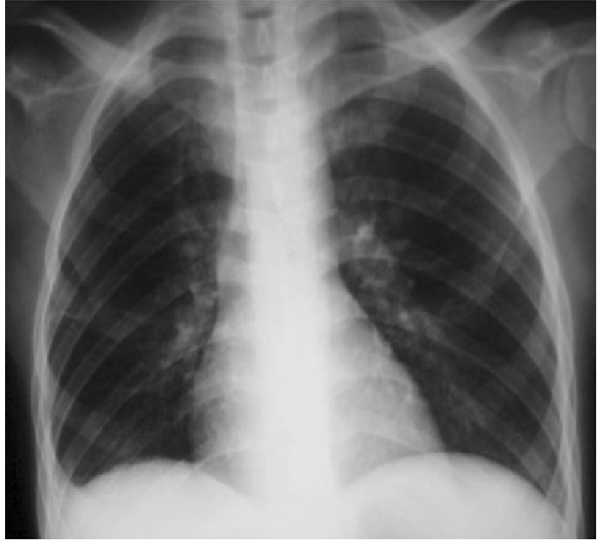
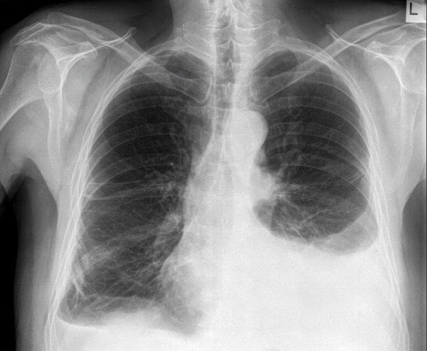

Slide 15
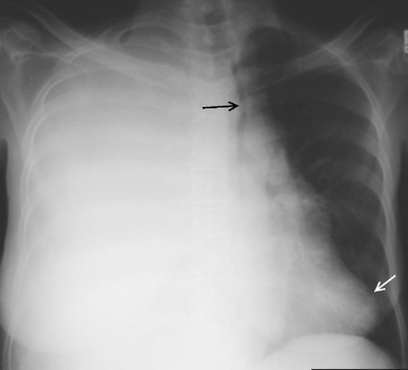

Slide 16
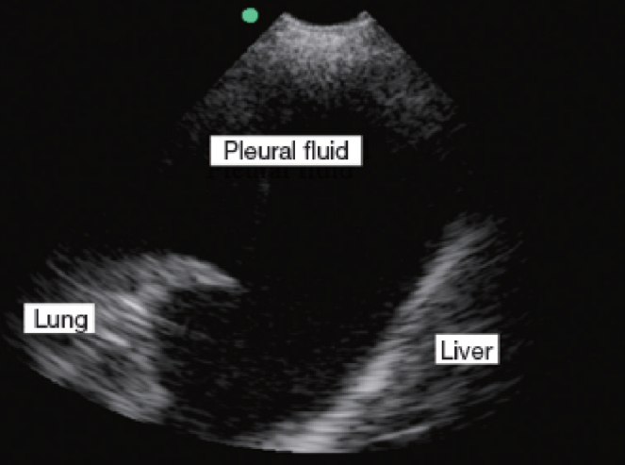
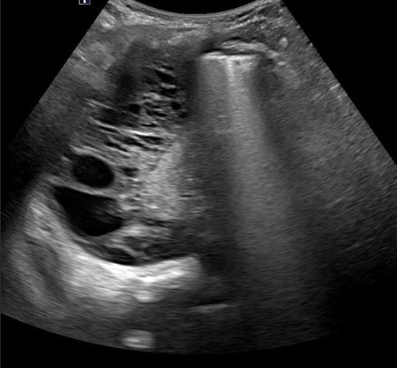

Slide 17
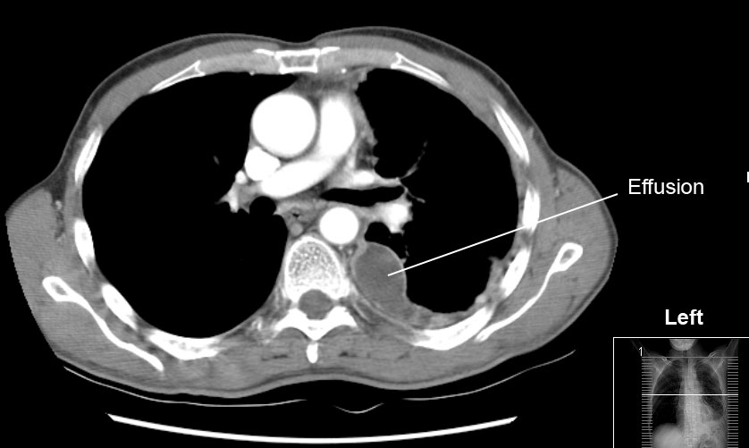
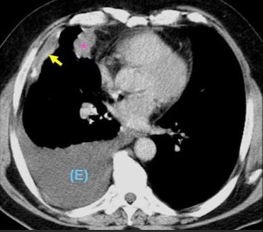

Slide 18
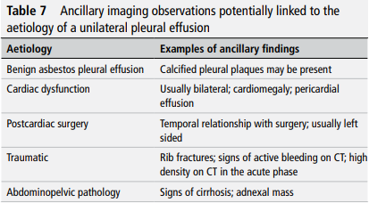

Slide 19
Question?
When to drain the fluid?

Slide 20
CLASSIFICATION
Exudate
Transudate
TRANSUDATE | PROTEIN | EXUDATE
< 25 g/L |  | >35 g/L
 | 25-35 g/L
 | LIGHT’S CRITERIA
Pleural Effusion: Work up

Slide 21
LIGHTS CRITERIA | EXUDATE =>1/3
PLEURAL FLUID PROTEIN/SERUM PROTEIN RATIO | 0.5
PLEURAL FLUID LDH/SERUM LDH RATIO | 0.6
PLEURAL FLUID LDH | >2/3 SERUM LDH
Pleural Effusion: Work up

Slide 22
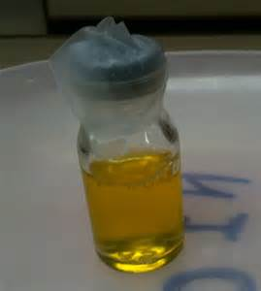
Exudative Pleural Effusion
Common causes | Less common causes | Rare causes
Malignancy Parapneumonic effusions Tuberculosis | Pulmonary embolism Rheumatoid arthritis and other autoimmune pleuritis Benign asbestos effusion Pancreatitis Post-myocardial infarction Post-coronary artery bypass graft | Yellow nail syndrome (and other lymphatic disorders Eg lymphangioleiomyomatosis) Drugs Fungal infections

Slide 23
Transudative Pleural Effusion
Common causes | Less common causes | Rare causes
Left ventricular failure Liver cirrhosis | Hypoalbuminaemia Peritoneal dialysis Hypothyroidism Nephrotic syndrome Mitral stenosis | Constrictive pericarditis Urinothorax Meigs’ syndrome

Slide 24
Case 1
A 62-year-old woman who has congestive heart failure develops pneumonia and a right sided pleural effusion. Thoracentesis is performed in an effort to establish whether the pleural effusion is due to congestive heart failure or pneumonia.
Points to favour CCF in history and Examination.
????

Slide 25
Case 1
Which finding would indicate that the pleural effusion is due to congestive heart failure?
A. A protein content of 6 gm/dl
B. A pH of 7.13
C. A glucose content of 20 mg/dl
D. A lactate dehydrogenase (LDH) content of 100
mg/dl (with a serum LDH level of 420 mg/dl)
E. A pleural fluid-serum protein ratio of 0.7

Slide 26
Case 2
A patient is admitted to the hospital with shortness of breath and found to have a pleural effusion on chest X-ray. Thoracentesis is performed and the fluid is sent for laboratory testing. Results of the fluid analysis are: pleural protein 8.0, serum protein 6.5, pleural LDH 500, serum LDH 100.
Based on these findings, which of the following is the most likely etiology of the pleural effusion?
A. Bacterial
B. Congestive heart failure (CHF)
C. Cirrhosis
D. Nephrotic syndrome
E. Pulmonary embolism

Slide 27
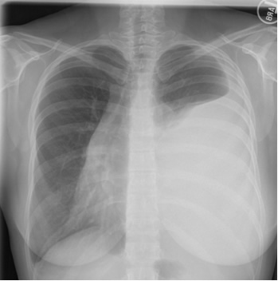
Case 3
A 37-year-old woman presents with 10-days of progressive exertional dyspnea. Her review of systems was pretty unremarkable.
She denied any fevers, chills, cough, sputum production or weight loss.
The only recent event that she can recall was that she had an upper respiratory tract infection 3 months ago at the same time that multiple family members were sick. Her symptoms resolved without antibiotic therapy.
Her only past medical history is allergic rhinitis.
She is a life-long non-smoker and had a recent negative mammogram.
A chest x-ray is performed.

Slide 28
Case 3
Thoracentesis is performed revealing
Straw-coloured fluid
RBC-- 2875
WBC-- 448 → differential
Polymorphonuclear cells 18%
Lymphocytes 37%
Macrophages 35%
Mesothelial cells 10%
Gram’s stain is negative.
LDH 406 (serum value 180),
Total protein 4.7 (serum value 7.0).
Cytology - no malignant cells are seen

Slide 29
Case 3
What would be the most likely diagnosis?
Malignancy
TB
Connective tissue disorder.
All of the above.
What further investigations would you like to arrange?

Slide 30
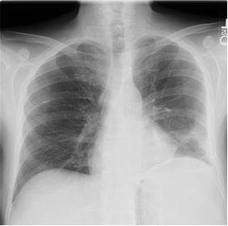
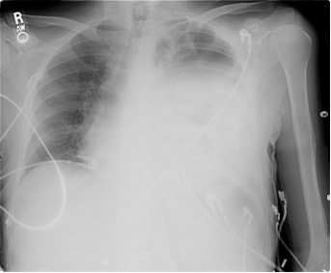
Case 4
A 45-year-old man is seen in clinic for fever, productive cough and dyspnea on exertion of several days duration.
A chest x-ray revealed a left lower lobe pneumonia but he was deemed stable for outpatient treatment and was sent home on oral levofloxacin.
Two days later, he returns complaining of increasing fevers, worsening left-sided chest pain and increasing dyspnea.
Notes:
the presence of a new effusion in a patient with worsening fevers, chest pain and dyspnea should raise a strong suspicion for a parapneumonic effusion or empyema. You will need to do a prompt thoracentesis to investigate this possibility. Although the effusion is large and you might think you could do the procedure safely without further imaging, either lateral decubitus films or an ultrasound to mark the fluid collection are warranted. Parapneumonic effusions can go from being free-flowing fluid collections to loculated effusions in a short period of time and you would want to make sure you were putting your needle into the proper space.

Slide 31
Case 4
Pleural fluid
Appearance- Cloudy
LDH - 1050 (serum value 135)
Total protein - 4.8 (serum value 7.8)
Gram’s stain reveals
      WBC 3+
      Gram positive cocci in chains
WBC differential
      polymorphonuclear cells 75%
      Monocytes 20%
pH is 7.15
Glucose is 25.
Notes:
The LDH is greater than the upper limit of normal for serum; the pleural fluid: serum ratio for LDH is > 0.6 while the pleural fluid: serum ratio for protein is > 0.5. This effusion, therefore, should be classified as an exudative process. More importantly, the gram’s stain has evidence of gram positive cocci. The patient, therefore, has an infected pleural space. Depending on which source you read, this may or may not be called an empyema. Some sources reserve the term empyema for pus in the pleural space while other sources will use the term to describe either pus in the pleural space or fluid with organisms on gram’s stain and/or culture

Slide 32
Case 4
What is the diagnosis ?
How to manage it?

Slide 33
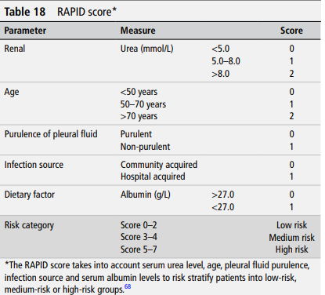

Slide 34


