Slide 1
COPD Guidelines (Case stories ) and Rescue Packs
Salim Meghjee
Barnsley NHS FT
November 2024

Slide 2
We covering the following
Different guidance available and how they interact
Levels of Evidence in the Guidance available
NICE and GOLD guidance
COPD and Statistics
COPD
Non-Pharmacological managements
Pharmacological management
When to refer to Secondary care
When to refer to other services
Self management plans
Self management plans – including rescue treatment

Slide 3
Guidelines
BTS - British Thoracic Society
NICE – National Institute for Health and Care Excellence
SIGN – Scottish Intercollegiate Guidelines Network
ERS – European Respiratory Society
ATS – American Thoracic Society
GOLD – Global Initiative for Chronic Obstructive Lung Disease

Slide 4
Guidelines
BTS - British Thoracic Society – September 2024 with NICE
NICE – National Institute for Health and Care Excellence – September 2024 ( Comment to GOLD guidance)
SIGN – Scottish Intercollegiate Guidelines Network – NO COPD
ERS – European Respiratory Society – 2017 with ATS
ATS – American Thoracic Society - 2017 with ERS
GOLD – Global Initiative for Chronic Obstructive Lung Disease November 2024

Slide 5
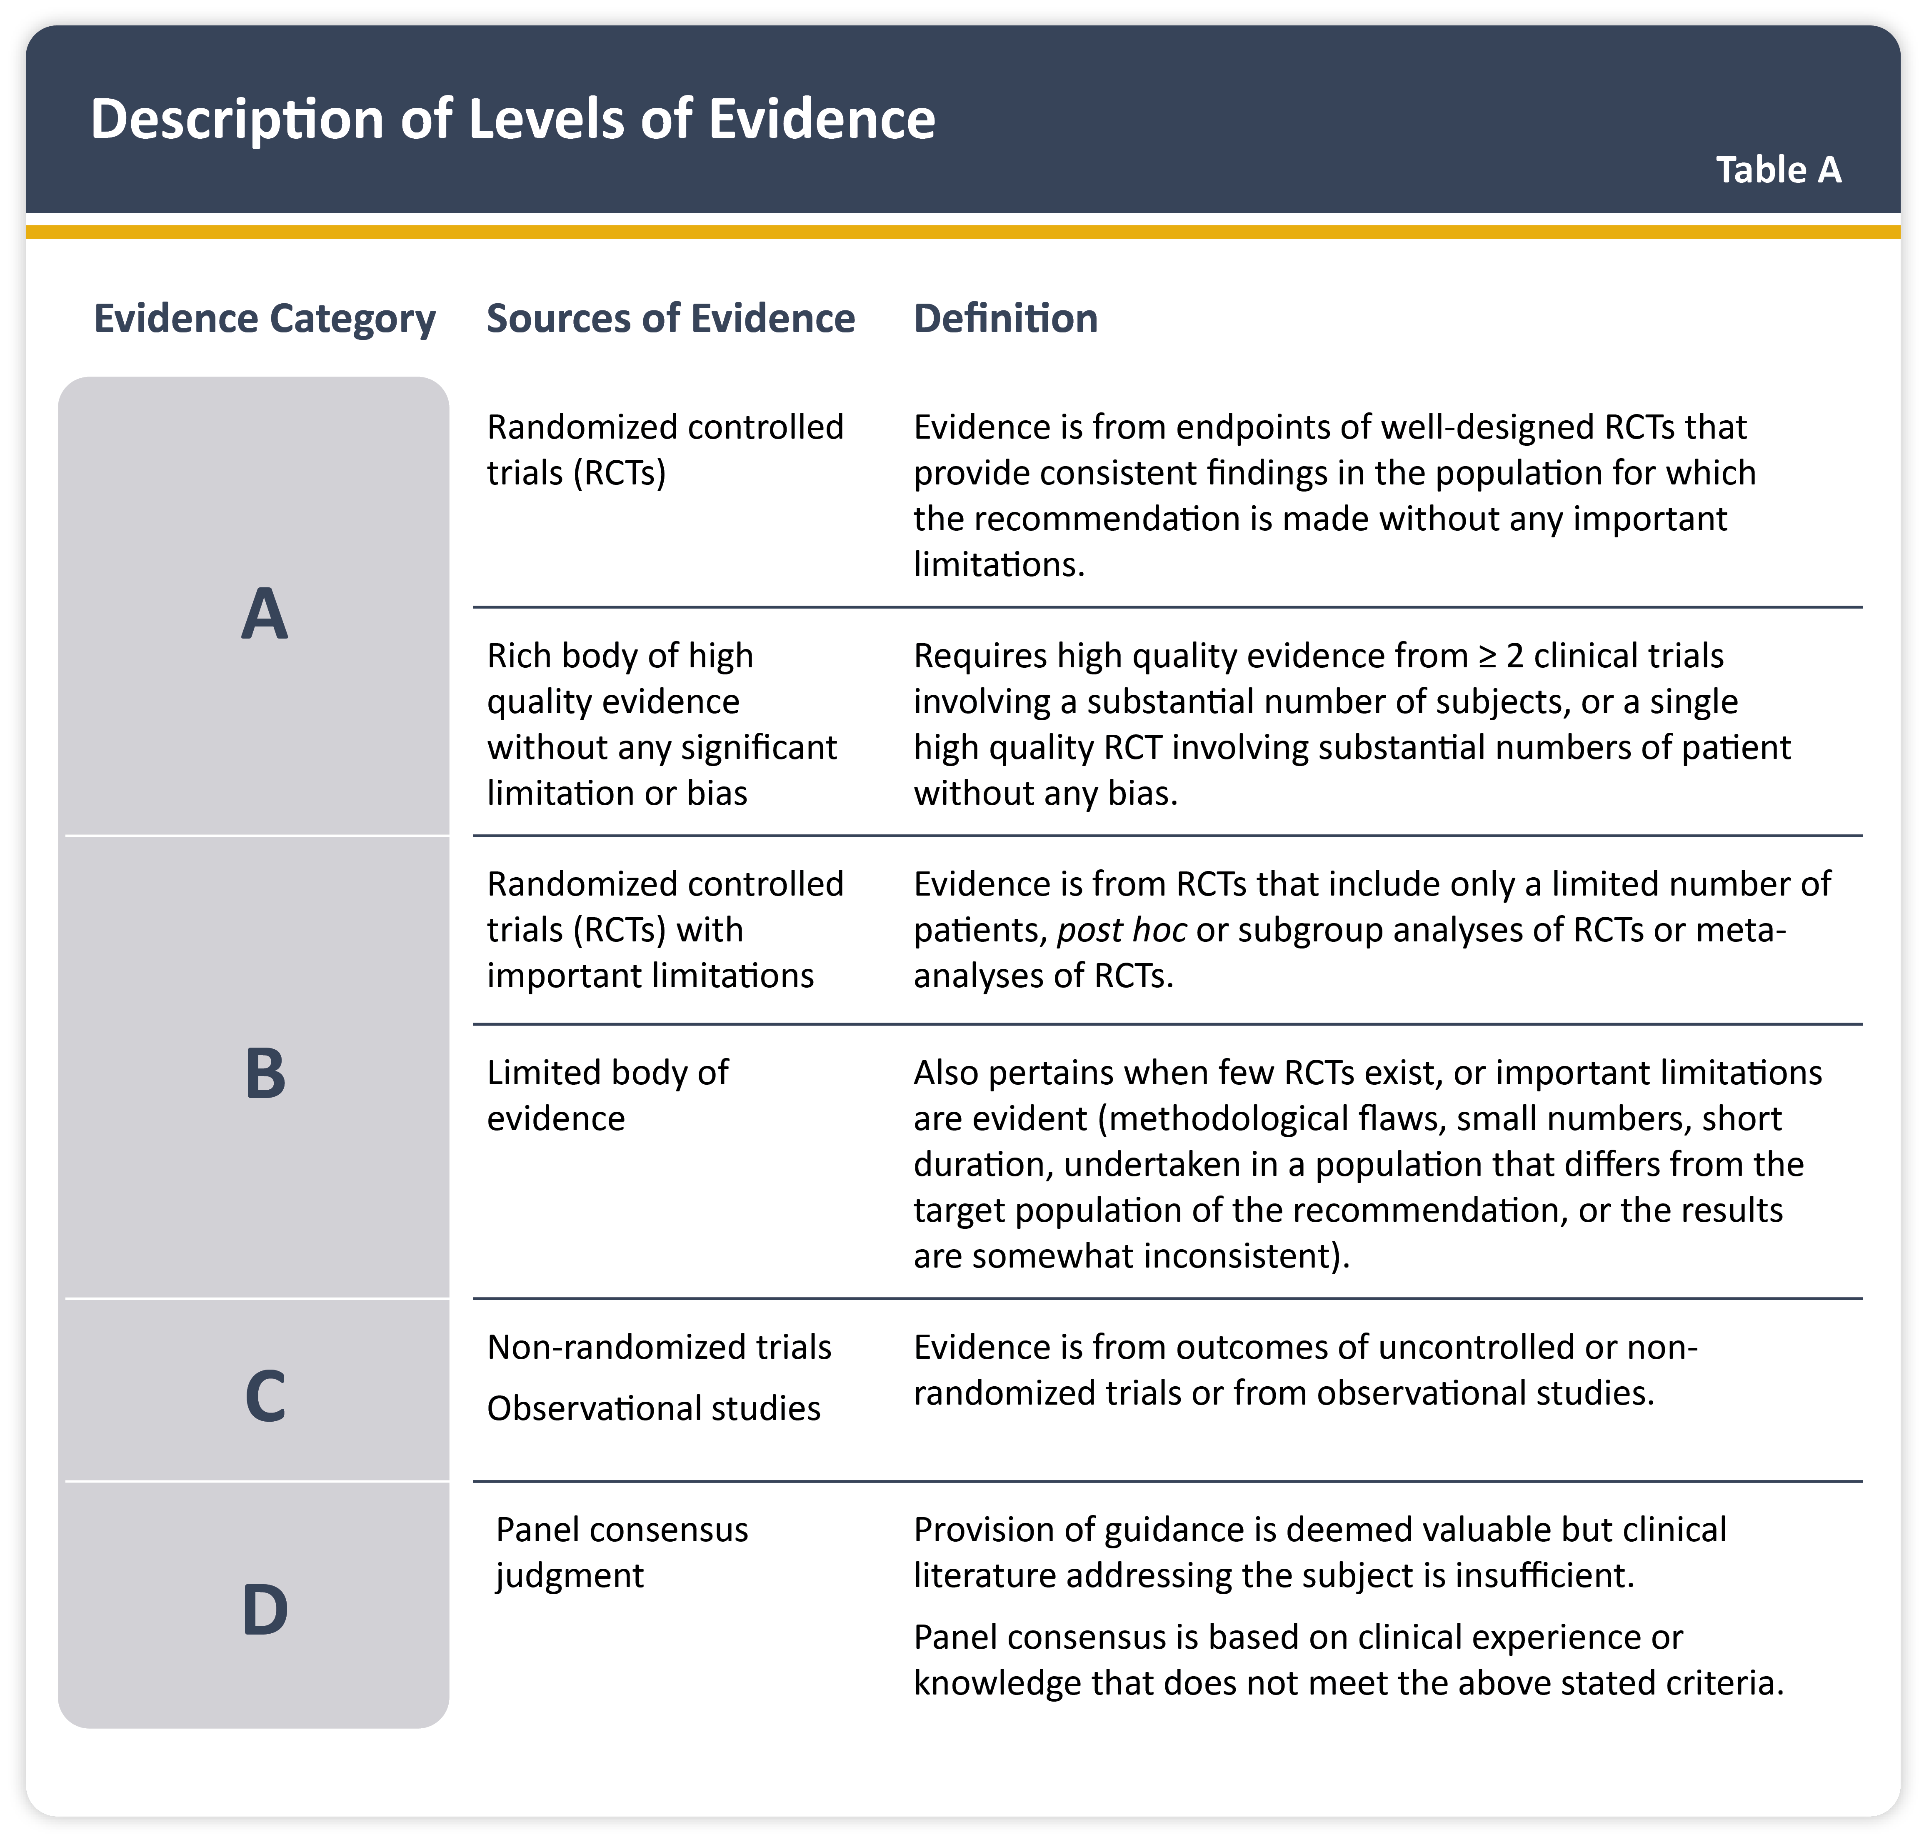

Slide 6
COPD and Statistics
Affecting 3 millions people in UK with 2 millions undiagnosed
COPD exacerbations: 2nd most common cause of emergency admission and one of the most costly inpatient conditions to be treated by the NHS
What % of COPD patient once discharged will be readmitted within 90 days to hospital ?
Major cause of mortality:
DH estimates 23 000 deaths per year in UK attributable to COPD¹
Premature mortality almost double that of EU average²
The missing millions?
Thought to be significant level of underdiagnosis¹
Early diagnosis and optimising interventions in primary care may improve outcomes and reduce costly admissions

Slide 7
COPD Diagnosis – Key points to look for
Consider a diagnosis of COPD for people who are over 35, and smokers or ex-smokers*, and have any of these symptoms:
exertional breathlessness
chronic cough
regular sputum production
frequent winter ‘bronchitis’
wheeze
and do not have clinical features of asthma:
chronic unproductive cough, variable breathlessness, night-time wakening
Ask about presence of other features:
Weight loss, effort intolerance, waking at night, ankle swelling, fatigue, occupational hazard, chest pain, haemoptysis (note: the last two are uncommon in COPD and raise the possibility of alternative diagnoses)
* although bear in mind a significant proportion of patients with COPD may have never smoked (~28% in a recent population study).⁴

Slide 8
Spirometry
Some points to consider in relation to spirometry…
Have operators received adequate training in spirometry?
Are operators confident to coach spirometry technique to patients and interpret readings?
Are spirometers maintained and adequately calibrated?
Bear in mind that the European Respiratory Society 1993 reference values recommended by NICE may lead to under-diagnosis in older people and are not applicable in black and Asian populations.³
BTS COPD consortium guide ‘Spirometry in Practice’ recommends reducing predicted values by 7% for Asians and by 13% for Afro-Caribbeans and includes calculations for elderly patients⁶
Notes:
This slides suggests some points for consideration that relate to not just the ‘quantity’ but the ‘quality’ of spirometry that is being performed within a practice.
The following BTS COPD consortium publication on practical spirometry, which is referred to in this slide, may be a useful resource to leave with a practice: Spirometry in Practice: http://www.brit-thoracic.org.uk/Portals/0/Clinical%20Information/COPD/COPD%20Consortium/spirometry_in_practice051.pdf.
The last bullet point in this slide is intended to highlight the limitations of the ERS reference values that are recommended by NICE to benchmark lung function. In relation to their suitability for use in elderly patients and for black and Asian populations, there are no recommendations made in the NICE guideline on how to apply these reference standards. However, the above-mentioned BTS publication advises on adjustment factors and calculations that can be applied for these groups.

Slide 9
Diagnosis: Spirometry
If COPD seems likely, NICE recommend performing spirometry:
Post-bronchodilator spirometry recommended for COPD
e.g. 15 mins after 400 mcg salbutamol; pMDI + spacer is suitable⁵
Working definition of COPD:
Airflow obstruction defined as FEV₁/FVC ratio < 0.7
If FEV₁ ≥ 80% predicted, a diagnosis of COPD should only be made in the presence of respiratory symptoms (breathlessness or cough)
Post-bronchodilator spirometry also used to grade severity of obstruction and can help guide choice of appropriate inhaled therapy:
Stage 1 - mild: FEV₁ ≥ 80% predicted (symptoms also should be present to diagnose COPD in people with mild airflow obstruction).
Stage 2 - moderate: FEV₁ 50-79%.
Stage 3 - severe: FEV₁ 30-49%
Stage 4 - very severe: FEV₁ < 30% (or FEV₁ < 50% but with respiratory failure).
To help early identification, NICE also recommend spirometry in patients > 35 yrs, current or ex-smokers, with chronic cough. Also, consider screening patients with chronic bronchitis.
Notes:
The use of spirometry is recommended by NICE, and spirometers are now widely available within primary care. Notably, post-bronchodilator spirometry is recommended to help diagnose COPD. We have anecdotal evidence that there is some uncertainty about how to perform post-bronchodilator spirometry; there are also no recommendations in the NICE guideline. Based on guidance from the Global Initiative for Chronic Obstructive Lung Disease (GOLD; http://www.goldcopd.org/), post-bronchodilator spirometry should be performed around 15 minutes after the administration of 400mcg salbutamol; a pMDI plus a spacer is suitable for this and there is no need to stop any regular meds prior to a post-bronchodilator test. It is good practice to record both ‘actual’ and ‘% of predicted’ values.
Spirometry is also important to grade the severity of airflow obstruction; n.b. new thresholds for severity based on post-bronchodilator spirometry were adopted by NICE in the 2010 COPD guideline (shown in the slide), which are now in line with those used by GOLD.
To help early identification, NICE also recommend spirometry in patients > 35 yrs, current or ex-smokers, who are presenting with chronic cough. Also, NICE recommend that consideration is given to screening patients with chronic bronchitis.
A note about QOF indicators relating to spirometry:
In the 2012/13 QOF guidance, there are two indicators relating to the use of spirometry in COPD:
- COPD15: the percentage of all patients with COPD diagnosed after 1 April 2011 in whom the diagnosis has been confirmed by post bronchodilator spirometry (5 points)
COPD10: the percentage of patients with COPD with a record of FEV1 in the preceding 15 months’ (7 points).
QOF guidance is available at http://www.bma.org.uk/images/qofguidance2012-2013_tcm41-212149.pdf.

Slide 11
COPD or asthma or both?
Resolving the two conditions can be problematic, particularly in older patients. Conditions may co-exist (~ 20% of patients⁷)
Findings that can help identify asthma (from NICE³):
On reversibility testing, there is a large (>400 ml) response to bronchodilators
A large (>400 ml) response to 2 weeks, 30 mg/day oral prednisolone
Serial peak flow measurements showing 20% or greater diurnal/day-to-day variability
Clinically significant COPD is not present if FEV₁ and FEV₁/FVC ration return to normal with drug treatment³
Reconsider diagnosis of COPD if a patient reports a marked response to inhaled therapies³
Notes:
The differential diagnosis of asthma and COPD can be tricky. The two conditions can co-exist (in around 20% of patients). As stated in an earlier slide, a key feature of asthma is the variable and reversible nature of the obstruction, which is not found with COPD. However in advanced asthma obstruction may not be reversible, due to airway remodelling.
Recommendations from NICE are presented in this slide to help differentiate the two conditions.
Some additional notes on ‘reversibility testing’ for COPD follow, as based on guidance from GOLD⁵:
- perform the spirometric test when a patient is clinically stable and free from respiratory infection
- patients should not have taken short-acting bronchodilators within the previous six hours, or long-acting bronchodilators within the previous 12 hours, or s.r. theophylline within the previous 24 hours
measure FEV₁ before administering a bronchodilator
administer the bronchodilator (e.g. 400 micrograms salbutamol via a spacer)
wait 15 minutes and measure FEV₁ again

Slide 12
Diagnosis: other tests³
As part of initial diagnosis, NICE also recommends:
chest X-ray to exclude other diagnoses (investigate abnormalities using a CT scan)
full blood count to identify anaemia or polycythaemia
BMI calculation
Also consider screening for alpha-1 antitrypsin deficiency
Associated with 1-2% of cases; consider screening in younger patients, minimal smoking, or family history
Additional investigations may be needed in some circumstances, e.g.
Serial peak flow to help exclude asthma
transfer factor for carbon monoxide (TLCO) or CT scan, to investigate symptoms that seem disproportionate to the spirometric impairment
ECG/echocardiogram if features of cor pulmonale;
pulse oximetry to assess need for oxygen
sputum culture if purulence persistent
Notes:
This slide summarises other tests that may help in the diagnosis and management of the condition, as recommended by NICE.

Slide 14
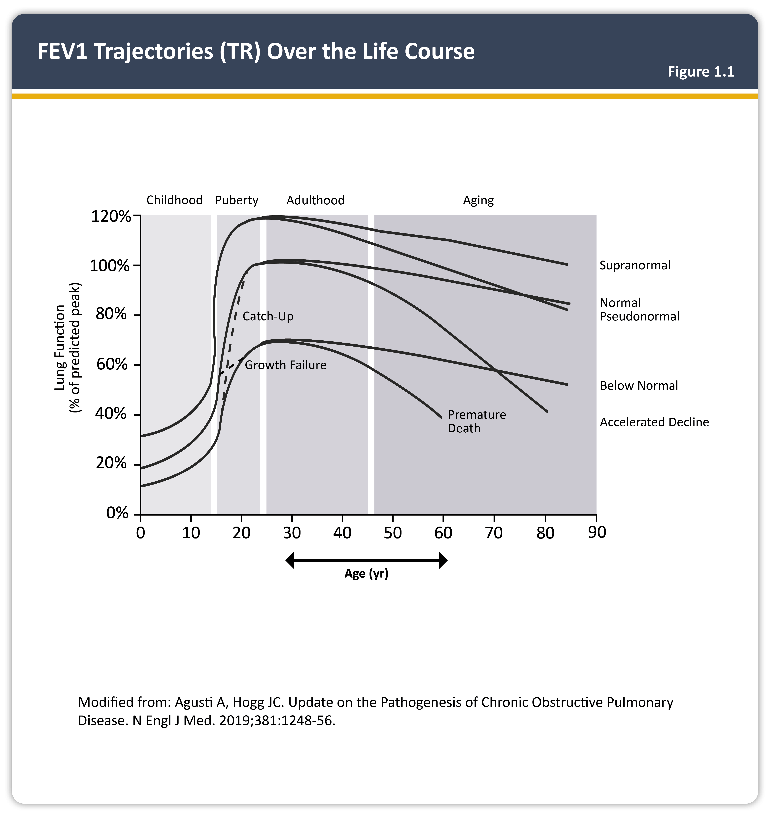

Slide 15
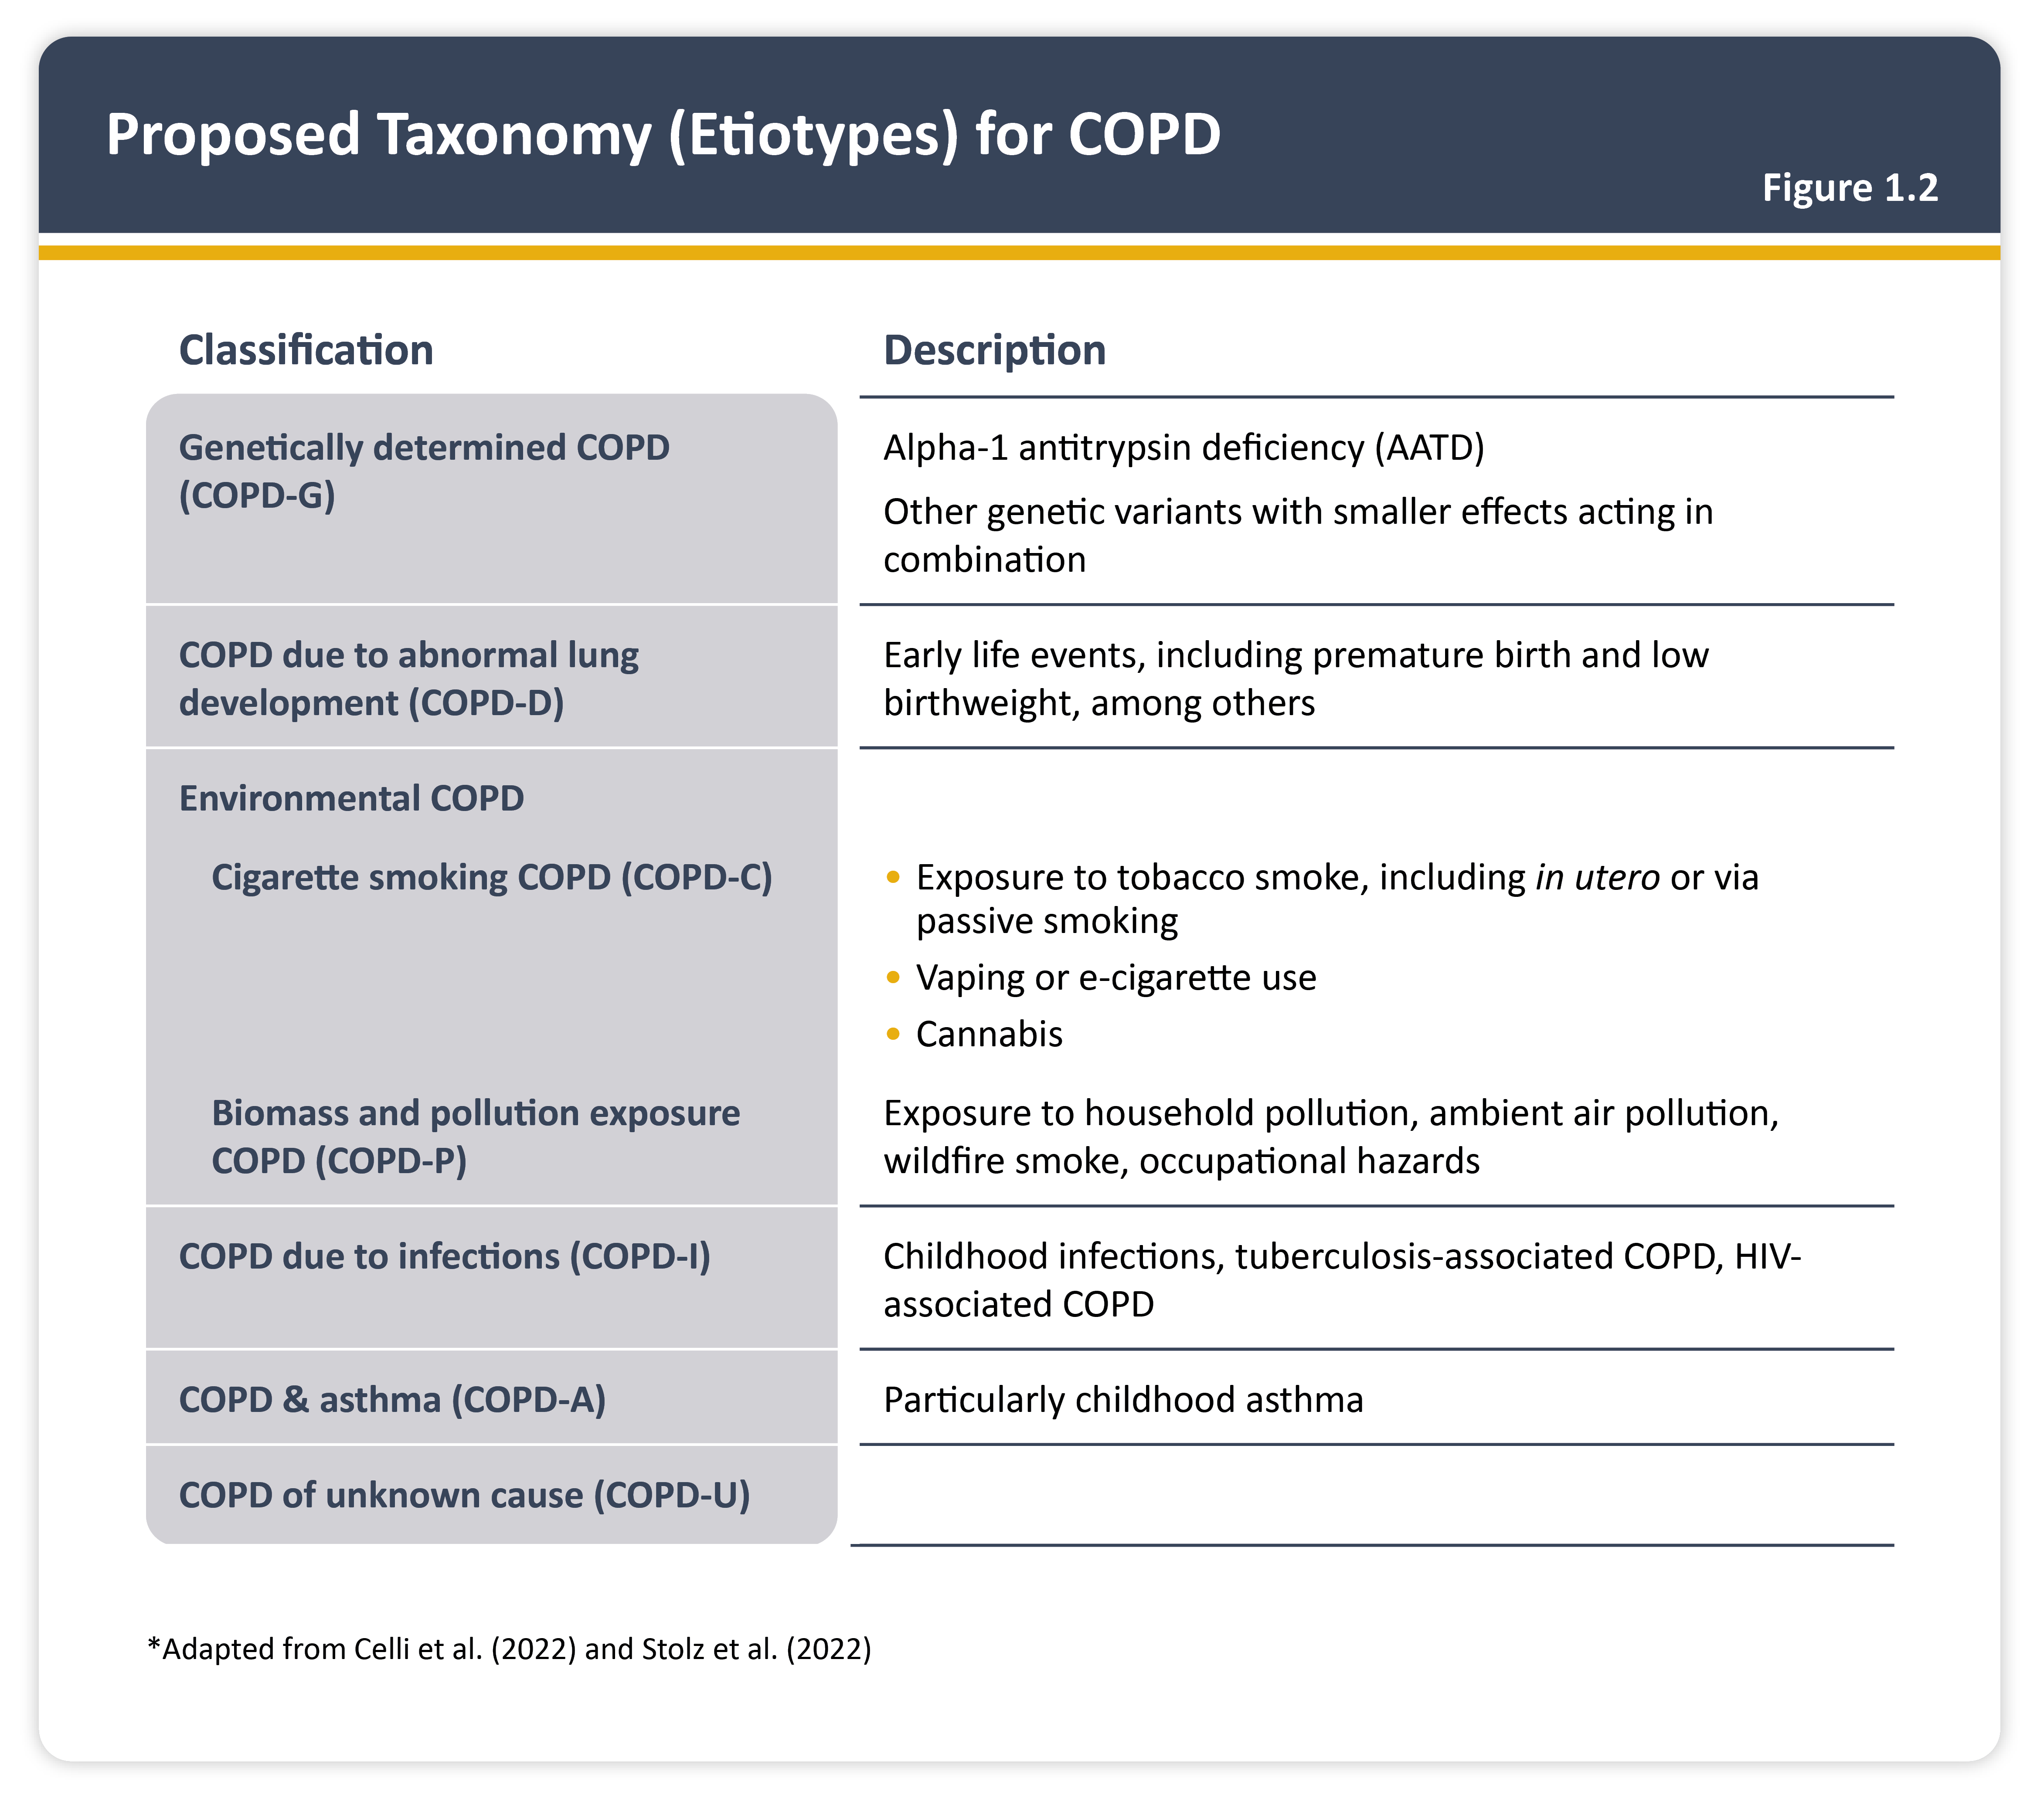

Slide 16
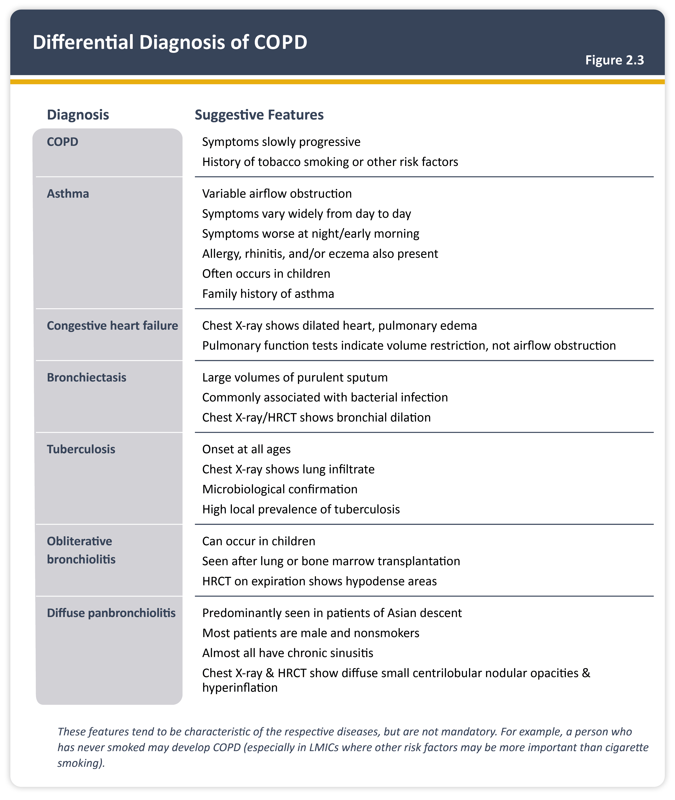

Slide 17
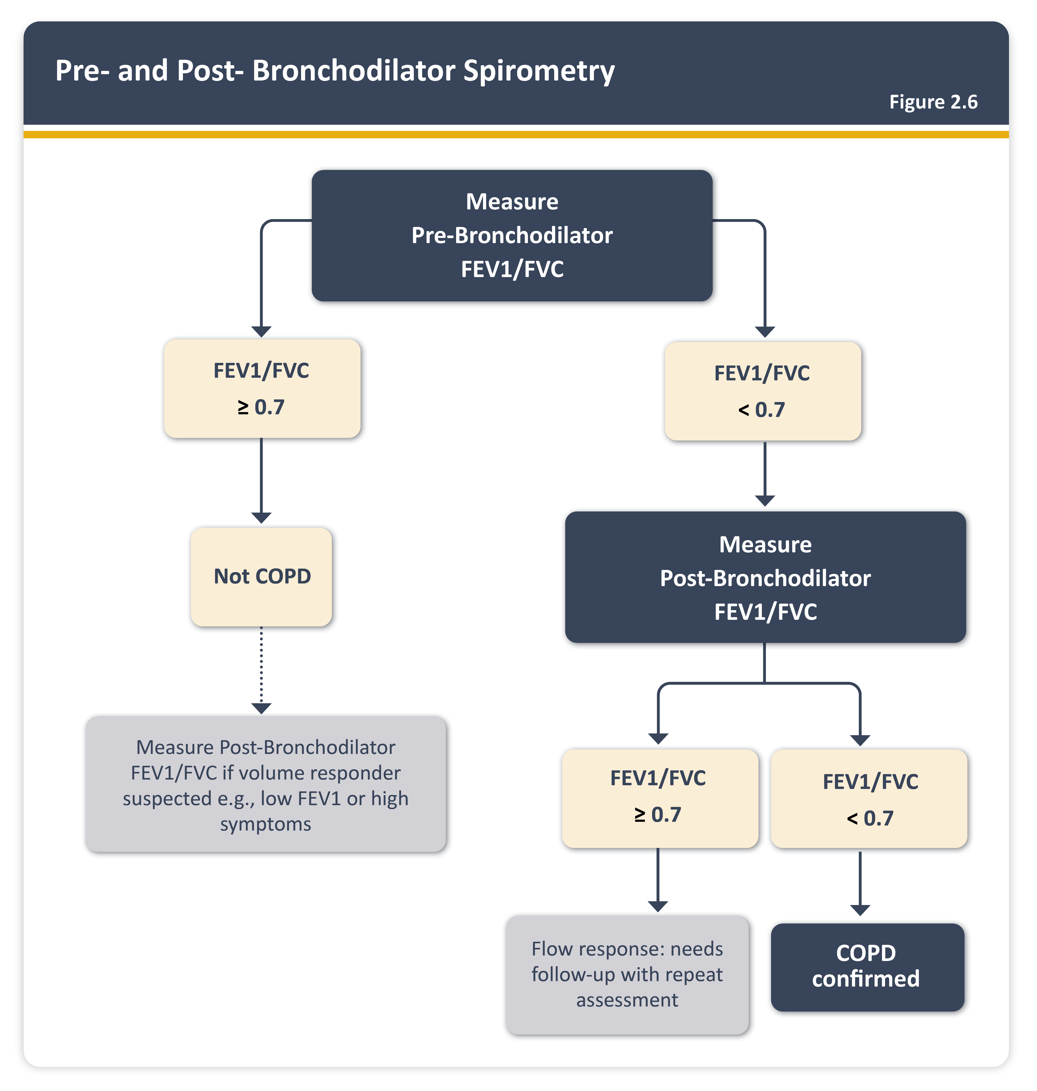

Slide 21
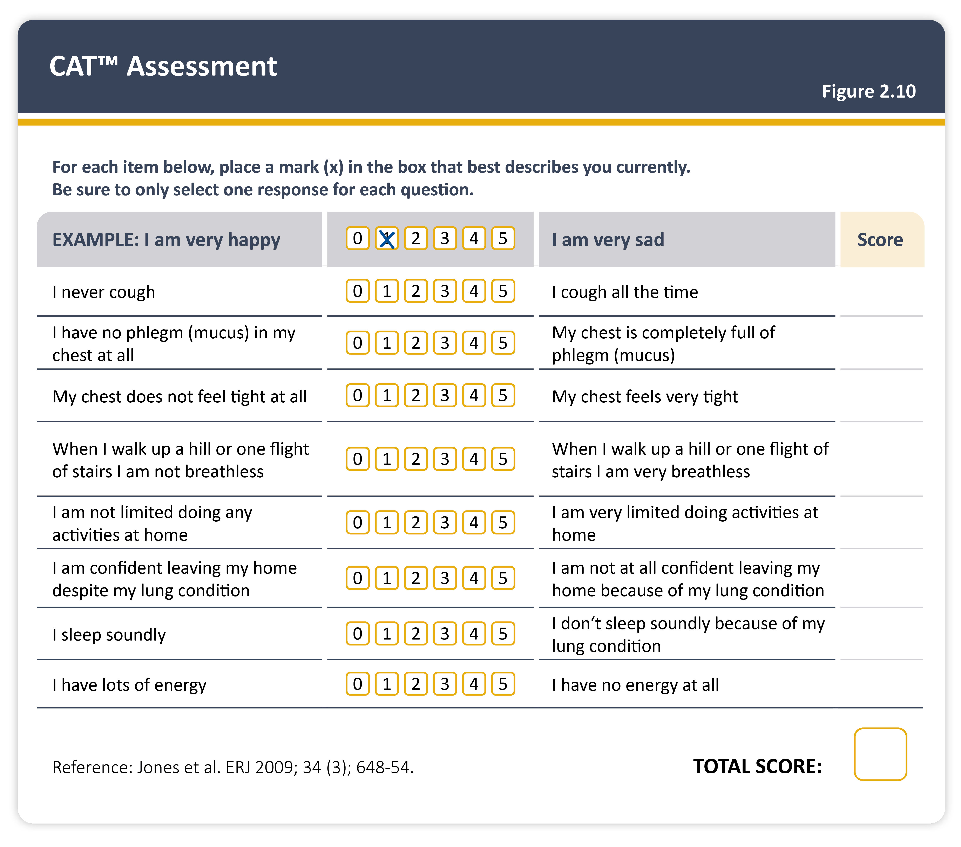

Slide 24
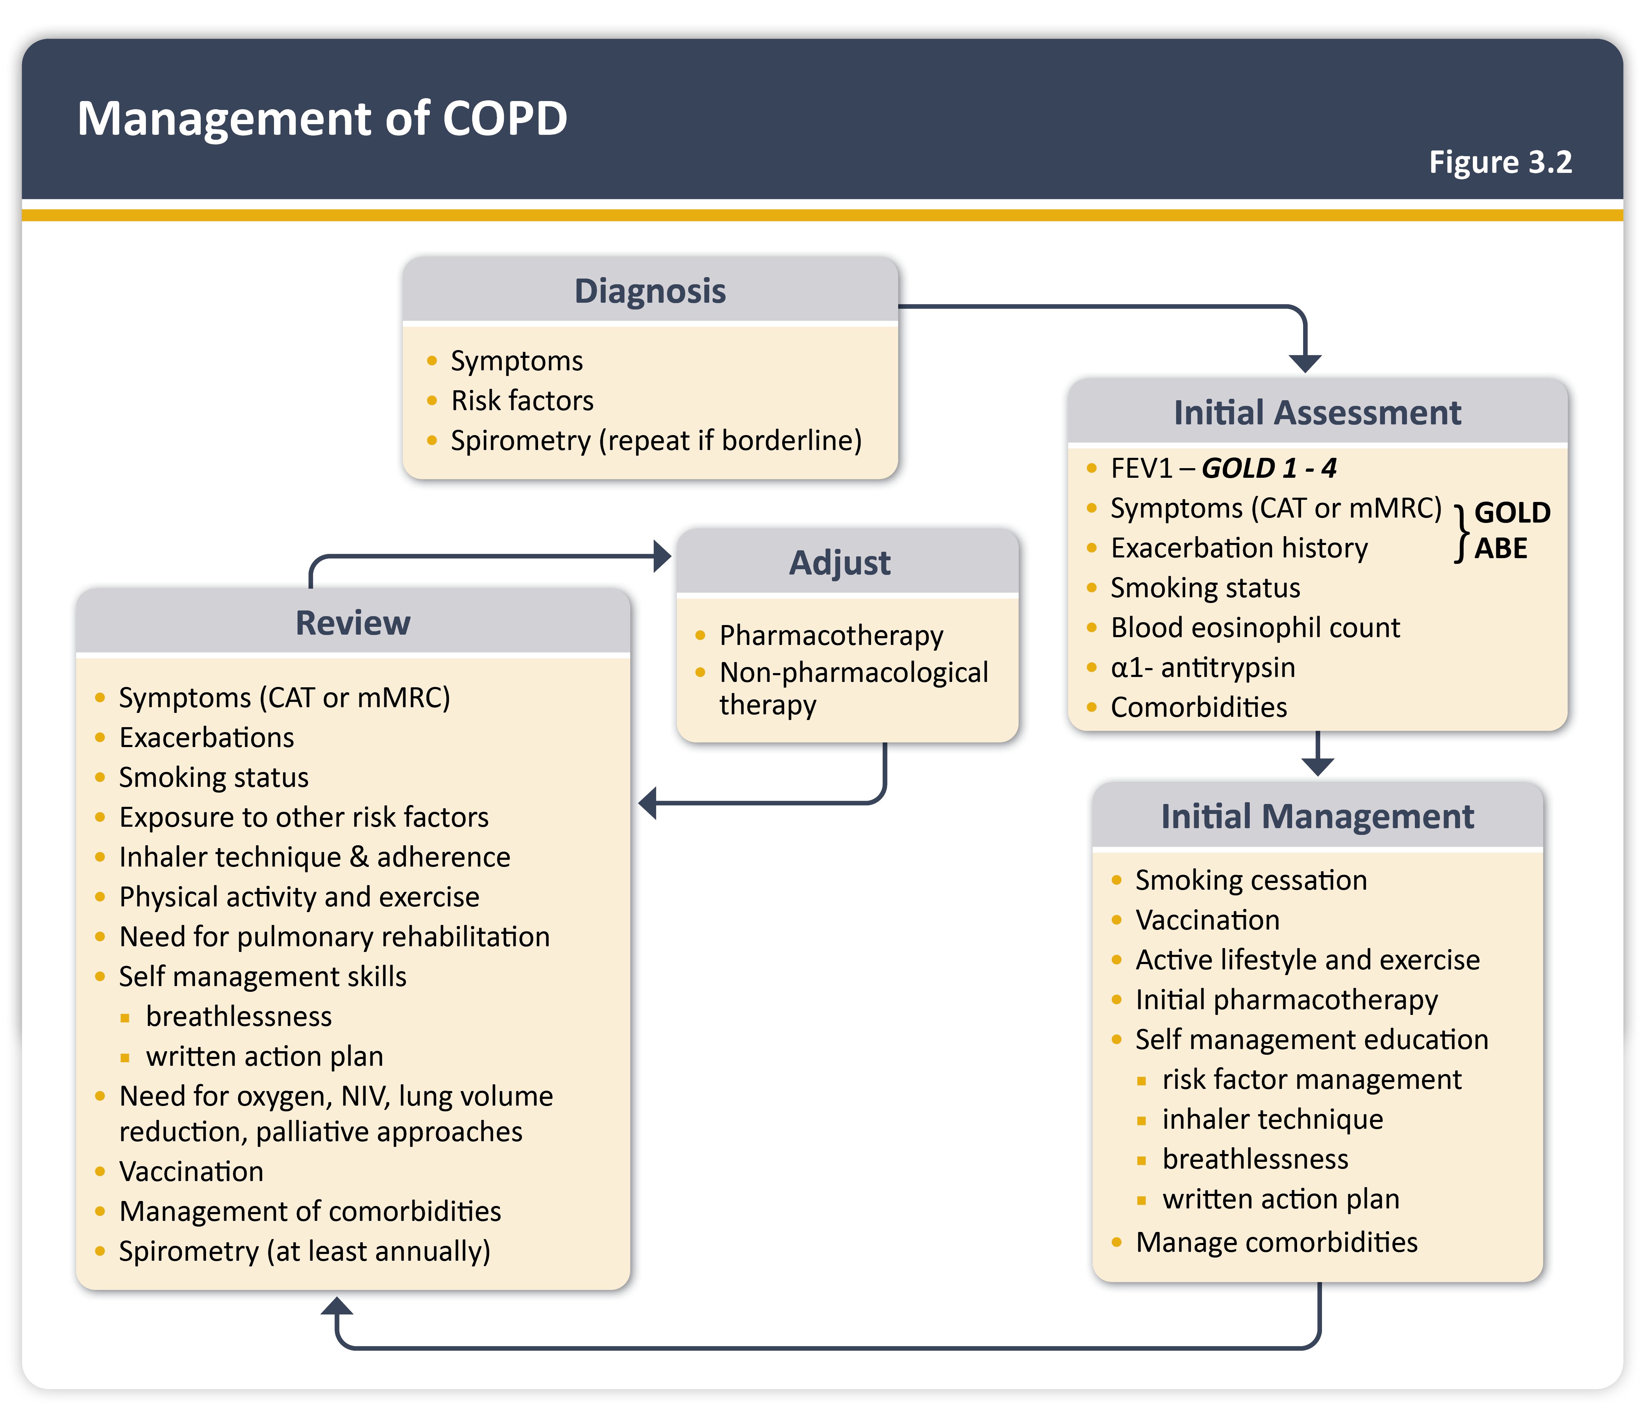

Slide 26
Non – Pharmacology management Vaccination
Make sure all up to date with their vaccinations
Yearly Flu
COVID
Pneumococcal

Slide 29
Pulmonary Rehabilitation
Indicated in ALL patients with relevant symptoms and / or high risk of Exacerbation (Evidence A)
Pulmonary Rehabilitation improves dyspnea, health status and exercise capacity (Grade A evidence)
Pulmonary Rehabilitation reduces hospitalization among patients who had recent exacerbation

Slide 30
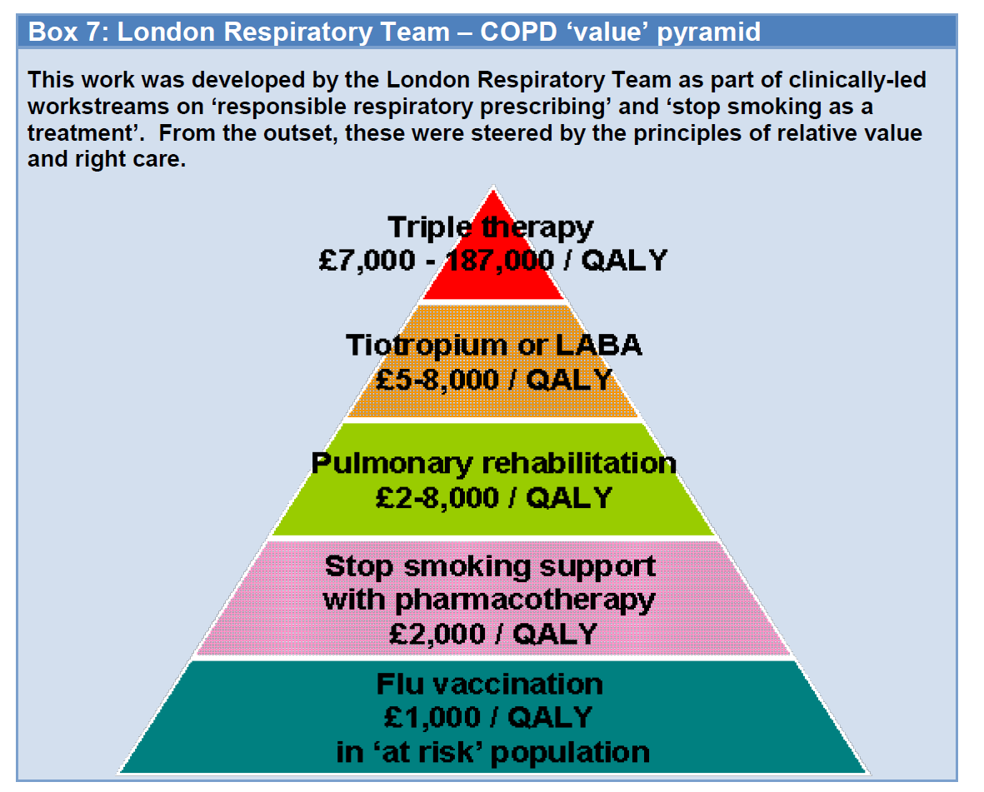
COPD VALUE Pyramid QALY – Quality – adjusted life year One QALY equates to 1 year in perfect health

Slide 32
Principle of inhalers to be given – LOTS of different inhalers available now
Technique / Technique / Technique
Reduce number of different devices
Use of spacers
Patient cognition , dexterity and strength for inhalation
Green house Pollution – avoiding MDI if possible due to CF (Carbon Tetrafluoride gases affecting ozone)
Compliance factors – Once daily vs twice daily
Costs

Slide 33
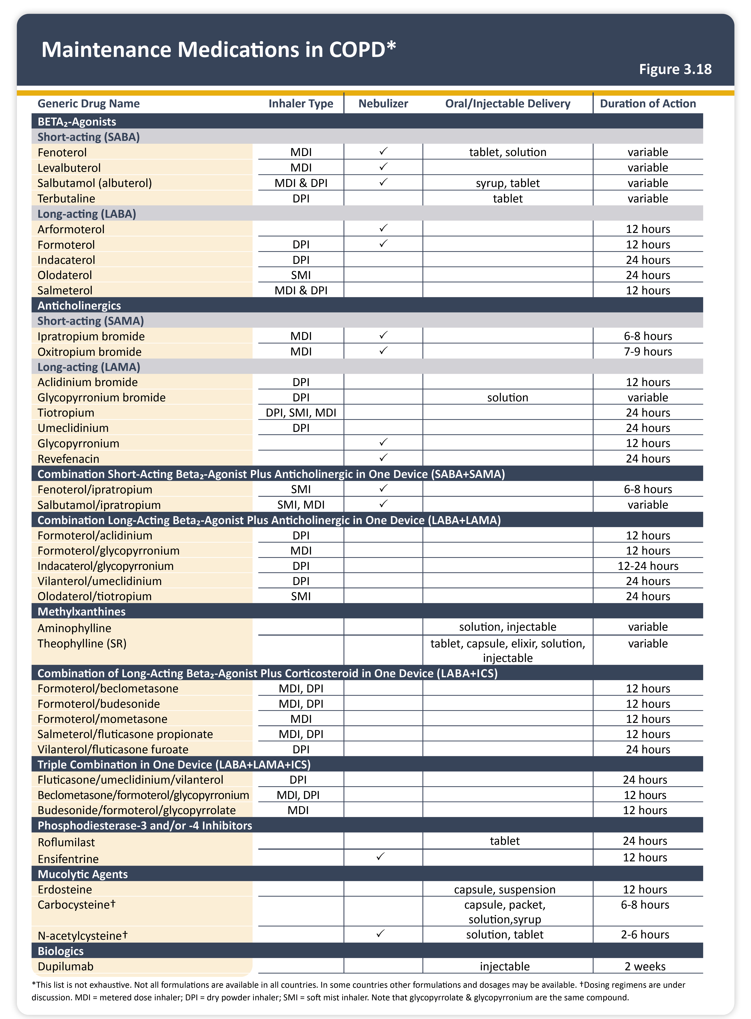

Slide 35
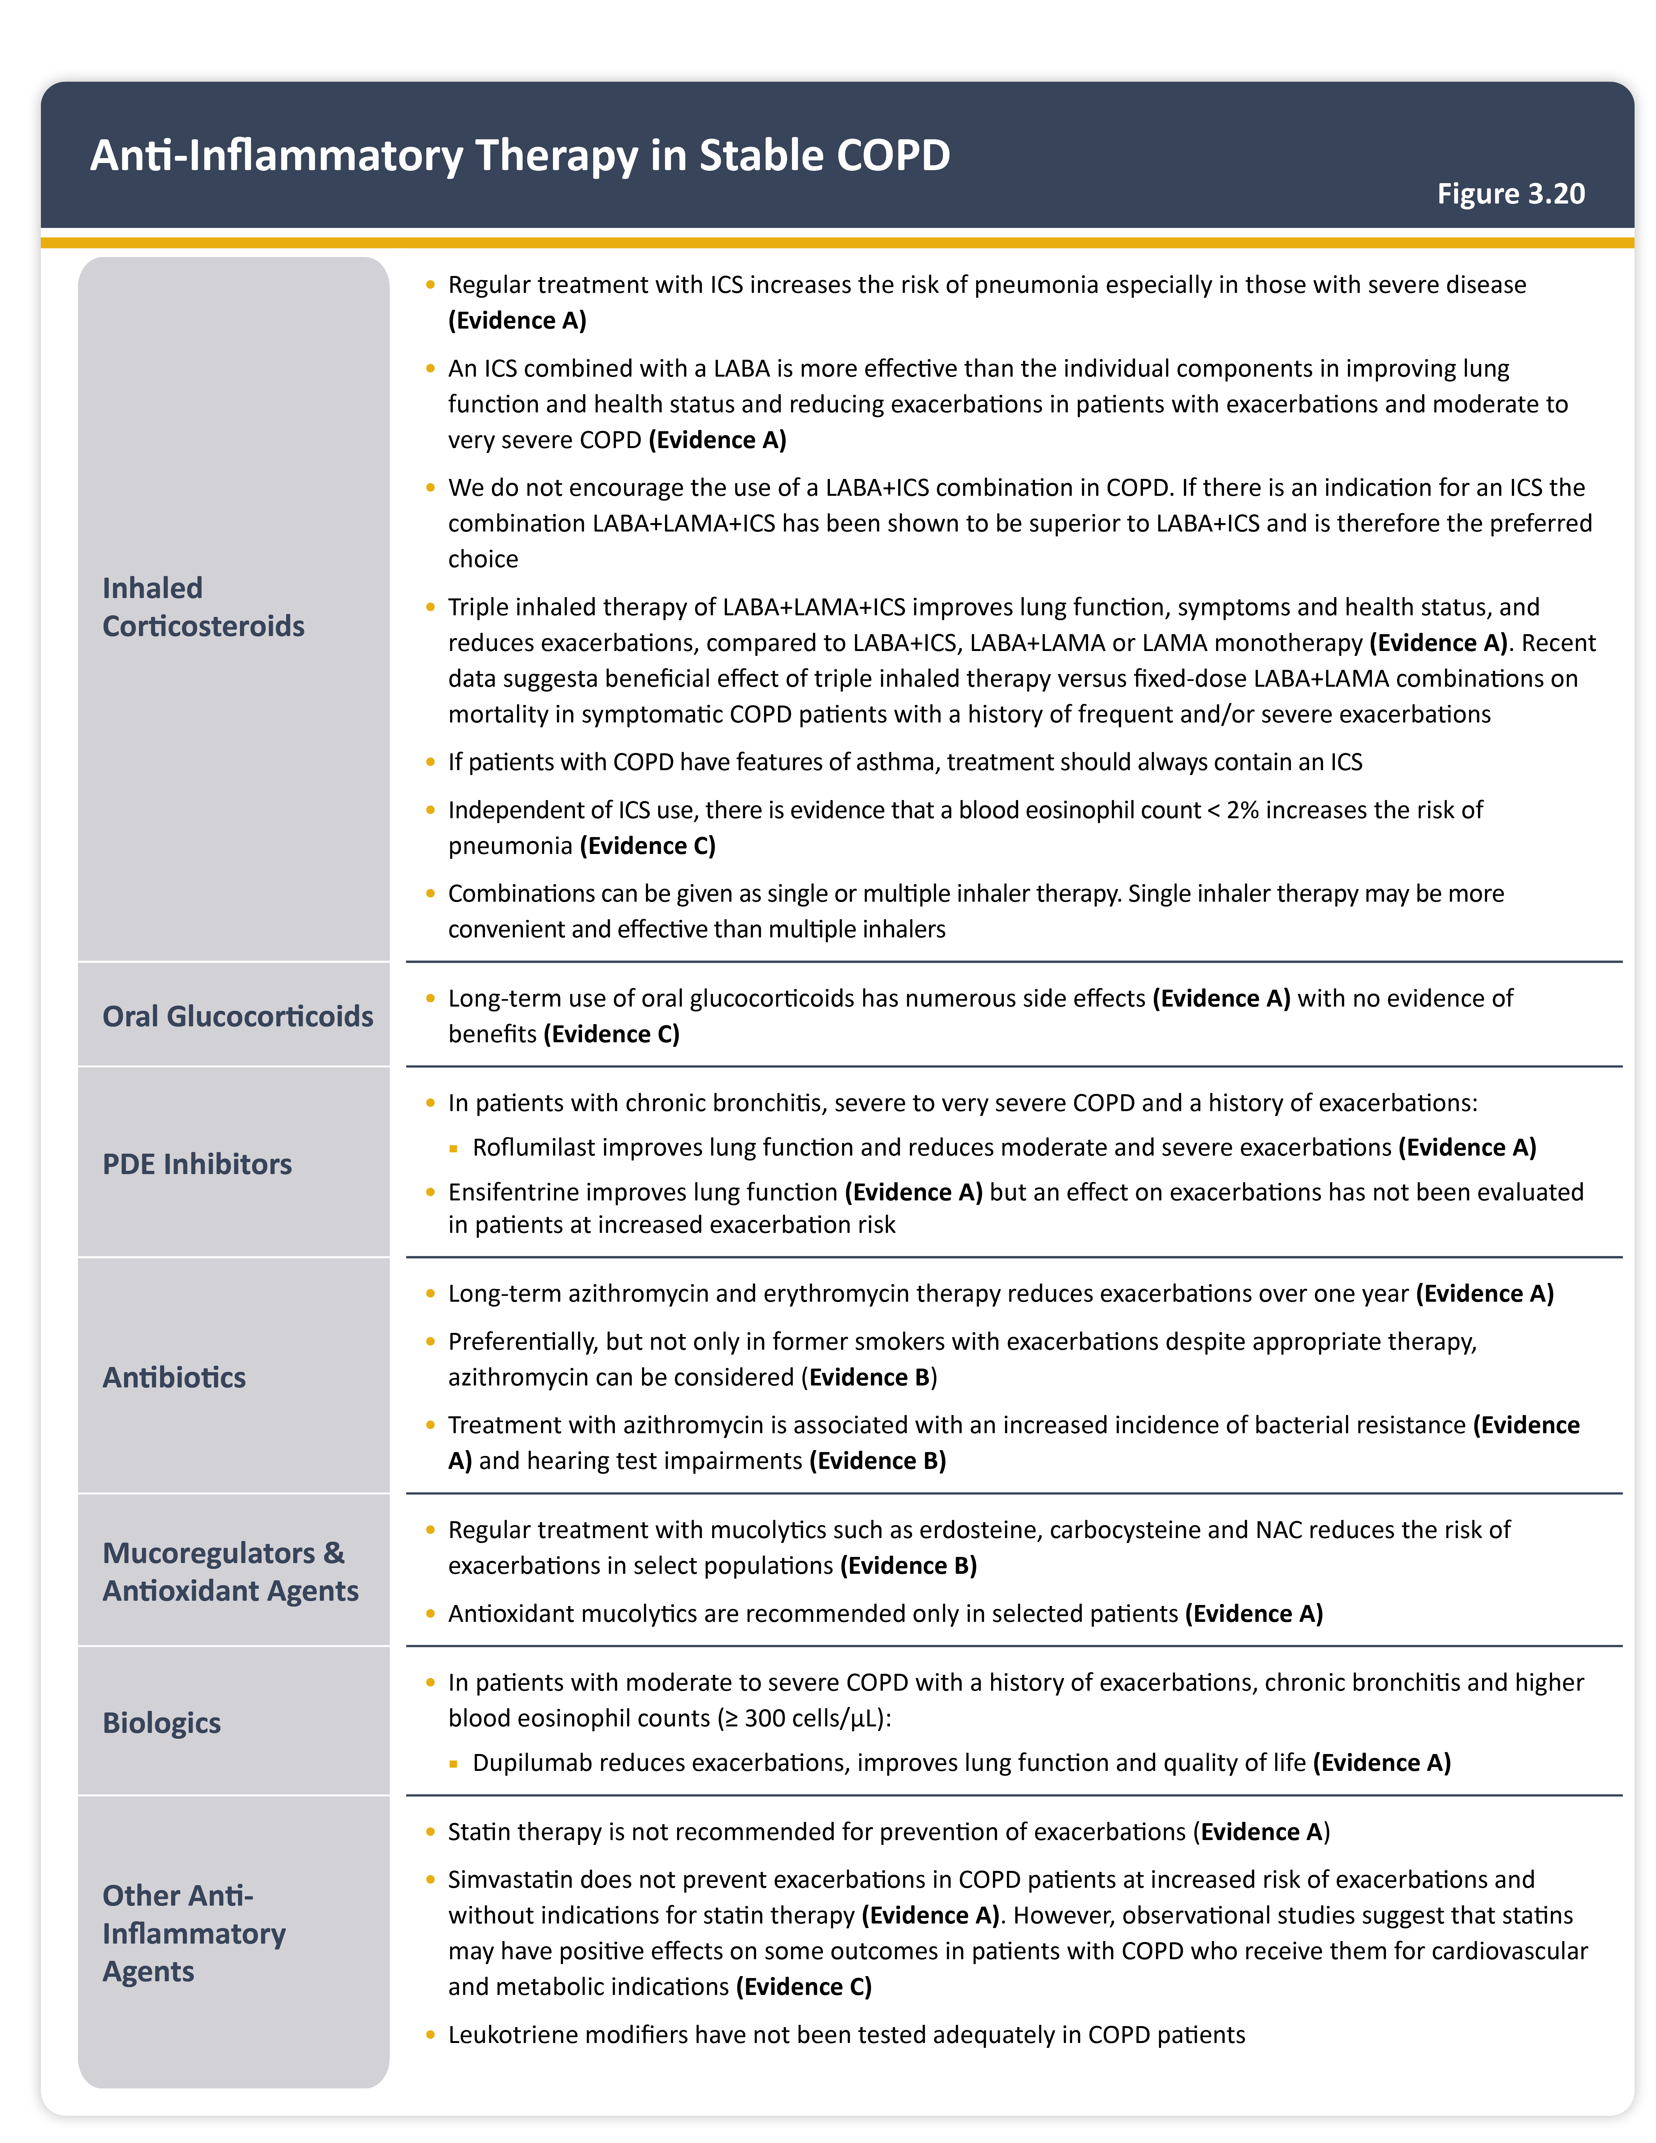

Slide 36
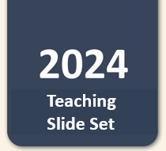
Initial pharmacological treatment
Teaching
Slide Set

Slide 37
Initiating Inhaled Corticosteroids treatment

Slide 38
Stable COPD and long-term oral steroids
No evidence to suggest they help in COPD patients
Initial help – increase appetite. Feeling of wellbeing
More long-term side effects (Grade A)
NEVER start long term oral steroids in Primary Care
Refer to Secondary care for further assessment

Slide 39
Oral Theophylline in stable COPD
phosphodiesterase inhibitors which blocks adenosine receptors and relax smooth muscles of bronchial airways
Grade B evidence to be used after LABA / LAMA or patients unable to tolerate inhalers
However narrow therapeutic range – high chance of side effects
Needs blood levels monitoring regular
Many interactions with other common drugs
Preferable to be started in secondary care

Slide 40
Oral Mucolytic therapy
Some limited evidence it reduces exacerbation in very selected patients ( high volume of sputum and multiple exacerbations)
2 preparations
Carbocisteine capsules – 2 caps TDS ( can lead to poly pharmacy)
N- actly cysteine – 600 mgs once a day
Trial in patients with cough and excessive secretions
Trial for 3 – 6 months – consider to stop if does not work

Slide 41
Biologic Therapy
Dupilumab – GRADE A evidence
Moderate to severe COPD patients with history of exacerbations and high blood eosinophil counts ( > 300 Cells / uL)
REDUCES EXACERBATION AND IMPORVES QUALITY OF LIFE

Slide 42
Leukotriene modifiers eg Montelukast
No evidence and not adequately tested as yet.

Slide 43
Long term Azithromycin
People with COPD and has > 3 acute exacerbation needing oral steroids and at least one hospitalizations
REFER TO SECONDARY CARE TO CONSIDER AZITHROMYCIN
Grade B evidence

Slide 44
Long term Azithromycin
Optimize inhalers treatment
Optimize non –pharmacological treatment
Optimize airway clearance
Pulmonary Rehabilitation

Slide 45
Long term Azithromycin
Perform ECG and Bloods ( LFTS)
Send sputum to exclude Atypical Tuberculosis NTM
(Nontuberculous mycobacterium )
Counsel side effects of medication
Grade B evidence to reduce exacerbations
Need to give for 6- 12 months
Serial LFTs 1 month and then 6 monthly
Careful with other drugs which cause increase in QT interval

Slide 46
When to refer to secondary care
Red flag symptoms
Severe COPD (by Spirometry) or on monitoring the disease is deteriorating fast
Diagnosis uncertainty
Cor-pulmonale clinically
Family history of alpha 1 anti-trypsin

Slide 47
When to refer to secondary care
To Breath team about LTOT and Ambulatory Oxygen assessment
Considering long term home Nebulisers
Chest Xray showing bullous lung disease who is still symptomatic despite maximum therapy

Slide 48
End Stage COPD
All evidence is Grade D
Advance decision making
Advance care planning
Escalation of treatment
Respect form
Preference of place of death
Inappropriate interventions
Personnel financial welfare and will making

Slide 49
End Stage COPD
All evidence is Grade D
Multidisciplinary with GP/ Palliative care team
Breathlessness
Simple measure like fan / open window
Opiates / benzodiazepines
Oxygen
Cough
Secretions
Insomnia
Depression
Anxiety

Slide 50
When should you refer COPD patient to other professionals
Chest Physiotherapy
Sputum clearance
Breathing exercise
Social services
Help with daily activities – manpower, benefits or equipment
Dietician
Exclude malignancy as these patients are of high risk of cancer
Psychological services
Anxiety
Depression

Slide 51
Self management plan with patient with COPD NICE guidance September 2024
Symptoms management
Non – pharmacological – diet, active or passive smoking, weather, aggravating factors,
Importance of vaccinations
Importance of compliance with normal medications

Slide 52
Self management plan with patient with COPD NICE guidance September 2024
Recognition of when acute exacerbation is starting
Increasing cough
Increasing breathlessness
Increasing sputum / purulent
+- fever
How to manage that with increased use of inhalers
Rescue treatment with antibiotics and Oral steroids
Education and guidance when to use steroids and antibiotics
THE ABOVE IS GRADE D EVIDENCE
Evidence also shows the above ‘Does NOT cause harm’.

Slide 53
Self management plans in GOLD 2024
Same as in NICE but NO mention of rescue pack.

Slide 54
Barnsley Respiratory Research with Professor Mason
RAPID study – (Rescue packs post – discharge in COPD patients)
Study by This Institute at Kings College University
We are recruiting patients
Study to end in 2027

