Slide 1
Asthma guidelines review and case presentation
Dr H Mahdi
Respiratory Consultant
Barnsley Hospital NHS Foundation Trust
Nov. 2024

Slide 2
Review of GINA guidelines 2024
Case presentation

Slide 3
Mr DE
54 year
Referred on 1/7/2024
The referral letter: Thanks for seeing this patient with
PMH of Hypertension, on Amlodipine and Losartan.
He smoked 6-10 cig/day for 25 years, but has stopped now.
He is very athletic and goes to gym every day. He has no allergies.
He comes with history of cough, SOB and wheezing. He said this is third chest infection in 18 months.
O/E he is well not short of breath and chest sounded clear. His PEF 65.5 predicted
I have prescribed him Doxycycline, Prednisolone and salbutamol inhaler, but I would be grateful if he could have a spirometry in view of his smoking history and repeated chest infections

Slide 4
Asthma guidelines Review GINA 2024 (GINA was established by the World Health Organization and the US National Heart Lung and Blood institute in 1993 to improve asthma awareness, prevention, and management worldwide.)
What is asthma
Asthma is a heterogeneous disease,
Usually characterized by chronic airway inflammation.
It is defined by the history of respiratory symptoms, such as wheeze, shortness of breath, chest tightness and cough, that vary over time and in intensity,
Together with variable expiratory airflow limitation.

Slide 5
Asthma
Asthma is a common, chronic respiratory disease affecting 1-29% of the population in different countries. (12% in UK)
One or more of asthma symptoms may predominate.
Respiratory symptoms of asthma are often non-specific
Multiple differential diagnosis for cough and dyspnoea
Over diagnosis and under-diagnosis of asthma are common
Peak Expiratory Flow (PEF) although is less reliable than spirometry in asthma but better than nothing
“ The sensitivity of spirometry was 0.97 and that of PEFR was 0.95 (p = 0.721), whereas the specificity of spirometry was 0.37 and that of PEFR was 0.28 (p = 0.227). Both tests yielded the same results for the positive predictive value (0.98)”.

Slide 6
Clinical Phenotypes of asthma
Allergic asthma: This most easy recognised
Commences early in life
F/Hx of atopy
High eosinophilic airway inflammatory
Respond well to ICS treatment
Non-allergic asthma
Asthma that is not associated with allergy
The cellular profile of the sputum of these patients may be neutrophilic
Often demonstrate a lesser short-term response to ICS
Cough variant asthma and cough predominant asthma
Cough may be the only symptom of asthma
Spirometry usually normal
Variable airflow limitation may be absent apart from during bronchial provocation testing

Slide 7
Clinical Phenotypes of asthma
Adult-onset (late-onset) asthma
Asthma first time presented in adult life
More in women
Usually no allergies
Often required high dose of ICS
Occupational asthma should be ruled out in patients presenting with adult-onset asthma
Asthma with persistent airflow limitation
Some patients with long-standing asthma develop airflow limitation that is persistent or incompletely reversible
This is thought to be due to airway wall remodelling
Features of both asthma and chronic obstructive pulmonary disease
Asthma with obesity*
Obesity is most common co-morbidity (38% in USA)
Worse respiratory symptoms and poor control
Increased risk for asthma exacerbations
Poor response to therapy
*Asthma and obesity: mechanisms and clinical implications
Cynthia Wilson Baffi,
Daniel Efrain Winnica &
Fernando Holguin
Asthma Research and Practice

Slide 8
Differential Diagnoses of asthma
The differential diagnosis in a patient with suspected asthma varies with age. Any of these alternative diagnoses may also be found together with asthma.
For patients adolescents and adults:
Chronic upper airway cough syndrome
Inducible laryngeal obstruction
Hyperventilation, dysfunctional breathing
Bronchiectasis
Cystic fibrosis
Heart failure
COPD
Inhaled foreign body
PE
TB
Pertussis
Tracheomalacia
Other

Slide 9
Diagnosis of asthma
Making the diagnosis of asthma before treatment is started unless patient has severely uncontrolled respiratory symptoms
It is often more difficult to confirm a diagnosis of asthma once the patient has been started on inhaled corticosteroid (ICS)-containing treatment,
this reduces variability of both symptoms and lung function

Slide 10
Criteria for initial diagnosis of asthma
Making diagnosis of asthma is based on identifying both a characteristic pattern of respiratory symptoms and variable expiratory air flow limitation.
HISTORY OF TYPICAL VARIABLE RESPIRATORY SYMPTOMS
The following features are typical of asthma and if present, increase probability of asthma:
Respiratory symptoms: cough, SOB, chest tightness and wheeze
Symptoms are often worse at night or on waking
Symptoms occur variably over time and vary in intensity
Symptoms are often triggered by exercise, laughter, allergens or cold air
Symptoms often appear or worsen with viral infections
The following features decrease the probability that resp. symptoms are due to asthma
Chronic production of sputum
Chest pain
SOB associated with dizziness, light-headedness or peripheral tingling

Slide 11
Criteria for initial diagnosis of asthma
CONFIRMED VARIABLE EXPIRATORY AIRFLOW LIMITATION
The greater the variations, or the more occasions excess variation is seen, the more confident the diagnosis of asthma.
If initially normal tests does not rule out asthma, can be repeated during symptoms or in the early morning
One or more of the following tests to confirm variable air flow limitation
1- Bronchodilator responsiveness (reversibility) test with spirometry or PEF
Increase from baseline in FEV1 or FVC of ≥12% and ≥ 200ml or PEF ≥ 20% after 200-400mcg of salbutamol
Stop SABA more than 4 h before the test
Stop long-acting bronchodilator 24-48h before test
Baseline normal spirometry less likely will show positive test
2- Excessive variability in twice daily PEFR over 2 weeks
Adults: average daily diurnal PEF variability > 10%*
Children: average daily diurnal PEF variability > 13%*

Slide 12
One or more of the following tests to confirm variable air flow limitation
3-Increase in lung function after 4 weeks of treatment
Adults: increase from baseline in FEV1 by ≥12% and ≥200 mL (or PEF by ≥20%) after 4 weeks of daily ICS-containing treatment.
4-Excessive variation in lung function between visits (good specificity but poor sensitivity)
Adults: variation in FEV1 of ≥ 12% and 200 mL (or in PEFT of ≥ 20%) between visits.
5- Positive bronchial challenge test (limited specificity)
Adults: Fall from baseline in FEV, of ≥ 20% with standard doses of methacholine, or ≥ 15% with standardized hyperventilation, hypertonic saline or mannitol challenge, or >10% and >200 mL with standardized exercise challenge
Positive test may also seen in allergic rhinitis cystic fibrosis, COPD

Slide 13
Other tests
These test are useful in more severe asthma patients
Allergy tests (total IgE, specific IgE, skin prick) these not specific for asthma nor present in all asthma phenotypes
Imaging studies are not routinely used to diagnose asthma
FENO (Fractional concentration of Exhaled Nitric Oxid) high in asthma with high Th2 inflammation (high eosinophil, IL-13, IL-4). It is non-specific
It is also high in eosinophilic bronchitis, allergic rhinitis, eczema.
It is low in non-allergic asthma, asthma with obesity

Slide 14
Assessment of asthma
Asthma control: the extent in which the feature of asthma can be observed in the patient or have been reduced or removed by treatment. This assessed in two domains
Symptom control
Risk of adverse outcome
“Patients with infrequent or mild symptoms are still at risk of severe or fatal exacerbation” try to avoid term mild asthma

Slide 15
How to assess a patient’s asthma
Symptom control - ask about frequency of:
Daytime and night-time asthma symptoms
Night waking
Activity limitation
Use of SABA
Other tools to assess recent symptom control such as:
Asthma Control Test ACT (assess symptoms control in last 4 weeks)
Asthma Control Questionnaire ACQ (assess symptoms control in last week)

Slide 16
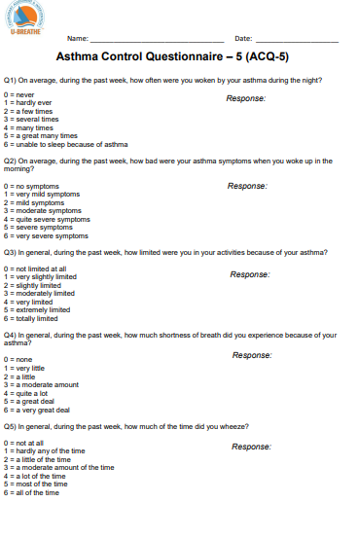

Slide 18
Cont. Assessment a patient’s asthma
Assess the patient’s risk factors for exacerbations that are independent of symptoms control
History of ≥1 exacerbation in the previous year
ASBA only treatment
Over use of SABA (≥ 3 canisters/year increase risk of exacerbation, ≥1 canister per month increase risk of mortality )
Poor adherence
Incorrect inh technique
Low FEV1 (<60%)
Exposures such as smoking
Socioeconomic problems
Blood eosinophilia
There are no suitable composite tools for assessing exacerbation risk

Slide 19
Cont. Assessment a patient`s asthma
Other assessment: Assess
medication side effects,
comorbidities,
ask the patient/caregiver their asthma goals and treatment preferences,
check lung function periodically
How to describe a patient’s asthma control
Asthma control should be described in terms of symptom control and future risk domains. E.g.
Ms X has good asthma symptom control but she is at risk of exacerbation because she has had severe exacerbation within last year
Mr Y has poor asthma symptom control. He also has several addition risk factors for future exacerbation including low FEV1, continue to smoke and poor medication adherence

Slide 20
Goals of asthma management
To achieve best possible long-term outcomes for individual patient
Good long-term symptom control
few/no asthma symptoms
no sleep disturbance due to asthma and
unimpaired physical activity
Minimized long term risk of
asthma-related mortality,
exacerbations
persistent airflow limitation and
side effects of treatment

Slide 21
Non-pharmacological Treatment strategies
Cessation of smoking, environmental tobacco exposure and vaping
Encourage regular physical activity for its general health benefits,
improve quality of life in moderate/severe asthma
use ICS-LABA for exercise induced bronchospasm
Avoid occupational or domestic exposures to allergens or irritant
Avoidance of indoor allergens is not recommended as general strategy in asthma
Remediation of dampness or mould in homes reduces asthma symptoms and medication use in adults
Weight reduction for obese patients, (great improvement in asthma outcomes seen after Bariatric surgery)
Dealing with emotional stress (relaxation strategies and breathing exercise, mental health assessment for patient with anxiety or depression)
Avoid medications that may make asthma worse, e.g B-blocker, NSAID

Slide 22
Medications and Strategies for adults and adolescents
GINA does not recommend treatment of asthma with SABA alone. Instead, they should receive Inhaled corticosteroid (ICS)-containing treatment to reduce their risk of serious exacerbation and to control symptoms
ICS treatment can be delivered regular daily treatment or with as needed low-dose ICS-formoterol taken whenever needed for symptom relief
Reduction of severe exacerbations is a high priority across treatment steps
To reduce risk and burden to patients
Reduce burden to the health system
Reduce the need for oral corticosteroid (OCS) which have long-term cumulative long-term adverse effects

Slide 23
Treatment tracks for adults and adolescents
The treatment figure for adults and adolescents shows two tracks, largely based on the choice of reliver
Treatment may be stepped up or down within a track using the same reliver at each step
Treatment may be switched between tracks according to individual patient's need
Track-1 in which the reliever is low-dose ICS-formoterol is preferred approach recommended by GINA
Track-2 in which the reliever is an ICS-SABA (step-1) or SABA (step2-5) is an alternative if
track-1 is not possible or
patient well control and no exacerbation in last year on their current treatment

Slide 24
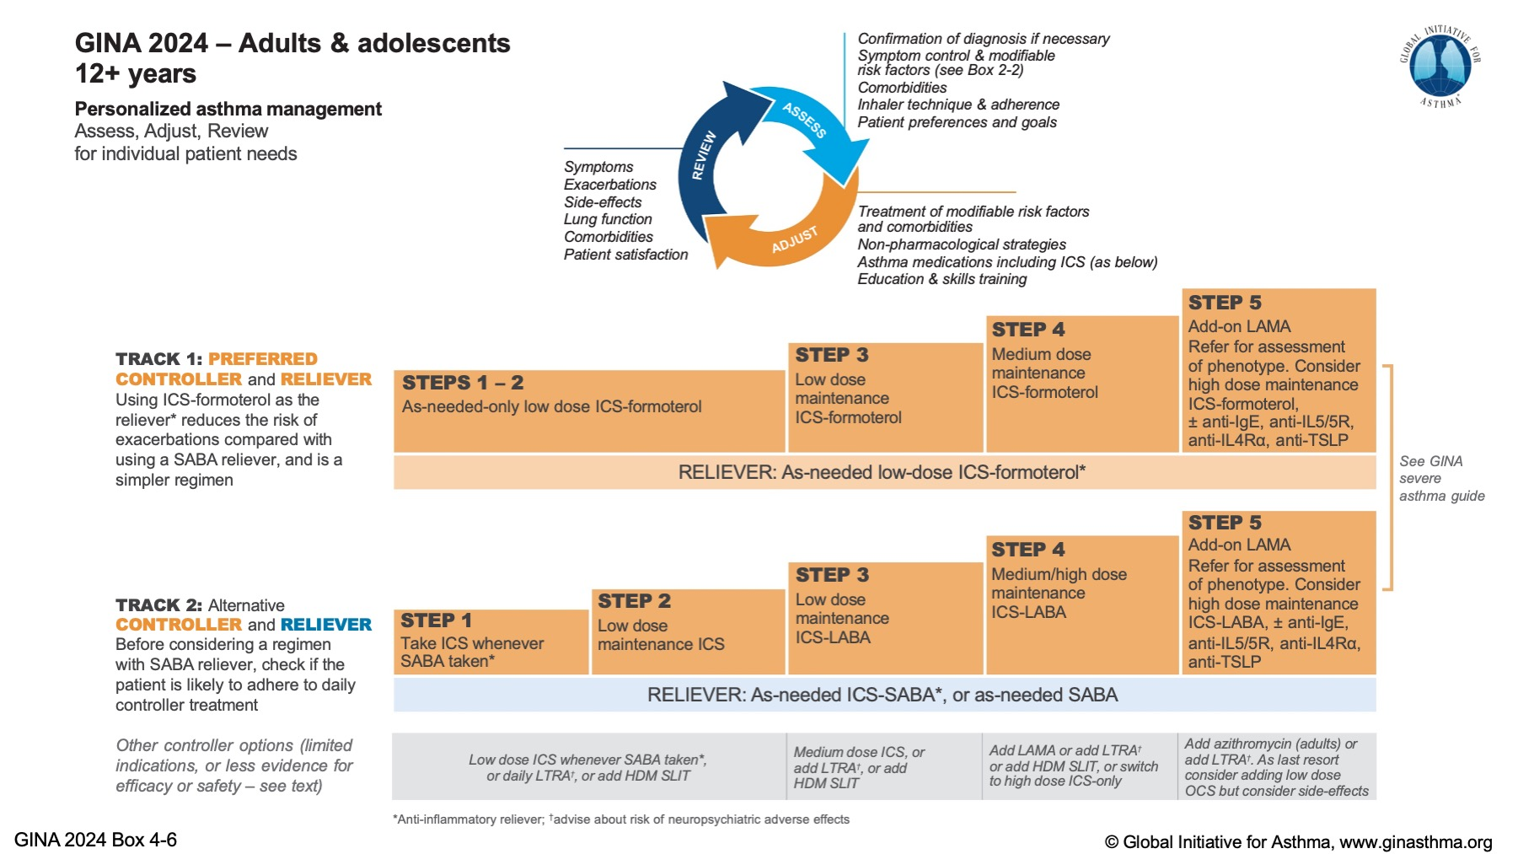

Slide 25
Track-1 treatment
Step 1 and 2 combined (AIR(Anti-Inflammatory Reliever)-only) low dose ICS-formoterol as needed for patients who were considered by their clinician to have mild asthma e.g.
were taking SABA alone or
daily low dose ICS or
LTRA with SABA as-needed only
Treatment will be low-dose ICS-Formoterol as needed only
This compared to SABA as needed only
This reduced risk of severe exacerbations
Reduce emergency department visits or hospitalisation by 2/3
Compared to daily low dose ICS and SABA as needed
Reduce emergency visits or hospitalisation.
No clinically important difference in symptom control

Slide 28
Track-1 treatment
Step-3-5 treatment: low-dose ICS-formoterol as maintenance-and-reliever therapy (MART).
As compared to maintenance ICS and LABA plus as needed SABA
This reduces the risk of severe exacerbations (32%-23%)
With similar or better symptom control
Step-3 low dose ICS-Formoterol daily (one inhalation once or twice daily) and as needed
Step-4 by increase ICS-formoterol maintenance dose increase to medium by increased number of maintenance inhalations (2 inhalation twice daily) plus as needed
* ICS-formoterol should not be use as reliever while patient taking different ICS-LABA maintenance because of clinical evidence of safety efficacy is lacking

Slide 30
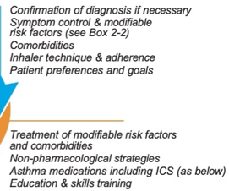
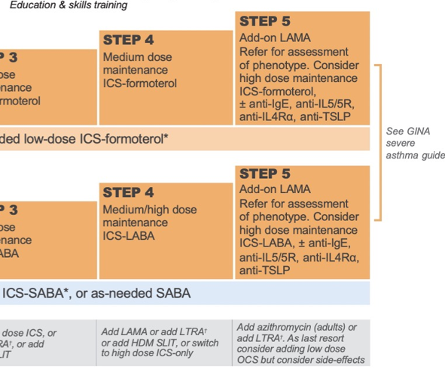
Track-1 and 2 treatment Step-5

Slide 31
Initial asthma treatment for adults and adolescents
Step-1 : asthma symptoms 2 days/week or less
Step-2: asthma symptoms 3-5days/week with nearly normal/mildly reduce PEFR/FEV1
Step-3: asthma symptoms nearly daily, or wake up due asthma once/week or low PEFR/FEV1
Initial presentation in acute exacerbation: treat the exacerbation including OCS then commence medium dose MART (step-4)
After Starting initial controller treatment
Arrange for review in 2-3 months or earlier depend on clinical urgency

Slide 32
Medications and doses for GINA Track-1
The reliver and controller inhaler is low dose ICS-formoterol either
Budesonide-formoterol 200/6 or Beclometasone dipropionate (BDP)-formoterol 100/6
Step (1 and 2) (AIR-only): low dose ICS-Formoterol as needed (maximum dose 8 inhalations/day)
Reduce severe exacerbations and ED visits/hospitalisation by 65% compared to SABA alone
Reduces ED visits/hospitalisation by 37% compared to daily ICS plus SABA as needed
Step (3-5) MART Maintenance And Reliever Therapy with low dose ICS-formoterol, reduces severe exacerbations by 32% compare with same dose ICS-LABA.
(Maximum total 12 inhalations in any day)
Step 3 MART; 1 inhalation twice (or once) daily plus as needed
Step 4 MART: 2 inhalations twice daily Plus as needed
Step 5 MART: 2 inhalation twice daily plus as needed and refer for specialist assessment

Slide 33
Different ICS low, medium, high doses

Slide 34
Stepping Up or Down
Stepping- Up: check first
First confirm the symptoms are due to asthma
Check inhaler technique
Check adherence
Multimorbidity
Allergen exposure
Stepping down to find minimum effective treatment
Asthma good controlled achieved and maintained for 2-3 months
Reduce ICS by 25-50% every 3 months interval

Slide 35
Investigating poor symptom control and /or exacerbation despite treatment
Watch patient using their inhaler
Discuss adherence and barriers to use inhaler
Confirm the diagnosis of asthma
If no previous confirm variable air flow limitation, consider having ICS dose and repeat lung function after 2-3 weeks
If possible, remove potential risk factors (e.g. smoking, occupational or domestic allergen exposure, drugs (beta blockers, NSAIDs))
Assess and managed comorbidities e.g. rhinitis, obesity, GERD, depression/anxiety, OSA.
Consider treatment step-up for 3-6 months and reassess
Refer for expert advice if asthma still uncontrolled after 3-6 months on high dose of ICS-LABA, doubt about diagnosis or suspected occupational asthma

Slide 36
When to refer to expert opinion
Difficulty confirming the diagnosis of asthma
Suspected occupational asthma
Persistent or severely uncontrolled asthma or frequent exacerbations
Symptoms suggesting complications or sub-types of asthma e.g. ABPA
Any risk factors for asthma-related death
Patient had near fatal attack (ICU admission or mechanical ventilation for asthma)
Suspected or confirmed anaphylaxis or food allergy in adults with asthma

Slide 37
Mr DE
54 year
Referred on 1/7/2024
Reason for referral: Thanks for seeing this patient with
PMH of Hypertension, on Amlodipine and Losartan.
He smoked 6-10 cig/day for 25 years, but has stopped now.
He is very athletic and goes to gym every day. He has no allergies.
He comes with history of cough, SOB and wheezing. He said this is third chest infection in 18 months.
O/E he is well not short of breath and chest sounded clear. His PEF 65.5 predicted
I have prescribed him Doxycycline, Prednisolone and salbutamol inhaler, but I would be grateful if he could have a spirometry in view of his smoking history and repeat chest infection

Slide 38
History review of Mr. DE
Patient seen on 24/10/2024
Symptoms started in Jan 2023 after Covid
He had repeated “chest infection” every 3-4 months
Chest infection: He gets SOB, wheezy, cough, with little sputum, settled in three week after course of antibiotic and OCS
He was prescribed Salbutamol inhaler and used it frequently with some symptomatic benefit
In August 2024 he was prescribed Clenil inhaler and his symptoms have significantly improved now use salbutamol 1-2 a day mostly before exercise
He had no sleep disturbance due to breathing
He noted air conditioning and viral cold main triggers for his chest
In the past when he got colds usually goes to his chest and it last about 2-3 weeks
He works in a prison
Ex-smoker for 2 years. Smoked 6-7 cig/day for 30 years

Slide 39
Cont: Mr DE
O/E chest shows occasional ronchi
He had CXR on 29/8/2024 was reported normal
Past blood eosinophil highest was 0.4
What is the diagnosis ?
What is your management plan?

Slide 41
Take home messages
Asthma: Respiratory symptoms that vary over time and in intensity, due to variable expiratory airflow limitation
In asthma lung function may vary in time between normal and severely obstructive in same patient
Try to confirm the diagnosis before start treatment, use PEFR if no access to spirometry
Treatment with low dose ICS-formoterol AIR or MART can cover majority of asthma patients

Slide 42
Thanks for listening
Any questions?

