Slide 1
NHS Barnsley Talking Therapies
Tom Brown
Team manager, CBT and EMDR psychotherapist
Samuel Johnson
Senior Psychological Wellbeing Practitioner
Formerly known as IAPT - improving access to psychological therapies

Slide 2
About our service
The service was set up in 2008 as IAPT, it was re-branded nationally in 2023 to NHS Barnsley Talking Therapies: for anxiety and depression (BTT)
The team is based at Rose Tree Avenue, Cudworth
We offer primary care talking therapies to people who have a Barnsley GP, are aged 16+ and have mild to moderate common mental health problems of Anxiety and/or Depression
We offer therapy face to face in various settings including our base, lift buildings, some community centres and Barnsley College. We also provide Virtual (MST) or over the telephone (step 2) sessions. We offer Courses, Workshops, Groups and Individual one to one treatment
We accept self-referrals online via our website / (potentially AI system in near future), over the phone or referrals from any professional involved in the persons care (with the persons consent)

Slide 3
About our service
We offer a range of therapies to treat the following mental health conditions:
Generalised anxiety disorder (GAD)
Post Traumatic Stress Disorder (PTSD) single incident and complex
Depression
Body Dysmorphic Disorder
Panic disorder (with or without agoraphobia)
Health anxiety
Phobias
Obsessional Compulsive Disorder (OCD)
Social anxiety

Slide 4
Stepped care model – step 2
Focus of the intervention | Nature of the intervention
Mild to moderate depression; Mild to moderate GAD; Mild to moderate panic disorder; Mild to moderate OCD; Mild to moderate specific phobias. | NICE approved low intensity psychological treatments for: Less Severe Depression: Individual facilitated self-help, computerised CBT GAD: Individual non-facilitated and facilitated self-help, psychoeducational groups Panic disorder: Individual non-facilitated and facilitated self-help, psycho-educational groups, Agoraphobia package (for Panic with Agoraphobia). OCD: Brief Individual LICBT (including ERP). Phobias: Graded Exposure programs All problems = Understanding and Managing Wellbeing (psycho-education group)/various workshops

Slide 5
Stepped care model – step 3
Focus of the intervention | Nature of the intervention
More severe or persistent depression that has not responded to a low-intensity intervention Initial presentation of moderate or severe depression GAD with marked functional impairment or that has not responded to a low-intensity intervention moderate to severe panic disorder; OCD with moderate or severe functional impairment; BDD with mild – moderate impairment PTSD. | NICE approved high intensity psychological treatments for: Depression: CBT, Counselling for Depression and Couple Therapy for Depression Generalised Anxiety Disorder (GAD): CBT Panic disorder: CBT Obsessional Compulsive Disorder / Body Dysmorphic Disorder (mild impairment): CBT (including ERP) Post Traumatic Stress Disorder (PTSD): Trauma-focused CBT, EMDR Health Anxiety: CBT Unresolved Bereavement: Counselling Phobias: CBT Social Anxiety: CBT

Slide 6
Where referrals come from
Referrals come from GP’s, any associated professional and self-referral.
Clients can be advised of / directed to the BTT website and make a self-referral (this will soon be AI-led)
We work collaboratively with other mental health services in Barnsley, as well as the ICU unit at Barnsley Hospital NHS Foundation Trust, where we offer therapy and support to clients and staff
We work jointly with Barnsley College where we offer a full Talking Therapies service to students aged 16+ and staff members

Slide 7
What happens next?
After referral:
Clients' needs are identified on referral and any potential high risks will be triaged by a duty clinician. Onward referral may be made at this point, if required
Clients are given access to ‘choose and book’ for a suitable 60-minute phone-based screening assessment within 1 week

Slide 8
What happens next?
After assessment:
Clients are considered for Talking Therapies treatment, as defined previously in the stepped care model
Access to online cCBT, alternatively a psychoeducational course
Signposting and/or referrals made to other services e.g. Social Prescribing, BSARCS, IDAS, CAB, Social Care, Barnsley Bereavement, Recovery College, Drugs and alcohol services, and any other 3rd sector services as appropriate to clients' needs

Slide 9
Long term conditions and anxiety and depression
We understand the correlation between physical and mental health and we want to ensure parity of esteem when working with all clients.
Staff trained to work with depression and anxiety alongside physical long term health conditions e.g. (not exhaustive list):
Diabetes
Cardiovascular disease
Respiratory disease
Medically unexplained symptoms
Persistent Pain

Slide 10
How pharmacy services can support people with common mental health problems
Early identification of a common mental health problem (as described previously) is important in successful treatment and recovery.
Anyone who is newly px antidepressants or anxiolytics, ideally a pharmacist would:
Hold a discussion around the benefits of Talking Therapies
Provide a leaflet for the Barnsley Talking Therapies
Signposting to Barnsley Talking Therapies website
(Positive practice keeps the conversation alive with clients experiencing common mental health problems)

Slide 11
Access to mental health services
Mild to moderate anxiety and depression
Barnsley Talking Therapies referral
Organic mental health
Memory services - GP
Concerns possible first episode psychosis
Early Intervention Team
GP - self referral
Urgent and ALL other mental health needs
SPA
GP/professional referral
Urgent out of SPA hours
IHBTT
Out of Hours GP - 111
Services work together to meet people’s need so will redirect.
If not sure, please ring and ask.

Slide 12
Case Study
Patient Assessment
Melissa – pseudonym – 19 years old, Heterosexual Female – lives in Barnsley with her mother and 2 siblings
Problem Descriptor - Generalised Anxiety Disorder (F41.1 in ICD-11*; 300.02 in DSM-5*). Onset = 1 year
Sertraline 100mg for last 6 months – reported limited benefit. Did not know talking therapy was an option during this time.
Diverse needs: presented with Learning Difficulties and similar characteristics to Learning Disability (DoH, 2001);
Basic literacy – “I really struggle to read and write so need pictures and easy words”.
Significantly reduced ability to understand new or complex information
Reduced ability to cope independently
Few or no standard school qualifications and no paid employment
MDS
PHQ9- 9 (mild)
GAD-7 – 16 (severe) W&SAS – 20
DSM
PSWQ - 64 – “currently have problems with worry and may benefit from treatment”
*American Psychiatric Association (2013); World Health Organisation (2020)

Slide 13
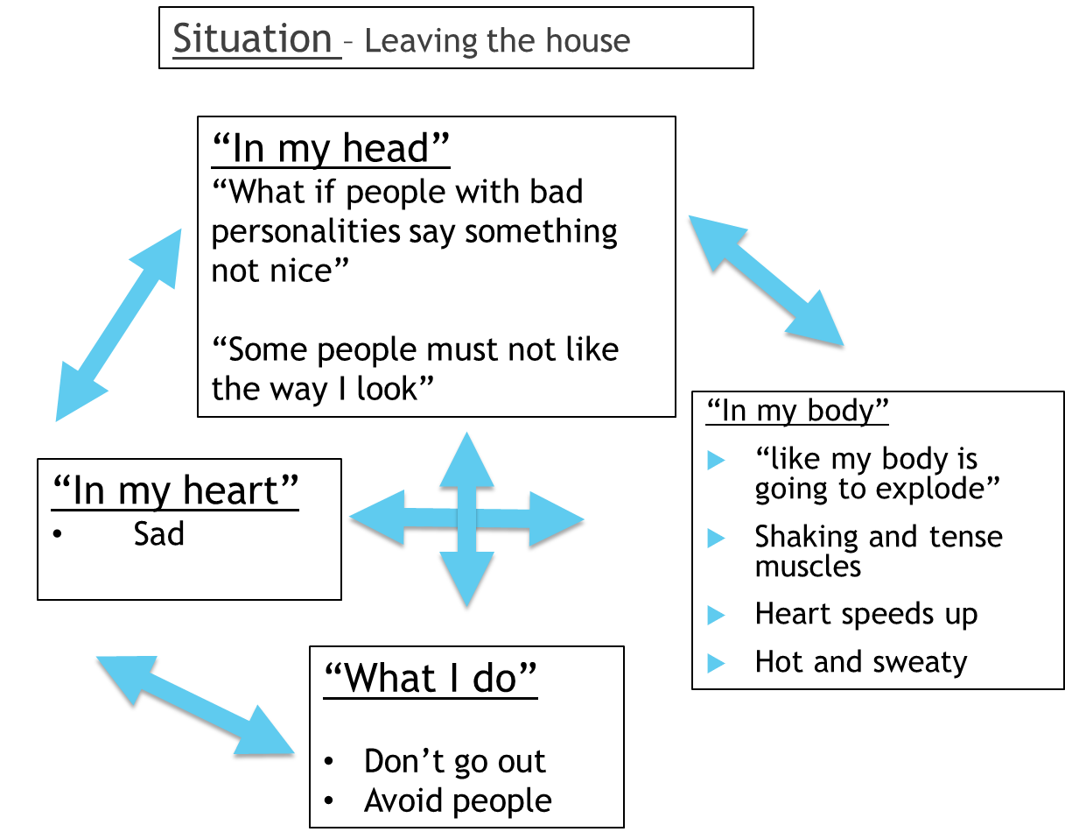
Case Study
Helping clients to make sense of the maintenance of their own symptoms
Williams & Garland (2002)

Slide 14
Case Study
Problem Statement
“My main problem is feeling worried too much. I feel sad when I am worried. When I am worried I shake and feel so hot like my body is going to explode. I think “people won’t like me” and that “they could not be nice to me”. This means that I do not go out. When I do go out I avoid people.
Goal
“To not feel as worried all the time. If I felt less worried I would be around people more and do more fun things like shopping. “
Structured, focused on the current time, and goal-oriented

Slide 15
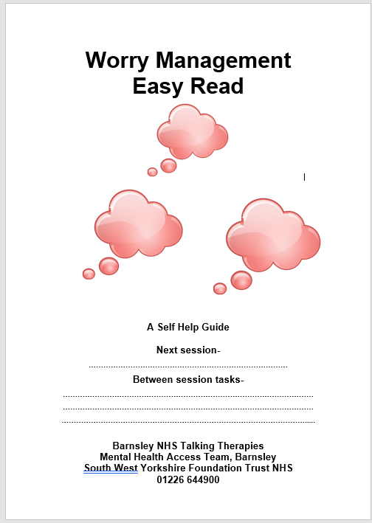
Case Study
Intervention
6 sessions of LICBT
Worry Management
Easy Read
Longer appointments
More repetition
Social supports
NICE guidelines (NCCMH, 2011).
Reasonable adjustments to treatment, in line with NICE guidelines
Notes:
NICE guidelines state people with GAD who have a mild-moderate learning disability should be offered the same intervention with necessary adjustments to take account of the disability and the practitioner should receive regular high-quality supervision (NCCMH, 2011).
GSH booklet in Easy Read produced by our service, adhering to ‘guidelines for producing easy read’ (Department of Health, 2010)
Longer appointments agreed – Socratic Questioning (Bennet-Levy, 2006) and pros and cons list
More repetition - crucially important for the effectiveness of treatment for people with learning difficulties to support retention of key information (McCabe et al, 2006)
Involvement of mother to support therapy - social supports are vital for people with learning disabilities to facilitate their learning of new skills and engagement in new activities in CBT (Dagnan & Chadwick, 1997)

Slide 16
Case Study
Treatment outcome
Reduction in clinical outcome measures – PHQ9- 9; GAD-7 – 9; W&SAS – 12, PSWQ - 40
Melissa met her goal – “I have been able to go Christmas shopping at a busy shopping mall with my mum without worrying as much”.
Employment support – agreed mutually a referral to employment support at session 5 – BTT Employment Advisors
Suggested consultation with GP/Pharmacist regarding Sertraline medication having limited benefit
Referral to SWYT adult learning disability services for further exploration of learning disability
Effective, timely and promotes relapse prevention and maintenance for more long-lasting change

Slide 17
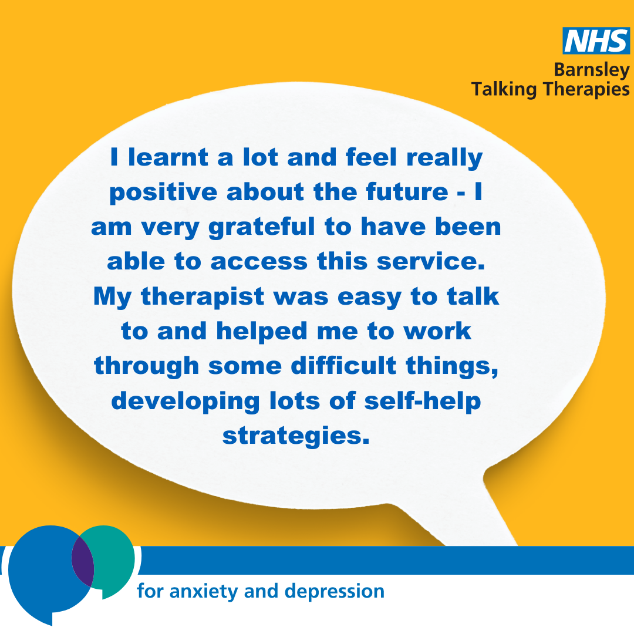
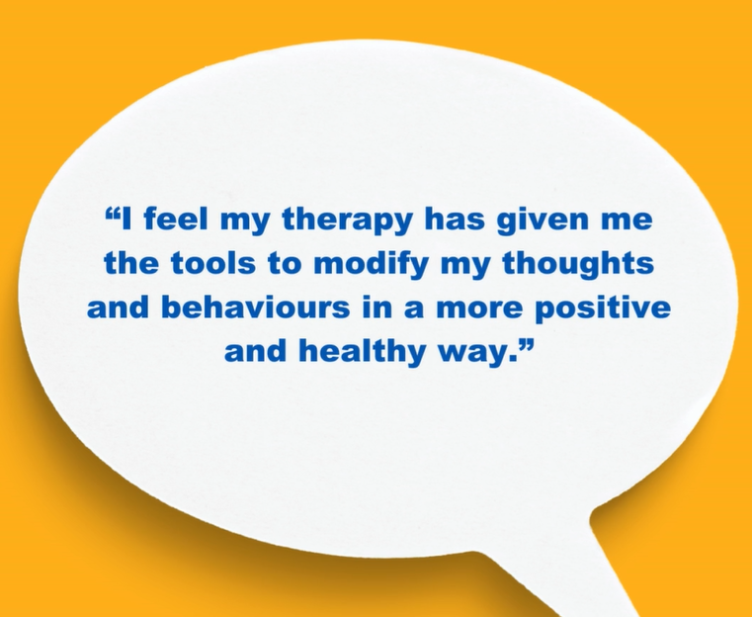
Client Feedback

Slide 18
Questions Welcome
Refer to our service:
Online:
www.barnsley-talkingtherapies.nhs.uk
Call: 01226 644900
Follow us on socials:
Instagram: @barnsleytalkingtherapies Facebook: @TalkingTherapiesBarnsley
Monthly Newsletter:
If you would like to get a copy of our
newsletter, please email us:
barnsley.talkingtherapies@swyt.nhs.uk
This document has been produced by the Trust NHS Barnsley Talking Therapies Team, barnsley.talkingtherapies@swyt.nhs.uk, Tel: 01226 644900 (Mon- Fri 9.00am – 5.00pm)

