Slide 1


BMA Industrial Action what does it mean for Barnsley GPs?
Presented by Dr Clare Bannon

Slide 2

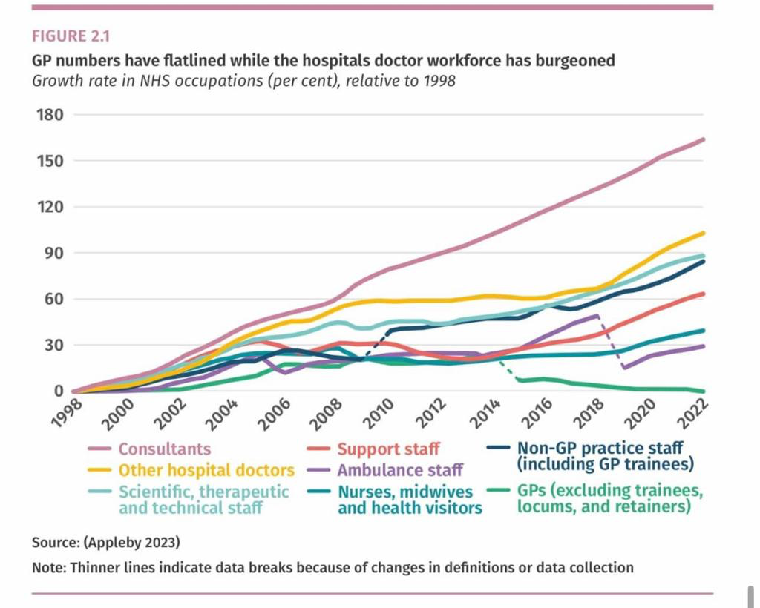
Changing Demand
The average number of patients each GP is responsible for has increased
by 17%
Total NHS budget £160.4bn (23/24)
GP £11.605m (23/24)
% of pie = 7.235%
367,000,000 appts for £11.5bn (22/23)
29 million more GP appts per annum with 2,200 fewer GPs than 2015.
Cost to government? Cost to NHSE? Cost to you?
Industrial action – most importantly, what is the cost to our patients?
Presented by Dr C Bannon

Slide 3
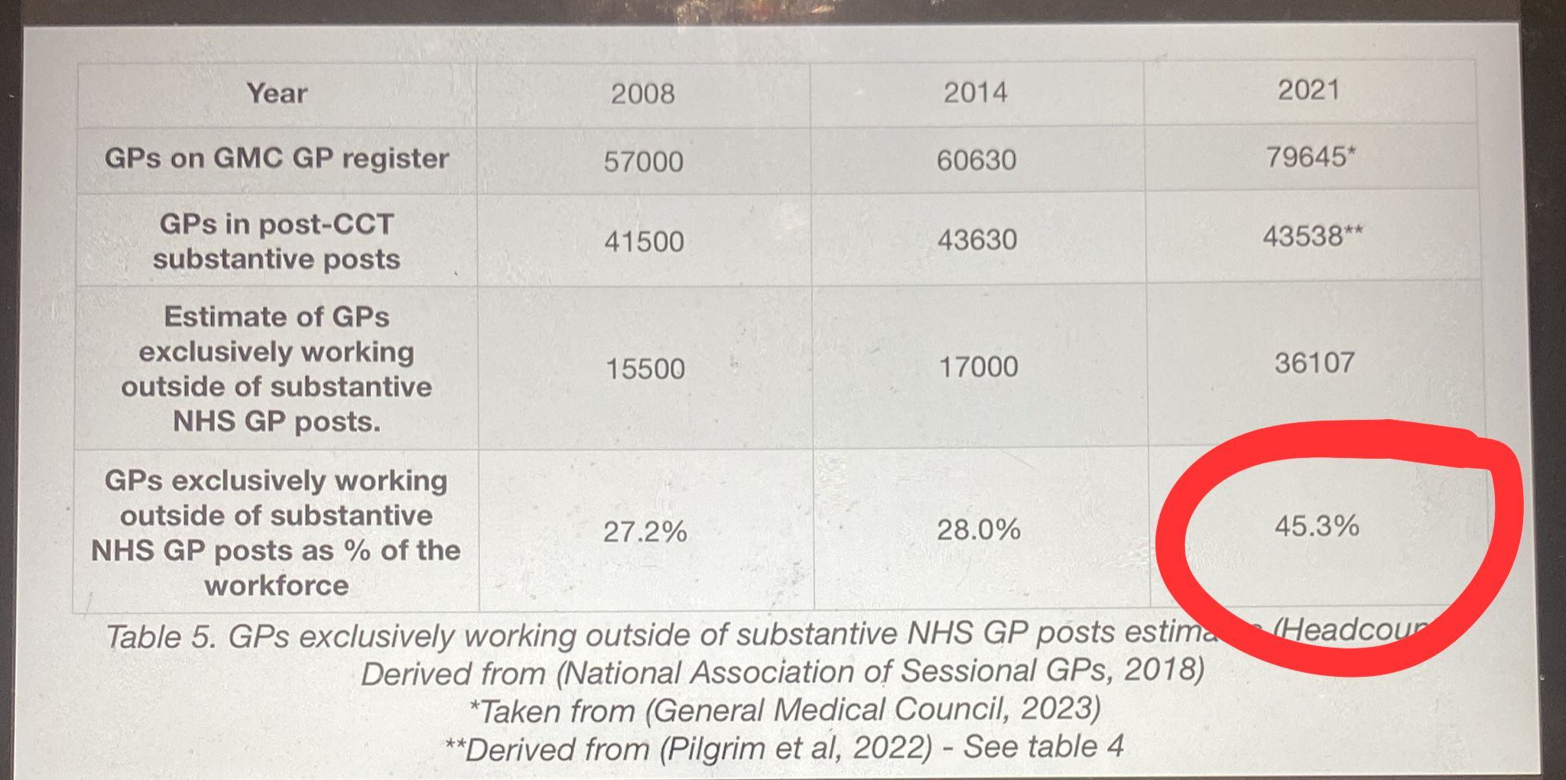
Changing Demand
Presented by Dr C Bannon

Slide 4
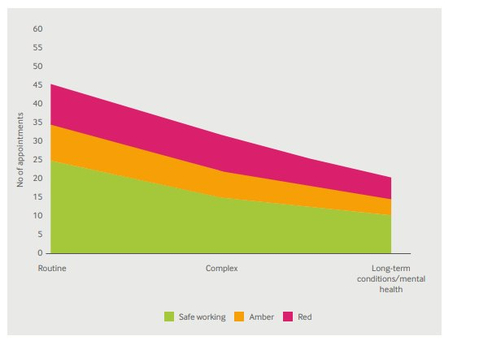
Safer Working
Mike’s Slides
2015 study of 25 European countries -more than 25 direct consultations per day made GP unsustainable
Range 10-35 depending on complexity
This must be the priority in any action
Not a short-term action but method to get off the
hamster wheel 111, iHeart, A&E, Sheffield WIC
This will not end, it is up to Wes to solve
Previous slide and rising GP unemployment
Webinars and individual discussion
Presented by Dr C Bannon

Slide 5
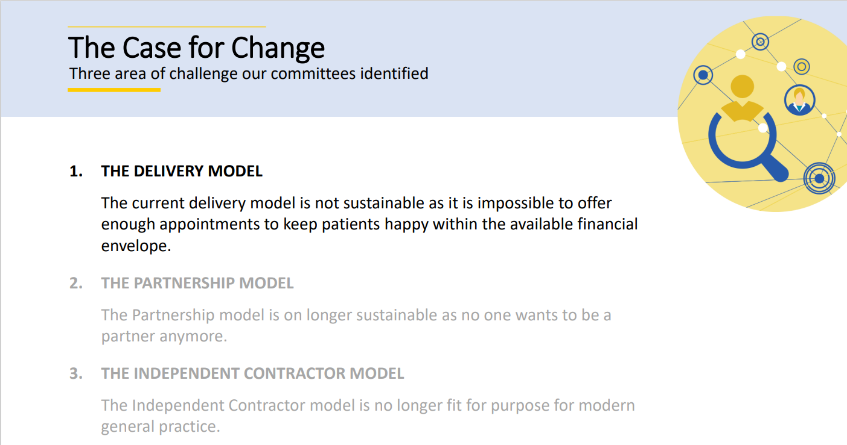

Slide 6
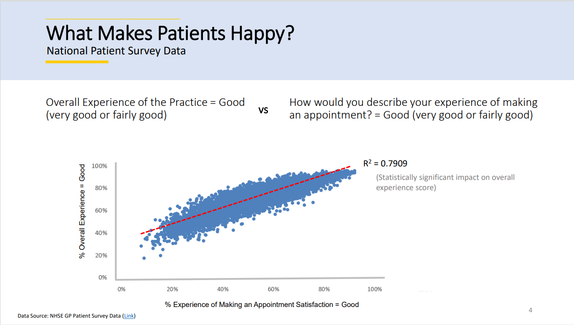

Slide 7
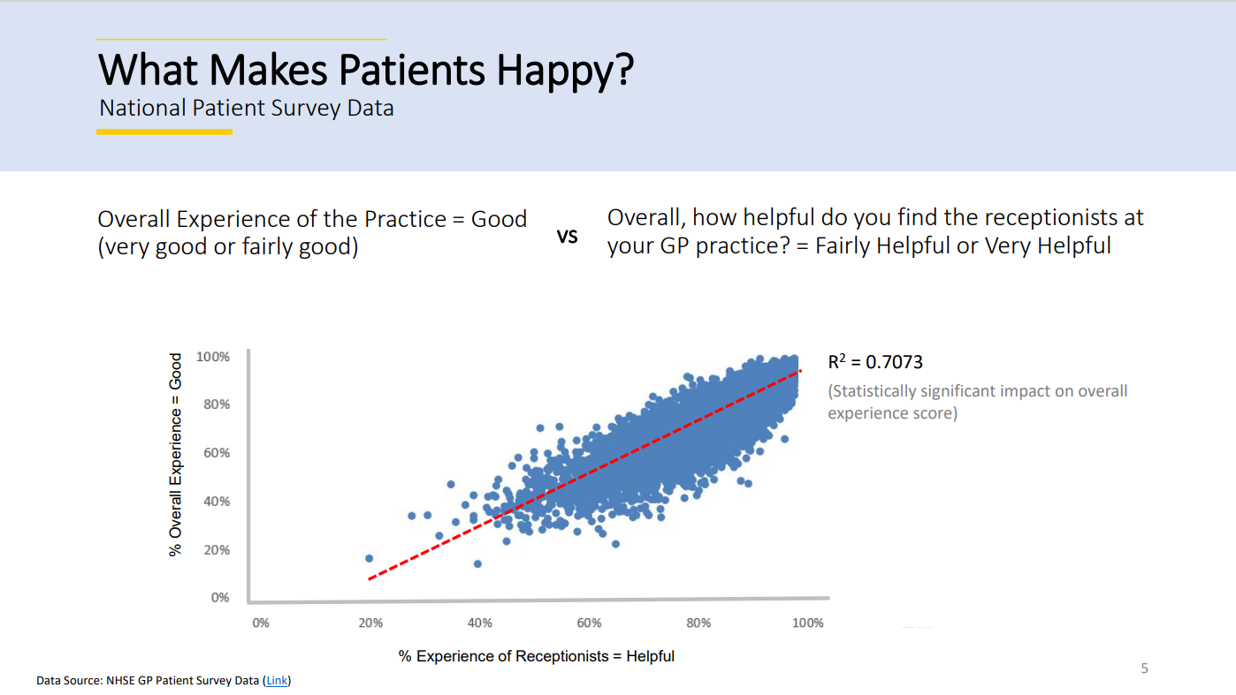

Slide 8
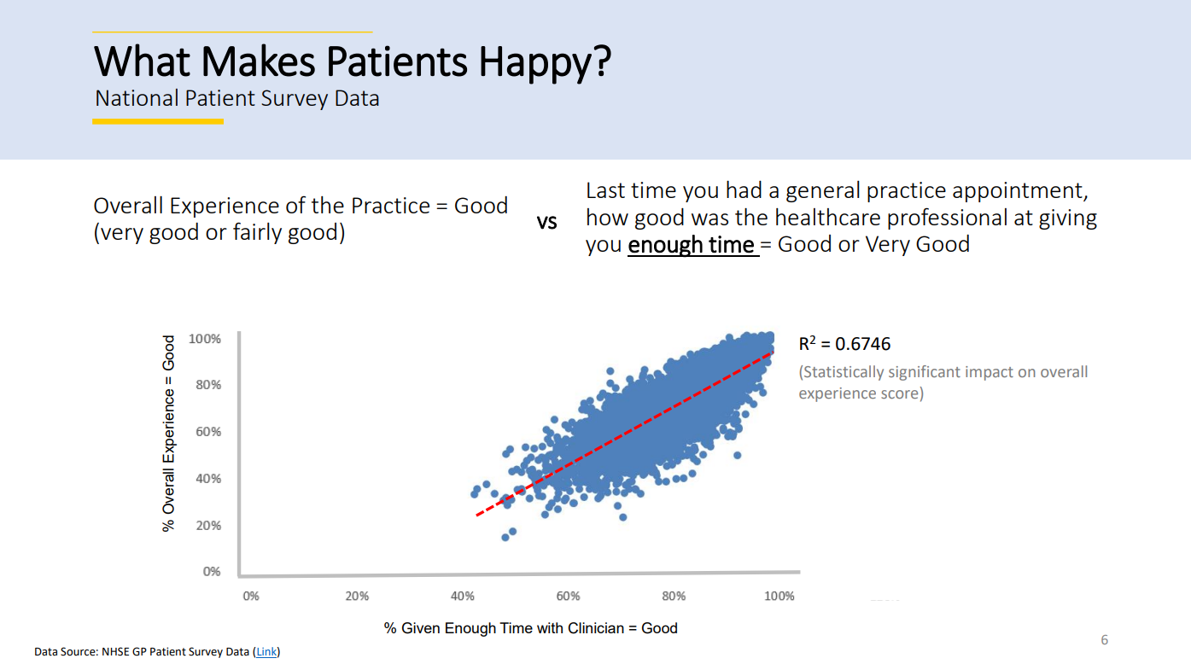

Slide 9
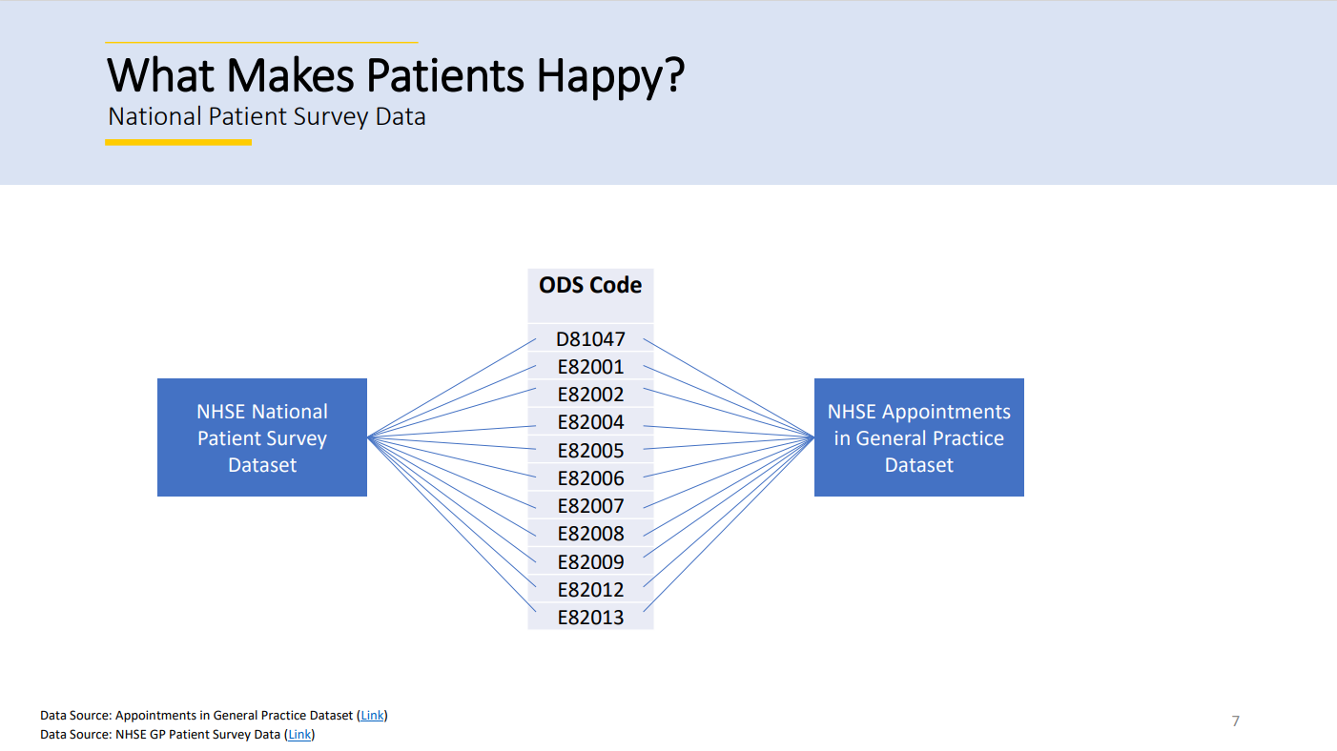

Slide 10
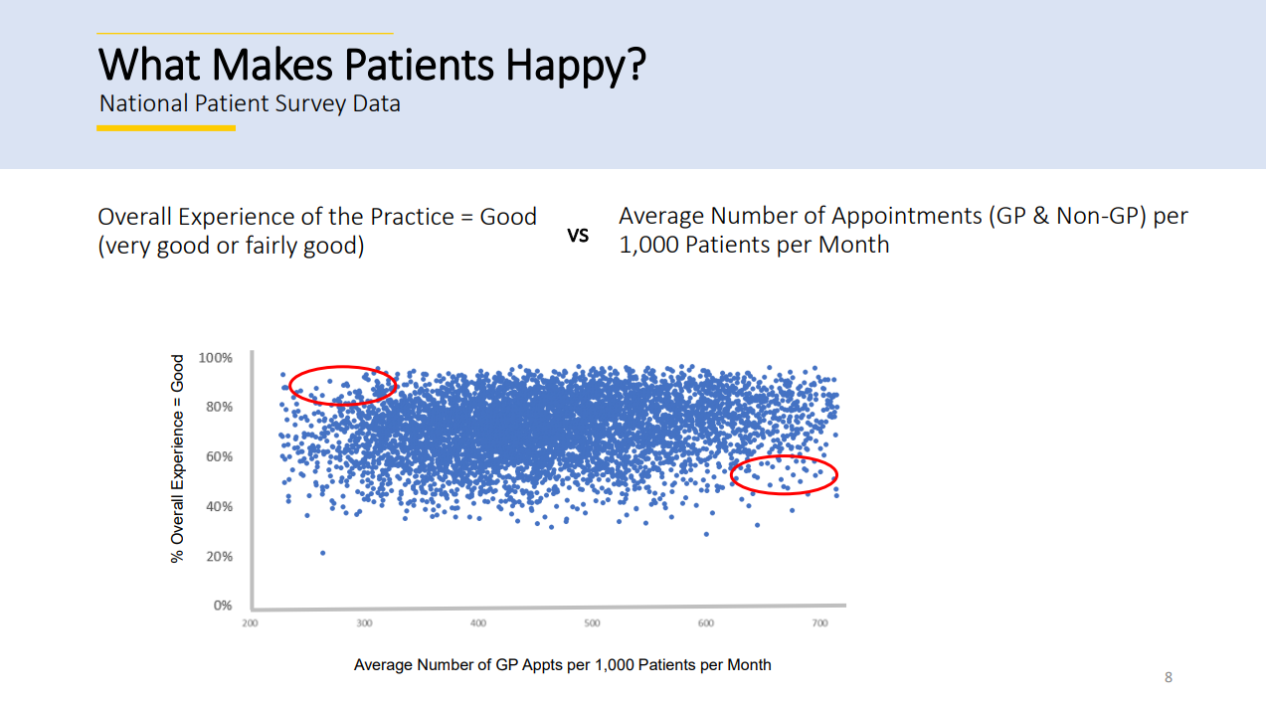

Slide 11
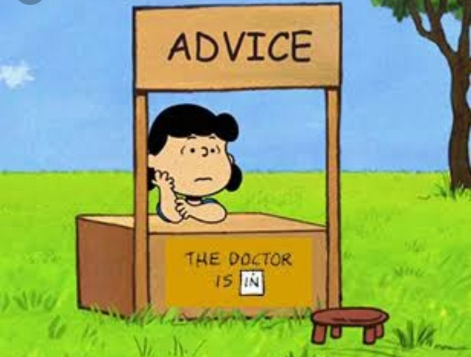
Advice and Guidance
Advice and Guidance, see BMA guidance
Only use if genuinely want brief advice
Long list of actions for the GP is not appropriate
Please bear in mind the number of consultants continues to rise but the number of fully qualified full-time GPs is over 800 fewer fully qualified FTE GPs since 2019
Over that same time period we are seeing 20% more patients
We should not take on further hospital work
Presented by Dr C Bannon

Slide 12

Serve notice on commissioning Gaps
In Barnsley there are a number of services that are unfunded.
Phlebotomy – this is only funded for shared care drugs. We are not funded to provide blood tests for any other reasons.
Spirometry - clear guidance from NHSE that is clear this should be available for GPs to book via eRS.
ECGs - these do not form part of essential services patients should be referred
PSA Call and Recall- LMC Template letter
MGUS call and recall- LMC Template letter
Presented by Dr C Bannon
Notes:
Where possible these patients should be referred to the phlebotomy service at the glassworks or hospital. We are often asked about bloods for QOF – the requirement here is to organise the test not perform it.
There is very clear guidance from NHSE that is clear this should be available for GPs to book via eRS. The hospital is accepting referrals for spirometry and we would encourage practices to use this
many areas have an ECG locally commissioned service, providing ECGs does not form part of essential services and where possible these patients should be referred
Providing recall for PSA testing under the direction of the hospital should have a formal, funded shared care arrangement. There are not robust mechanisms in place to manage these patients in General Practice. The LMC has been made aware of a number of significant events concerning the follow up of PSA results, which may require actioning even when in the normal range. We do not have the infrastructure in place or the knowledge to independently decide how to manage these results. GMC guidance ‘Good medical practice’ is clear that Drs should ‘provide a good standard of practice and care and work within competence’. Please see attached letter to serve notice to urology about accepting the care back.
There is a significant level of risk in managing patients with Monoclonal gammopathy of undetermined significance. Patients are monitored due the increased risk of malignancy. Monitoring of these patients does not fall into the GMS/PMS definition of essential services, and legal advice taken by the BMA suggested GPs treating such patients are putting themselves at risk, due to their limited knowledge of the condition. All patients with MGUS should be returned to haematology for the appropriate specialist follow up. There are several examples across England of good practice such as University college London MGUS , nurse led telephone follow up clinic that utilises Nurse specialists to follow up these patients. Please see attached letter to return all patients currently under follow up for

Slide 13

Shared care
Some funding for shared care but it is not enough for the work involved
Raised with Medicines Management team that PSSRU figures should be used
Propose to continue initially but not support any new shared care during period of action
Consider giving notice 3 months from August 1st to withdraw from all shared care due to financial unsustainability
Presented by Dr C Bannon
Notes:
Personal Social Services Research UnitUniversity of Kent and University of York Research

Slide 14
Vaccinations
IOS funding for vaccinations is still £10.06
A band 5 nurse costs £60 an hour with practice associated costs (room/oncosts mandatory training etc)
On top of this there are DNAs, call and recall, Admin/reception time
If giving a vaccine in a 10min appointment, we are subsidizing vaccine administration
Consider carefully if £7.54 for COVID is sustainable
Consider New RSV vaccination programme
Presented by Dr C Bannon
Notes:
Personal Social Services Research Unit University of Kent and University of York Research

Slide 15

Data Sharing Agreements
We recommend practices do not sign any new data sharing agreements
ICB ‘Connecting GP data
Whilst could be beneficial in long term, must have the funding to underpin plan is to use for service redesign
We are not recommending Scriptswitch or Eclipse are switched off as feel these have important safety uses
Presented by Dr C Bannon

Slide 16

LMC Incorporation
We are re-structuring the LMC to provide YOU better services
We intend to establish as a limited liability company by guarantee
We are following suit other LMCs (BBO, Doncaster etc)
Will NOT change your representation
Currently we are unable to employ staff or provide any extra services (training etc) which is preventing us represent you better
All levy paying practices/GPs will be members
This also allows essential flexibility for our functionality
Presented by Dr C Bannon

Slide 17
Thank you for listening.
Questions?
01226 355 824
barnsley.lmc@nhs.net
www.barnsleylmc.co.uk

