Slide 1
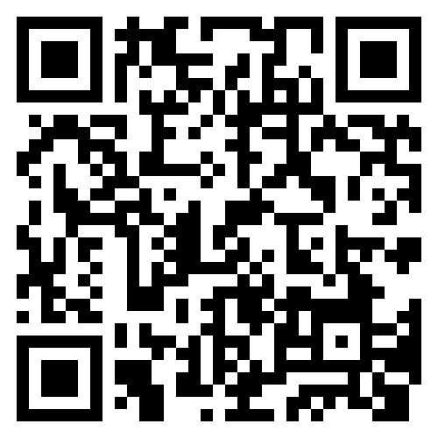
Survey: Referring to Pulmonary Rehabilitation (PR)
Short survey to see if there is a need to offer support to people working in Primary Care to refer their patients to Pulmonary Rehab.
Access the survey by scanning the QR code OR navigating to the link below:
https://forms.office.com/e/Q3xvvVDg4B
Notes:
LTP – increase access to PR over 10 years
90% people who do PR report an improvement in QoL

