Slide 1
Thinking Pharmacy First
Patient Safety
Discharge Medication Service
End of Life Care

Slide 2
Patient Safety
Hospital report:
Patient's mother brought in a Levothyroxine 125micrograms/5ml bottle which she got from her community pharmacy.
It was labelled for a different strength of Levothyroxine (25micrograms/5ml) and has the instructions 'take 3mls OD’.
Wrong strength supplied.
Patient's mum has been giving 1.5ml of this instead - wrong dose being administered.

Slide 3
Patient Safety
Action taken:
I contacted the patient's base hospital and the endocrinology registrar confirmed that the dose should have been 15micrograms once daily. This matches the label on the bottle (3mls of 25micrograms/5ml = 15 micrograms). Patient's mum had been giving 1.5mls because she had once observed a nurse draw up 1.5mls (of a 50mcg/5ml) and has been doing the same ever since she observed that in July. She has been giving 1.5ml OD of the 125micrograms/5ml which is 37.5micrograms OD. Patient's last TFTs were 'normal' on 3rd July 2023 in base hospital but hasn't had a follow up in clinic since then.
I called the community pharmacy and they will investigate. I removed the bottle from the ward.
I asked Drs to repeat TFTs urgently alongside monitoring her physical health, ECG and heart rate and to gain some input from endocrinology on how to proceed.

Slide 4
Patient Safety
Discussion points:
Liquid Medicines
Children’s dosage
Community / Hospital Interface
Pharmacy Communication with Patient’s mother
Stock ordering (probably an owing)

Slide 5
Patient Safety
District Nurse Report: Baby discharged from Neonatal Unit.
Neonatal family care nurse visited family home.
TTO's included Calcium carbonate (0.5mmol/ml oral suspension).
Instructions electronically sent to GP as follows: *GP to continue Calcium carbonate oral solution 0.86mmol QDS PO/NG*
Parent has request repeat prescription from GP and was very confused by the medication she received. Mum showed the family care sister the prescription.
GP has prescribed Calcium effervescent tablets with very unclear dosage instructions.
Prescription label as follows: **76 Calcium Carbonate effervescent tablets 1.25mg. 0.86mmol to be taken 4 times per day as directed. Dissolve or mix with water before taking.**

Slide 6
Patient Safety
Comments from assessor:
Effervescent tablets should only be issued for neonates if the oral suspension is unavailable.
These dosage instructions are inadequate.
Dosage instructions for effervescent tablets should make clear that each tablet is the equivalent of 12.5mmol of calcium per tablet.
For preparation, dissolve one tablet in 24ml of sterile water to produce a solution of containing 0.5mmol/ml (1ml displacement value).
The dosage would therefore be 1.72mls QDS.
The baby is also fed by NGT, so this also should have been added to the label.

Slide 7
Patient Safety
Discussion points:
Liquid Medicines
Children’s dosage
Community / Hospital Interface
Pharmacy Communication with Patient’s parents.
Stock ordering (probably an owing)

Slide 8
Patient Safety
Community Pharmacy Report (1): query to hospital, cc surgery
On the last discharge on patient’s Buprenorphine dose was reduced from 10mcg to 5mcg. (April) The surgery last issued a prescription (March) for Buprenorphine was prior to admission, so the hospital supply is the current dose. The DMS (May) lists the strength at 10mcg which therefore is a dose increase. There is no indication in medication changes that the buprenorphine dose has been increased. Please confirm the correct dose. AND Famotidine tablets: Famotidine listed in the Medication Changes section as 40mg. Famotidine listed in Discharge Medication as 20mg. Please confirm the correct dose.

Slide 9
Patient Safety
Hospital response:
According to the medicine reconciliation there was a bit of confusion which strength patch the patient was on as it wasn't actually prescribed on the previous D1 but did have a medication change note regarding it. However, the 10mcg strength was the most recent dose on EPMA. The nurse did confirm patient was wearing patch on admission but was unable to recall which strength. The medical team therefore, continued the dose at 10mcg/hr whilst inpatient and onto discharge. XX (CP) can the patient's ongoing analgesia be reviewed in primary care.

Slide 10
Patient Safety
Hospital response:
For the Famotidine it is the 20mg OD dose. Unfortunately, the medication changes is manually added and not pulled across from EPMA and only list the Famotidine 40mg tablets on the drop down list, this has been raised to the clinical system team however, it is not a simple addition onto the database. The whole list of medications will need to be removed and a whole new medication list have to be inputted. The EPMA team I believe is working to
update the list soon. It should be explicit what dose of Famotidine was started on the medication changes section via the free text box but this must have slipped through the net.

Slide 11
Patient Safety
Community Pharmacy Report (2): query to surgery
Buprenorphine patches: On the last discharge Buprenorphine dose was reduced from 10mcg to 5mcg. The surgery last issued a prescription for Buprenorphine on <date>, so the hospital supply on <date> is the current dose. The DMS lists the strength at 10mcg which therefore is a dose increase. There is no indication in medication changes that the Buprenorphine dose has been increased. Please confirm the correct dose. Famotidine tablets: Famotidine listed in the Medication Changes section as 40mg. Famotidine listed in Discharge Medication as 20mg. Please confirm correct dose

Slide 12
Patient Safety
Surgery response:
Scripts received from surgery, no reply to above queries either by phone or email. Scripts matched DMS but queries not answered. Our response from hospital query came after scripts issued so not clear if surgery followed up on above queries or prescribed based on discharge information. After medication plan sent to care agency and surgery - surgery called to say that Amlodipine now stopped

Slide 13
Patient Safety
Discussion points:
Controlled Drugs
Multiple hospital discharges within short period of time and GP records not updated before readmission
Communication with Surgery
Community / Hospital Interface
Communication with Care Agency

Slide 14
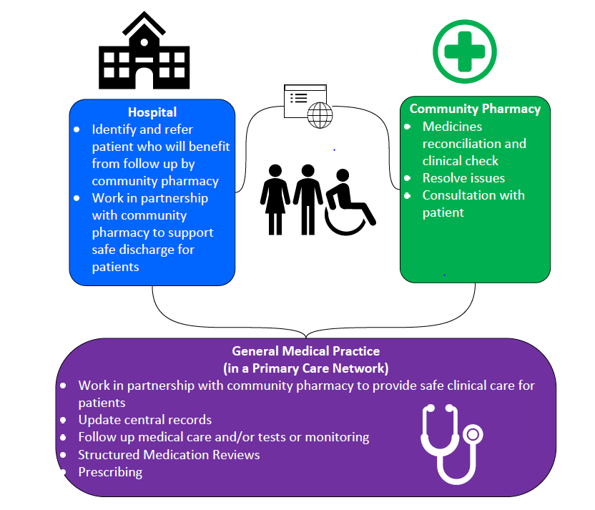
Discharge Medication Service

Slide 15
Discharge Medication Service: Aims
Optimise the use of medicines, while facilitating shared decision-making
Reduce harm from medicines due to transfers of care
Improve patients’ understanding of their medicines and how to take them following discharge from hospital
Reduce hospital readmissions
Support the development of effective team working across hospital, community and PCN pharmacy teams and general practice teams, and provide clarity about respective roles

Slide 16
Discharge Medication Service: Benefits
Changes to medicines on discharge can result in confusion about what medicines a patient should be taking
Sometimes errors are made when new prescriptions are issued following a stay in hospital, as there may be communication problems between the hospital and the patient’s general practice
Discharge from hospital is associated with an increased risk of harm due to medicine changes, but this can be avoided

Slide 17
Discharge Medication Service: The 3 Steps
A discharge referral is received by the pharmacy and checked
The first prescription is received by the pharmacy following discharge
Check the patient’s understanding of their medicines regime

Slide 18
Step 1: Check for clinical information and actions
Hospital queries to: bdg-tr.apcreports@nhs.net
GP queries consider involving clinical pharmacist.
List of clinical pharmacist by practice shared via PharmOutcomes
Patient – check understanding of dose and how to take it – ideally ask to see the label on discharge medication especially important on specials and children's medication

Slide 19
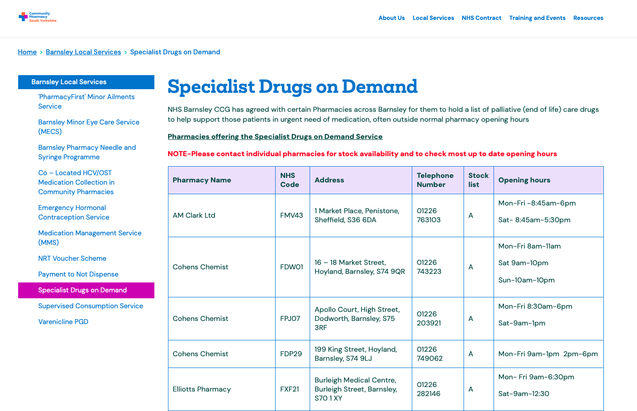
End of Life Care
southyorkshire.communitypharmacy.org.uk/barnsley-local-services/specialist-drugs-on-demand/

Slide 20
Collaborative working for better patient outcomes

Slide 21
Pharmacy First Referral
NHS 111 – Urgent Supply | NHS 111 – Minor Ailment / Clinical Pathway | GP – Minor Ailment / Clinical Pathway | Self-referral – Clinical Pathway
Via PharmOutcomes, notification in NHS mail | Via PharmOutcomes, notification in NHS mail | Via PharmOutcomes, notification in NHS mail, or NHS mail or Accurx | Walk in, telephone call
Process via Pharmoutcomes or provider of choice
 |  | If via NHS mail or Accurx complete Patient Registration First | Complete Patient Registration
 | Choose Either Minor Illness or Clinical Pathway
If supply required, print Pharmacy First Urgent Supply Token, dispense, charge if appropriate and submit with month end scripts

Slide 22
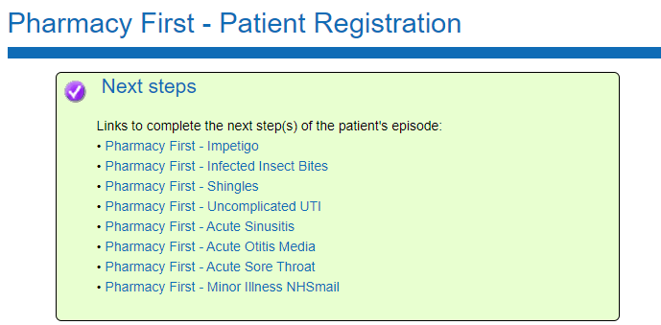
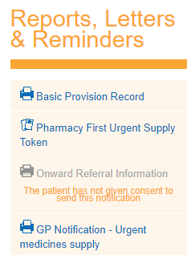

Slide 23
Accurx Referrals

Slide 24
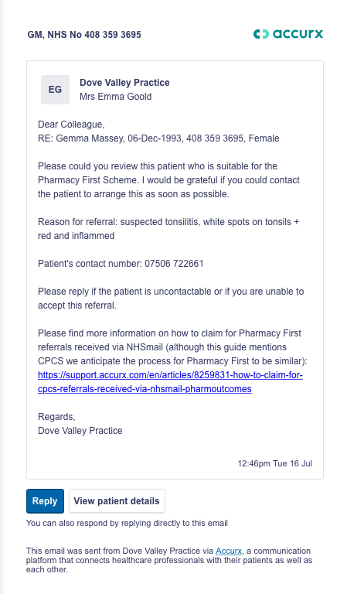
Accurx Referrals
Patient Name
Date of Birth
NHS Number
Contact Number

Slide 25
Updating the GP record
Community Pharmacy Working across layers of scale
Notes:
Self Referral -

Slide 26
Benefits
Community Pharmacy Working across layers of scale
To Note:
Update Record will not be used to communicate urgent information (eg safeguarding) or actions for the GP – usual channels of communication will be used
Currently documents cannot be attached to messages – ABPM reports will come by email
Notes:
Self Referral -

Slide 27
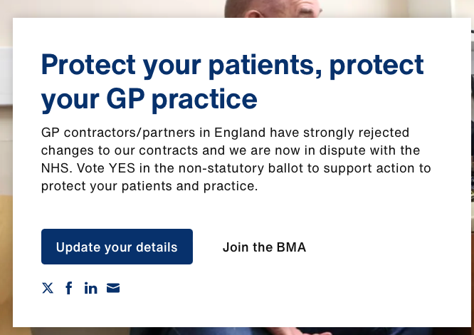
GP Ballot 2024
Switch off GP Connect functionality to permit the entry of coding into the GP clinical record by third-party providers.
Community Pharmacy Working across layers of scale
https://www.bma.org.uk/our-campaigns/gp-campaigns/contracts/gp-contract-202425-changes

Slide 28
Patient Safety Issues
Clinical information on advance services not received in a timely manner
Pharmacy fail to send information to surgery
Surgery do not process information
This may apply to:
Hypertension
Contraception
Pharmacy First Urgent Supply
Pharmacy First Minor Ailments
Pharmacy First Clinical Pathway

Slide 30
Resources
southyorkshire.communitypharmacy.org.uk

