Slide 1
Gynaecology - it’s all about women
Gianina Tutoveanu 17/07/24

Slide 2
Objectives
Gianina Tutoveanu 17/07/24
Menstrual cycle
Abnormal vaginal bleeding
Bleeding on HRT
Endometriosis

Slide 3
References
Gianina Tutoveanu 17/07/24
NICE guidelines (endometriosis/abnormal bleeding)
The Obstetrician and Gynaecologist (TOG)
British Menopausal Society (BMS) - Unscheduled bleeding on HRT guidelines
The European Society of Human Reproduction and Embryology (ESHRE) - endometriosis
RCOG Greentop guidelines

Slide 4
What is the menstrual cycle
Gianina Tutoveanu 17/07/24
A series of physiological changes that occur in women on a monthly basis.
Production of an egg and thickening of the endometrium to allow implantation, should fertilisation occur.
Complex interaction of the hypothalamus, pituitary and ovaries - HYPOTHALAMIC-PITUITARY-GONADAL AXIS.

Slide 5
The Hypothalamic – Pituitary - Gonadal axis
Hypothalamus -> GnRH
Anterior pituitary gland
FSH
LH
Ovaries
Negative feedback to hypothalamus
GNRH production is reduced
FSH/LH production is reduced
If the egg is fertilised
GNRH/FSH/LH will remain inhibited
Menstruation stops
Oestrogens and inhibin are produced
FSH stimulates the ovarian follicles production
Graafian (dominant) follicle- the most sensitive to FSH
LH promotes the Graafian follicle to change to corpus luteum - >progesterone
Progesterone stimulates the endometrium to become receptive to the fertilised egg implantation

Slide 6
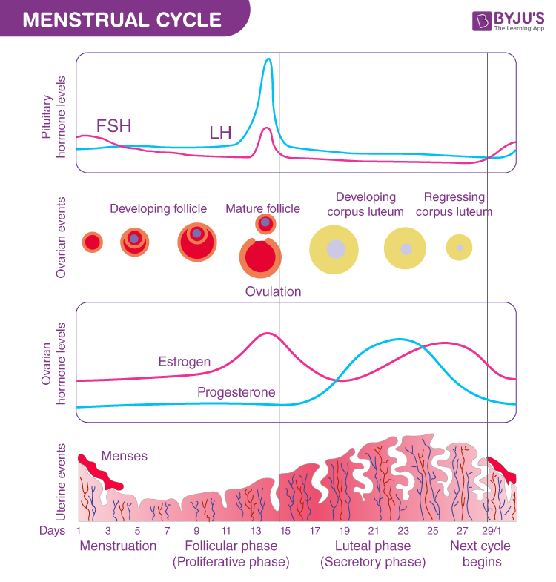
Menstrual cycle - follicular phase
Gianina Tutoveanu 17/07/24
FSH levels rise.
The fully mature follicle (Graafian follicle) produces oestrogens.
Oestrogens inhibits the growth of other follicles.
Oestrogens surge results in endometrial thickening, LH inhibition and cervical mucus thinning.
LH surge (day 12) is triggered by high levels of oestrogens.
High levels of LH stimulate the Graafian follicle membrane to break and release the egg (in 24-48h).

Slide 7
Menstrual cycle- luteal phase
Gianina Tutoveanu 17/07/24
The Graafian follicle changes to the corpus luteum (FSH/LH controlled).
The corpus luteum secretes Progesterone.
Endometrium becomes receptive to implantation.
Negative feedback causing decreased FSH/LH.
Corpus luteum degenerates and the Progesterone levels fall.
The drop in Progesterone triggers menstruation.

Slide 8
If fertilisation occurs
Gianina Tutoveanu 17/07/24
The fertilised egg starts producing HCG.
HCG prevents the degeneration of the corpus luteum.
Progesterone secretion is maintained.
Menstruation is prevented.
The placenta will take over at 8 weeks.

Slide 9
Practical aspects
Gianina Tutoveanu 17/07/24
The contraceptive pills have a negative feedback on the hypothalamus-pituitary-ovarian axis.
The progesterone inhibits the GNRH pulsatility, hence the LH surge.
GnRH analogues (used for treatment of endometriosis) inhibit the pituitary receptors, hence the production of FSH/LH.
Ovulatory disorders
GnRh agonists
X
Pituitary release of FSH/LH
Progesterone
X
GNRH pulsatility
X
FSH/LH surge
Type I - Hypothalamic/pituitary failure
Hypogonadotropic hypogonadism -low FSH/LH, low oestrogens
Type II - Hypothalamic/pituitary dysfunction (PCOS)
FSH/LH dysfunction, normal oestrogens
Type III - Ovarian failure
High FSH/LH, low oestrogens

Slide 10
Any questions?

Slide 11
Abnormal vaginal bleeding
Gianina Tutoveanu 17/07/24
Premenopausal/Postmenopausal
Menorrhagia
Postcoital bleeding
Irregular bleeding

Slide 12
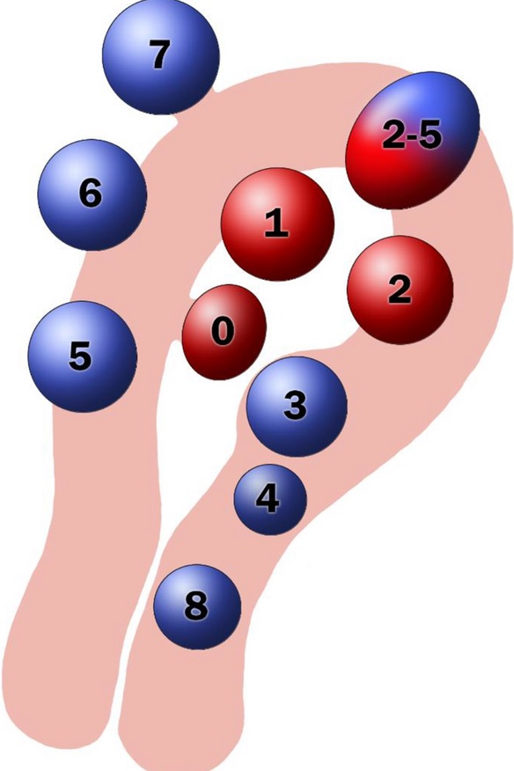
Let's talk about fibroids
30% incidence rate
More common in black women
Commonest benign tumor in women
Symptoms depend on the location and the size of the fibroid
Symptoms: heavy bleeding, dysmenorrhoea, pressure symptoms
FIGO classification: grade 0-8
Investigations: USS or MRI
Treatment: depending on the severity of the symptoms, fertility , position of the fibroid, woman’s choice

Slide 13
Fibroids - treatment
Gianina Tutoveanu 17/07/24
Pharmacological
Non-hormonal: TXA/NSAIDS/Ulipristal acetate *(Esmya)
Hormonal: Mirena IUS/COCP/POP
GnRH analogues
Surgical
Hysteroscopic resection
Endometrial ablation
Myomectomy
Hysterectomy
Uterine artery embolisation

Slide 14
Postmenopausal bleeding
28 days target diagnosis
2ww referral/investigations/diagnosis
PMB
USS
Endometrial biopsy if ET 4mm or more
Vaginal/speculum examination if ET <4mm
Reassure &discharge if
USS and examination are normal
Endometrial biopsy is Normal and no further symptoms
Treatment
Depends on the pathology
Polypectomy
Mirena coil if indicated
Hysterectomy: cancer/hyperplasia /recurrent PMB
Offer further investigations (hysteroscopy) if
Endometrial polyp suspected on USS
Recurrent symptoms
Women on tamoxifen

Slide 15
PMB on HRT
Gianina Tutoveanu 17/07/24
Increased number of women on HRT
HRT does not increase the risk of cancer
Oral preparations/Mirena IUS reduce the risk of bleeding
Transdermal HRT has less overall risk, but increased risk of bleeding
https://thebms.org.uk/wp-content/uploads/2024/06/01-BMS-GUIDELINE-Management-of-unscheduled-bleeding-HRT-MAY2024-G.pdf

