Slide 1
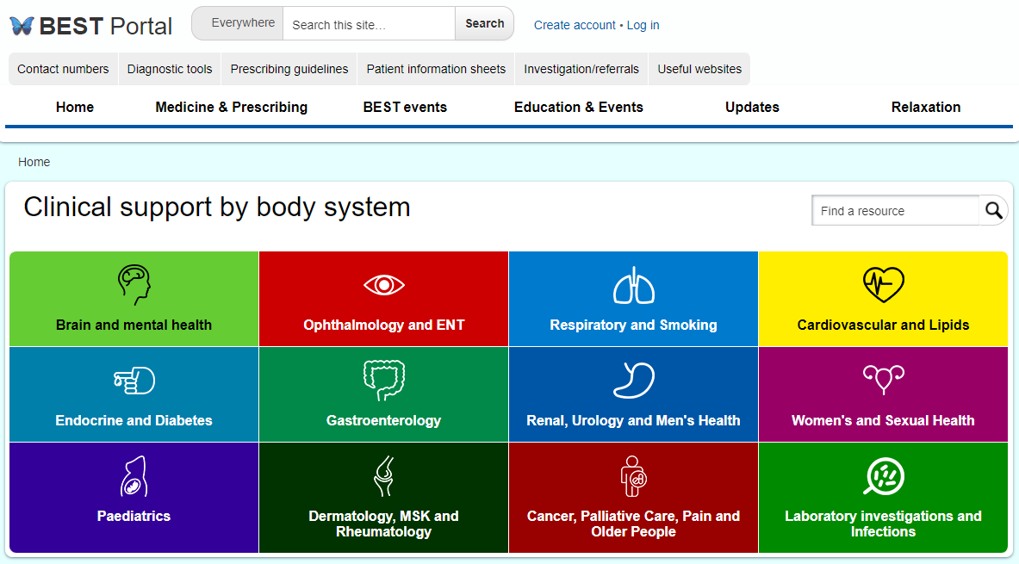
BEST Portal
best.barnsleyccg.nhs.uk
Notes:
I hope you’re all familiar with this screen.
As you can see the website is full of useful information to support you in your practice. ***********CLICK ********* For each body system there are the above corresponding sections supporting them.
Since the beginning of the year, Dr Atcha and I have been working with the Site Kit Team to develop a new editing platform to support the BEST Portal. I’m delighted to say this is now complete and due to go live on Monday! Link on this slide.
The content and functionality of the new website remains exactly the same for users. The main change is that each page has had to have a new IP address, which means any pages of the old website set as favourites of referenced elsewhere would need to be updated to the new site links.
*****CLICK*****

Slide 2
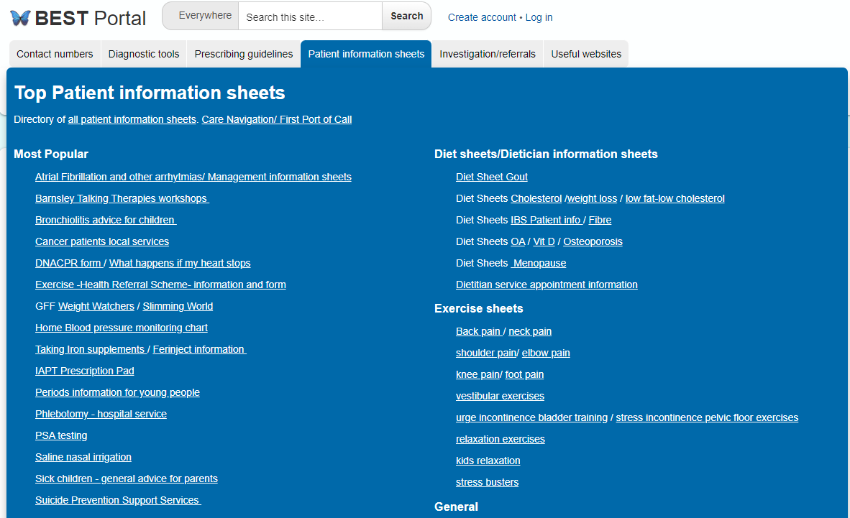
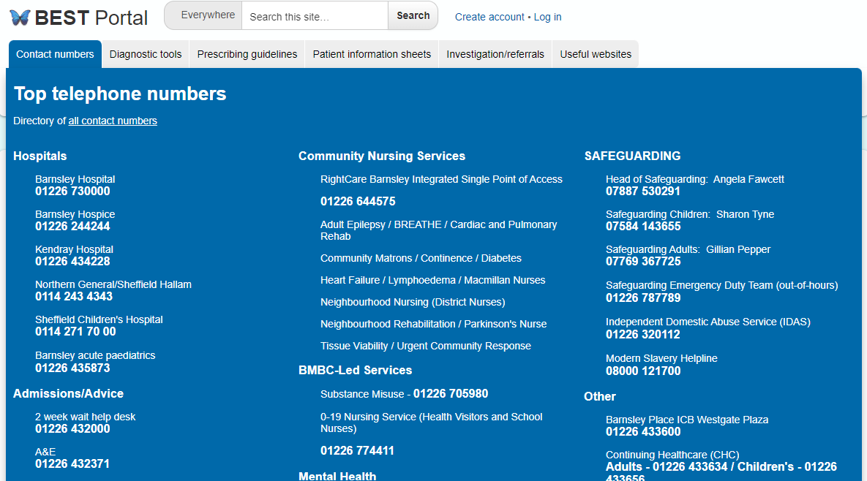
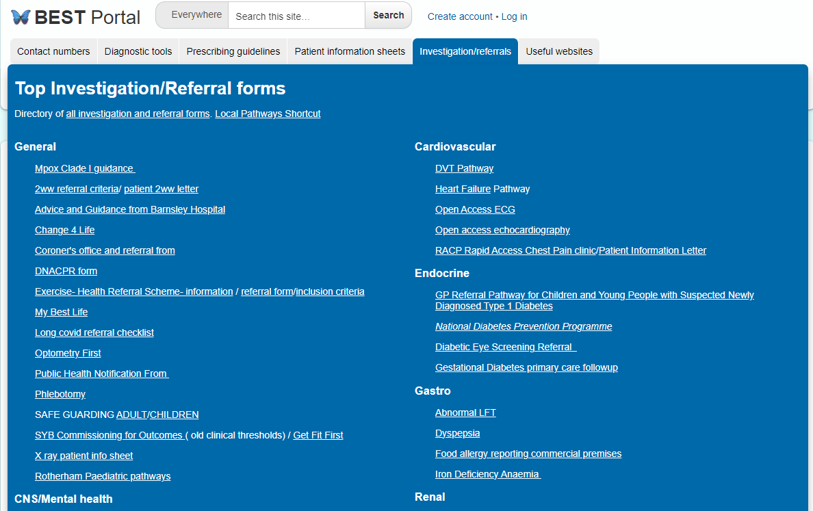
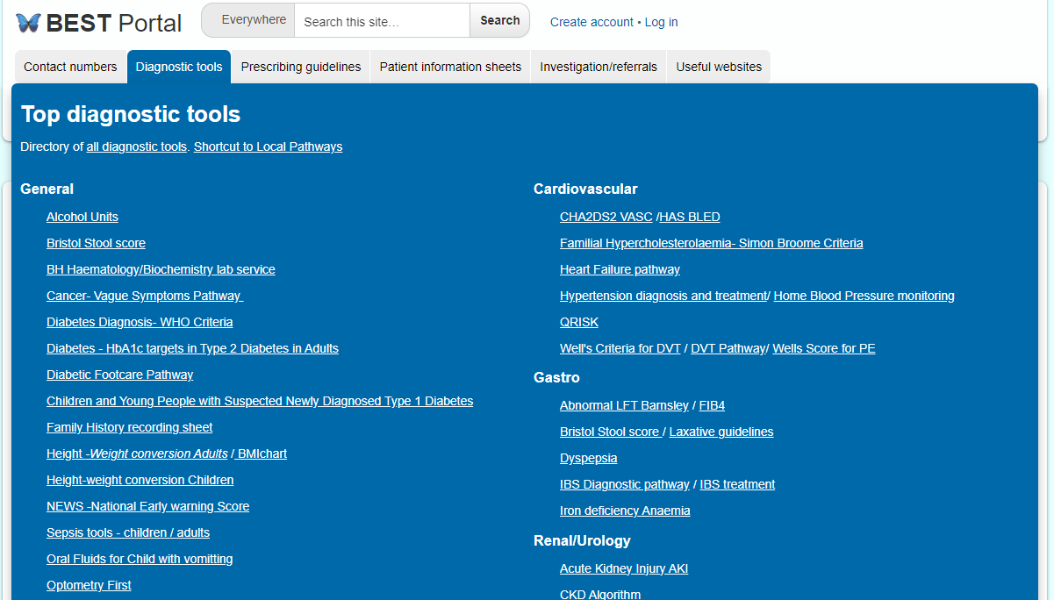
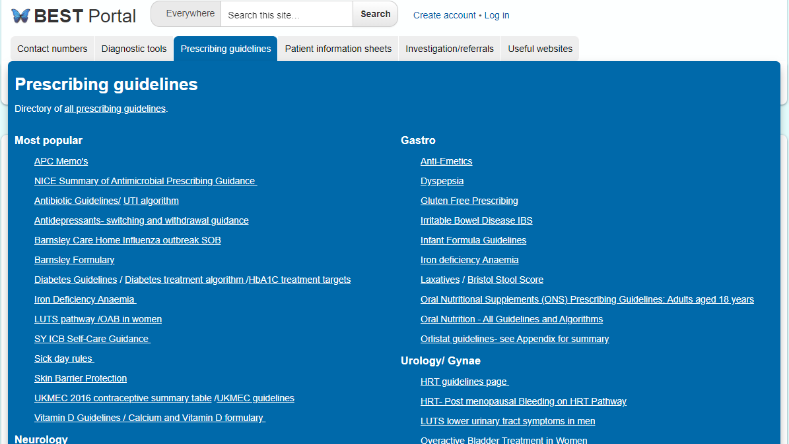
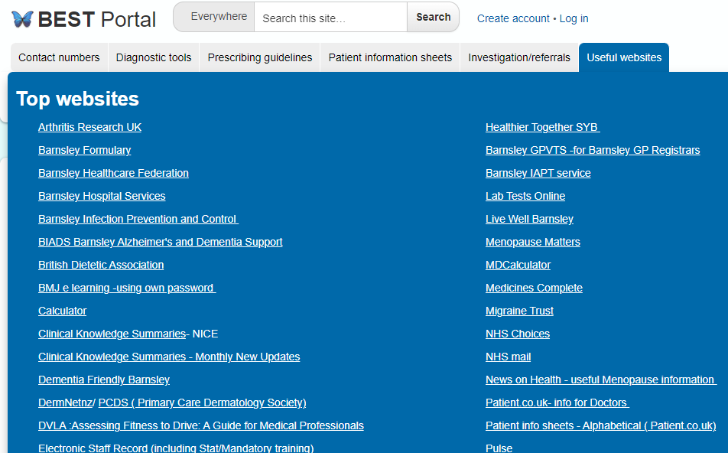
Accessibility
Notes:
*****CLICK***** For ease of finding the information you need, the website has these really useful ‘Top Tabs’ which links to the most frequently used Diagnostic Tools, Prescribing Guidelines etc… *****CLICK***** *****CLICK***** *****CLICK***** *****CLICK*****

Slide 3
Updates
BEST Events – presentations and videos
Referral criteria and investigation forms - 197
eBMJ courses
- 413
Patient information sheets
- 436
Diagnostic tools
- 100
National guidelines and pathways
- 145
Local pathways and guidelines
- 221
Useful websites
- 128
Services
- 243
Contact numbers
Prescribing Guidelines
- 142
Education and Events
News and Updates
Practice Nurses
Relaxation
Commissioning
Practice Information
Primary Care, Secondary Care and Social Care
Working and Appraisal
New Pathways
Asthma
LFTs
Heart Failure
CKD
Bleeding on HRT
Notes:
Dr Atcha and I have reviewed the whole website and updated the areas in green. Relevant updates have been listed under the ‘News’ and ‘Updates’ sections so please do review these areas from next week.
The peach areas are what I’m currently working on updating.
The Medicines Optimisation Team at the ICB manage the Medicines and Prescribing areas including Prescribing Guidelines, APC memos etc.
****CLICK****

Slide 4
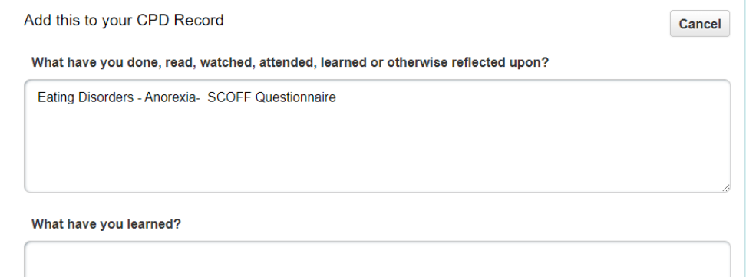
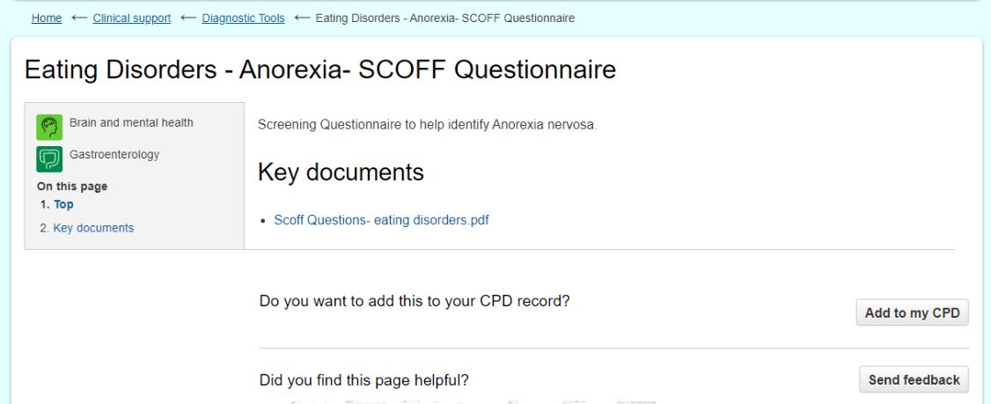
CPD
Notes:
As well as being used for clinical resources, the website can also be used to record your CPD – from accessing the clinical resources within the website to logging external CPD.
Some pages of the website can count towards your CPD. *******CLICK******* For example Diagnostic Tools. You will see the option at the bottom of the page. *******CLICK****** You can then add more details as appropriate.
It is important the website is only open in one tab so it can record your CPD
*******CLICK*******

Slide 5
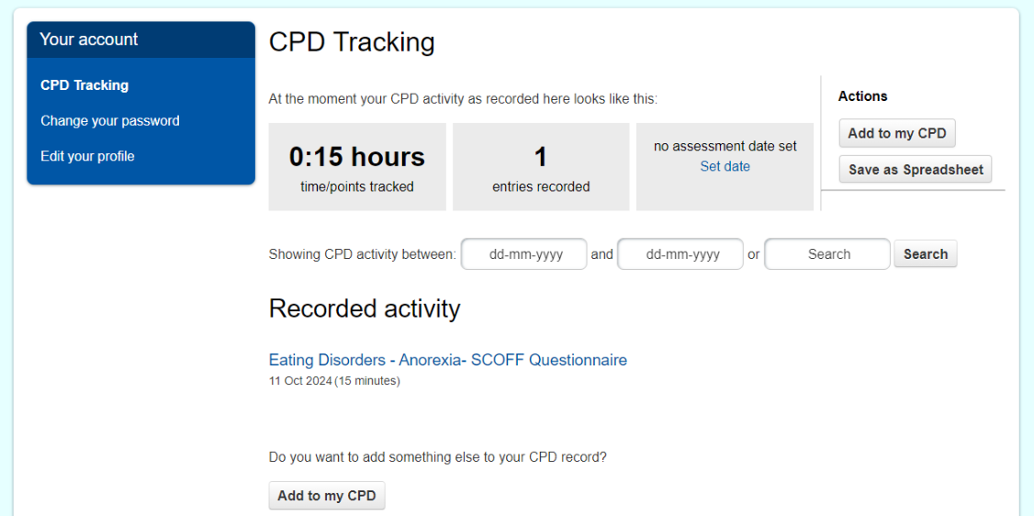
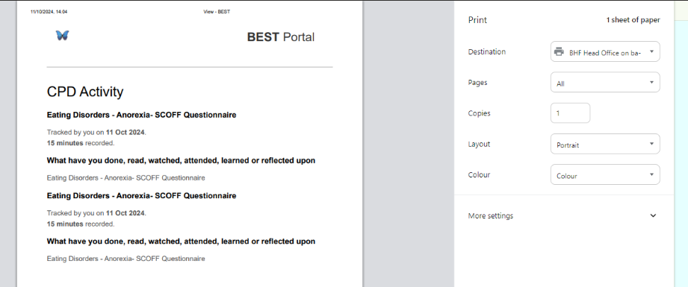
CPD
Notes:
This is the log in screen where you can access your CPD tracking. ******CLICK*****
Here you can record external CPD, see a list of your CPD, set your appraisal date and search by a date range or title. ******CLICK*****
You can see the details of each activity by clicking on the title ******CLICK***** Here you can edit, save or print as required.
*******CLICK*******

Slide 6
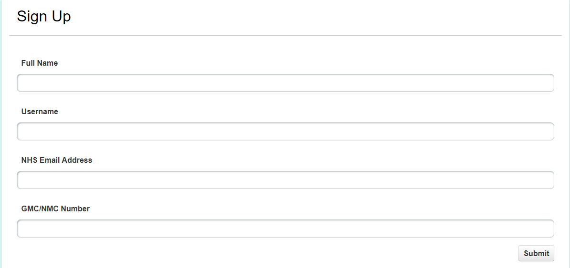
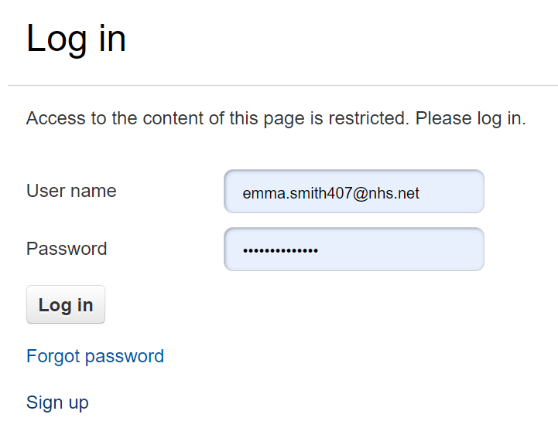
Creating an account
If already a member, select log in then ‘Forgot Password’
You will then receive an email with a new password
Notes:
*******CLICK*******
To create a new account, complete the requested fields as above. This will come to me for approval. Once I’ve checked your details, I will set you up a temporary password which I’ll email to you. When you first log, on it will prompt you to change it.
For those of you who have tried to register recently, please bear with me and I will set you up on the new system and send you details as soon as possible.
*******CLICK******* If you already have an account, you will need to select ‘Forgot Password’. You’ll then automatically receive an email with a new password.
The site doesn’t store passwords so these weren’t able to be transferred over.
*******CLICK*******

Slide 7
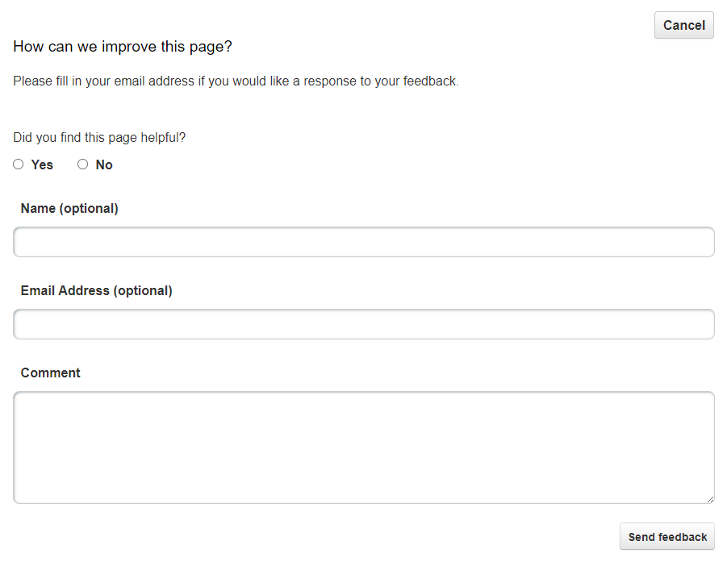
Support
Emma Smith
BEST Lead Administrator
emma.smith407@nhs.net
07897735549
Link to feedback form: here
Notes:
My contact details are on the slide. If anyone requires any further training, please do get in touch.
We are always keen to receive feedback from staff on how you use the site and what we can do to improve it. Above is the link to a Microsoft Form for feedback *******CLICK*******
Additionally, on the majority of pages, there is a ‘Send Feedback button’ which we receive and review.
Thank you for listening.
Dr Atcha and I are happy to answer any questions you may have.

