Slide 1
Cytosponge
By Stacey Oliver

Slide 2
What is Cytosponge
It is known a ‘Sponge on a string’ pill test.
Cytosponge consists of a spherical sponge in a dissolvable capsule, which is attached to a thread.

Slide 3
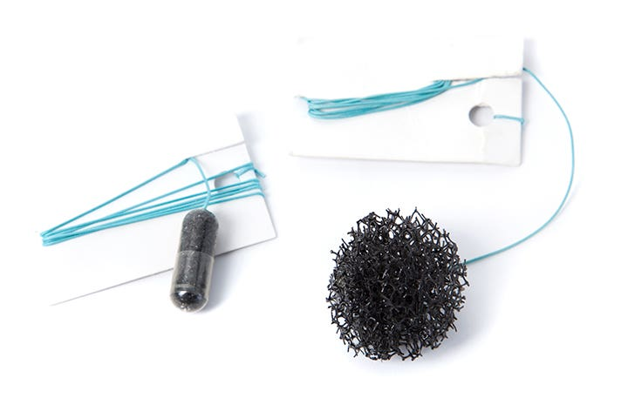
Cytosponge
The Cytosponge cell collection device is indicated for use in the collection and retrieval of surface cells in the Oesophagus for histological analyses.
Cytosponge IFU

Slide 4
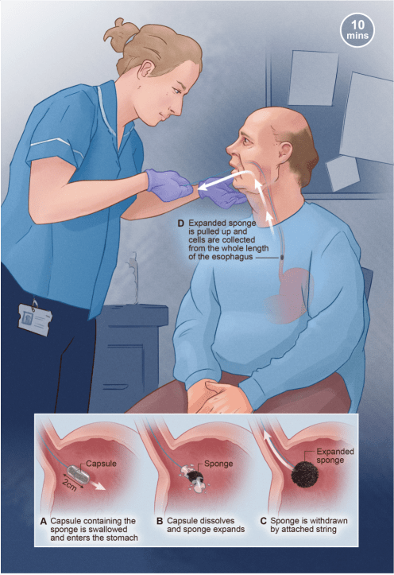
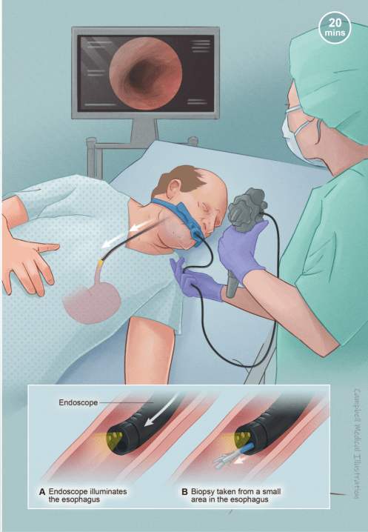

Slide 5
Indication for Cytosponge
Patient Group
Barrett’s surveillance
Reflux

Slide 6
When was Cytosponge introduced?
Cytosponge was introduced during the Covid 19 pandemic.
NHS England Trials carried – to help reduce capacity within endoscopy department. This will minimise the number of upper GI endoscopy procedures required for those at low risk for which endoscopy can be delayed or in some cases avoided. (These slots can be utilised for other patient’s in more urgent need)
Detection of early cancers

Slide 7
Development of the service
The cytosponge service will run along side the capsule endoscopy service, providing minimally invasive procedures to patient’s.
The patient’s will be vetted by the CNS to ensure Cytosponge is a appropriate investigation
A pre procedure telephone consultation will be offered to discuss cytosponge as a alternative investigation
The clinics will be nurse led and over seen by a Gastroenterology Consultant.
The service will be run from the CDC as a diagnostic alternative to OGD for appropriate patient’s
Pathological assessments of the cytosponge samples will be carried out centrally by the company Cyted. The cost of the procedure and pathological assessment per patient is approx. £ 270

Slide 8
Continue
Results will be analysed by the Gastroenterology consultant or the CNS
A Results clinic appointment will be given to patient’s and they will be informed of any further follow up plan.
Alternate Sponge then OGD will be the surveillance pathway to ensure safety netting.

Slide 9
Who Can refer?
Secondary care
Primary care can refer for consideration for Cytosponge
(This may change as research evolves)

Slide 10
Clinical Evidence
The Cytosponge test is well-tolerated with high specificity (92%) and sensitivity (80%, higher for clinically significant findings) Kadri et al. 2010, Ross-Innes et al. 2015
American College of Gastroenterologists states, “…a swallowable, non endoscopic capsule sponge device combined with a biomarker is an acceptable alternative to endoscopy for screening for BE in those with chronic reflux symptoms and other risk factors ”
Shaheen et al 2022 Cytosponge Real World Data Endoscopy Bottlenec
The Cytosponge can be used as a triage tool for endoscopy to identify people at risk of oesophageal cancer NICE MedTech Innovation Briefing 2020

Slide 11
Current Guidelines and recommendations
Cytosponge has recently been endorsed by the American and European gastroenterological guidelines. (Currently reviewing BSG and NICE guidance following recent trials)

Slide 12
Benefits
Nurse led service 1 nurse in a clinic setting
Minimally invasive for patient’s
Service provided from the CDC
Releasing endoscopy slots to be utilised for patients on other upper GI pathways
Reducing endoscopy waiting lists.
More environmentally friendly

