Slide 1
Chronic Kidney Disease Updates
Dr Shailesh Agarwal
Specialist Registrar in Renal Medicine
Sheffield Teaching Hospitals

Slide 2
Agenda
KFRE
SGLT2i
Finerenone
CKD Cases

Slide 3
Kidney Failure Risk Equation (KFRE)

Slide 4
Kidney Failure Risk Equation (KFRE) – What is it?
Risk Prediction Model
First outlined by Tangri et al in 2011
Ideal model: accurate, easy-to-implement, highly generalizable
Relies solely on info available to lab

Slide 5
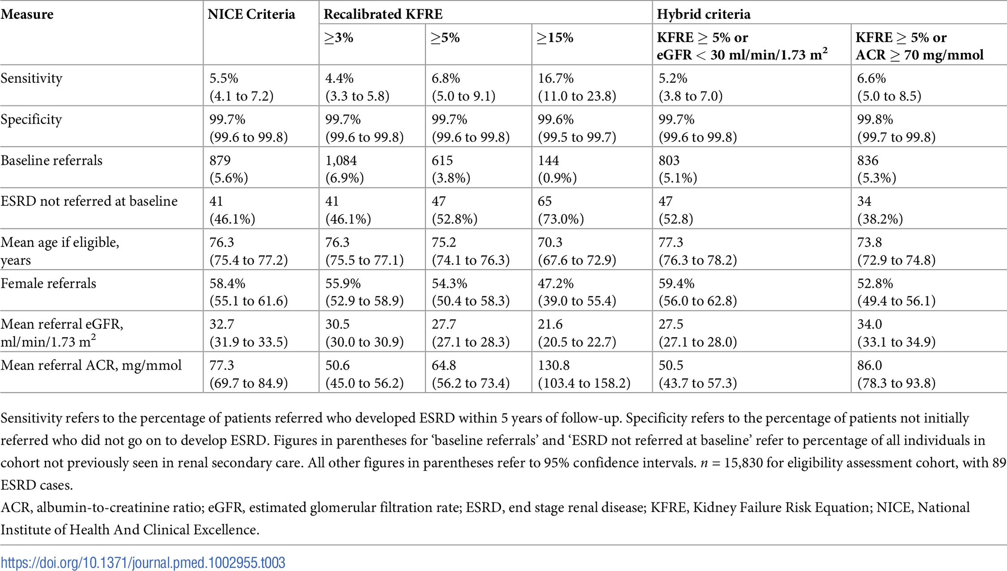
Why KFRE?

Slide 6
Nice Guidance

Slide 7
How to KFRE?

Slide 8
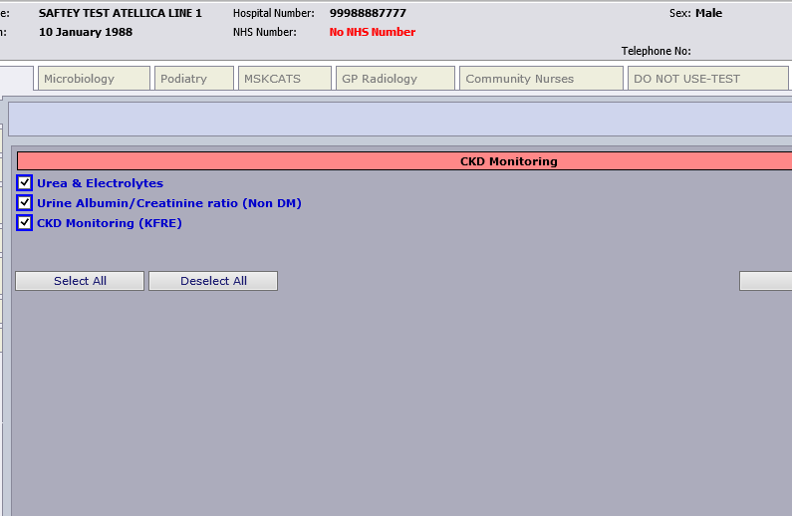
How to KFRE?

Slide 9
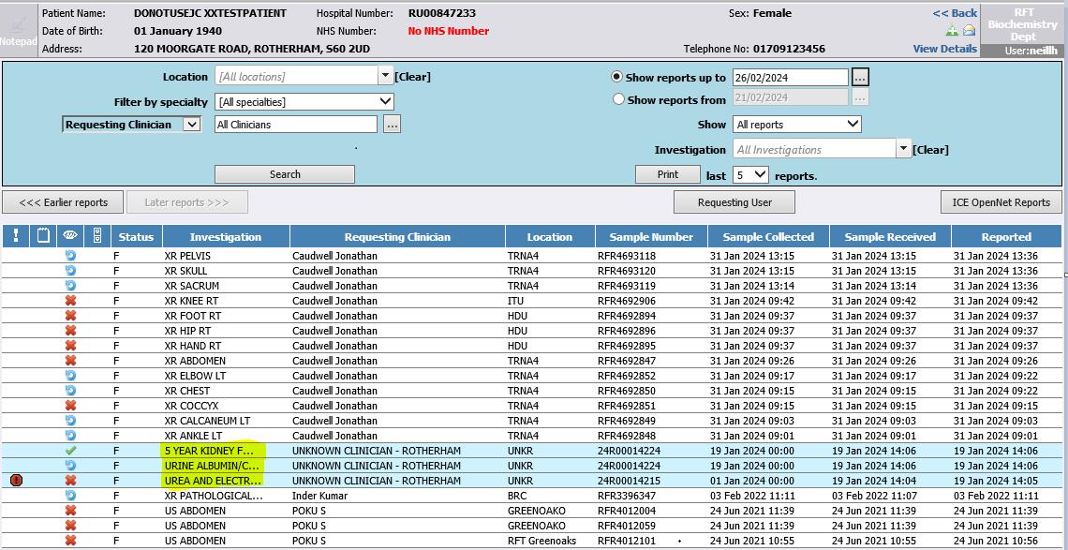
How to KFRE?
Note from labs:
Do not request U&E and uACR separately – won’t calculate KFRE
If you request CKD monitoring and send both samples within 30 days of each other, a KFRE will be calculated (must be SAME request)

Slide 10
KFRE – Take home points
KFRE is a validated tool to quantify risk of needing kidney replacement over 5 years
It will only be reported if eGFR < 60ml/min
NICE guidelines now advise referral for anyone with KFRE >5% rather than all patients with eGFR < 30ml/min
It does NOT account for competing risk of death – therefore in elderly, comorbid patients where risk of death from other cause is higher, it may be reasonable to use advice and guidance first

Slide 11
SGLT2i
Empagliflozin and Dapagliflozin

Slide 12
Dapagliflozin outcomes
Heerspink HJL et al. Dapaglifozin in CKD. N Engl J Med 2020;383:1436-46.

Slide 13
Empagliflozin outcomes

Slide 14
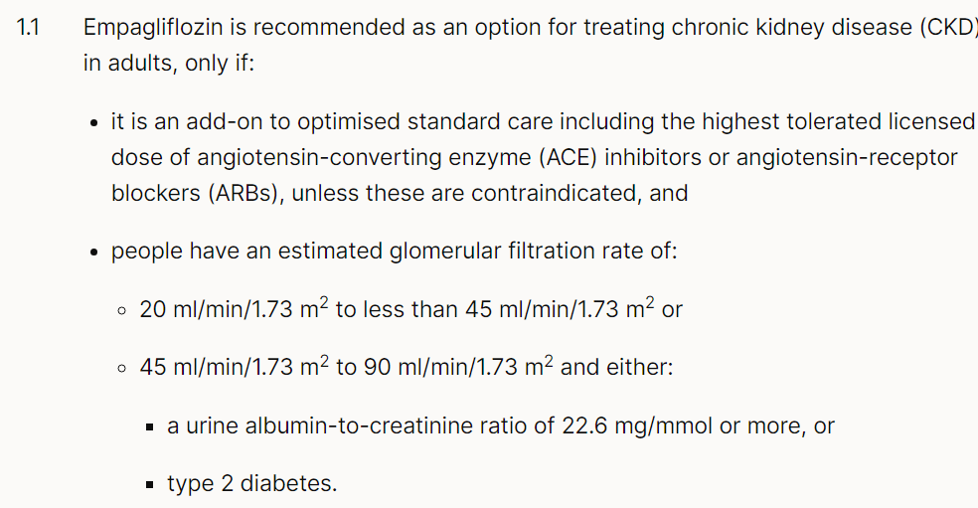
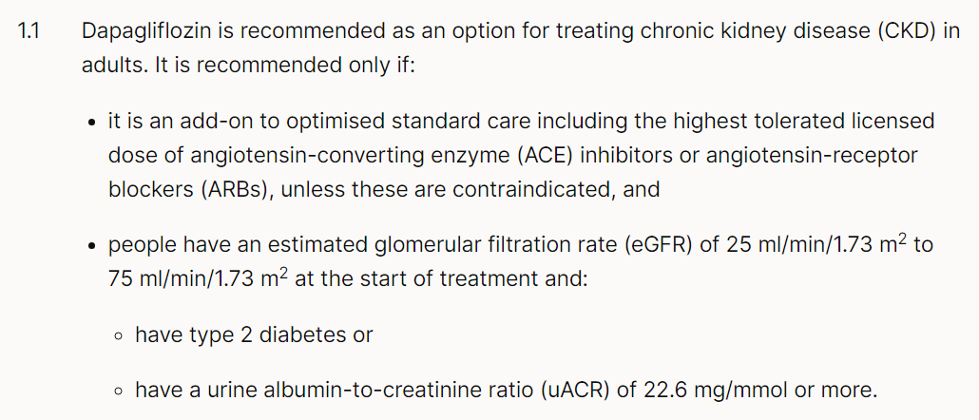
NICE SGLT2i

Slide 15
SGLT2i Summary
Credit: Dr Matthew Gittus

Slide 16
Finerenone
The New Kid on the Block

Slide 17
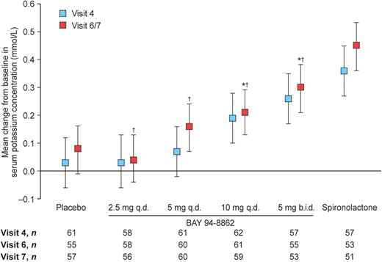
What is it?
Non-steroidal MRA
Main concern with steroidal MRA is hyperkalaemia
Finerenone more potently blocks MR than spironolactone and eplerenone
For the same benefit in reducing BNP, albuminuria, causes lower incidence of hyperkalaemia
Pitt, B., Kober, L., Ponikowski, P., Gheorghiade, M., Filippatos, G., Krum, H., Nowack, C., Kolkhof, P., Kim, S. Y., & Zannad, F. (2013). Safety and tolerability of the novel non-steroidal mineralocorticoid receptor antagonist BAY 94-8862 in patients with chronic heart failure and mild or moderate chronic kidney disease: a randomized, double-blind trial. European Heart Journal, 34(31), 2453–2463. https://doi.org/10.1093/EURHEARTJ/EHT187
Kolkhof, P., & Bärfacker, L. (2017). 30 YEARS OF THE MINERALOCORTICOID RECEPTOR: Mineralocorticoid receptor antagonists: 60 years of research and development. Journal of Endocrinology, 234(1), T125–T140. https://doi.org/10.1530/JOE-16-0600

Slide 18
Finerenone outcomes

Slide 19
NICE Finerenone

Slide 20
BEST CKD Pathway
Credits: Dr Sabiha Atcha
Available via BEST website: https//best.barnsleyccg.nhs.uk

Slide 21
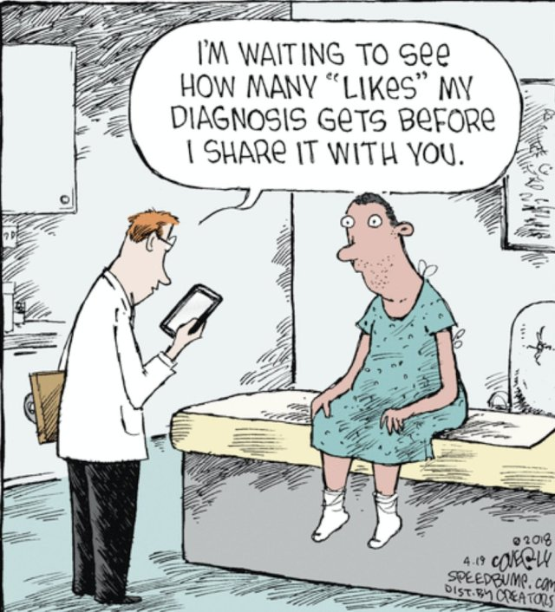
CKD Cases
A little bit of fun!

Slide 22
Case 1
85 year old Morgan Freeman
BG:
Obstructive Uropathy
Hypertension
LVSD – EF 30%
OA
Frail
Current eGFR 26ml/min

Slide 23
Case 1
Background of AKI in 2015 due to obstruction – had a TURP
Kidney function recovered to eGFR 28ml/min then
Hb 120
BP 126/70

Slide 24
Case 1
Prescribed drugs:
Bisoprolol 5mg OD
Ramipril 5mg OD
Atorvastatin 20mg OD
Aspirin 75mg OD
Tamsulosin 400 micrograms OD
Co-codamol 8/500 2 tabs QDS
Furosemide 40mg OD
No OTC NSAID use

Slide 25
Case 1
What next?
Urine dipstick: 1+ blood, –ve protein
Urine ACR: 1.4mg/mmol
US abdomen: 2 x 9.6cm kidneys, thin cortices, 2 simple cysts on right kidney, 1 on left. No ongoing obstruction

Slide 26
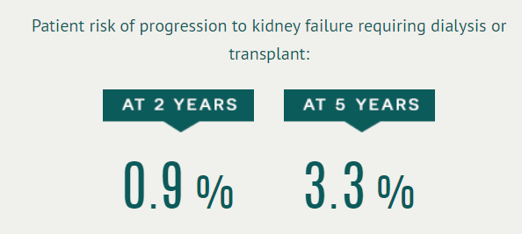
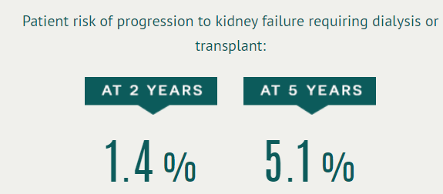
Case 1
Refer?
Remember ACR can vary with time – best to check early morning sample to minimise risk of dilute sample
Consider competing risks
If uACR 3.8mg/mmol

Slide 27
Case 2
36 year old Rebecca Ferguson
Type 2 diabetes
Laser treatment in right eye
eGFR 46ml/min
HbA1c 67mmol/mol (previously 70-80 for years)
BP 138/88

Slide 28
Case 2
Current medications:
Tresiba OD
Novorapid TDS
Metformin 1g BD
Ramipril 5mg OD
Amlodipine 10mg OD
Atorvastatin 20mg OD

Slide 29
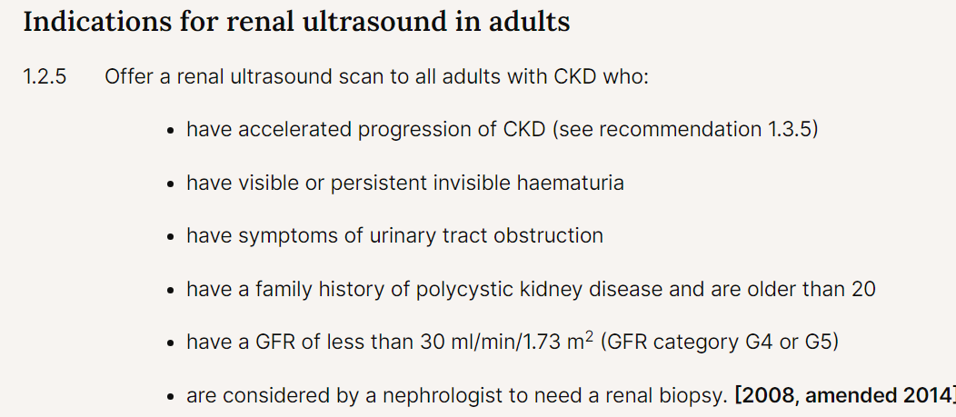
Case 2
What next?
ACR 158mg/mmol
No blood
Albumin 38
?Ultrasound

Slide 30
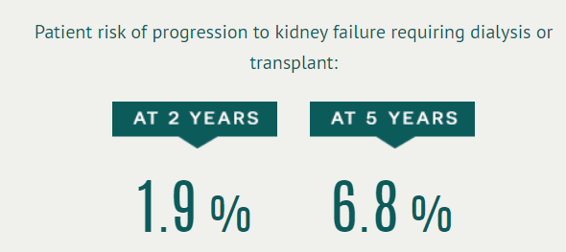
Case 2
Refer?
Things to do while waiting for appointment?
Maximise ACEi
Start SGLT2i while waiting for appointment
Be aware, both of these cause a slight decline in KF, but confer longer term reno-protection

Slide 31
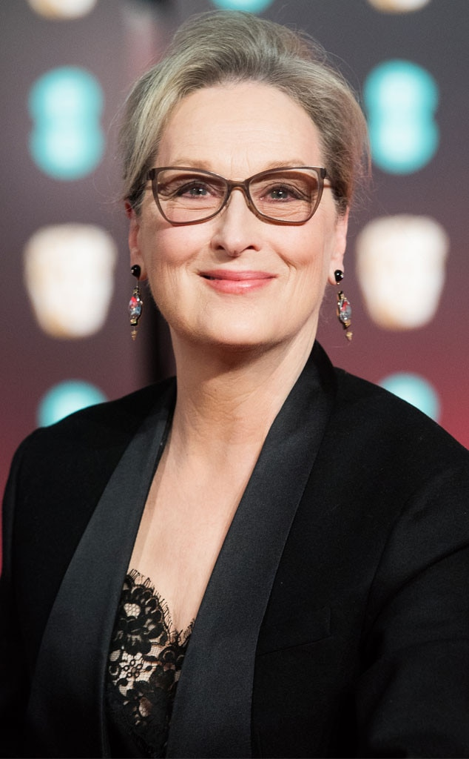
Case 3
74 year old Meryl Streep
BG:
Hypertension
Smoker
BMI 34
BP 158/92
eGFR 45ml/min (Creat 108umol/L)
2 years ago eGFR 55ml/min (Creat 92umol/L)

Slide 32
Case 3
Current medications:
Amlodipine 10mg OD
Bendroflumathiazide 2.5mg OD
Not taking NSAIDs

Slide 33
Case 3
What next?
Urine dipstick – Blood 2+ Protein 1+ Leuk 2+
Urine ACR – 20mg/mmol
MSU – negative
Ultrasound: Both kidneys 10.5cm

Slide 34
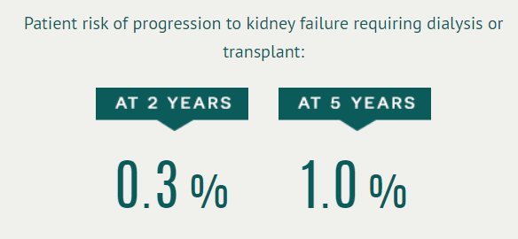
Case 3
Refer?
Repeat urine dip after 6 weeks:
Blood 1+ Protein 1+ Leuk 2+
Urine ACR 10mg/mmol
MSU –ve
Repeat urine dip after 6 more weeks
Bloods 2+ Protein 1+ Leuk 2+
Urine ACR 13mg/mmol
MSU -ve
UROLOGY!

Slide 35
Case 3
What else?
Lifestyle: Advise weight loss, exercise, stopping smoking
Start ACEi for BP management
Start atorvastatin 20mg OD
Consider Empagliflozin when eGFR <45ml/min

Slide 36
Chronic Kidney Disease. A life we didn’t choose but a life we deal with every day. Being poked and prodded, surgery, dialysis, transplant, all temporary ways to prolong a life…CKD a silent killer.
Anonymous

Slide 37
Thank you
Dr Shailesh Agarwal
Shailesh.agarwal1@nhs.net

