Slide 1
Abdominal Aortic Aneurysm (AAA) Screening Programme
Alex Brown – South Yorkshire and Bassetlaw AAA Screening Programme Manager

Slide 2
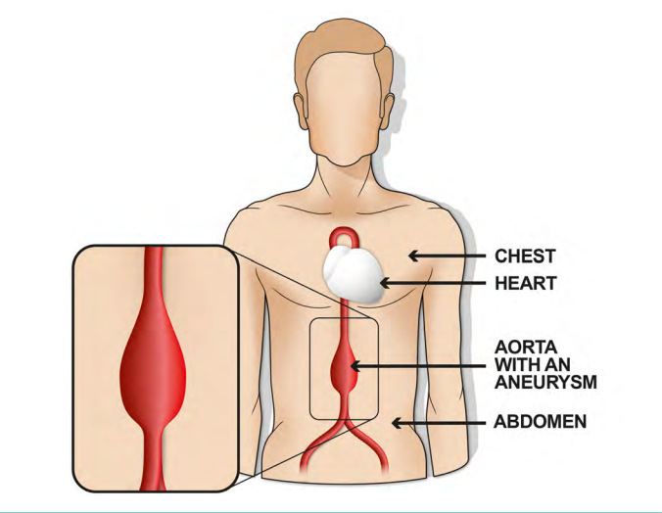
What is AAA?
Weakness in wall of aorta
Pressure of blood causes swelling or bulge
Generally occurs between renal arteries and bifurcation
Can be associated with thoracic aneurysm, particularly if supra-renal
Popliteal, femoral and/or iliac aneurysms may be present

Slide 3
AAA Symptoms
Usually asymptomatic
Slim patients may have prominent aortic pulse but not definitive
Symptoms of ruptured AAA
Tenderness to abdomen (over aorta)
Abdominal/lower back pain which may spread to groin/buttocks
Other symptoms include: dizziness, nausea, tachycardia, loss of consciousness
If any of the above symptoms are present in a patient with known AAA they should attend A&E immediately and inform them of suspected rupture

Slide 4
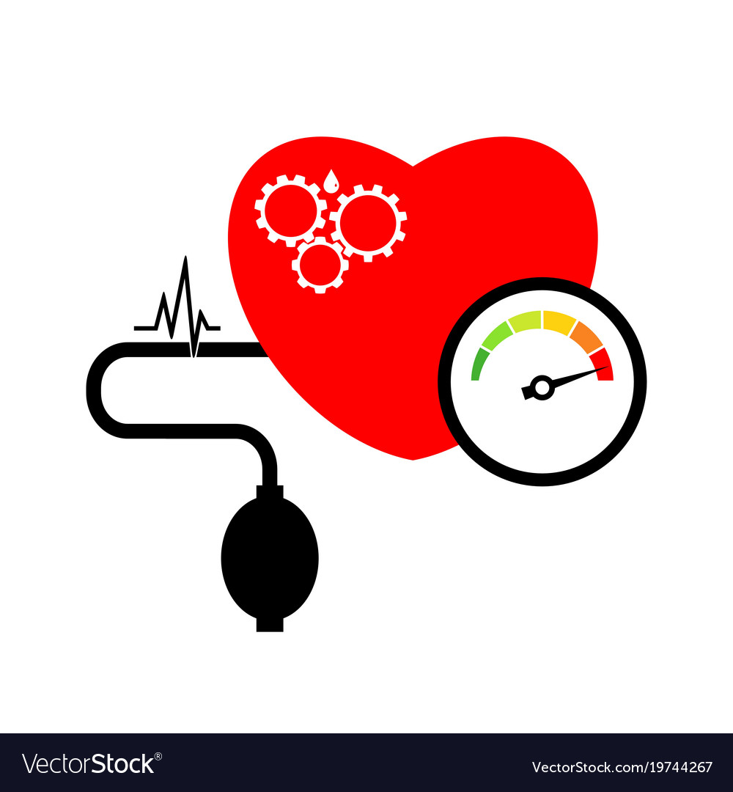
AAA Risk Factors
Male (as assigned at birth)
65 years or over
Smoker
High blood pressure and/or cholesterol
Family history
Genetic conditions e.g. Marfan syndrome
Can affect anyone
65+

Slide 5
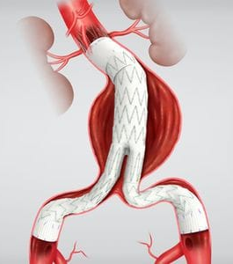
Treating AAA
Endovascular Aneurysm Repair (EVAR)
Open Repair
Conservative Management

Slide 6
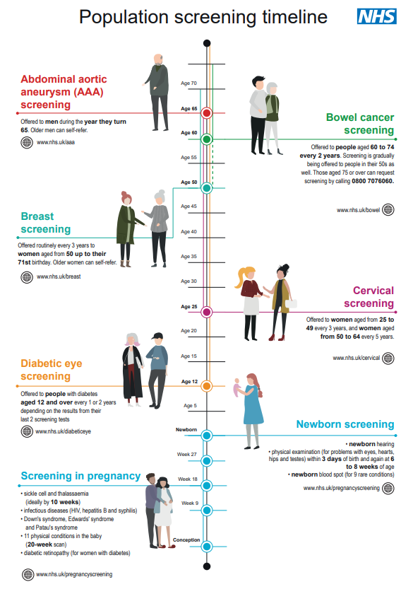
NHS Screening Timeline
Guidance also available for trans and non-binary people
AAA screening is single scan (if normal) and therefore new cohort each year

Slide 7
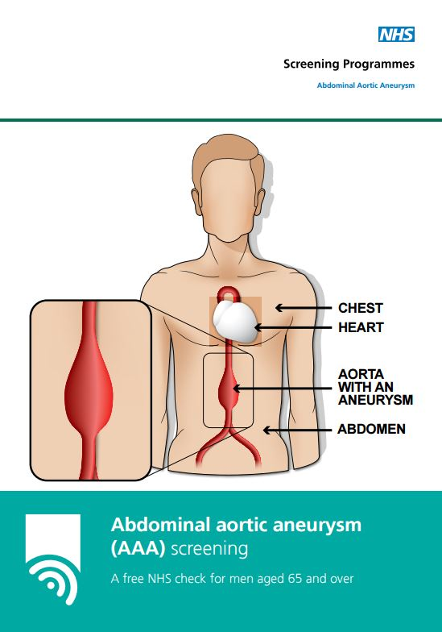
The AAA Screening Programme
Started in 2009 in some areas, began screening in 2013 in SYB
Screened around 83,000 men to date with 831 aneurysms detected (1%)
Uptake for 2023/24 cohort was 82.4% (based on Q4 figures)
Uptake in deprived areas was 76.8%
4.8% of men decline screening

Slide 8
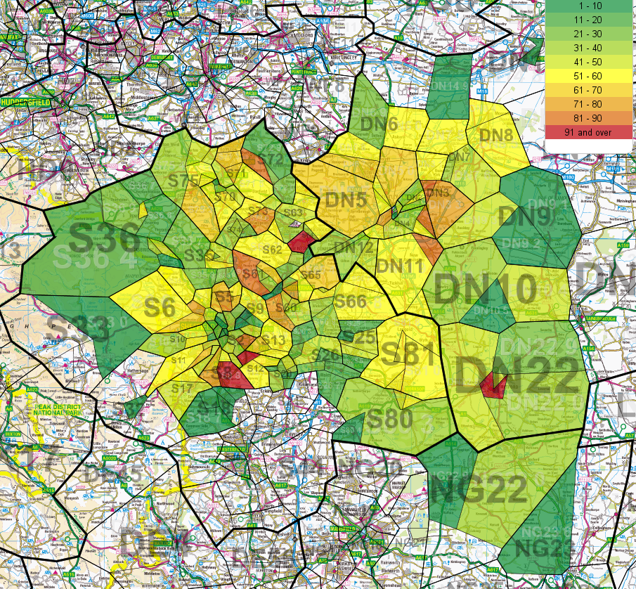
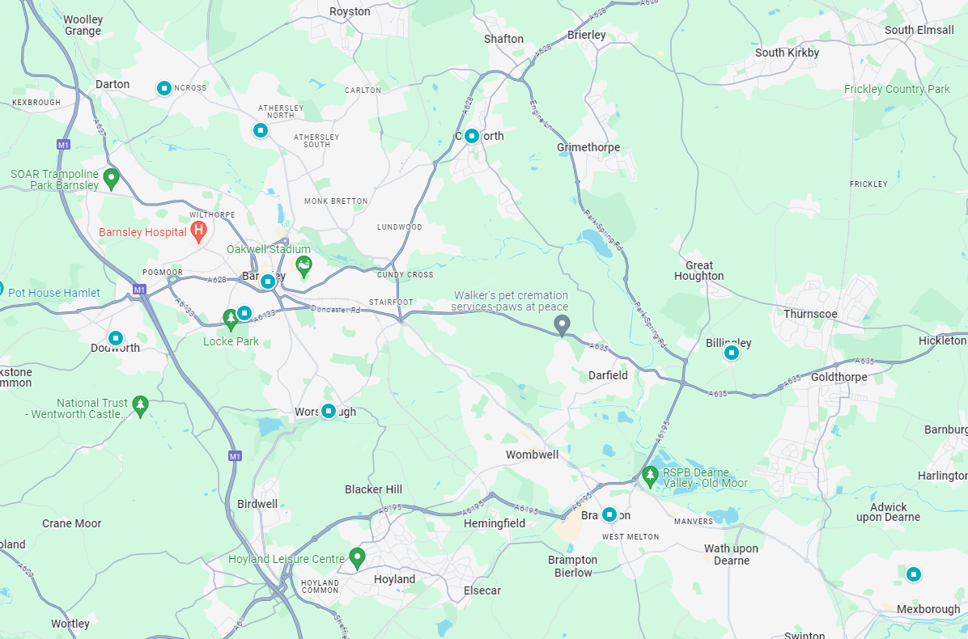
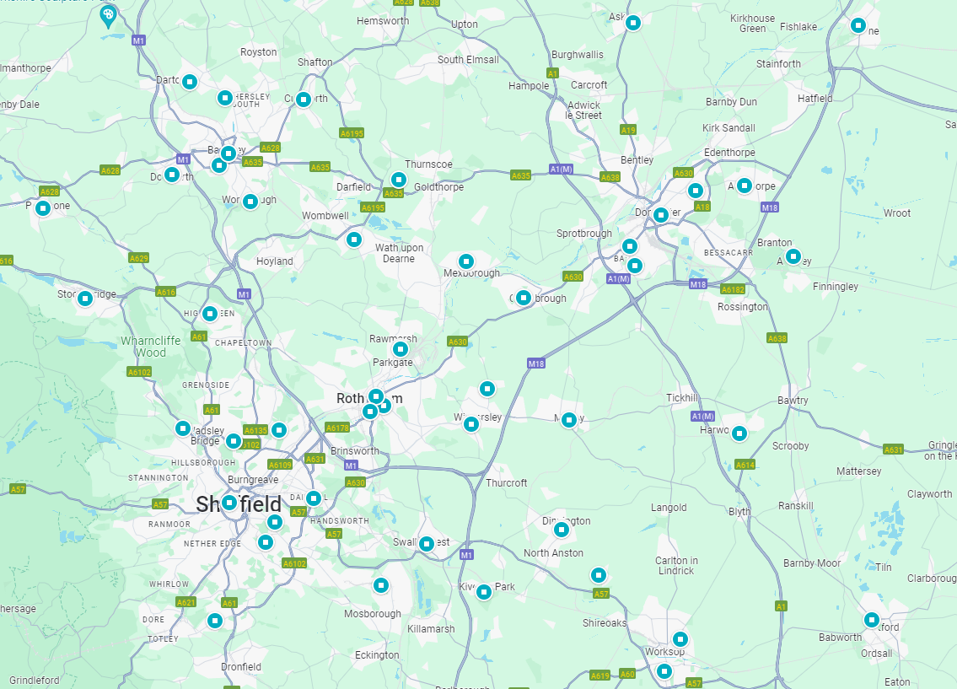
AAA Screening in SYB
Based at Montagu Hospital in Mexborough under DBTH
In SYB, screen 9,000 men annually across 45 sites including:
Medical Centres
Village Hall
Football Stadium
In Barnsley:
10 sites including Glass Works CDC
(Penistone not shown here)

Slide 9
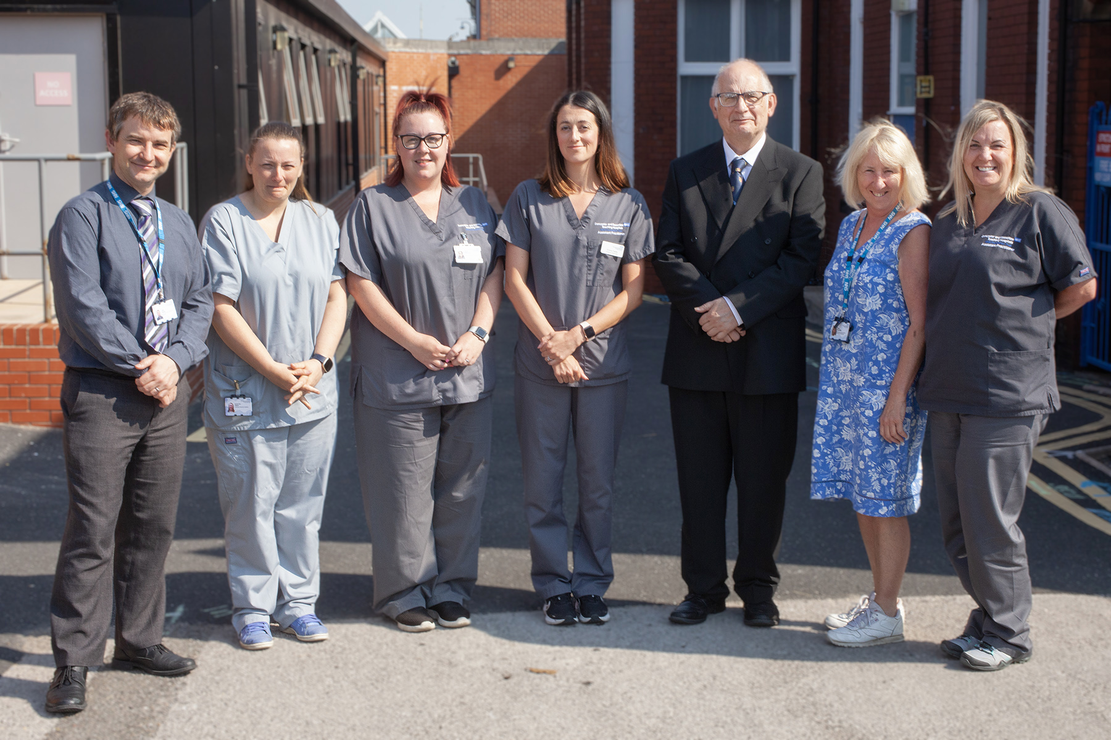
AAA Screening in SYB
Screening Programme team:
Programme Manager
Clinical Lead (Mr. Ray Cuschieri)
Nurse Practitioner (Paula Cairns)
Six screening technicians (4.0 WTE)
Screening Administrator
Overseen by NHSE Screening and Immunisations Team plus Commissioners
Screening Quality Assurance Service monitors activity, audits and responds to incidents

Slide 10
NAAASP Programme Standards
All screening programmes in England measured against 15 standards:
Cohort Initial Screen Uptake and Coverage (four standards)
Surveillance Screen Uptake and Coverage (six standards)
Image QA and Nurse Assessment (three standards)
Referrals (two standards)
RAG rating system for all programmes
SYB is high performing

Slide 11
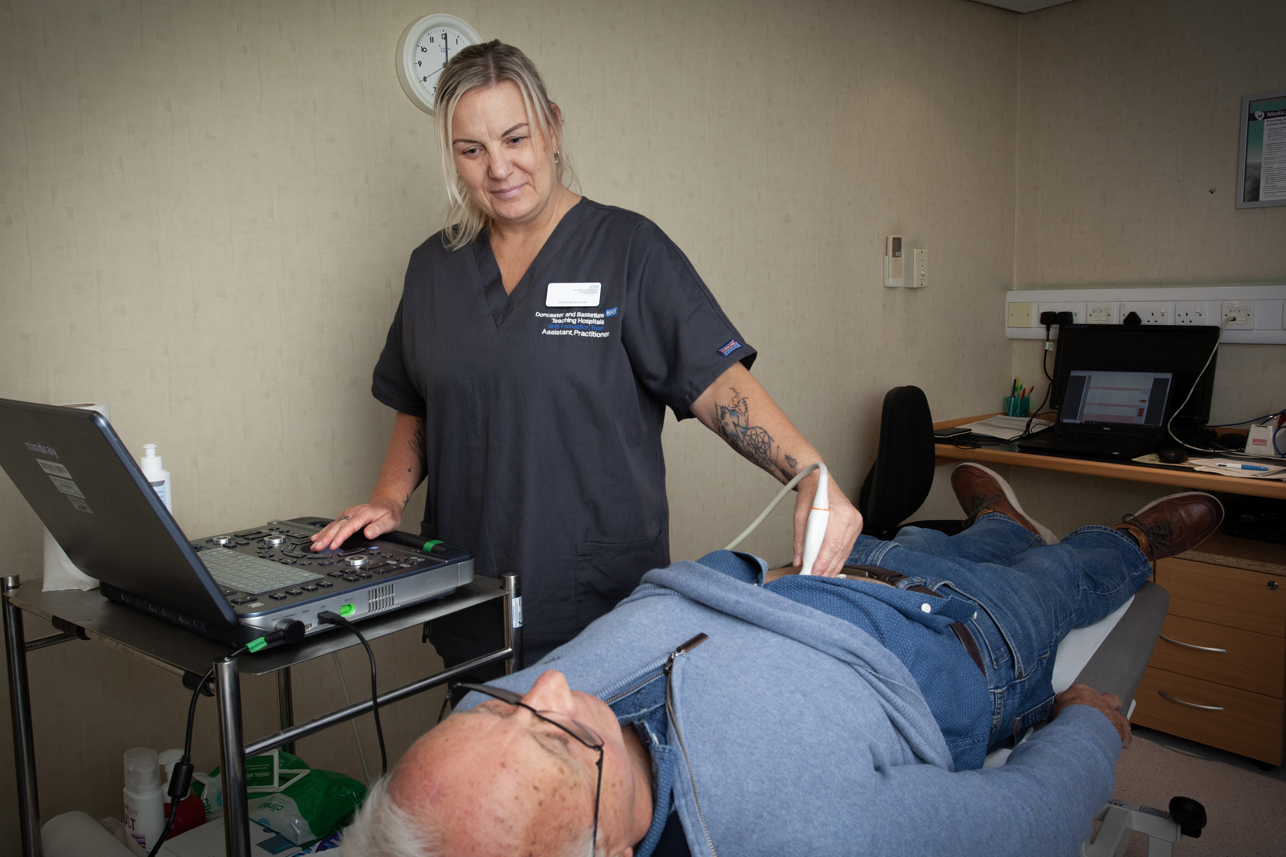
Screening Appointments
Provided with contact details via NHS Spine
Subjects invited to local clinic via letter
Reminder SMS messages at 10 and 2 days prior to appointment
Normally 10-15 minute appointment
Consent taken at time of appointment
Ultrasound scan performed
Results given on day
GP informed via letter

Slide 12
Self Referrals
Men who were 65 before the programme started may contact office for an appointment
Complete and return self-referral form
Process is otherwise the same
Quite common for men to not remember being screened
Debate around maximum age for screening

Slide 13
Screening Outcomes
Normal aorta of less than 3 cm diameter
Can have aneurysms below this threshold
Small aneurysm (3.0 cm to 4.4 cm) –> annual surveillance (and nurse assessment)
Medium aneurysm (4.5 cm to 5.4 cm) -> quarterly surveillance (nurse assessment at transition from annual)
Large aneurysm (5.5 cm and above) -> vascular referral (to be seen within 2 weeks)
Any aneurysm over 7 cm requires urgent referral via on-call vascular surgeon
>7cm = Urgent Referral
Large 5.5-6.9 cm = Referral
Medium 4.5-5.4 cm = Quarterly
Small 3-4.4 cm = Annual
Normal <3cm = Discharge

Slide 14
Nurse Assessments
Vascular Nurse Specialist employed by SYB AAASP
Men offered face-to-face or telephone appointment
Initial detection of aneurysm
Change from annual to quarterly surveillance
Review of current medication
Review of lifestyle e.g. smoking, diet, activity levels
Recommendations made to GP via letter

Slide 15
Managing Risk Factors in AAA Patients
Can help to slow growth of aneurysm by encouraging:
Smoking cessation
Increased activity levels – AAA Active or other community exercise groups
Improving diet
Statins
Antiplatelet therapy
Covered in nurse assessment but with support from GP

Slide 16
Psychological Impact of AAA
Delivering bad news
“Ticking time bomb”
Anxiety around surveillance appointments
Impact on lifestyle e.g. travel insurance, driving licence, etc.

Slide 17
The Role of Primary Care
Promotion
Discuss at NHS Health Check (now included on Ardens)
Can supply materials
Health Inequalities
Contacts in “hard to reach” groups
Provide list of LD flagged men to allow for reasonable adjustments
Highlight patients with male history
“Prehabilitation” and support

Slide 18
The Role of Primary Care (cont.)
Incidental Findings
Flagged to GP for further investigation
Results Recording
Coding advice to be provided soon
Best Interest Meetings
Monitoring for symptoms of rupture
Venues
Always looking to improve choice

Slide 19
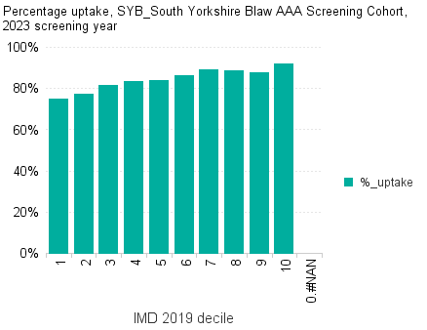
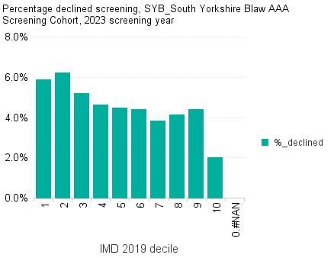
Deprivation and AAA

Slide 20
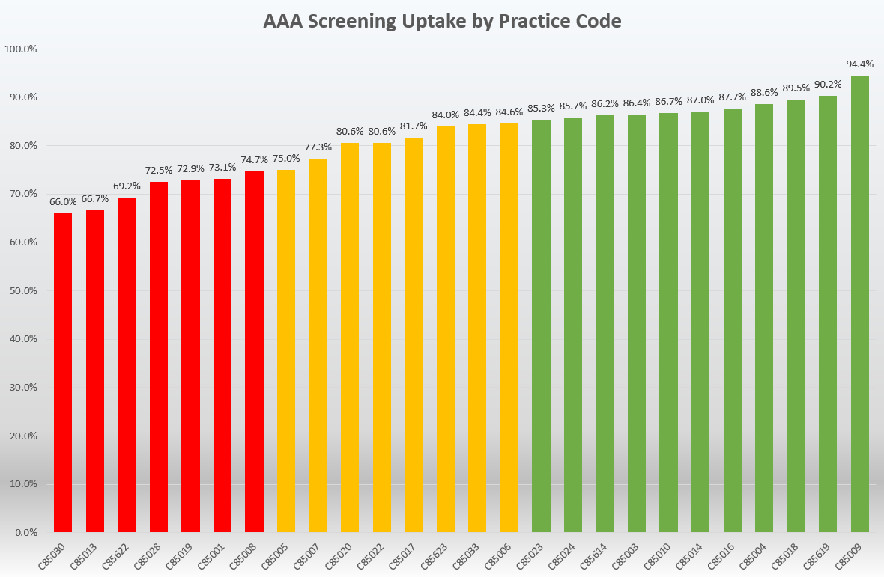
Uptake by GP Practice
Uptake = subjects attending / subjects invited
Targets are:
Acceptable = 75%
Achievable = 85%
Average across region = 79.5%
Programme would like to work with practices with < 75% uptake to improve this

Slide 21
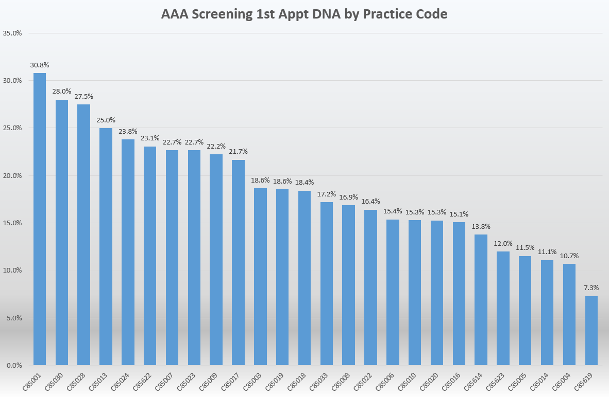
1st Appointment DNA by GP Practice

Slide 22
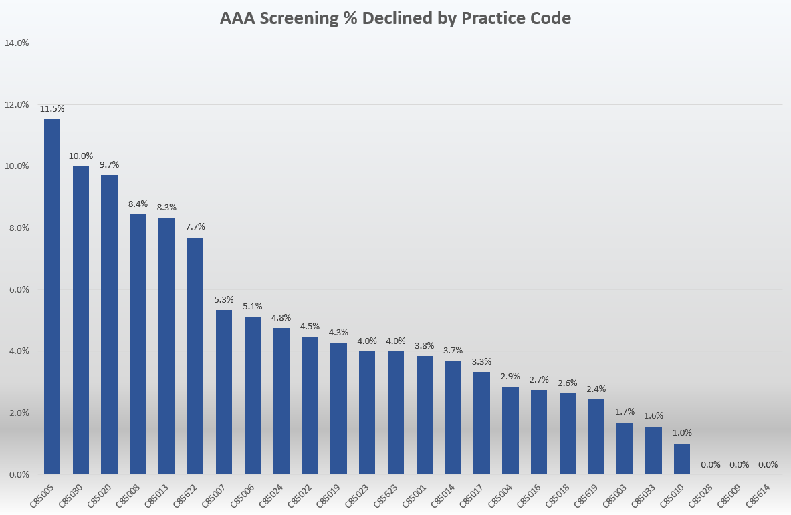
Percentage Declining Screening by GP

Slide 23
Thank you for listening
Any questions?

