Slide 1



Opioids (CROP)
Chris Lawson – Portfolio Director Meds Opt (Strategy & Delivery)
October 2024 Pharmacy BEST

Slide 2
Reducing opioid use in chronic non-cancer pain
For every 62 people with chronic pain prescribed opioids for longer than 90 days, one will die who would not have if the chronic pain had been managed with biopsychosocial interventions alone (Gomes et al, 2011), (Häuser et al, 2020).
For people prescribed opioids for chronic pain, 1 in 10 suffer moderate harm.

Slide 3
National MO Target Area
Pharmacological management of chronic non-cancer pain is associated with minimal benefits, and potential harm, when compared to effective biopsychosocial interventions.
SY MO Target Area
Reduce prescribing high dose (>120mg OME) CNCP by 50%

Slide 4
CROP (Campaign to Reduce Opiate Prescribing)
SY national opioid triangle (Guardian) – Barnsley second highest below Doncaster.
SYICS (Spring 2021) – ran for one year
Extracted anonymised data from GP systems and reports collated for practices for discussion/action
Report identified 8 cohorts of patients @ high risk (varying degrees) of risk for review
Practices had progress within reports highlighted

Slide 5
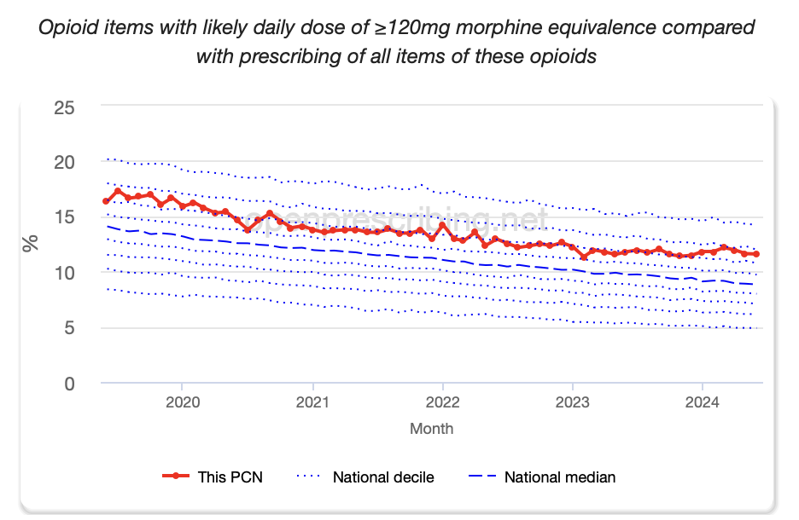

Slide 6
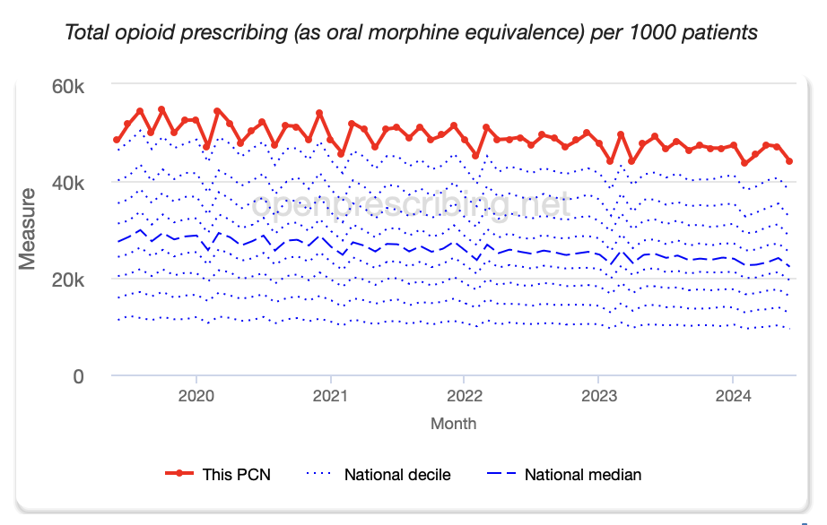

Slide 7
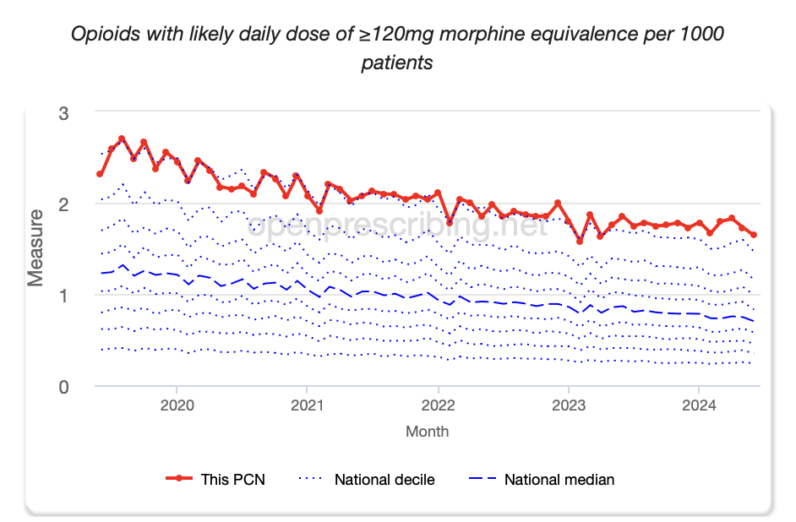

Slide 8
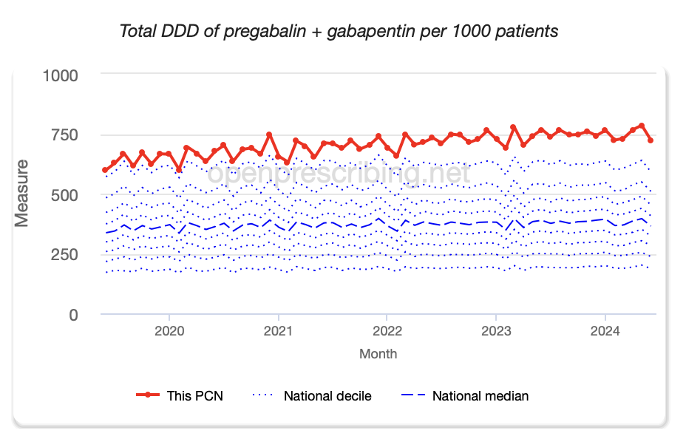

Slide 9
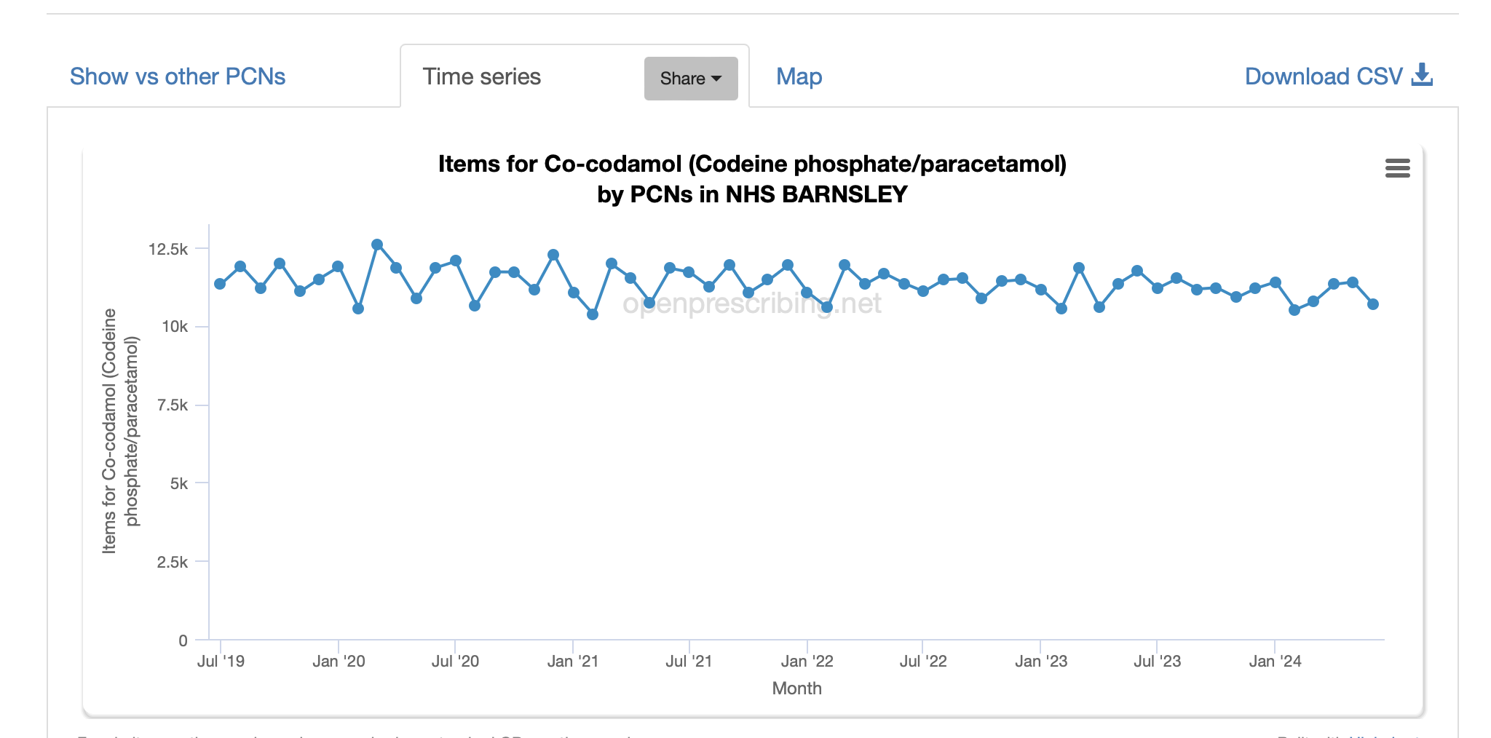

Slide 10
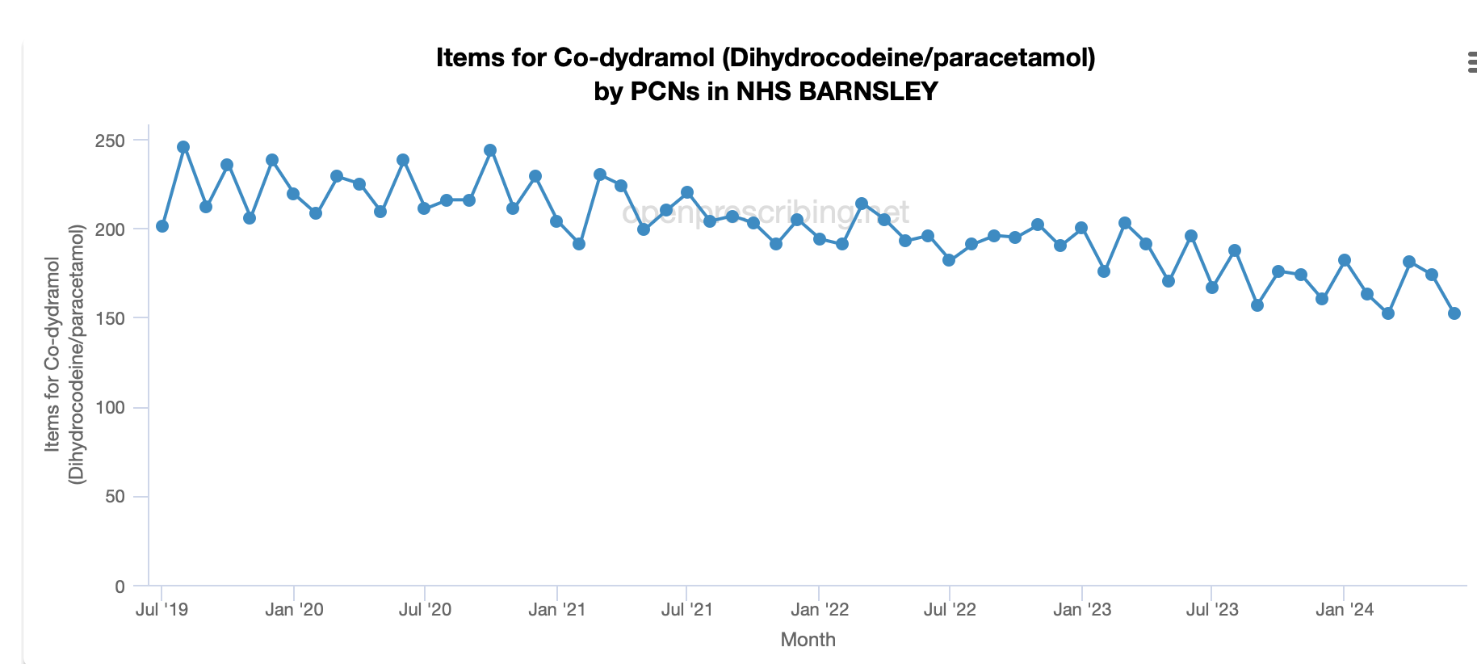

Slide 11
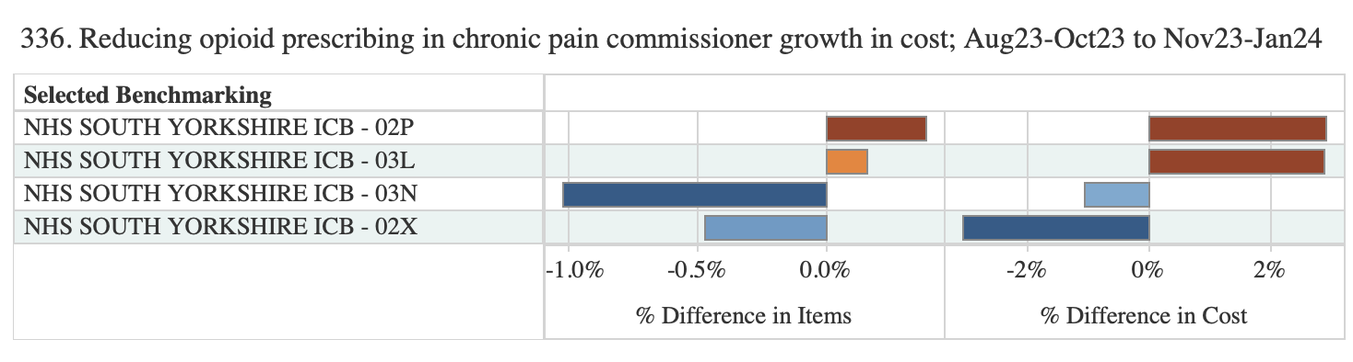
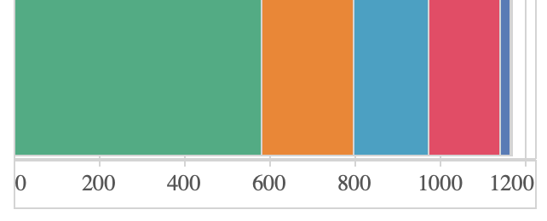
Prescribing Growth since CROP
Barnsley 02P, Doncaster 02X, Rotherham 03L & Sheffield 03N
Notes:
6 months ending Jan 24 In SY Barnsley has highest item and cost growth, Rotherham lower item growth, Sheffield lowest item growth and Doncaster second lowest

Slide 12
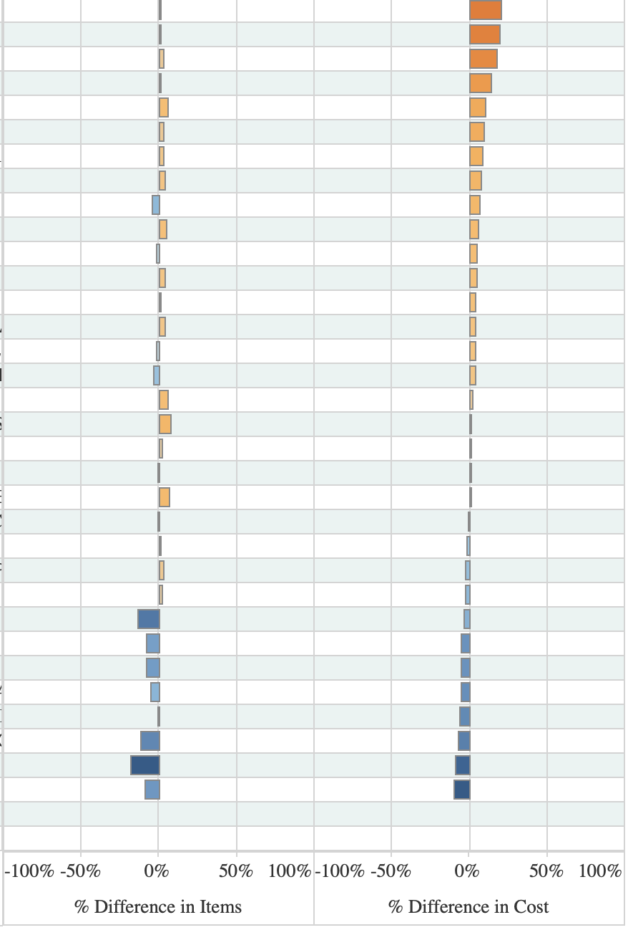
Variation across Barnsley Practices - same six months

Slide 13
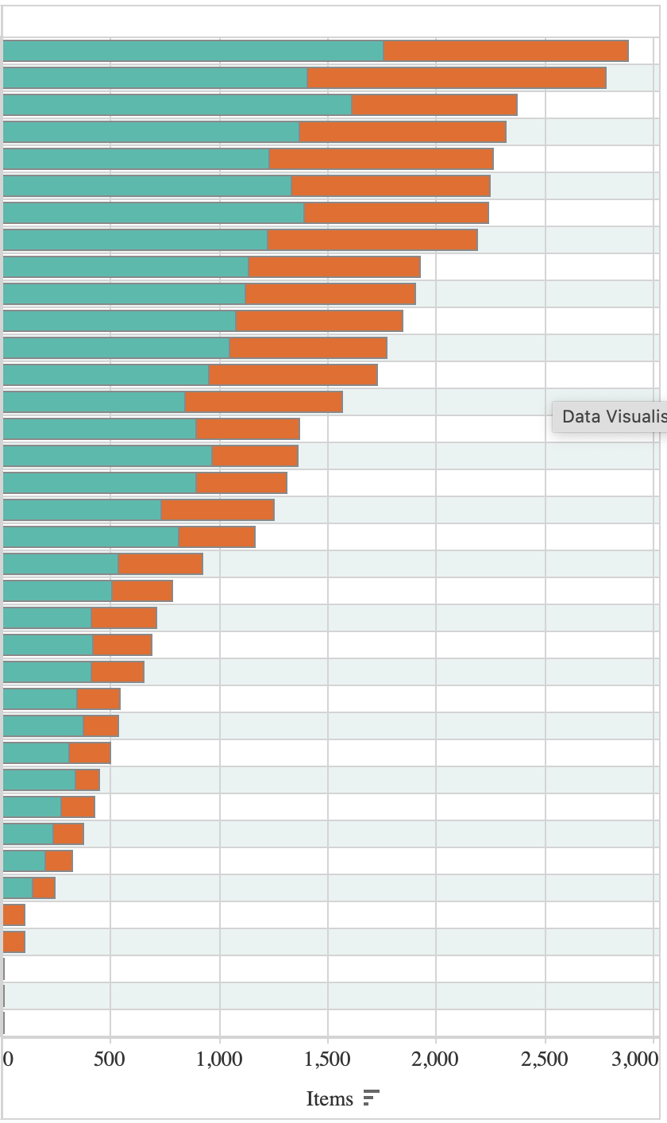
Growth in items across Barnsley practices; variation items per weighted denominator

Slide 14
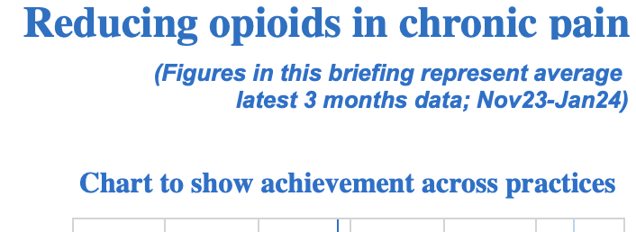
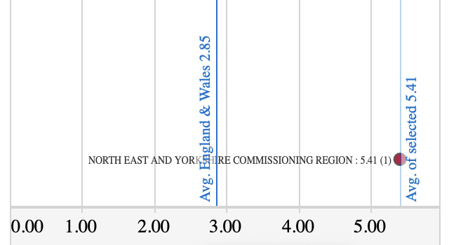
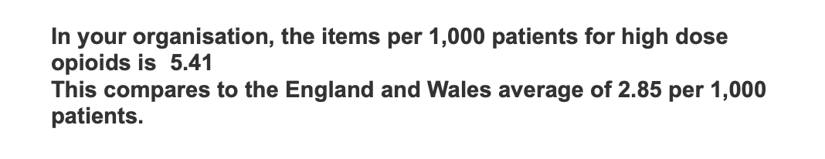
Barnsley position against national @ Jan 24

Slide 15
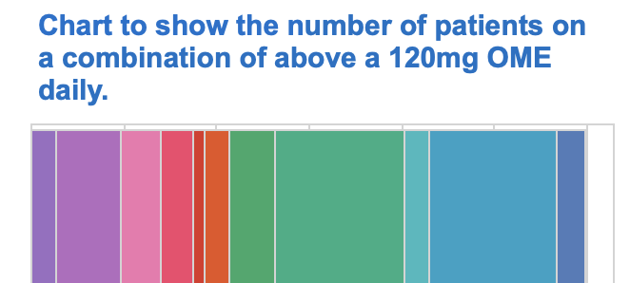
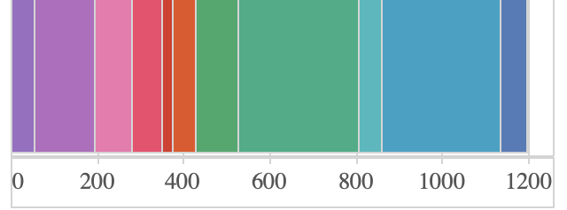


Slide 16
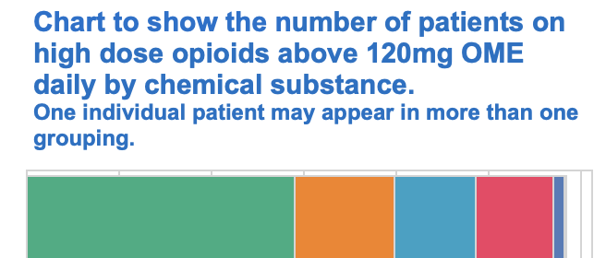

Slide 17
Areas within 2024/25 workplan
High dose opioid review for chronic pain Review as in previous years - collaborative area for opioid prescribing/national area. Expand to include other opioids inc <120mg/day Oral Morphine Equivalent. Aug – discussed with clinician, 8th Nov 24 monitor progress and 31st Jan 25 completion
CROP and patient structured medication reviews (part of DES target areas).
Practice SOP introduced for prescribing of Controlled drugs in practice
Medication Reviews
Pain management reviews - Review at least once every 6 months - Patients prescribed >120mg oral morphine equivalent, excluding EOL*prescribed opioids <120mg/day of oral morphine or equivalent (including morphine sulphate 10mg/5ml oral solution and other liquid opioids) for chronic pain. Patients who have ordered significant quantities of liquid opioids prioritised for review – small cohort identified.
Co-codamol review

Slide 18
Points to consider when first prescribing

Slide 19
Medicines associated with dependence or withdrawal symptoms: safe prescribing and withdrawal management for adults
NICE guideline [NG215]Published: 20 April 2022

Slide 20
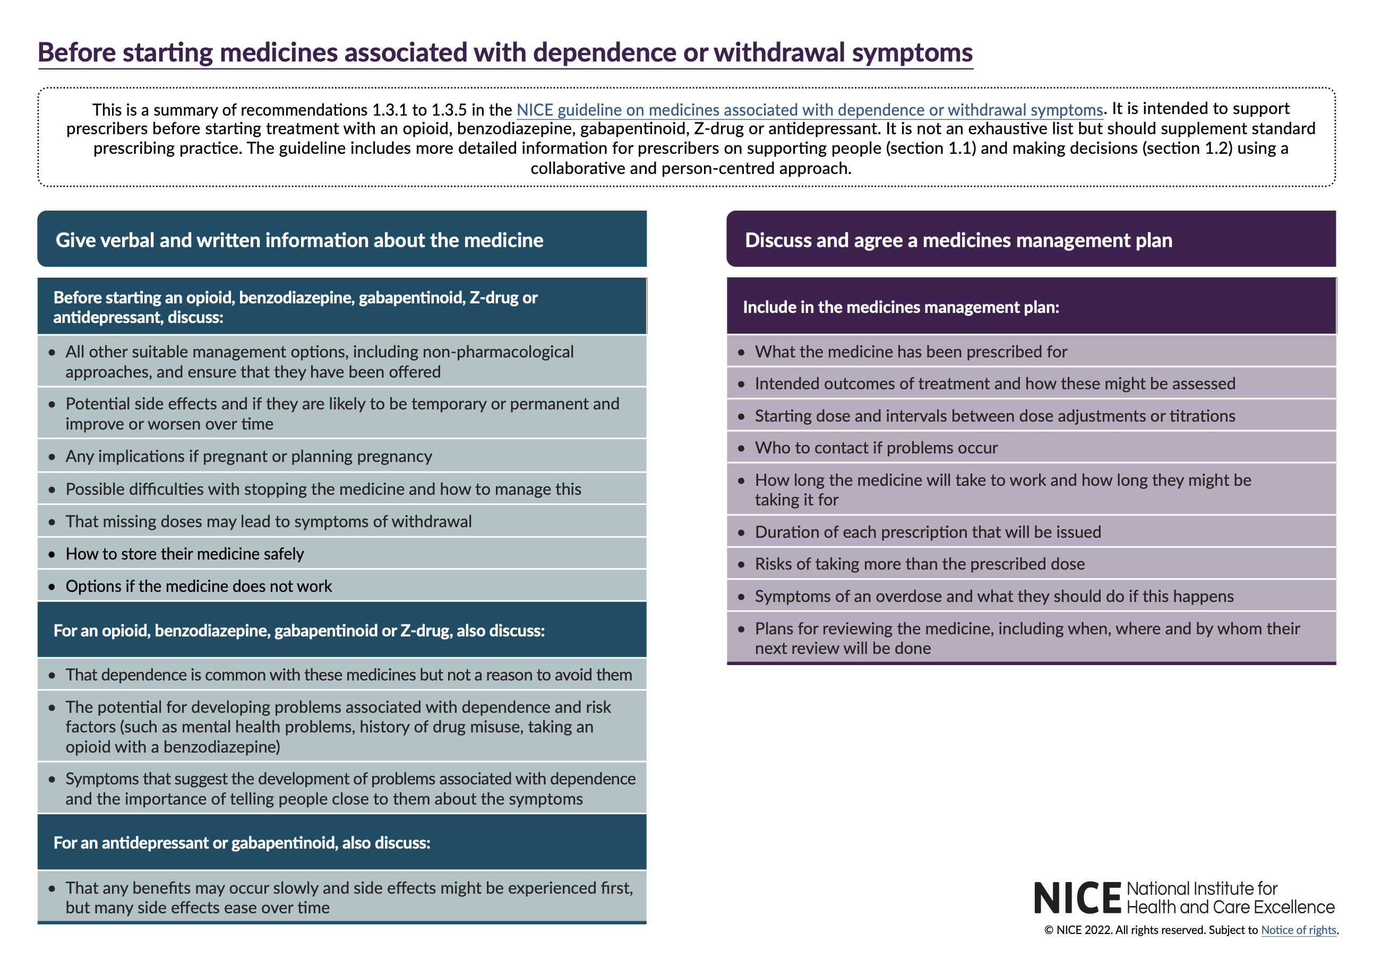

Slide 21
PrescQIPP Bulletin 336 ( November 23)

Slide 22
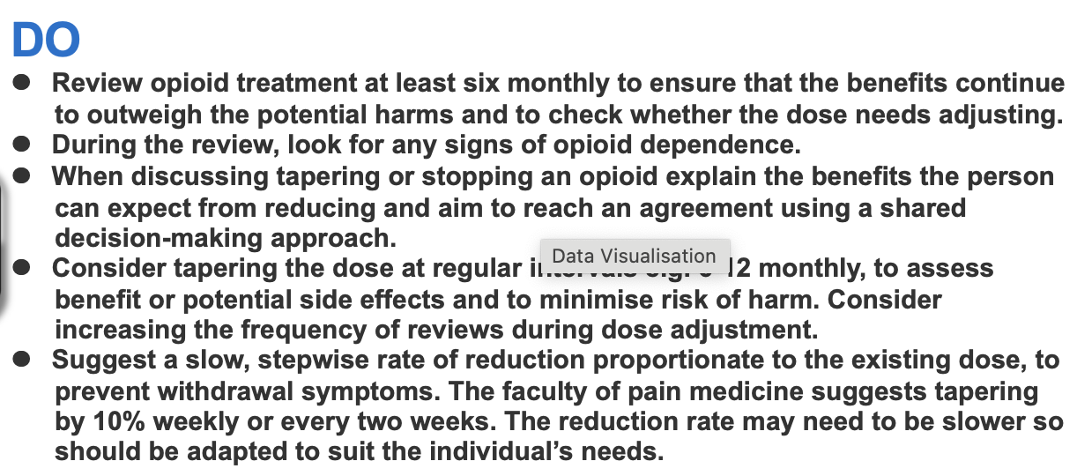

Slide 23
Tapering / Dose Reduction Resources
National & Local

Slide 24
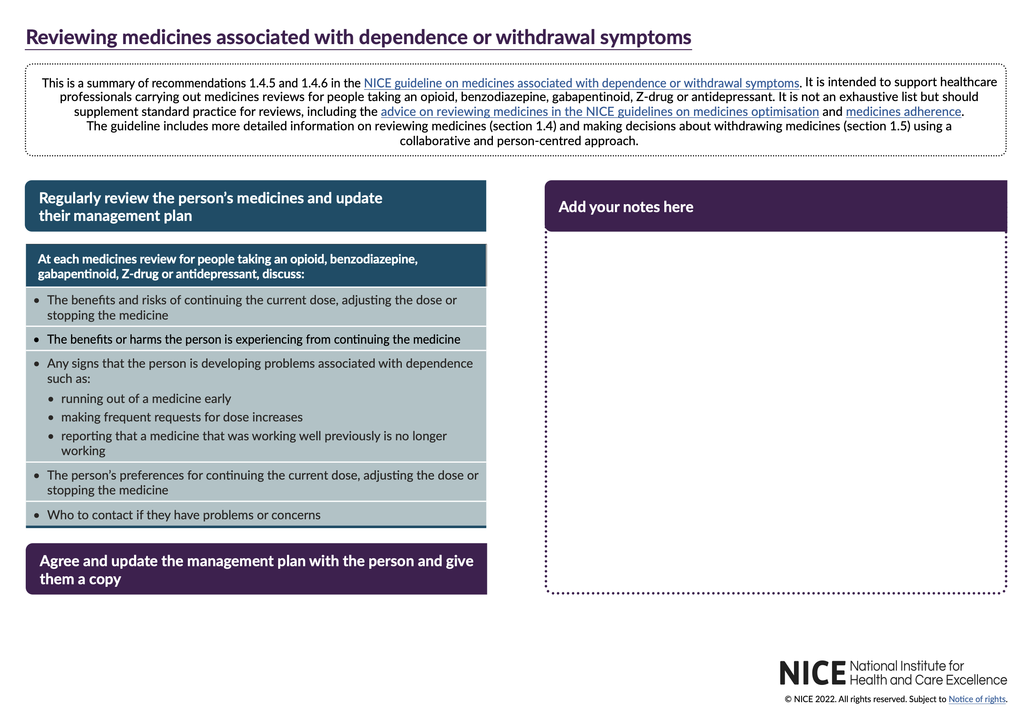

Slide 25
Local Resources
SY Opioid Resource Pack – endorsed by IMOC, on website - lots of links and useful resource e.g.
The Pain Toolkit gives practical advice and techniques to help manage pain. Website: www.paintoolkit.org
Hunter Integrated Pain Service (Australia) An excellent five minute overview of chronic pain. Website: www.youtube.com/watch?v=5KrUL8tOaQs
‘Brainman stops his opioids’ Website: www.youtube.com/watch?v=MI1myFQPdCE
Another good explanation of how your mood can affect pain. Website: www.tamethebeast.org
Videos about chronic pain and how to manage it Chronic pain: www.healthtalk.org
Chartered Society of Physiotherapy Website: www.csp.org.uk/publications/10-things-you-need-know-about-your-back
A very good video about back pain: https://youtu.be/24P7cTQjsVM · Word Health Organisation (WHO) animated videos Depression and Stress
Apps: Mindfulness: www.headspace.com/headspace-meditation-app Active walking: www.nhs.uk/oneyou/active10/home#xfEeV0FM3W4Xo5gM.97
Mood diary: https://itunes.apple.com/gb/app/wellmind/id918138339?mt=8
Barnsley resource Pack – use for PDA revews , has been circulated to practices ; data collection, clinical audit & information to support reviews Opioids in Chronic Pain Practice Guide MOS 2024-25 V1.0 July 2024.docx (sharepoint.com)

Slide 26
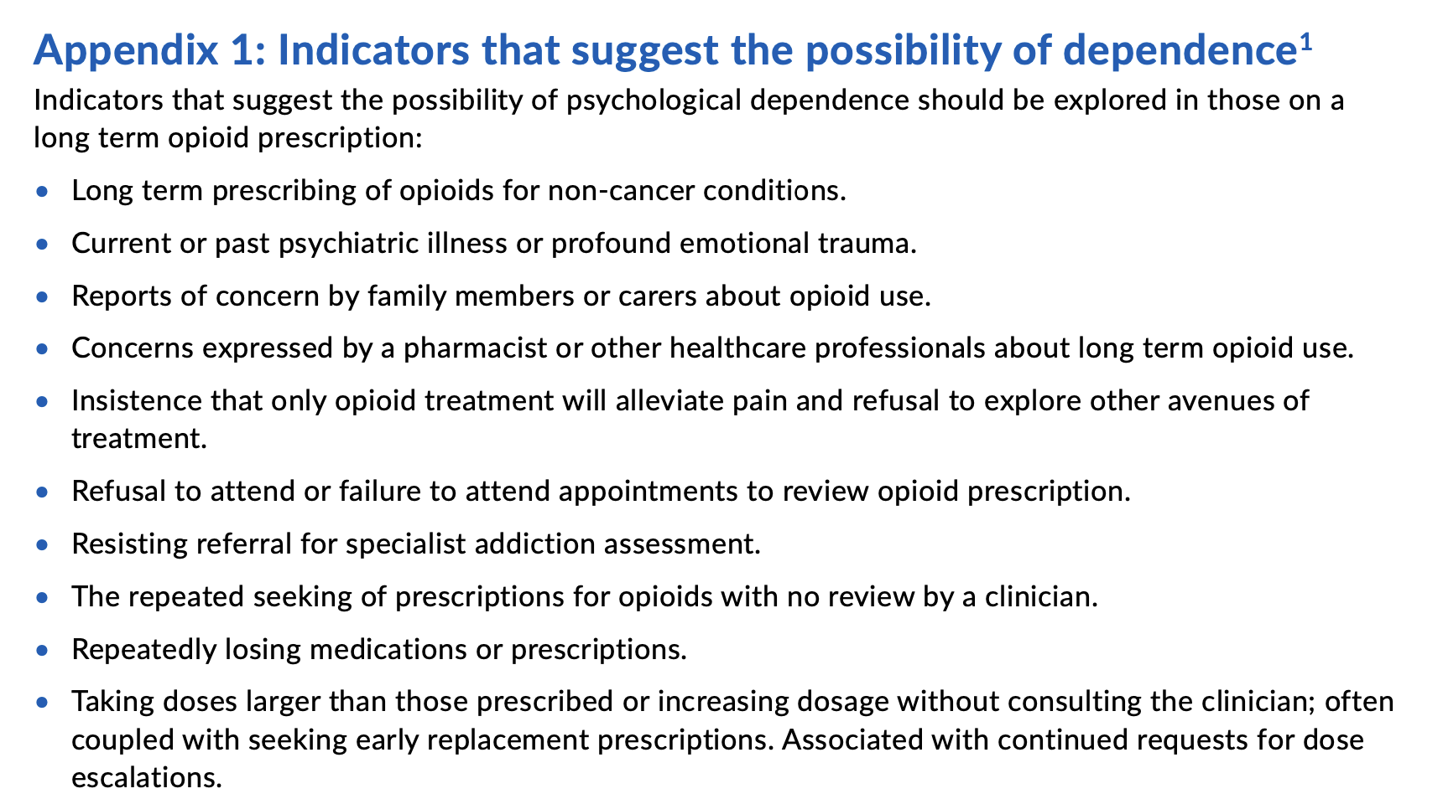

Slide 27
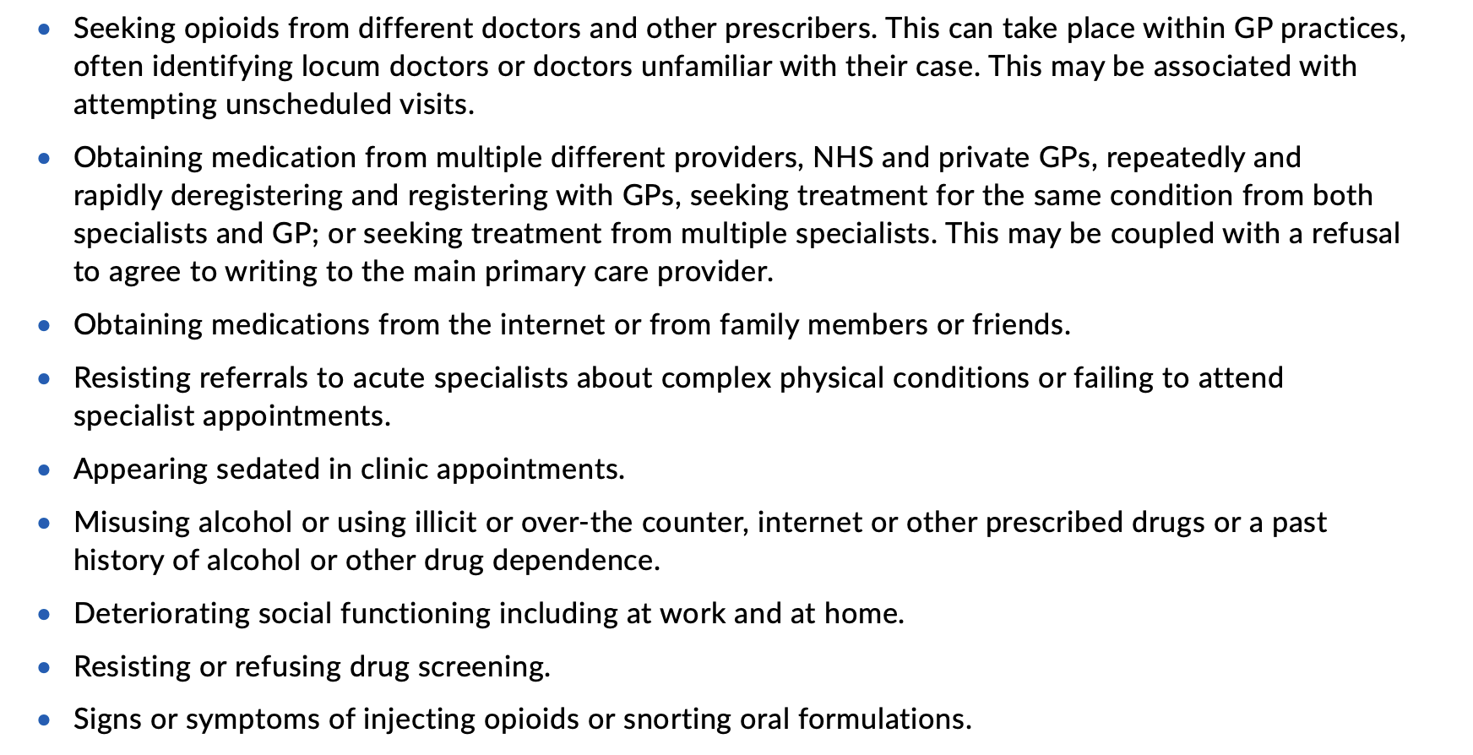

Slide 28
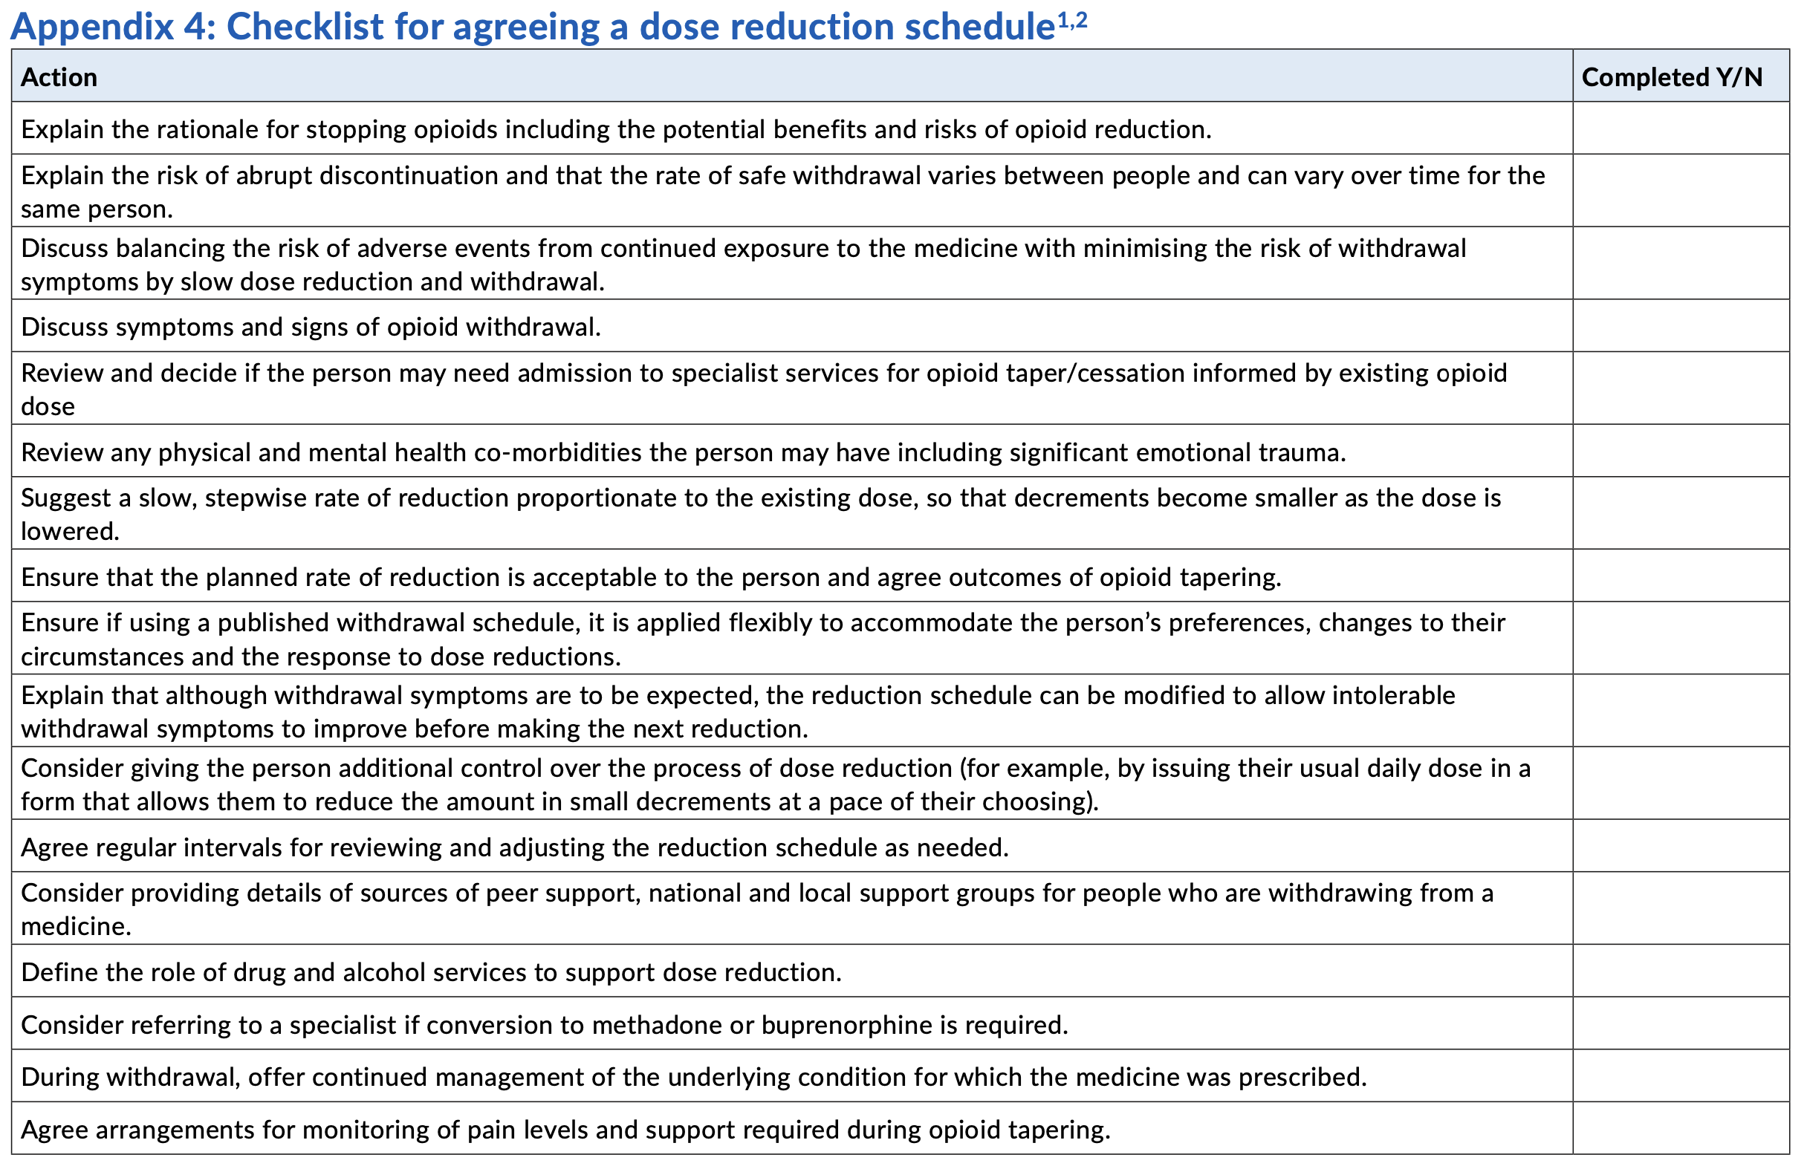

Slide 29
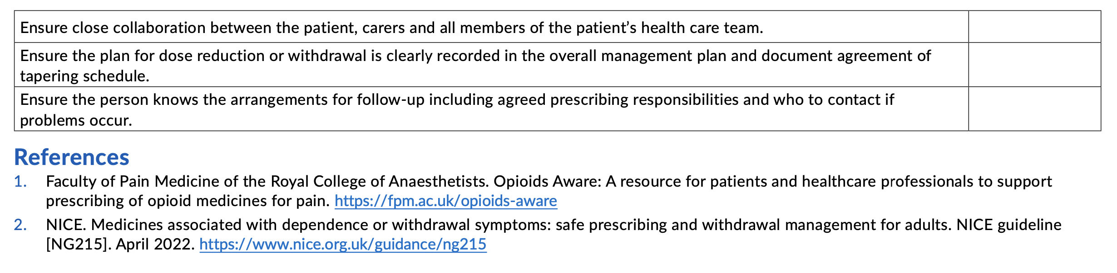

Slide 30
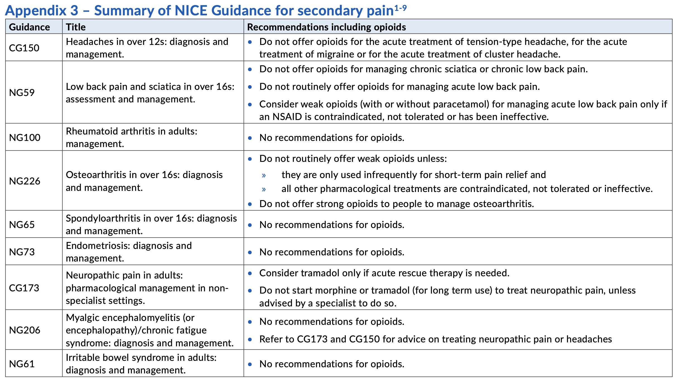

Slide 31
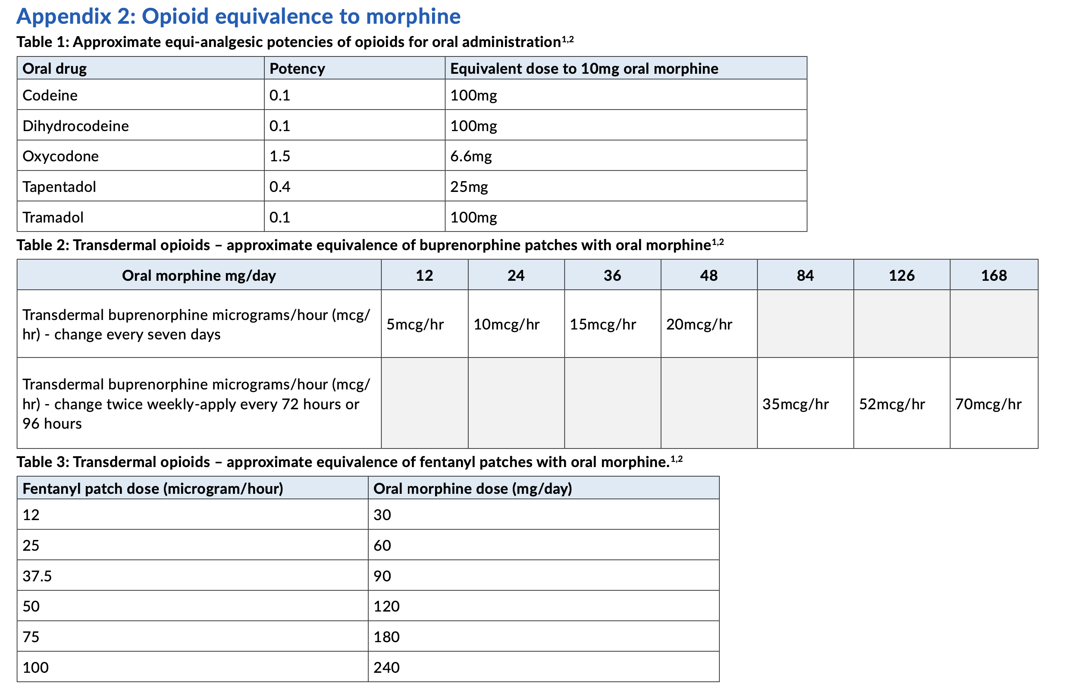

Slide 32
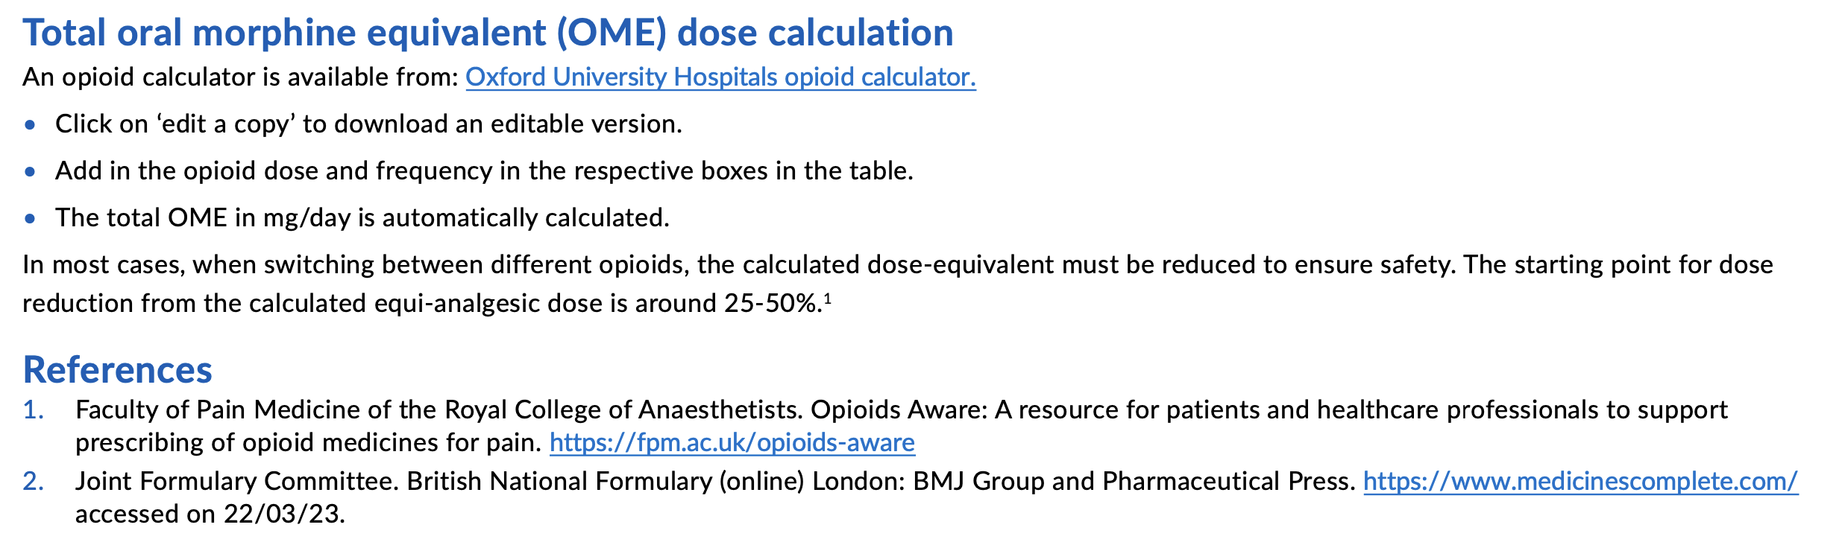

Slide 33
Current opportunities for Community Pharmacy to support this work? Thoughts ?
DMS Referrals
CPCS?
Pharmacy First Healthy Living promotions
Referrals to support services
8
Notes:
May want to ask tom to quickly run his eye over ...
Flu/Covid Vaccinations – priority groups
DMS Referrals – potential to refer patients with recent acerbation for inhaler checks and or advice on medication
Smoking Cessation National Advanced Service – increase uptake if supported increase in referrals
New Medicines Service – self explanatory – ensuring this is promoted e.g. practice nurses, GP’s, breather teams etc
Healthy Living promotions ? - not sure if this would be an opportunity as not clear if self directed by the pharmacy but worth exploring as the resp group are looking at winter campaigns - may be a quick win for pharmacies if the resources and key campaign messages are supplied, stickers for prescription bags etc
Prepare for our newly qualified pharmacists with IP in summer 2026 – providing opportunities to maintain competencies etc

Slide 34
Questions & Feedback ?

