Slide 1




Cancer Alliance Grant Project
Presented by
Ross Fletcher, CEO/Chief Nurse
Julia Bowness, Head of Business Development
Rebecca Lambert, Head of Clinical Services and Quality Matron
Chris Black, Complimentary and Wellbeing Therapist
Brianna Allsopp, Marketing and Communications Officer
Notes:
Ross to introduce/begin presentation.

Slide 2

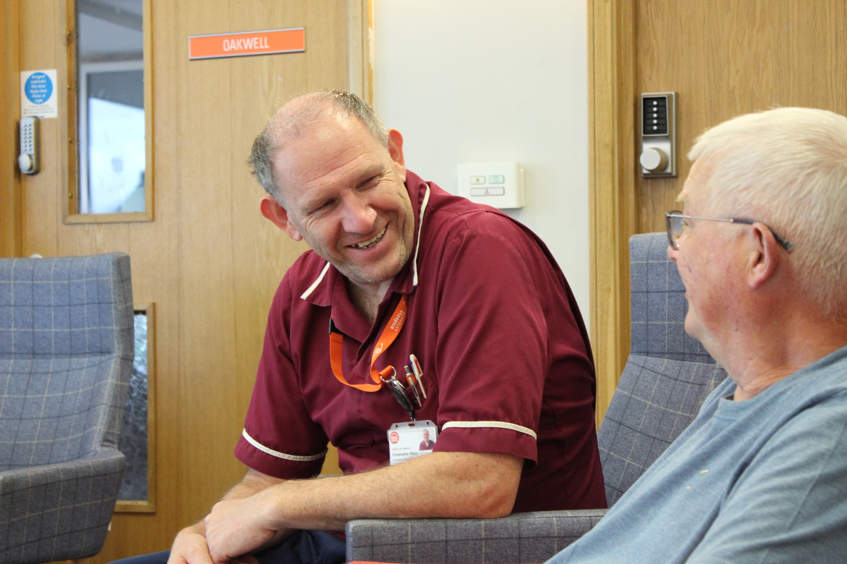




What did we want to deliver?
Work with specialist hospice staff to create a series of short, online videos sharing helpful techniques and information for anyone diagnosed with cancer to access.
Videos would complement existing treatment pathways and support with self-care, self-awareness and regulate the mind, breath and body movement.
Videos to be shared with GPs in targeted deprived areas of Barnsley to ensure more people diagnosed with cancer can access and be supported by our services.
Notes:
Julia to speak

Slide 3







Project timeline
Q1
Q2
Q3
Q4
Video preparation and work with Cancer Champions
Further rollout to Grimethorpe and Brierley
Evaluation for final rollout
Initial rollout to Athersley
Review and evaluation data from Grimethorpe and Brierley
Evaluate the project as a whole
Work with ICB to coordinate further distribution to South Yorkshire boroughs
Hospice team to present data to GP/Cancer Champion South Yorkshire networking meeting
Plan and produce video content with hospice staff
Draft website content to accompany videos
Educate Cancer Champions on benefits of content
Create an online form to gather feedback from users
Draft marketing copy for email and text messaging
Share trackable links with GPs
Monitor analytics from launch
Review and evaluation data from Athersley launch
Prepare further marketing
Rollout to Brierley and Grimethorpe GPs
Notes:
Julia to speak

Slide 4
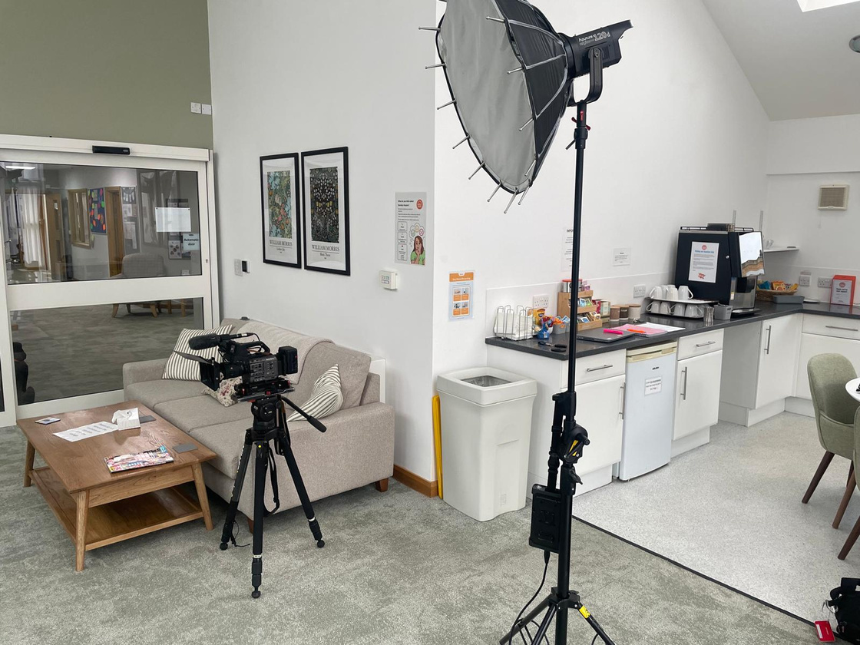
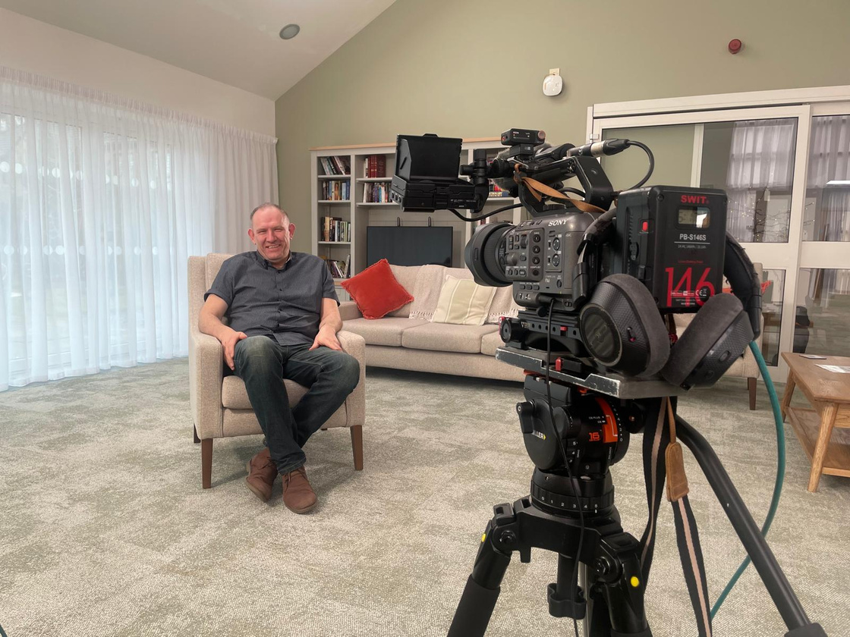
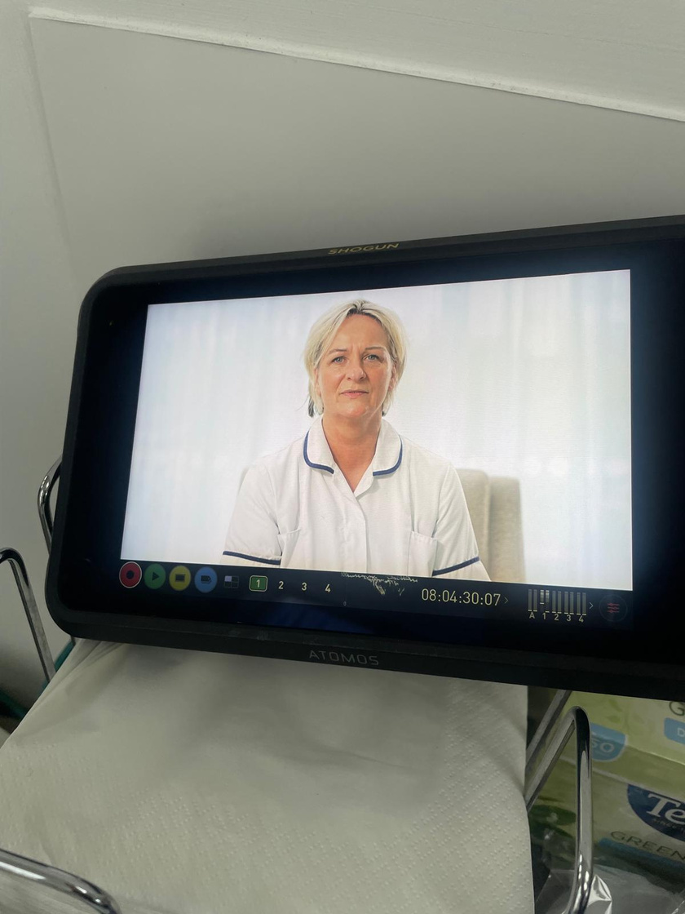
Producing the videos
In March, we worked with a local videographer to produce a total of four videos. Each video was around five minutes long and focused on a different technique.
Notes:
Brianna to speak

Slide 5


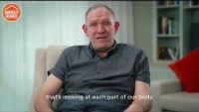
Body Scan
Video content
Each of the four videos focused on a different relaxation technique, all of which we use here at the hospice with our patients and service users.
Guided Visualisation
Qi Gong
Tai Chi
Notes:
Chris to discuss four techniques chosen and use at the hospice.

Slide 6


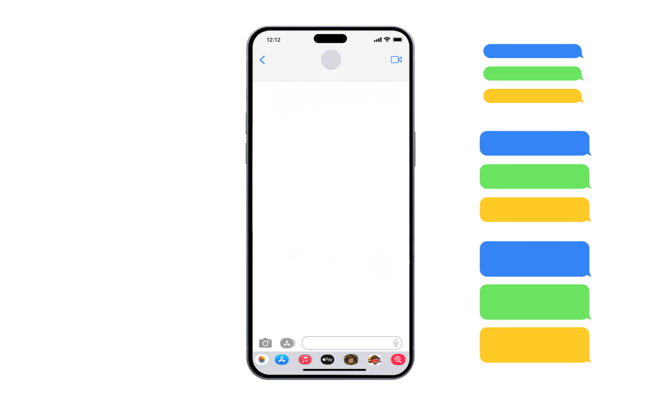


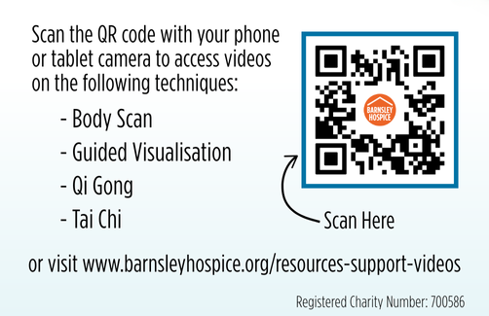
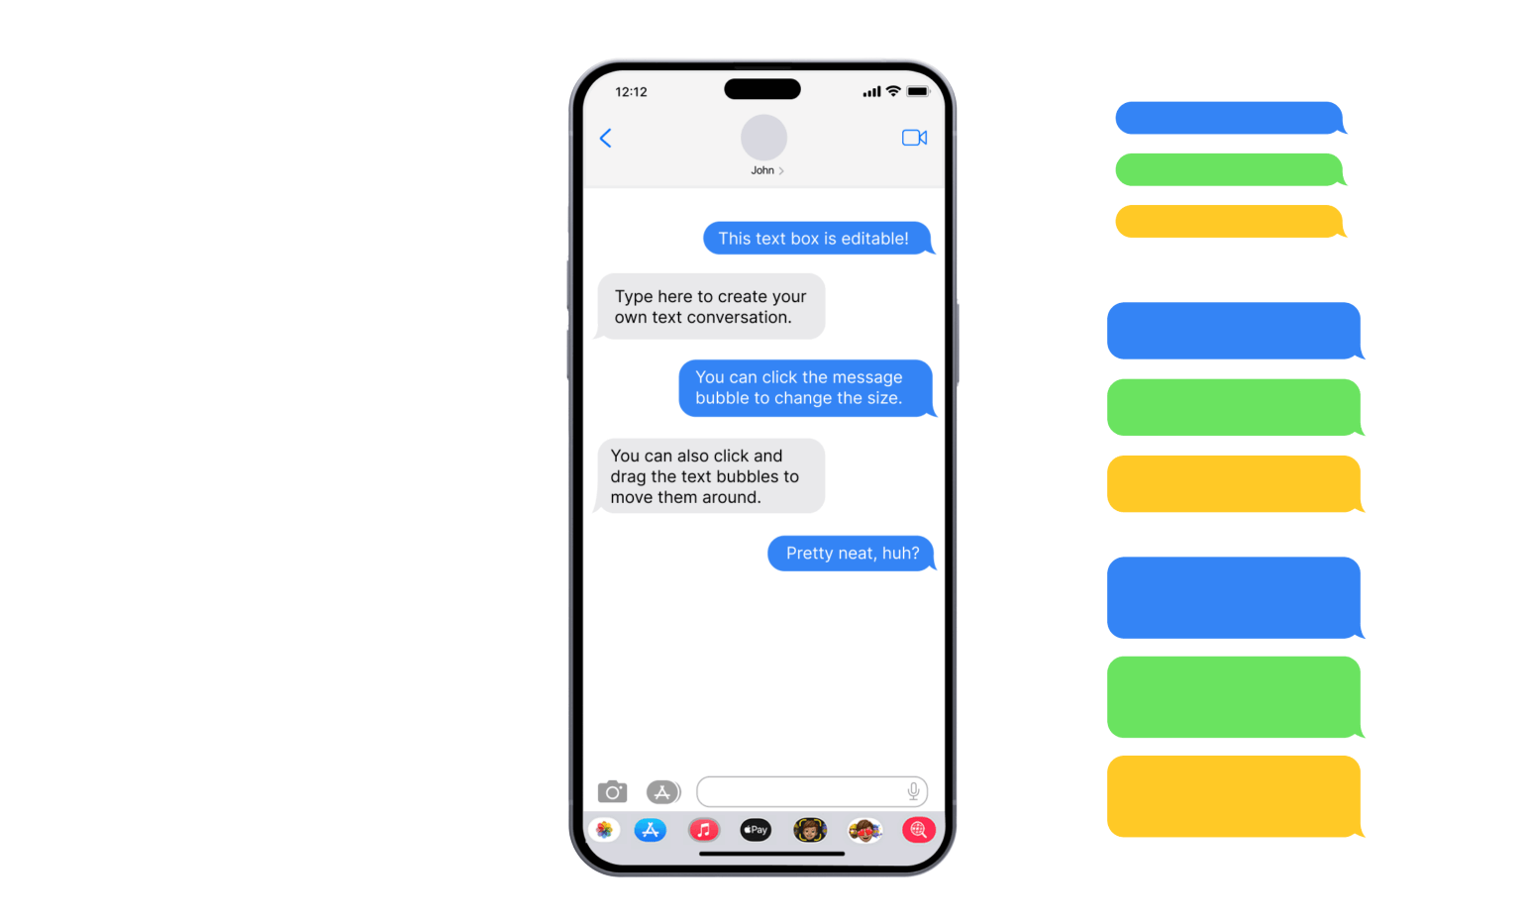
Rollout to Athersley
We started promoting the videos to Athersley GPs in July. Visiting 6 medical centres
Prepared email copy and text messages which doctors could use to share the video
Create tracked links so we could monitor who was visiting the videos from the Athersley area
Produced ‘business cards’ with QR codes on for GPs to hand out to patients
Hi Mr Smith,
As discussed, please find below a link to access the mindfulness and relaxation videos on the Barnsley Hospice website.
Each video is approximately 5 minutes long and can be viewed as often as required.
Thank you.
Notes:
Brianna to discuss marketing rollout

Slide 7


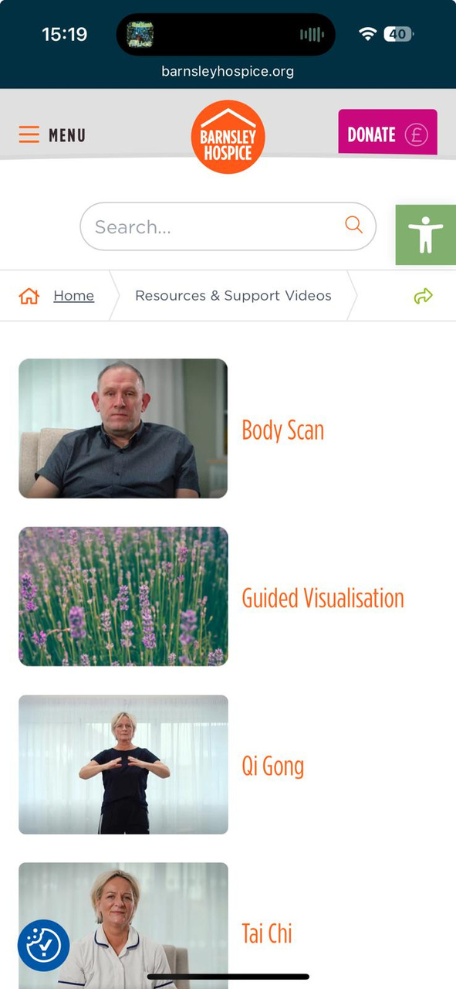
Data from Athersley
3 engaged sessions from the tracking links sent to GPs
3 scans of the tracked QR code
29 views of the video home page
14 views of Tai Chi
7 views of Qi Gong
4 views of Body Scan
2 views of Guided Visualisation
No feedback from online form
Notes:
Brianna to run through initial data review

Slide 8
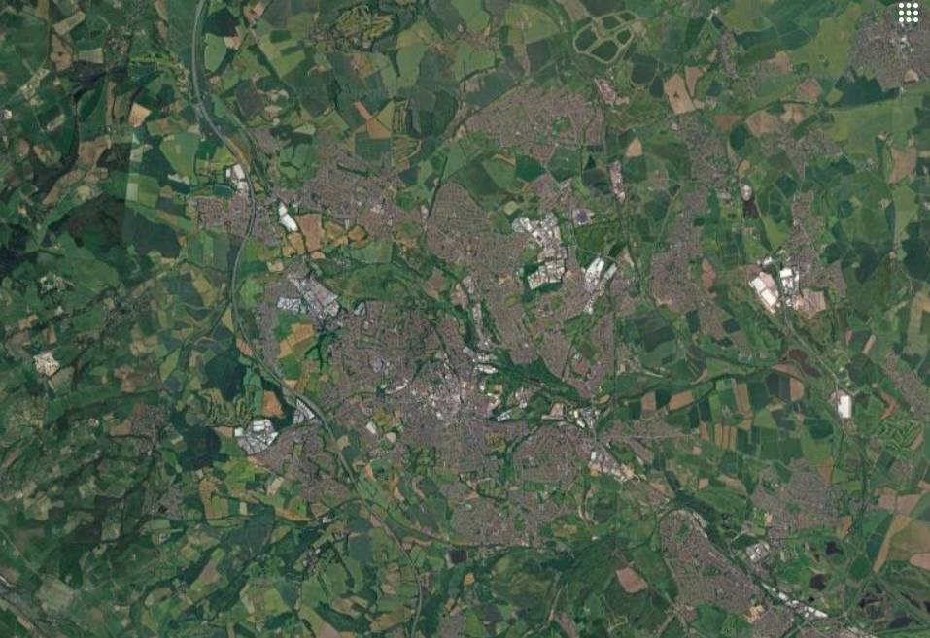

Rollout to Brierley and Grimethorpe
After we reviewed data from the Athersley rollout, we began outreach to GPs in the Brierley and Grimethorpe area
We visited four medical centres in the areas to drop off more tracked cards and emailed links to the videos to doctors at local practices
Following low engagement from Athersley, we once again contacted Karen Gug, Primary Care Deputy Manager, to help promote the videos to local GPs further
Brierley
Athersley
Grimethorpe
Notes:
Becky to discuss further rollout

Slide 9
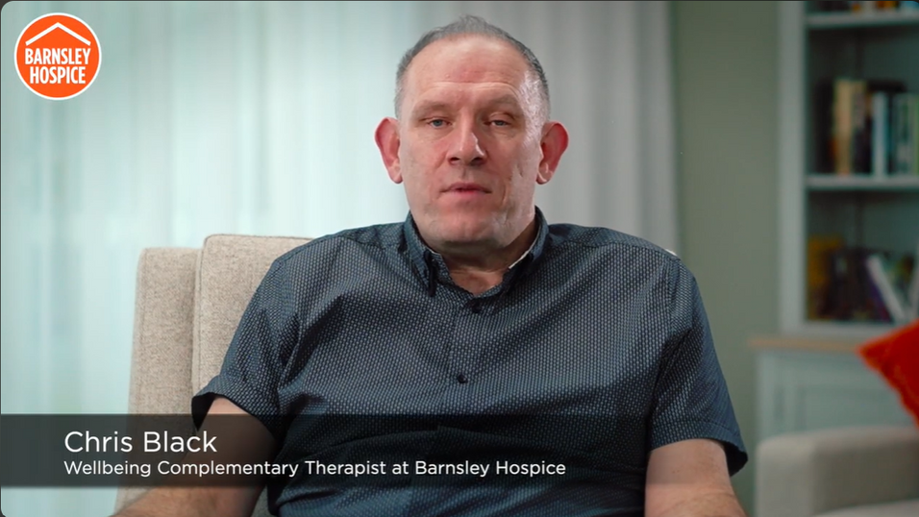
Data from further rollout
4 sessions from Brierley links and 1 more session from Athersley repush
56 total views of the video home page since Athersley launch
16 views of Tai Chi
10 views of Qi Gong
10 views of Body Scan
3 views of Guided Visualisation
No scans of the tracked QR code cards
No feedback from online form
Notes:
Becky to discuss data from overall rollout

Slide 10

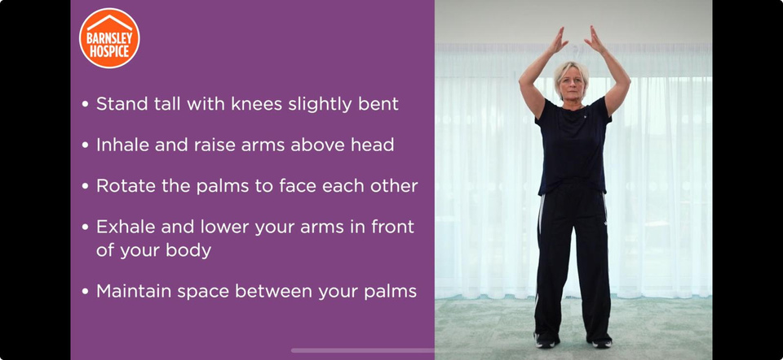
Moving forward
Since the further rollout to Brierley and Grimethorpe,
we’ve seen low engagement on the videos and links
shared with GPs
In Q4 to help us reach more people without relying on GPs to share the video links, we ask for your permission to promote via our hospice socials and website to people across our reach instead of just the 20% deprived areas of South Yorkshire
Just under 20,000 followers across our social channels
Over 2,900 sessions on our website each month on average
We also plan to share the resource links with our trusted partners, such as Barnsley Council, SWYFT, Citizens Advice Bureau, South Yorkshire ICB and Barnsley CVS. As well as if they could be hosted on the Cancer Alliance website information and resources section.
Notes:
Ross to end with overall review of project and plans for rollout to rest of South Yorkshire via hospice channels.

