Slide 1
Respiratory feedback & update
Brendan Walker – Clinical Pharmacist & Barnsley MO Respiratory Lead
October 2024 Pharmacy BEST

Slide 2
Barnsley Respiratory Transformation Plan
Have a strategic approach across Barnsley Health and Care Partners for COPD & Asthma Management which aims to bring together and support partners in the prevention, diagnosis, treatment and care of respiratory conditions.
1. Case Finding and screening for undiagnosed COPD and Asthma patients
2. Access to accurate and timely diagnostics in the community
3. Partnership projects to optimise respiratory care across the Barnsley system
4. Self-management and patient education
5. Using data to target cohorts of patients that are at risk of admission
6. Workforce Development
Barnsley Respiratory Transformation Group
YAS/ BREATHE/ PULMONARY REHAB/ BHNFT/ PRIMARY CARE/ MEDS OPT/ PUBLIC HEALTH
Notes:
At last meeting we briefly talked through this plan and asked for feedback on ways Cp would like to locally be involved

Slide 3
You said (in July) …….
How can community pharmacies direct or refer patients to respiratory services ? e.g. BREATHE and when is it appropriate to refer or signpost?
Improving CP access to patient records would significantly help in management. Pharmacist are blind as to where the patients are within the pathways and how stable they are. Could give or reinforce patient messages if had access to information.
Guidelines need improving re clarity and access i.e. understanding GINA guidance and MART . I've taken this as an action. We are launching new guidelines for asthma and we can start with them.
Reducing the range of inhalers would result in inhalers being better understood by clinicians and would be helpful and improve care - myriad of devices is confusing. I'm taking this away also as an action.
Inhaler checks would only be funded for initial consultation and one telephone follow up in New Medicines Service/ national services. How could pharmacies find funding for routine inhaler checks patients.

Slide 4
We Did ……
Patients can self-refer into the BREATHE service and BREATHE are also happy to accept referrals from community pharmacy for anyone with confirmed respiratory disease who are still experiencing symptoms/exacerbations despite being optimised or currently in an exacerbation and at risk of hospital admission.
We would like to develop some screening questions for pharmacies to ask patients when they are collecting meds or presenting at pharmacy whose condition appears to be in decline or be poorly managed.

Slide 5
We would also welcome a community pharmacy rep to sit on the Barnsley Respiratory Partnership Group
meets 10.00 am – 12 noon on the second Thursday of each month, face to face
previously had a strong focus on COPD but will be moving to Asthma as well, as a priority area of focus
ICB Pharmacy reps: Brendan and Deb Leese currently sit on this group but if interested contact Lynne White for further information/an initial discussion - lynne.white10@nhs.net

Slide 6
Altogether Asthma
The National Review of Asthma Deaths in 2014 highlighted many concerns about asthma care in the UK; Ten years on and the picture is not improving. Many patients continue to manage their asthma with inappropriate treatments and over reliance on bronchodilators remains very high locally. That is why here in Barnsley we are aiming for an asthma revolution.
SY is launching a new asthma guideline based on the GINA (Global Initiative for Asthma) strategy. If you are involved in the care of asthma patients, we encourage you to become familiar with these new guidelines and we invite you to attend a learning session with Asthma and Lung UK Respiratory Champion Deb Leese on one of the following dates:

Slide 7
Tuesday 8th October 8am – 9am
Thursday 10th October 7pm – 8pm
Monday 14th October 12 – 1pm
Wednesday 23rd October 12 – 1pm
Please respond to lynne.white10@nhs.net with the time/session that you would like to book on and we will send you the meeting invite and link so that it goes directly into your calendar.

Slide 8
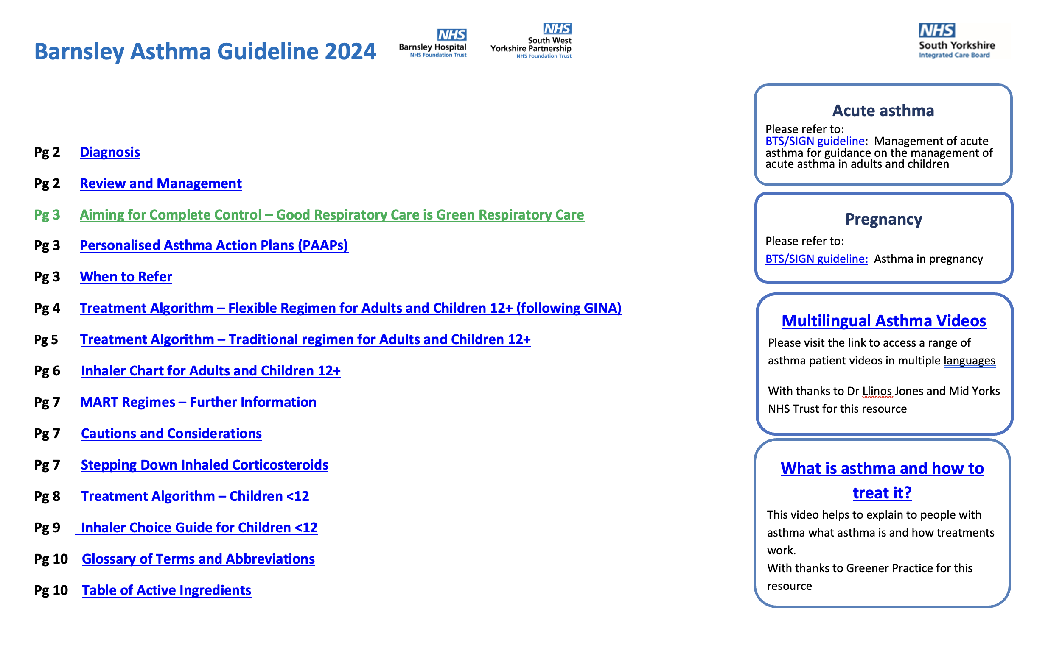

Slide 9
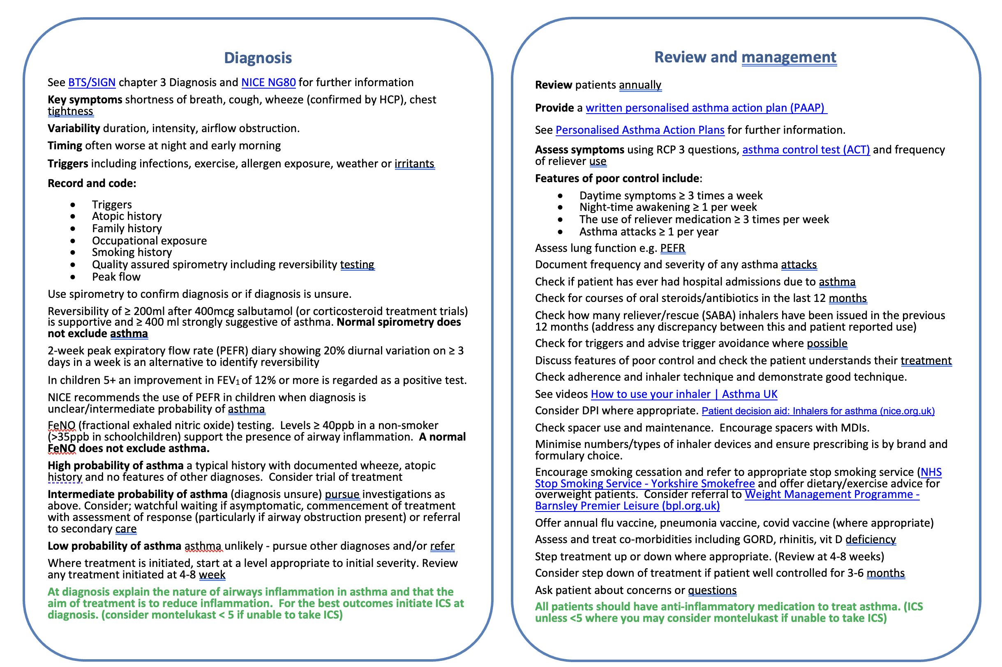

Slide 10
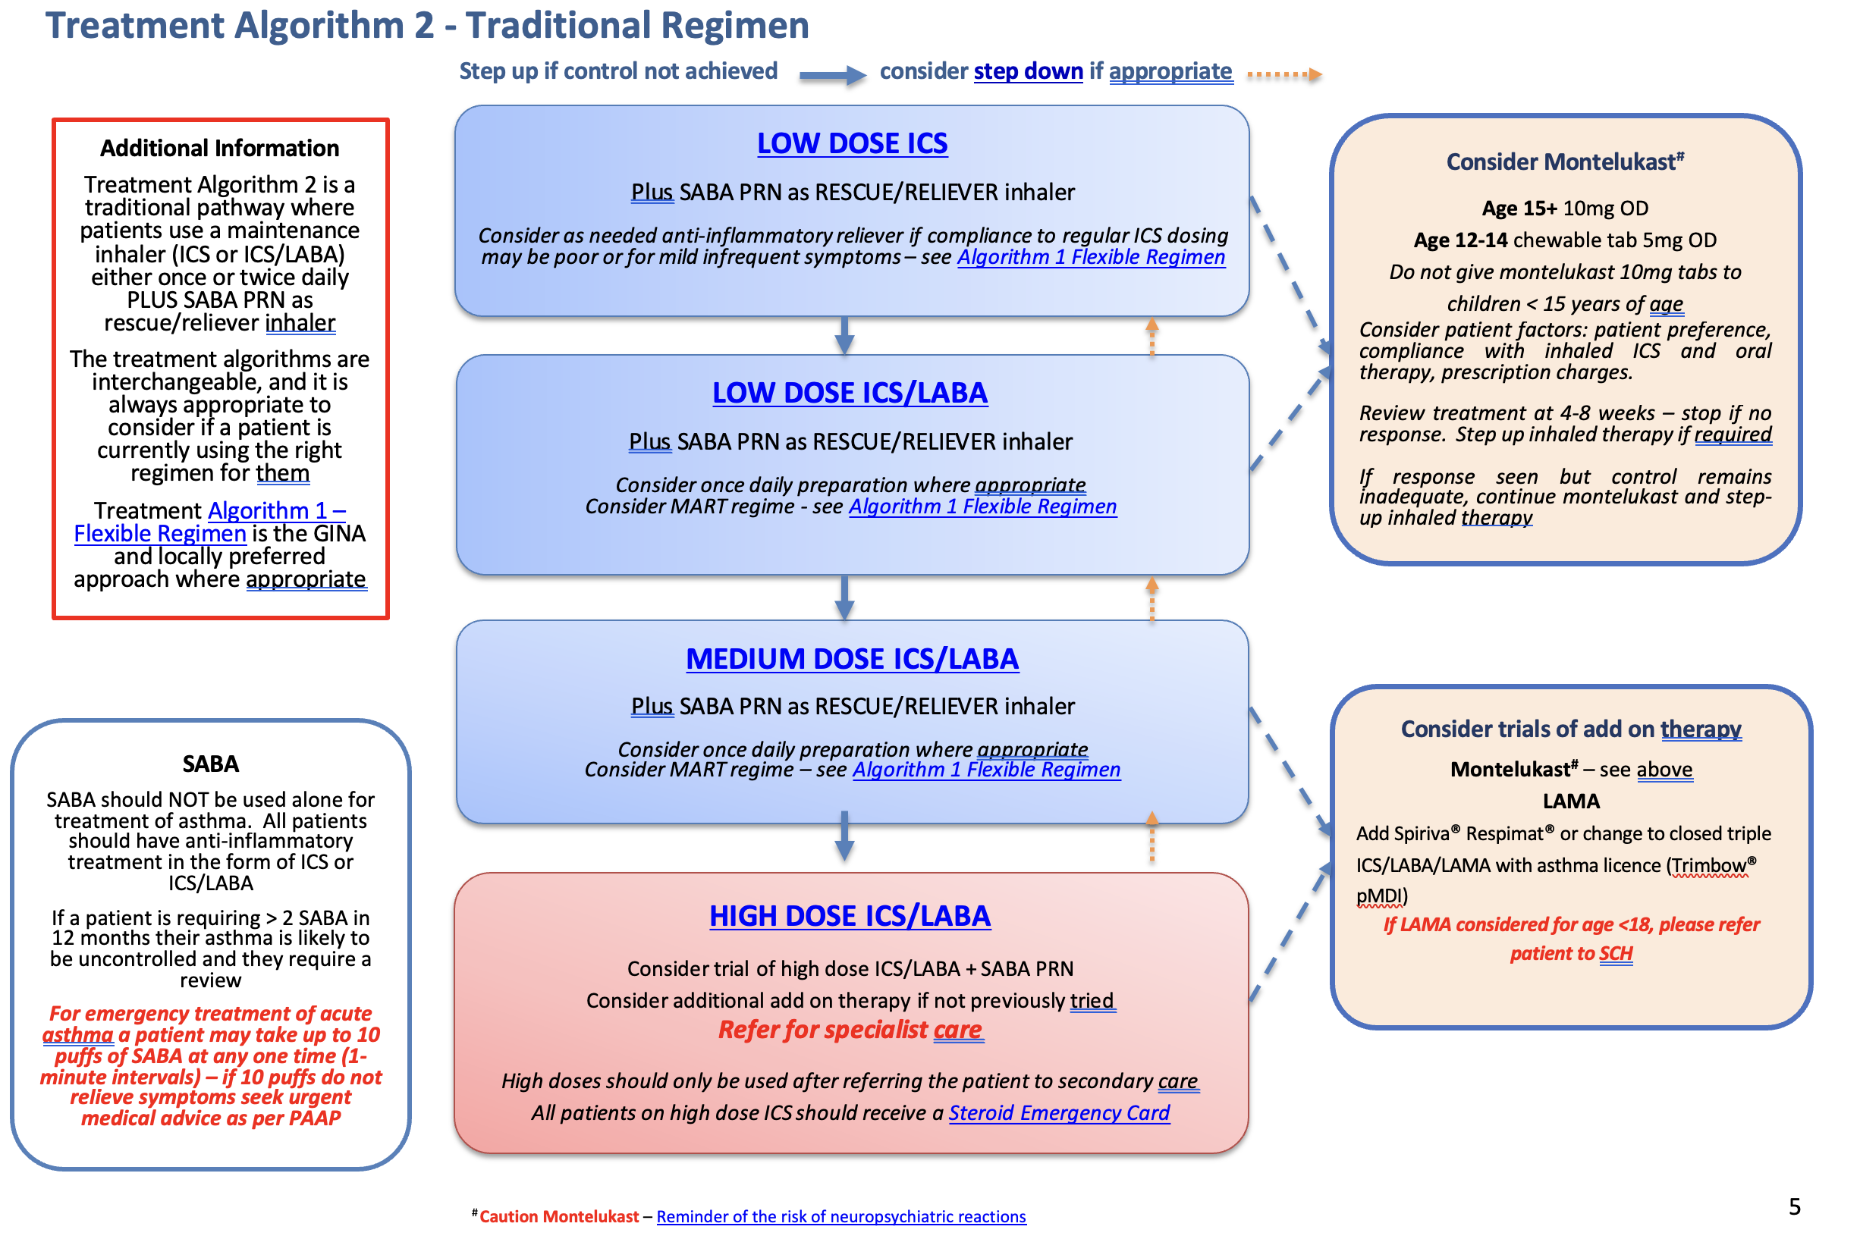

Slide 11
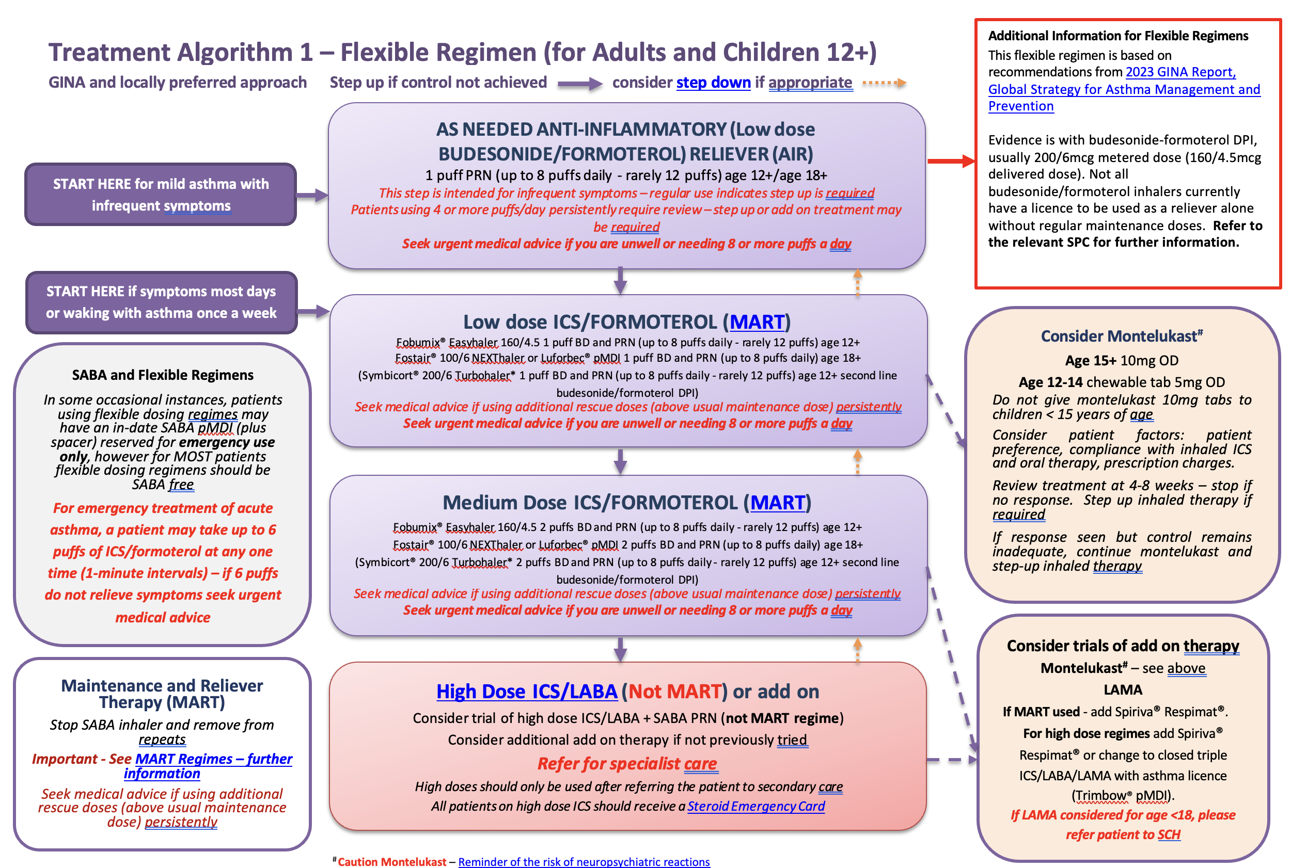

Slide 12
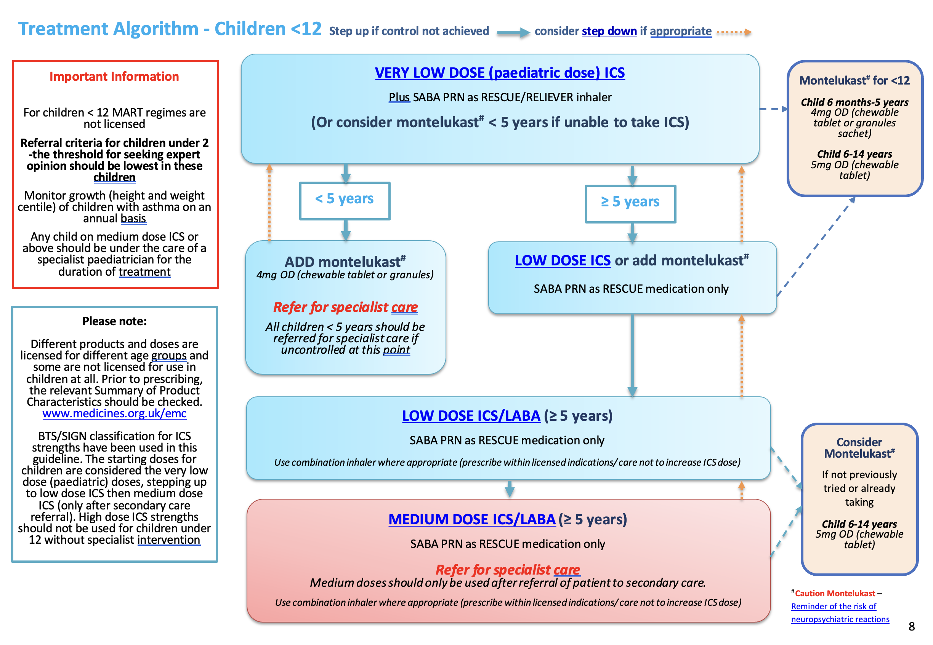

Slide 13
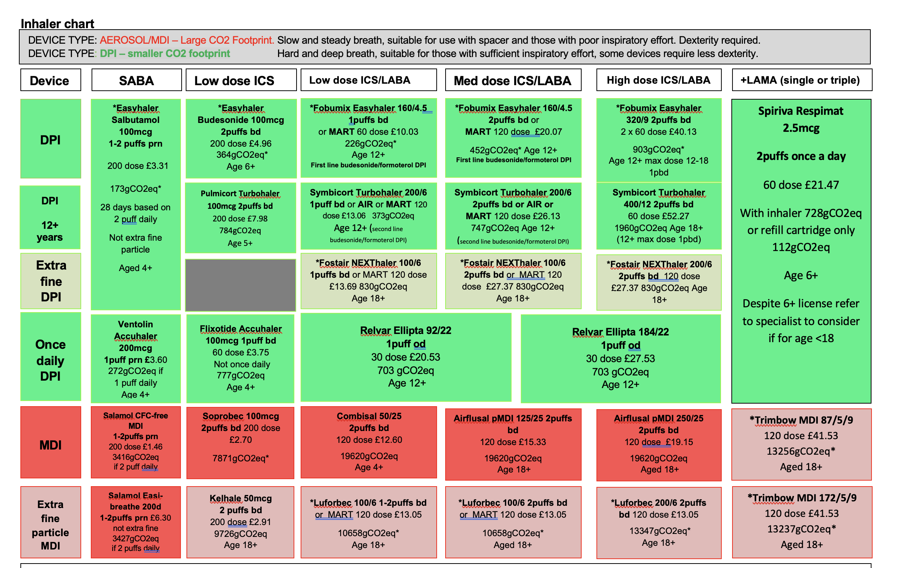

Slide 14
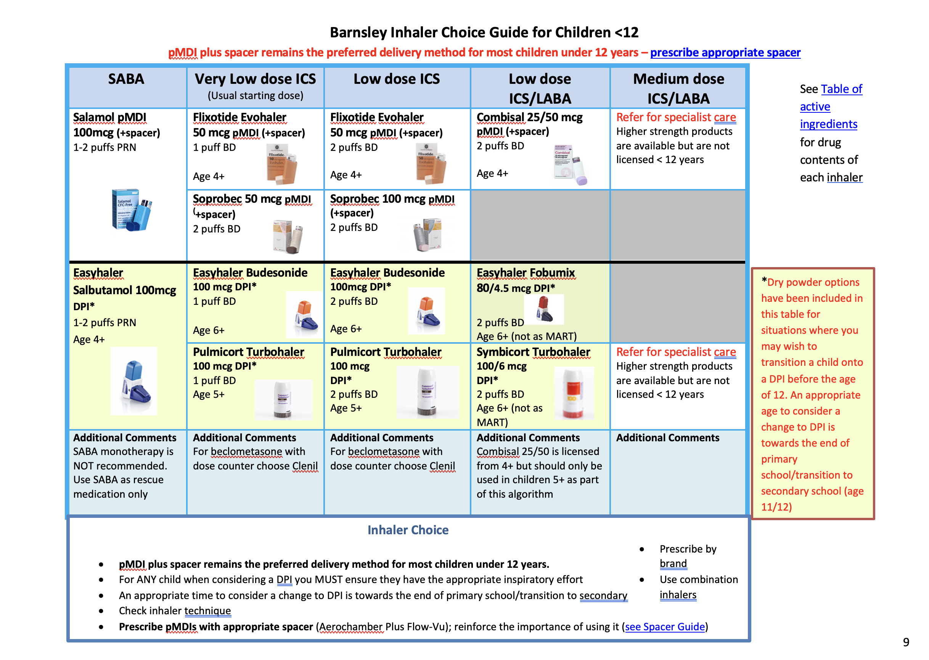

Slide 15
Next….
Share links - can access through BEST
barnsley-asthma-guideline-2024.pdf (best-prod-uks-wpp-site.azurewebsites.net)
Feedback update at future meetings
Questions?

