Slide 1
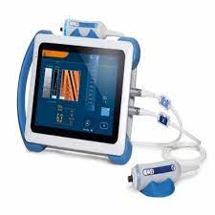
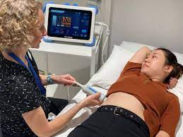
FIBROSCAN Lindsay Horobin Hepatology Nurse Specialist

Slide 2
WHAT IS A FIBROSCAN
It’s a Non-invasive quick and painless bedside test to measure the elasticity of liver tissue (or liver scarring), referred to as fibrosis
Provides enormous benefits to patients as in many cases there are no signs or symptoms of mild, moderate or severe liver disease
Uses an ultrasound probe to measure the speed of a vibration passing through the liver. ( the faster the wave the stiffer the liver)
Takes 15-20 minutes (often less)
Carried out in Medical Outpatients currently by Hepatology Nurse Specialist
Results given to patient on same day and lifestyle advice given and either discharged back to GP or referred for further management such as 6 monthly HCC surveillance
There can be some limitations with a liver fibroscan test.
Obesity
Liver inflammation
Ascites
Biliary obstruction
Liver congestion
Scar tissue

Slide 3
PATIENTS THAT WILL BENEFIT FROM A FIBROSCAN
People with potential recognised risk factors for liver disease
A history of excess alcohol intake
Diabetes
Obesity
People who have evidence of a liver condition where there is a need to work out severity
Metabolic Dysfunction Associated Steatotic Liver disease (MASLD) (Fatty Liver)
Alcohol related Liver Disease (ArLD)
Hepatitis B / C
Autoimmune Liver Disease
Primary Biliary Cholangitis
Primary Sclerosing Cholangitis
Haemochromatosis
Monitoring of patients on medication which may potentially cause liver damage

Slide 4
WHAT IS A NORMAL FIBROSCAN SCORE
A fibroscan score is recorded as a numerical value
The stiffer the liver the higher the numerical value will be
A fibroscan score is a numerical result ranging between 2-75kPa
A normal fibroscan range is approximately 2-8.5kPa
Scarring of the liver is measured by five stages
F0 = no scarring
F1 = mild scarring
F2 = Moderate Fibrosis
F3 = Severe Fibrosis
F4 = Advanced fibrosis or cirrhosis

Slide 5
FURTHER MANAGEMENT FOLLOWING A FIBROSCAN
F0 / F1 Fibrosis = Fibroscan score <7kPa normal liver no further management in secondary care required, discharged back to GP
F2 Fibrosis = Fibroscan 7 – 8.5kPa indicates mild scarring, lifestyle advice given, no further management in secondary care required, discharged back to GP
F2 / F3 fibrosis = Fibroscan 8.5 – 10.5kPa indicates moderate scarring, lifestyle advice given, repeat fibroscan in 12 months (organised by secondary care)
F3 /F4 Fibrosis = Fibroscan 10.5kPa and above –indicates severe scarring / Advanced fibrosis, lifestyle advice given and commenced on 6 monthly HCC surveillance (organised by secondary care)

Slide 6
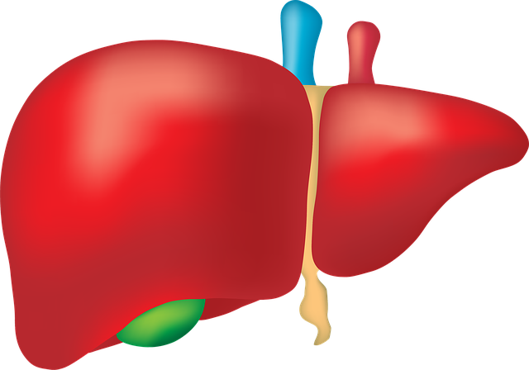
THANKYOU FOR LISTENING
ANY QUESTIONS ?

