Slide 1
Genetics in the NHS
Dr Jackie Cook, FRCP
Consultant in Clinical Genetics
Clinical Director for Rare Disease, North East & Yorkshire Genomic Medicine Service

Slide 2
Genetics in the NHS
Genetic services
Types and methods of genetic testing
Common genetic disorders encountered in General Practice
Cancer genetics and a family history of cancer
Common reasons for rejections of primary care referrals
Future developments that may impact on Primary care

Slide 3
Clinical Genetic Services
17 in England
Sheffield Regional Clinical Genomics Service
  6 consultants (4.7 WTE)
  12 genetic counsellors (9.1 WTE)
Commissioned by Specialist Commissioning - tertiary referral service
Commissioned to see patients with rare genetic conditions (affects less than 1 in 2,000) and families at high risk for an inherited condition

Slide 4
Sheffield Regional Clinical Genomics Service
Based at OPD2 at the Northern General Hospital in Sheffield, part of the Sheffield Children’s Hospital Trust
Cover South Yorkshire, North Nottinghamshire & North Derbyshire
  Sheffield
  Barnsley
  Rotherham
  Doncaster & Bassetlaw
  Chesterfield
  Grimsby
  Buxton

Slide 5
NEY Genomic Laboratory Hub
7 GLHs in England
NEY GLH
  Main hub lab in Leeds – majority of the genetic testing
  Lab in Newcastle – specialised genetic testing e.g. mitochondrial, RNA work
  Lab in Sheffield – dry lab analysis and reporting

Slide 6
Sub-specialities within Clinical Genetics

Slide 7
Diagnostic Testing
Sequencing a whole gene or more commonly a panel of genes with the aim of identifying a causative pathogenic variant
Previously only done in Clinical Genetics
Increasingly mainstreamed into secondary care
If there is strong clinical evidence that the patient has a specific genetic condition the diagnostic genetic test will be done in secondary care by the speciality managing their condition
Clinical Genetics see the most complex cases where the diagnosis is not straight forward and where the required test is not obvious.
Diagnostic testing is not done on unaffected individuals except in exceptional circumstances

Slide 8
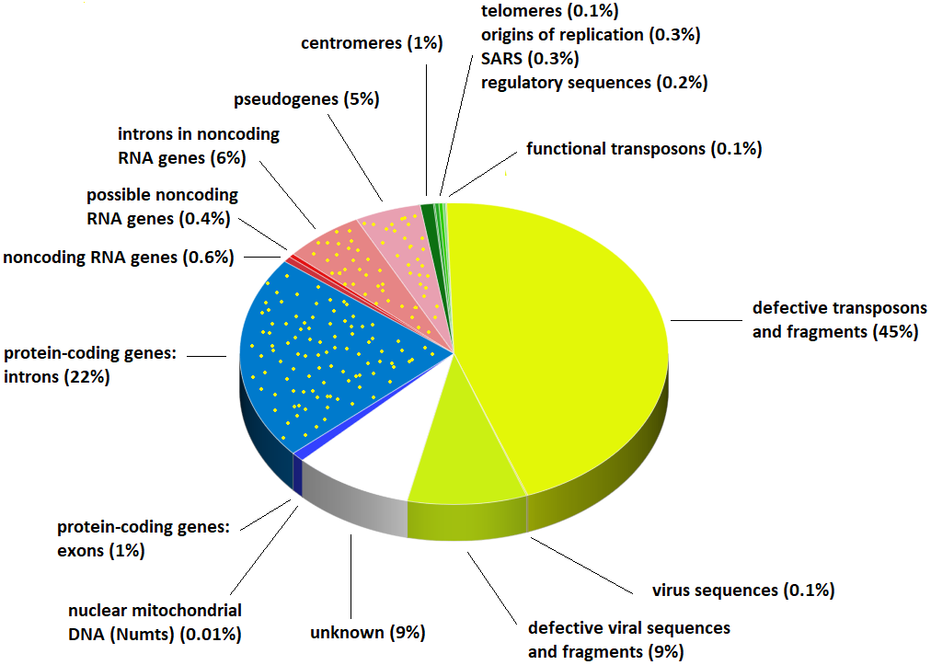
Human Genome
There are ~20,000 protein-coding genes
Protein-coding sequences make up 1% of the genome
Most known disease-causing variation is in the 1%
We’re not really sure about the rest…

Slide 9
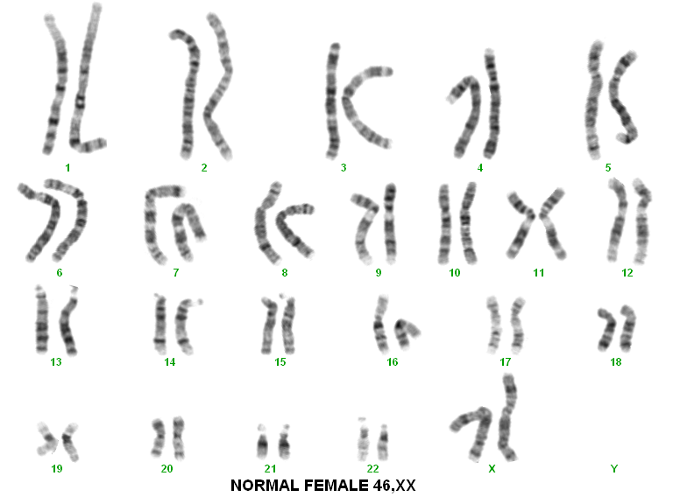

Slide 10
SNP Array
How we look at chromosomes in 2024
Single nucleotide polymorphisms – each individual has up to 5 million SNPs in their genome
Use technique to look for copy number variants (CNVs)
  Deletions
  Duplications
  Uniparental disomy

Slide 11
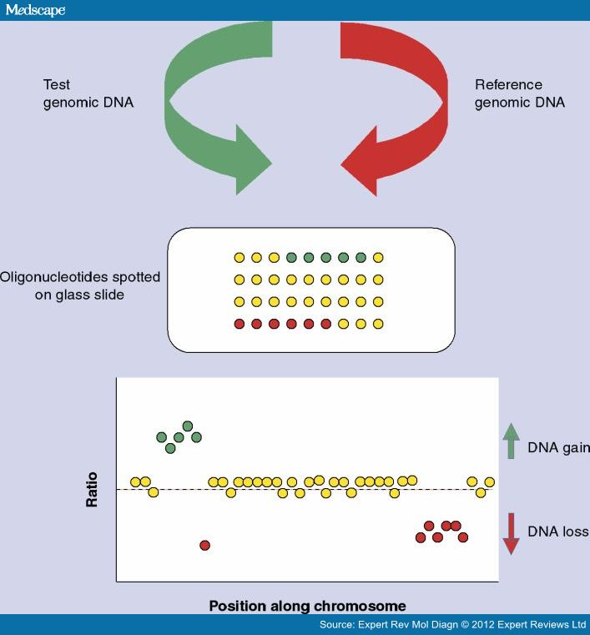
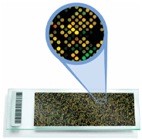
SNP Arrays / microarray

Slide 12
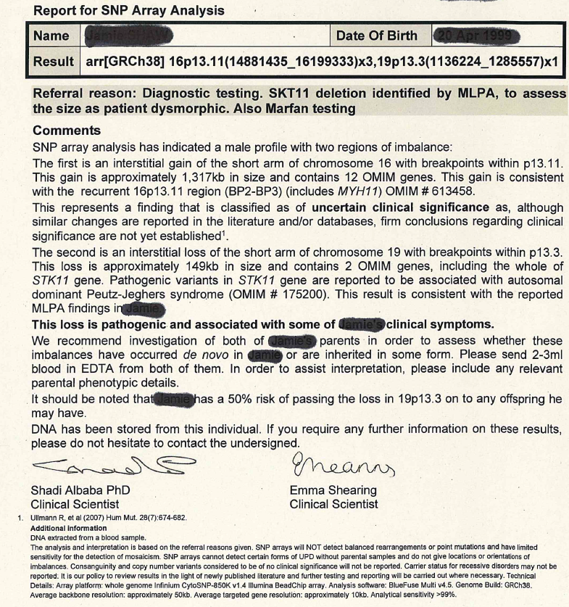

Slide 13
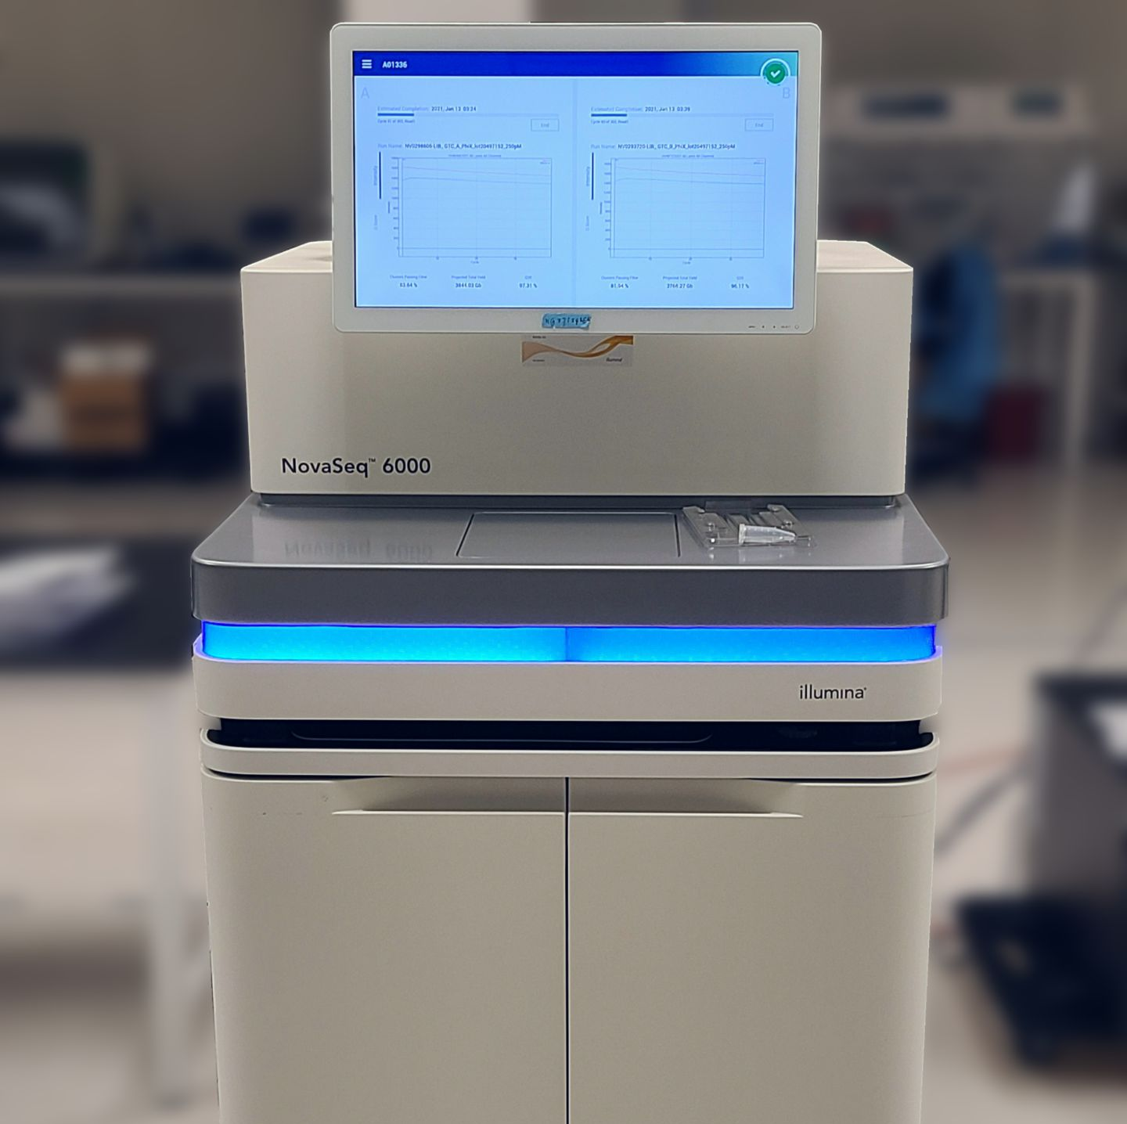
Next Generation Sequencing
Sanger sequencing – 10⁴ bases/run
Next generation sequencing – 10⁹-10¹⁰ bases/run
Sequence targeted genes e.g. all the cardiomyopathy genes
Notes:
13

Slide 14
What does the result mean – variant classification?
 |  | Posterior Probability that cause
5 | Pathogenic | 99%
4 | Likely Pathogenic | 90-99%
3 | Variant of Unknown Significance - VUS | 10-90%
2 | Likely benign | 0.1-10%
1 | Benign | <0.1%

Slide 15

What does the result mean – what is on the report?

Slide 16
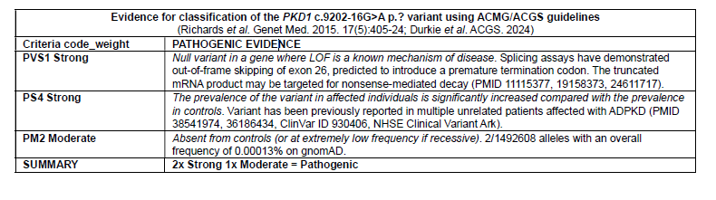
The evidence for Classification

Slide 17
Whole Genome Sequencing
There are ~20,000 protein-coding genes
Protein-coding sequences make up 1% of the genome
Most known disease-causing variation is in the 1%
We’re not really sure about the rest…
Whole Exome Sequencing looks at protein-coding regions
WGS looks at all coding and non-coding sequences
Diagnostic yield for all presumed genetic
conditions is 20-30% for both

Slide 18
Why can’t genetic testing be used to exclude a diagnosis?
There are about 20,000 genes which account for 1% of the genome
Each individual carries around 5 million variants in the coding genes
Not all genetic, inherited disease is due to pathogenic variants in the coding portions of the gene
There are regulatory mutation events that interfere with gene expression about which we know very little
In 2024 a genetic test will never rule out a diagnosis

Slide 19
Predictive testing
The causative pathogenic variant is known in the family
Testing to predict whether they may develop or be at increased risk to develop the condition in the future e.g. Huntington’s disease, inherited breast and ovarian cancer
Testing to see if they are a carrier of a recessive condition e.g. CF
Targeted test for the familial variant with a yes or no answer
Predictive testing is only done in Clinical Genetics
Often in response to a cascade letter sent to a patient’s relative

Slide 20
Prenatal testing - Methods of sampling
Chorionic Villous sample
  10 – 11 weeks
  Miscarriage risk 1 in 50
  Option of first trimester termination
Amniocentesis
  15 – 16 weeks
  Miscarriage risk of 1 in 100
  Not enough sample for a molecular genetic test
  Second trimester termination

Slide 21
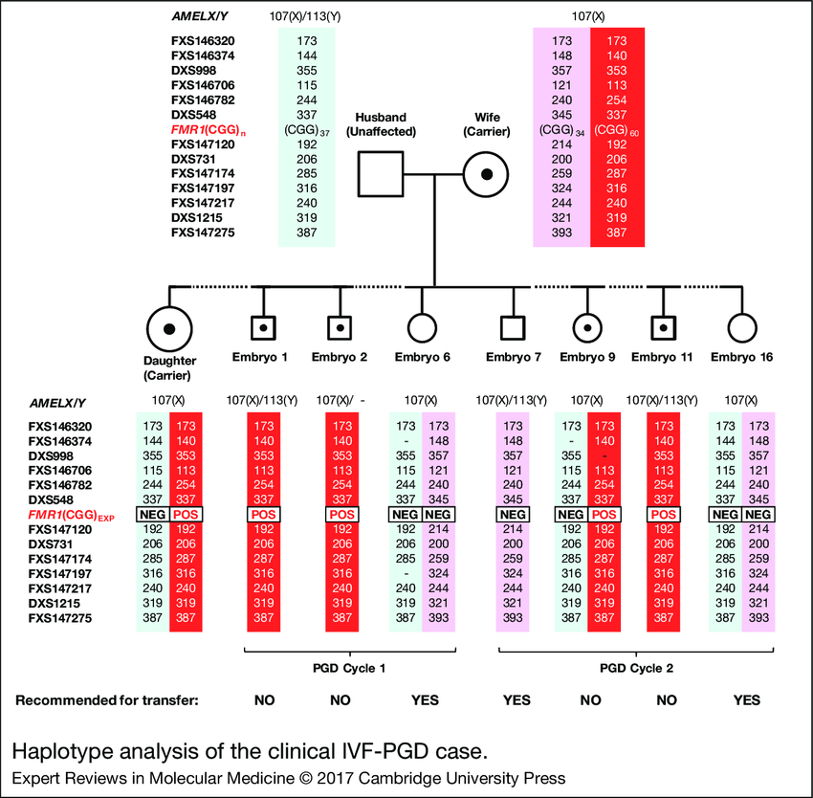

Preimplantation Genetic Diagnosis

Slide 22
Common genetics conditions seen in General Practice
Haemochromatosis
Alpha 1 anti-trypsin deficiency
Familial hypercholesterolaemia
Suspected Marfan syndrome

Slide 23
Haemochromatosis
Autosomal Recessive with incomplete penetrance
Causes progressive iron overload resulting in cirrhosis, diabetes, skin pigmentation and testicular failure
Incidence about 1/2000, carrier rate about 1/10
Iron studies show increased serum ferritin and raised transferrin saturation levels
2 common mutations C282Y and H63D
90% of symptomatic patients are C282Y homozygous, remainder are compound heterozygotes
Treated by venesection
Genetic testing can be requested by primary care

Slide 24
Autosomal Recessive Inheritance

Slide 25
Alpha 1 antitrypsin Deficiency
Autosomal Recessive with variable expression
Incidence 1/1600 – 1/1800, carrier rate 1/10
Predisposes to emphysema and cirrhosis
Normal variant – M variant
S variant 40% reduction in alpha 1 antitrypsin levels in SS individuals
Z variant 85% reduction in homozygotes
Rarely ZZ homozygotes will develop severe neonatal liver disease
Genetic testing can be requested by primary care

Slide 26
Familial Hypercholesterolaemia
1 in 250 people
Autosomal dominant
13X risk of coronary artery disease
LDLR, APLB, PCSK9
Think about if
  Total cholesterol > 7.5 mmol/L and / or
  Personal or first degree relative with premature coronary artery disease under 60
Referral to lipid clinic or inherited cardiac conditions clinic

Slide 27
Autosomal Dominant Inheritance
Parents

Slide 28
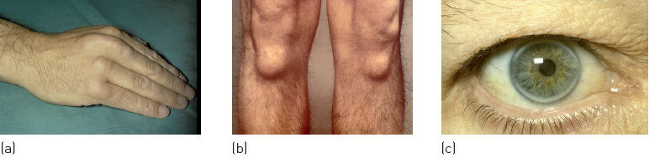

Cholesterol deposition in patients heterozygous for familial hypercholesterolemia. (a, b) Tendon xanthomata, and (c) corneal arcus.
Fig. Disease box 11 ©Scion Publishing Ltd
Photos courtesy of Dr Paul Durrington.

Slide 29

Marfan Syndrome
From Dean JCS (2007) Eur J Hum Genet 15: 724-33
Notes:
29

Slide 30
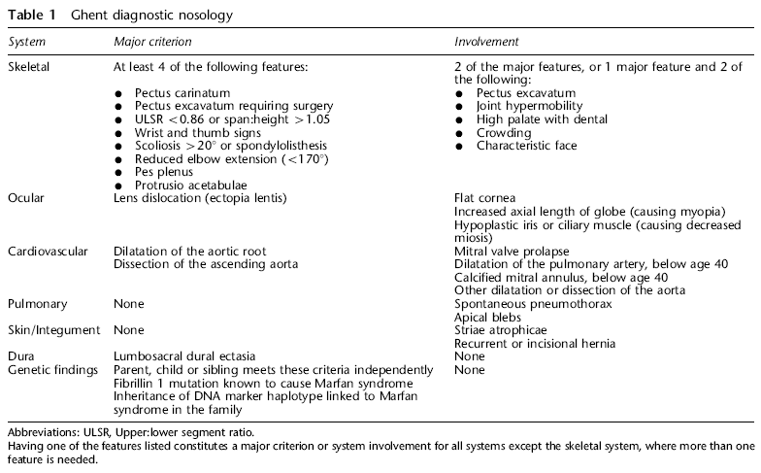
Marfan Syndrome
From Dean JCS (2007) Eur J Hum Genet 15: 724-33
Notes:
30

Slide 31
Cancer Genetics

Slide 32
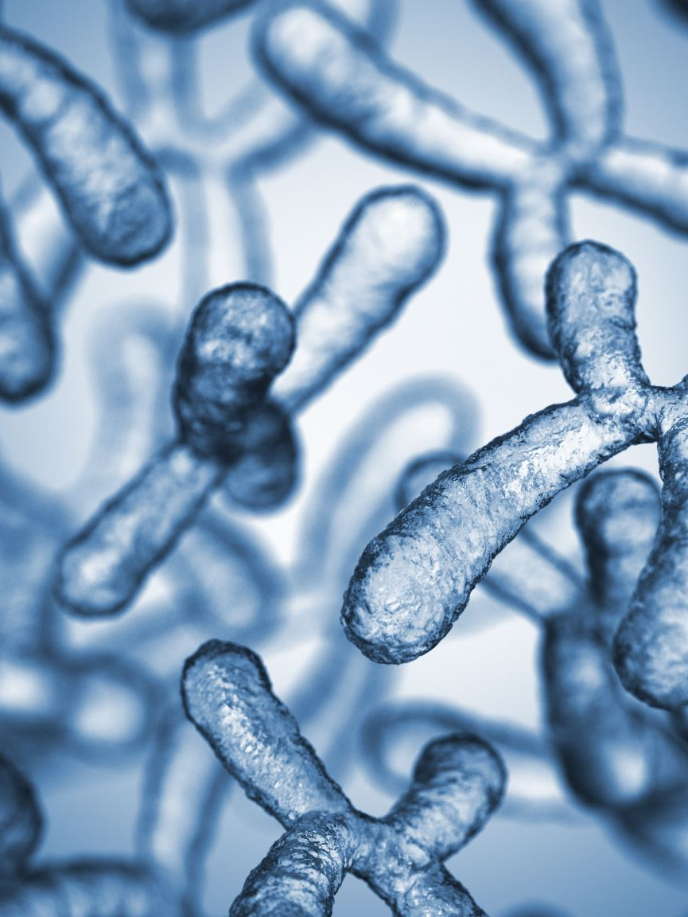
Cancer is a genetic disease, but rarely inherited
Cancer is due to damage to genes within the cell that are involved in cell growth and regulation
All cells accumulate genetic damage as we age – random event
Damage can include chromosome breaks and rearrangements, loss of genetic material, duplication of genetic material, specific genetic mutations
Damage to specific genes cause cells to grow out of control – driver mutation
Changes to genes that are confined to the tumour are called somatic or acquired variants

Slide 33

Causes of genetic damage within cells
Internal
Impaired repair, chemical reactions e.g. deamination, oxidation, alkylation
External
Radiation from the sun e.g. melanoma, skin cancers
Carcinogens in cigarette smoke – lung cancer
Ingested chemicals – bladder cancer
Inhalation of asbestos fibres – mesothelioma
Viral infections – HPV in cervical cancer

Slide 34

What can the mutations within a cancer tell us?
Diagnosis
  Usually obvious clinically
  May allow classification of a tumour subtype e.g. CTNNB1 mutation in a craniopharyngioma is associated with the adamantinomatous subtype
  Helpful for primaries of unknown origin
Prognosis
  E.g. KRAS mutations in colon cancer are associated with poorer survival and increased tumour aggressiveness

Slide 35

What can the mutations within a cancer tell us?
Treatment
  Lung cancer
    Presence of EGFR, KRAS and ALK mutations influence treatment and how responsive the tumour will be to different chemotherapy regimes
    Allows targeted, precision medicine
    Drugs are being developed that target specific genes and specific mutations within genes – pharmacogenomics
  Breast cancer
    HER2 amplification indicates treatment with Herceptin

Slide 36
Cancer in Families
1 in 2 people will develop cancer at some point in their lifetime
That means that most families will have a family history of cancer
Some families have a particular type of cancer that appears to have occurred more frequently than chance
More common in the common cancers e.g. lung, breast, colorectal, prostate
They occur around the typical ages for those particular cancers
This is due to multiple genes, each of small effect and shared environmental factors – polygenic / multifactorial

Slide 37
Why do some common cancers occur more often in some families than others?
We all carry variation in our genes that make us more or less likely to develop specific cancers, diabetes, hypertension, coronary artery disease, all common diseases
Each family unit, with shared genetic variants, is more or less susceptible to develop particular conditions
Compounded by a shared environment

Slide 38
Inherited Cancer
Breast / ovarian cancer
Accounts for around 5% of breast cancer and 10-15% of ovarian cancer
Bowel cancer / Lynch Syndrome
Accounts for around 2-4% of bowel cancer and 2.5% of endometrial cancer
A number of extremely rare “cancer syndromes” with more unusual tumour types

Slide 39
Important features in a family history of cancer
Several family members affected with the same cancer, in several generations, on the same side of the family, who are closely related to the patient
Young ages of diagnosis
Incidence of associated cancers e.g. breast and ovarian cancer or bowel and uterine cancer
Incidence of multiple primaries in a single family member

Slide 40
Lung cancer 65
Pancreatic cancer 58
BCC face 73
Lung cancer 72
Cervical cancer 43
Breast cancer 62
Bowel cancer 65
Breast cancer 59

Slide 41
Breast cancer 35
One relative – risk is determined by age of diagnosis

Slide 42
b.
a.
2 relatives with breast cancer
Breast 62
Breast 55
Breast 62
c.
Breast 55
d.
e.
Reast 62
Breast 55
Breast 62
Breast 55
Breast 62
Breast 55
2 relatives – risk determined by age, relationship to other affecteds and to patient

Slide 43
Hereditary Breast / Ovarian Cancer
Breast cancer at 42
Breast cancer at 54
Ovarian cancer
at 41
Breast cancer at 32
Ovarian cancer
At 45
Breast cancer at 38

Slide 44
Inherited Breast / Ovarian cancer
About 5% of breast cancer and 10-15% of ovarian cancer
3 high risk genes – BRCA1, BRCA2 and PALB2
Autosomal dominant inheritance
More common in women diagnosed at young ages, under 40
More common with triple negative breast cancers
More common when there is a significant maternal or paternal family history of breast and ovarian cancer
50-70 % lifetime risk of breast cancer (population risk around 13%)
10–40% lifetime risk of ovarian cancer (population risk around 1-2%)

Slide 45
Inherited Breast and Ovarian cancer
Initial diagnostic testing done on blood from an affected individual that meets the current criteria based on age, tumour type and family history
If a mutation is identified, cascade testing can be offered to family members
High risk individuals are offered screening and risk reducing surgery

Slide 46
Referral Pathways from Primary Care
Affected individuals, that meet the testing criteria (all ovarian cancers, breast cancer <40, triple negative breast cancer <60, bilateral breast cancer <60, male breast cancer) are tested either in secondary care or Clinical Genetics
Unaffected individuals with a family history that meets the NICE guidelines should be referred to the breast cancer family history units in secondary care. Most will not be offered genetic testing but will be offered enhanced breast screening
Individuals with a known familial pathogenic variant in one of the breast/ovarian cancer genes should be referred to Clinical Genetics for predictive testing

Slide 47
Hereditary Bowel Cancer
Bowel cancer at 43
Uterine cancer
at 43
Bowel cancer
At 54
Bowel cancer
At 54
Bowel cancer
At 29
Ovarian cancer
At 45
Bowel cancer
At 32

Slide 48
Lynch Syndrome
About 2-4% of bowel cancer and 2.5% of endometrial cancer
3 high risk genes – MLH1, MSH2 and MSH6
1 moderate risk gene PMS2
Autosomal dominant inheritance
More common if diagnosed at young age
More common when significant family history of bowel and endometrial cancer
High risk genes 40-70% lifetime risk of bowel cancer (population risk about 5%), 40% risk of endometrial cancer (population risk about 3%)

Slide 49
Lynch syndrome
Initial testing done on tumour
If indicated germline testing done on blood sample
If a mutation is identified, cascade testing can be offered to family members
High risk individuals are offered screening

Slide 50
Referral pathways from Primary Care
All patients affected with colorectal or endometrial cancer now have Lynch genetic testing on the tumour and are referred to Clinical Genetics if positive
There are no bowel cancer family history clinics so we will accept referrals for a family history of bowel cancer where there are multiple affecteds particularly diagnosed at young ages
Individuals with a known familial pathogenic variant in one of the Lynch cancer genes should be referred to Clinical Genetics for predictive testing

Slide 51
Reasons for rejection of referrals from Primary Care to Clinical Genetics
Referrals for a family history of cancer where the risk is not high. We will re-direct to a family history clinic for enhanced screening or give advice and guidance
Common genetic conditions where testing can be done in primary care
  Haemochromatosis
  Alpha 1 antitrypsin
Referrals for genetic conditions where testing is always done in secondary care
  Haematological conditions e.g. sickle cell, thalassaemia, haemophilia, factor V Leiden
  Familial hypercholesterolaemia

Slide 52
Reasons for rejection of referrals from Primary Care to Clinical Genetics
Hypermobility or Type 3 Ehlers-Danlos syndrome
  All the evidence suggests that this is not a single gene disorder and there is no diagnostic genetic testing for it as no causative genes have ever been identified
  Additional features that would be concerning include:
    Learning difficulties
    Dysmorphic features
    Pectus deformity, scoliosis or kyphoscoliosis
    Cardiovascular features including aortic dilatation, arterial aneurysms or dissections, valvular abnormalities

Slide 53
Reasons for rejection of referrals from Primary Care to Clinical Genetics
Diagnostic testing in unaffected individuals where no pathogenic variant has been identified in a family member. Diagnostic testing can never be used as an exclusion test
Testing for susceptibility genes e.g. HLA haplotypes. These do not give any prognostic information. They may be used in specialities such as rheumatology to inform diagnosis and direct treatment in affected individuals
Results of Direct to Consumer testing

Slide 54
Future Developments - Pharmacogenomics
Genetic testing to target treatment e.g. HER2 testing in breast cancer
Testing to identify individuals at risk of drug reactions e.g. DPYD testing before prescribing 5 FU
Testing to identify non-responders e.g. CYP2C19 testing before prescribing clopidogrel
Increasing numbers of drugs are being approved by NICE that require pre-prescribing genetic testing

Slide 55

Questions?

