Slide 1


Barnsley LMC Update January 2024
Presented by Dr Clare Bannon and Munsif Mufalil

Slide 2

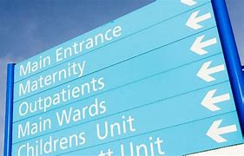
Primary- Secondary Care Interface
Contract Breeches
Cardiology Focus- Onward referrals, prescribing, letter sent to all Cardiologists
Improvements- In Barnsley Orthopedics , optometry providing Med3s, and communication to all departments around this
A&E can now refer to RACPC, ECHO recall should be automatic
Hopefully Radiology Access has improved with new process
Continue to feedback
South Yorkshire interface project ICB
Presented by Dr C Bannon

Slide 3

LMC Elections and structural update
We are currently holding elections for new committee members
2 from each ‘locality’
Opportunity to be involved with representing colleagues at place , ICB and informing national policy
Extended the nominations for a further week, please do consider putting yourself forward
Looking at LMC becoming a limited company
Changes to Mentoring
Peer support CQC
Further information will be sent out
Presented by Dr C Bannon

Slide 4

March 12th Event – Time to say no?
General Practice Safer working, How to say no, BMA Contract update.
Join us at this exciting event for GPs in South Yorkshire, brought to you by Sheffield, Rotherham and Barnsley LMCs.
With Guest Speaker Rachel Morris, GP and well-known Podcaster of, ’You are not a Frog- The podcast that helps people under pressure beat burnout and work happier
And David Wrigley Deputy Chair of GPC England
March 12th 7-9pm @Mercure Sheffield Parkway
Light Buffet will be provided
Presented by Dr C Bannon

Slide 5
Thank you for listening.
01226 355 824
barnsley.lmc@nhs.net
www.barnsleylmc.co.uk

