Slide 1
Nurses AHPs and Carers
Creating Partnerships Across Integrated Care Systems
Andrea Parkin BHF Head of Nursing and AHPs

Slide 2
Nurse/Carer Creating Partnerships Across Integrated Care Systems
New findings from Carers UK and the University of Sheffield show that unpaid carers in England and Wales contribute a staggering £445 million to the economy in England and Wales every day, equating to £162 billion per year.
The value of unpaid care is equivalent to a second NHS in England and Wales, which in 2020/21 received an estimated £164 billion in funding.
Unpaid carers are those looking after relatives or friends who have long term conditions, disability, illness, mental health conditions or who need additional comprehensive health and social care support as they age.
Despite increases to NHS funding over the last 10 years, increases to health and social care funding have not kept pace, as an integrated care system we are now relying ever more heavily on unpaid carers to manage families within our communities. Providing increasing hours of unpaid care, family members have no choice but to give up work or reduce their hours to do so, impacting adversely upon their physical, psycho- social and mental health needs.

Slide 3
Caring as a Social Determinant of Health Across Populations
There is increasing evidence that ‘caring’ should be considered as a social determinant of health as outlined in 2021 by a public health England report. Carers UK suggest that Caring can have a significant impact on health and wellbeing with 60% of carers reporting a long-term health conditions or disability compared to 50% non-carers.
In 2022, following the implementation of the Fuller report, Primary and Community Care systems were challenged to bring a specific focus on a working partnership with people, inclusive of carers and those professionals working within complex health and care systems. Moreover in 2023, Statutory guidance was issued to integrated care boards across England to enable and support universal system change, covering the core personalized care principles and the leadership required to realize these benefits.

Slide 4
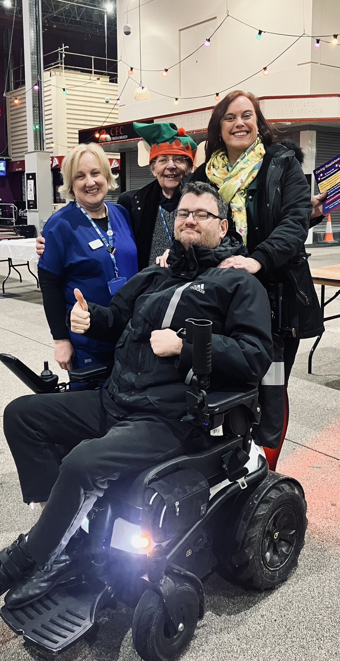
Development of Nurse and Carer Partnerships across Three Integrated Care Systems/ Conurbation.
The ‘Carers Roadshow’ is a concept developed by Trevor Clower who is a carer and an NHSE Peer Leader in Nottingham. The Carers Roadshow supports a ‘street to strategy ethos’ across local marketplaces delivered by local people working and living at the heart of communities to identify advise and support carers across the life course.
As the workforce closest to their communities our primary and community nurses in partnership with family carers share a long history of engaging and connecting with local communities and with addressing the social determinants of health that impact on the burden of caring responsibilities.
Combing the talents and expertise of both our carers, nursing teams together with our community voluntary and social enterprise sector, a joint carers roadshow across Yorkshire was developed encompassing three integrated care systems. This has been a large system piece of work in collaboration with roadshow founder Trevor Clower, Primary and Community Nursing teams together with Care System Leaders to support and enable unpaid carers within their local communities.

Slide 5
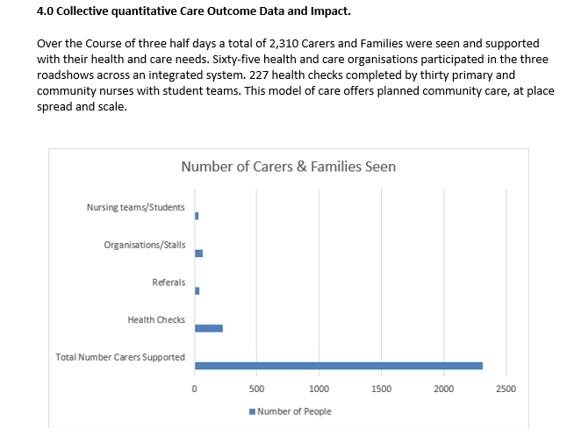

Slide 6
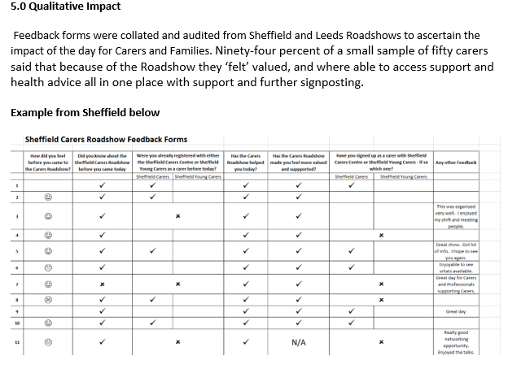

Slide 7
What do Staff Say?
‘Am a third-year student nurse, the carers roadshow has been a learning curve. It is great to feel your part of a bigger community team, all working together at the heart of our community.’
‘I have loved working with Trevor and unpaid carers, I wish we could have more diverse placements like this in our community placements. It has been fun and meaningful, feel like I have had influence in a small way.’
‘I am a Parish Nurse; this is my bread-and-butter work and care. We need to see the development of more Nurse and Carer Partnerships across the country.’
‘Am a General Practice Nurse and have been a carer for a brief period of my life and understand how difficult this can be. every integrated system should undertake these roadshows… it really helps us as nurses not to feel isolated or alone.’
‘What we offer as a District Nursing team is amazing. Our caseloads are vast, and often we do not always have the time to spend with our carers. I have really valued being part of the roadshows.
‘As a student nurse, I had no idea what to expect and was actually quite nervous about delivering health checks on a market stall, but actually I have really enjoyed the day and would recommend this to other students thinking of a community placement.’
‘We are specialist nurses working across the community and our local hospitals. We very rarely get the real time opportunity to see what our voluntary and social enterprise services can offer. I will be taking away a list of organisations that can support our patients and carers locally.’

Slide 8
Critical Impact & Outcomes
As an integral part of the roadshow planning, NHSE has supported the production of a video from one of the roadshows, that captures the essence and ethos of the day.
Carers Roadshow Barnsley (main film) (youtube.com)
Patient Care and Safety
Primary and Community Nurses Student Nurses identifying Carers, and their unmet needs. Recognition of ‘Caring’ as a social determinant of health. Forming Relationships to support population health across community voluntary and social enterprise sector. Creation of ‘Placement’ opportunities for primary and community nurses.
Sustainability
The Yorkshire Carers roadshows have also been highlighted by the national Carers team at NHSE and shared with Carers across England. Trevor Clower has presented this work at National Level. In terms of sustainability, all three integrated care systems have agreed to host an annual roadshow event to continue the development of integrated system care and nurse carer partnerships.
Spread and Scale
Additional 8 Roadshows Planned this year 2024: Including Birmingham, Cornwall and Greater Manchester

Slide 9
References and further reading
Leeds Carers Roadshow to Highlight Support Services for Unpaid Carers – Carers Leeds
Caring as a social determinant of health (publishing.service.gov.uk)
valuing-carers-report.pdf (carersuk.org)
Microsoft Word - FINAL 003 250522 - Fuller report [46].docx (england.nhs.uk)
Working in Partnership with People and Communities (england.nhs.uk)
Sheffield Carers Centre
General Practice Nursing National and Regional Update - Webinar 18 (14th July 2023) (vimeo.com)

