Slide 1
EHC UPDATE
Pharmacy BEST October 2024

Slide 2
About Spectrum
Not-for-Profit Social Enterprise
Employee-led, Values-driven, currently about 900 staff across the North of England
Three complimentary business units
Sexual Health (BISH/WISH)
Substance Misuse
Health and Justice
Passion to make a difference for vulnerable people
Senior clinical leaders with years of NHS experience in challenging and complex environments
Notes:
BELINDA (To hand over to Sylvia for next slide)
We are regulated by CQC

Slide 4
U18 conceptions /1000

Slide 5
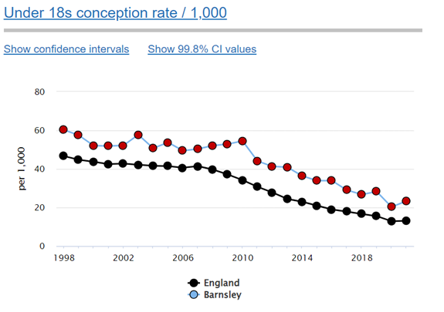
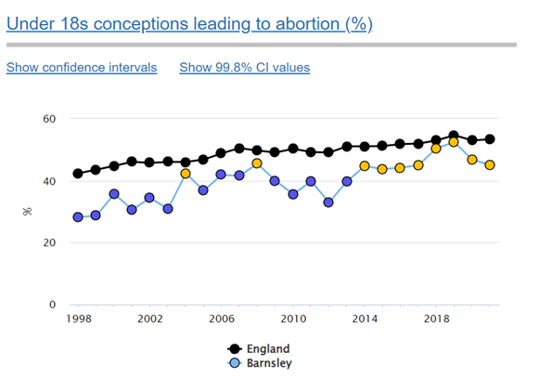
Fingertips Data

Slide 6
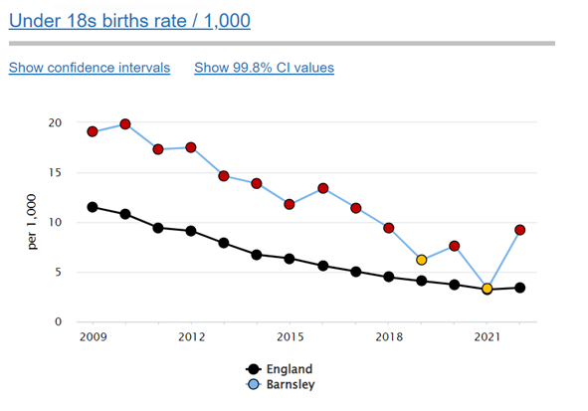
Fingertips Data (Cont.)

Slide 7
LARC UPTAKE

Slide 8
Service Model
Pharmacies can sign up to our contract to provide EHC ∴ ↑access for YP
The under 25 female population
Women who have had unprotected sex in the last 96hrs for Levonorgestrel (LNG) and 120 hours for Ulipristal (UPA).
The copper intra-uterine device is the recommended, most effective method of post coital contraception, refer into ISH but still give EHC.
The provision of the appropriate medication should be based on Faculty for Sexual and Reproductive Health (FSRH) Guidelines.

Slide 9
The Medicines available
Levonorgestrel (LNG) (1.5mg), issued via Patient Group Direction.
May need dose increasing to 3mg if BMI >26 or above 70kg (FSRH)
Ulipristal (UPA) 30mg issued as a P Medicine.
No further hormonal contraception for 5 days at least after UPA

Slide 10
Payments
There will be a reimbursement of the actual wholesale drug costs (NHS Tariff £5.20 for LNG and £14.05 for UPA + VAT @5%)
A payment of £18/consultation for pharmacists involved in this scheme.

Slide 11
Who will administer/dispense the medication?
Services need to be easily accessible
Dispense or Administer?
Ideally the consultation needs to be face to face
Open extended hours including evenings and weekends (this is not essential, especially if you are in an area of high need).
Locum pharmacists who feel they are competent to deliver EHC can sign the contract/PGD to deliver EHC in the pharmacy they are locum in.

Slide 12
What next for the patient?
EHC is not a method of contraception
If the patient consents, you can refer/signpost the patient to us for further support
To make sure they have obtained/recommenced a reliable method of contraception
They have had a period, if not they will need to do a pregnancy test.
Consented for a chlamydia postal kit to be sent out
Appointment for any further/ongoing care, if required

Slide 13
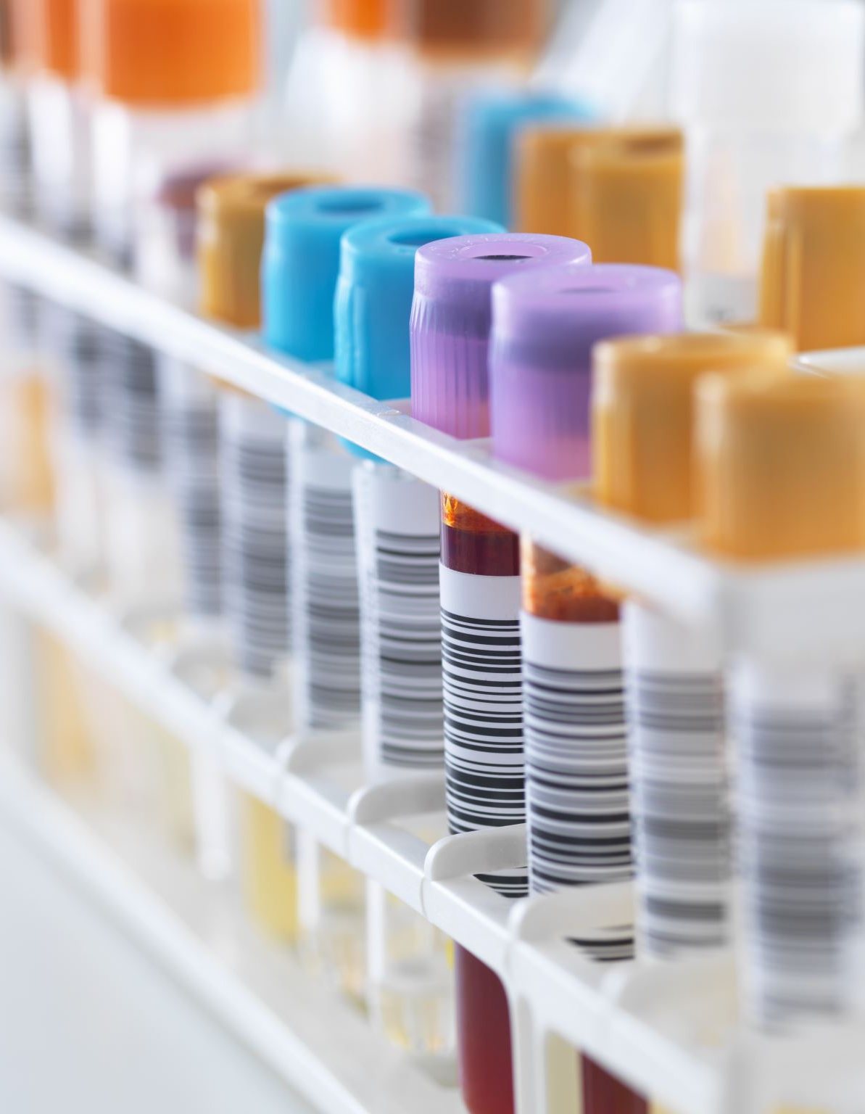
What else for the patient?
If the patient has received Emergency Contraception, the patient should be given advice on where/how to access condoms (C-Card), STI risk, and ongoing contraception options. We can support this with the provision of “Contraception Choices” information
Ideally (with consent) the patient should be referred in to Integrated Sexual Health services in order for there to be routine follow up after emergency contraception, (e.g. Menses, Pregnancy Test, STI testing, and ongoing contraceptive needs met)
We can support with posters with QR codes to order testing kits/condoms etc

Slide 14
Safeguarding
If the patient is under 19 - a safeguarding risk assessment in line with the national standards.
If the patient is under 16 - an assessment of Fraser Competence will also be required.
Referral into ISH service is significantly more important with young people as it means we will have an audit trail of where the patient is attending. This prevents young people being “trafficked” around services by exploiters as it is on one central record.

Slide 15
Safeguarding
It is expected that the pharmacist will be up to date with their safeguarding level 2 mandatory training.
There is no lower age limit for this scheme if there is immediate pregnancy risk, however your safeguarding procedures should be followed, and the patient should be referred to appropriate agencies.

Slide 16
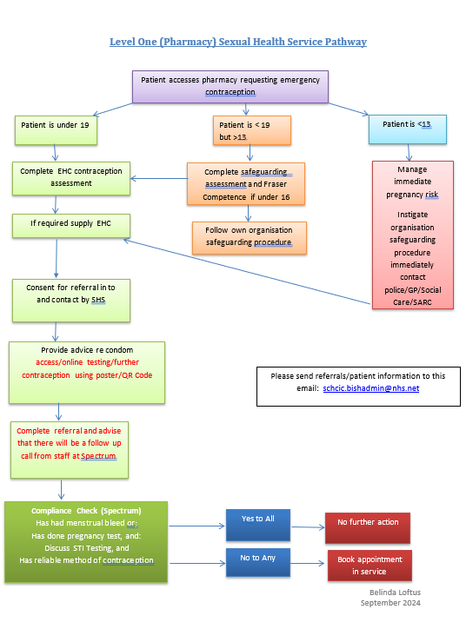

Slide 17
If the pharmacy wishes they can sign up to the C-Card Scheme which will involve some brief training and registration with the website, you are then able to order condoms as required through the website to provide to those young people accessing the service
To arrange training, please contact the service and ask to speak to a member of staff in relation to the C-Card Scheme/Chlamydia Screening Services
We can provide communication/posters for all this information

Slide 18
Referrals into ISH
Referrals can be made by phone or by sending the consultation assessment form through to BISH via PharmOutcomes or by using our safehaven inbox:
schcic.bishadmin@nhs.net

Slide 19
Questions

Slide 20
Thanks for listening

