Slide 1
Health Integration Team
Breaking Down the Barriers
Building Community Based Assets

Slide 2
Hi Everyone
Bev Jones BA (Hons) PgDip RN MMedSci NMP TB Dip
Lead Nurse HIT/TB
Ian Stables – RGN, BSc, ENB 998
Specialist Nurse HIT / TB
Health Integration Team / TB Service
170a Sheffield Road
Barnsley
S70 4NW
01226 731686
HealthIntegrationTeam@swyt.nhs.uk

Slide 3
Objective of today’s presentation.
Provide an overview of the HIT / TB services
Focus to be around HIT and developments within the service.
The Health Integration Team (HIT) was formed in 2008 having evolved from the team previously known as Barnsley Asylum Seeker Nursing Team (2003).
Aim
The origins of HIT was to facilitate the integration of overseas arrivals and ethnic minorities into mainstream health services.
Keys services provided by the Health Integration Team Barnsley
HIT Sheffield Road Barnsley (Asylum / Migrant / Traveller Health)
Mental Health Nursing Support Service
Barnsley TB service
Wakefield TB service

Slide 4
Health Integration Team
Barnsley Health Integration Team
Barnsley TB Service
Wakefield TB Service
Asylum Seeker Health following dispersal
Migrant Workers
New entrant screening
Mental Health nursing support service
Gypsy and Travellers
Drop in Service
Advice and Information on minor ailment
Community Events
Attend Women’s / Men’s group
Conversation Club
TB Champions
Caseload Management
Contact Tracing/Screening
Advice and Information
Education and Awareness
Consultant Chest clinics
Health promotion / prevention work
New Entrant Screening Clinic
Caseload Management
Contact Screening Clinic
Advice and Information
Education Awareness
BCG Vaccination
Chest X-rays
Underserved populations drop in sessions
Prisons
TB Champions / link nurse

Slide 5
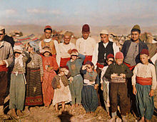
Initial Holistic Health assessment
Physical
Mental
Psychological
Emotional
Sexual
social
PATIENT EXPERIENCE
New Entrant Screening
TB screening
HIV
Hep C
Hep B
Sexual Health screening
Baseline bloods
Receive a Welcome pack
Information on all service to access in Barnsley, dentists, opticians, pharmacies, support groups etc including maps and contact details
SIGNPOSTED AND REFERRED DIRECTLY AT POINT OF CONTACT
Notes:
The focus of the presentation today revolves around the work being developed at HIT Sheffield Road Barnsley.

Slide 6
Partnership Working – Community Based Assets

Slide 7
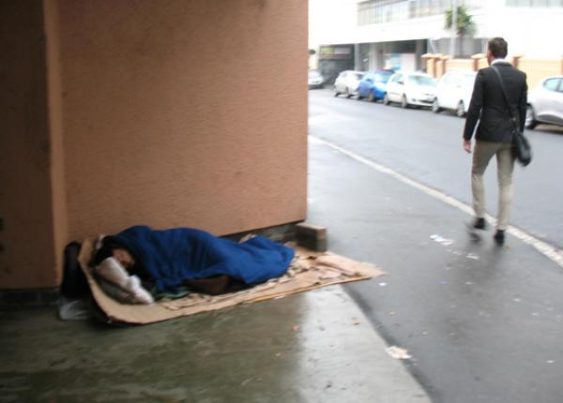
CONVERSATION CLUB
WOMEN’S GROUP
MEN’S GROUP
HOMELESS DROP-IN
MIGRANT DROP-IN
ROADSIDE ENCAMPMENT VISITS

Slide 8
Our Partners
Home Office
Asylum Housing Provider
Refugee Council
Voluntary Action Barnsley
Barnsley Metropolitan Borough Council
Independent Domestic Abuse Service
MIND
BSARC
Spectrum BISH service
Urban House
Police
GP surgeries

Slide 9
NHS Services Primary and Secondary care
Mental Health service
Ashiana
Combat Trafficking Unit
Salvation Army
Homeless Drop-in Centre
Social Prescribing
TB services
Public Health England
Child Health Services
Schools and Colleges
Prisons
ASOS and other large employers

Slide 10
Future HIT Plans
GO WITH THE FLOW!
Each individual’s needs are fluid and are constantly changing.
We are a multi-skilled, proactive team who deal with whatever flows in through the door.

Slide 11
Future TB Service plans
Embed and extend current Community TB Champions across Barnsley PCN network
Increase Health Promotion and TB awareness training across all other services and agencies
Increase GP referral in to HIT for new entrant screening for all new arrivals
Development of Wakefield’s TB service Band 5 Community TB staff Nurse - (development post, initial focus on health promotion and prevention work)

