Slide 1
An introduction to the work of MSIUK Reproductive Choices
Angela Keane

Slide 2
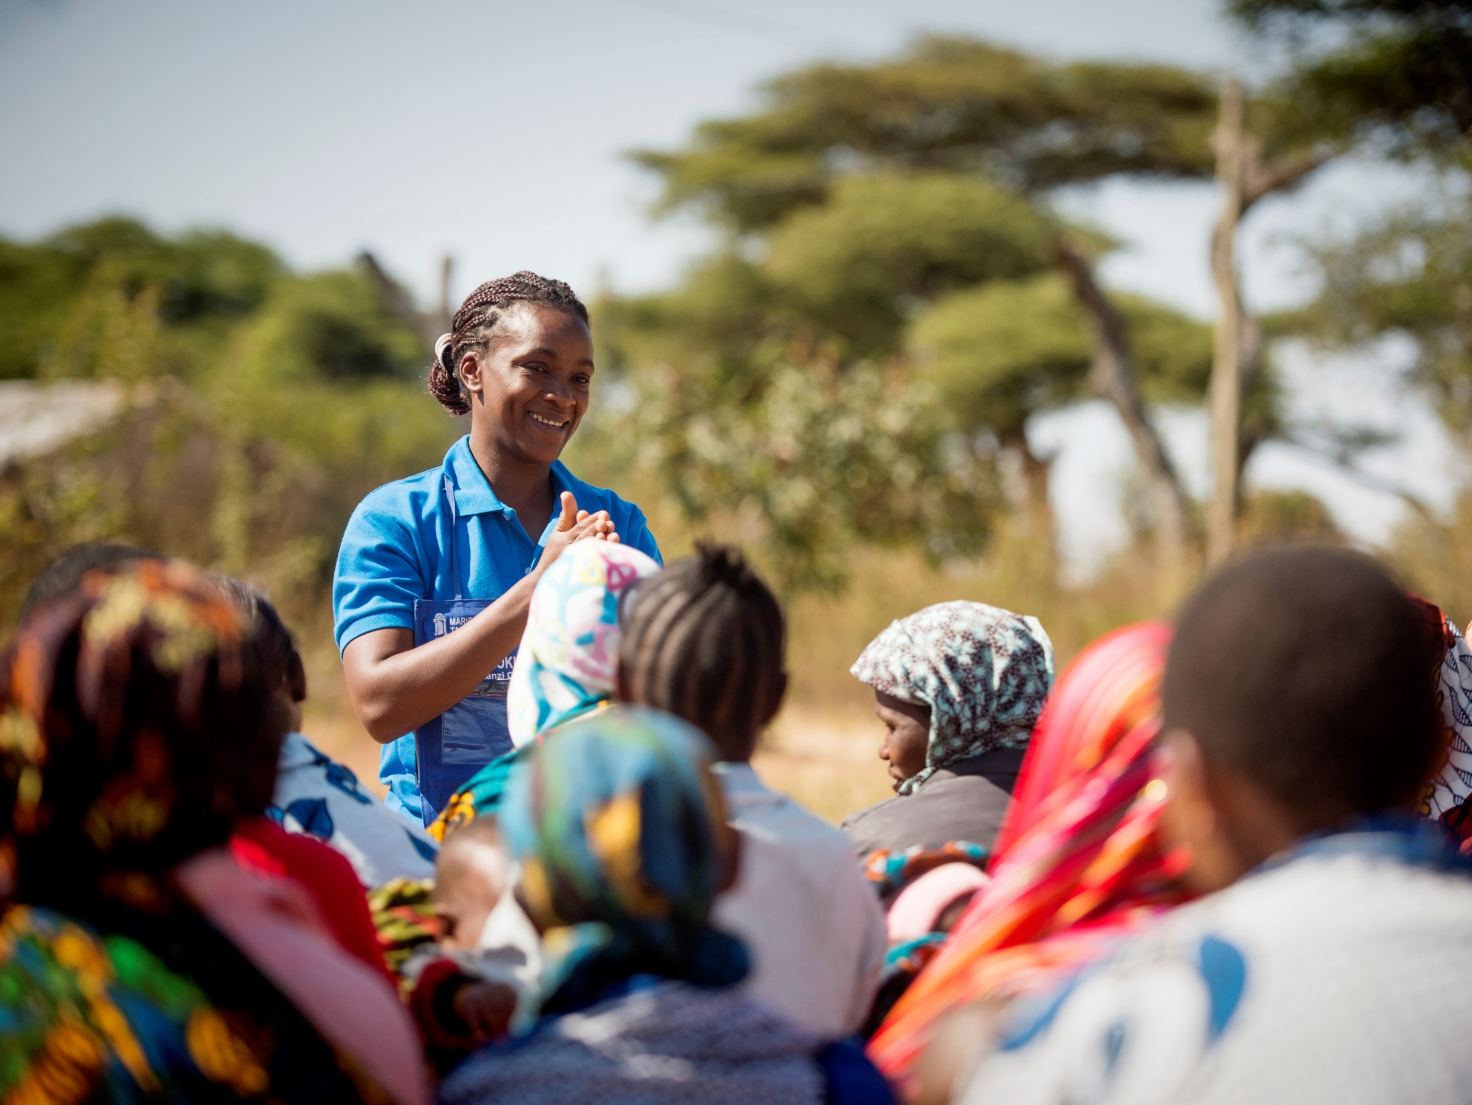
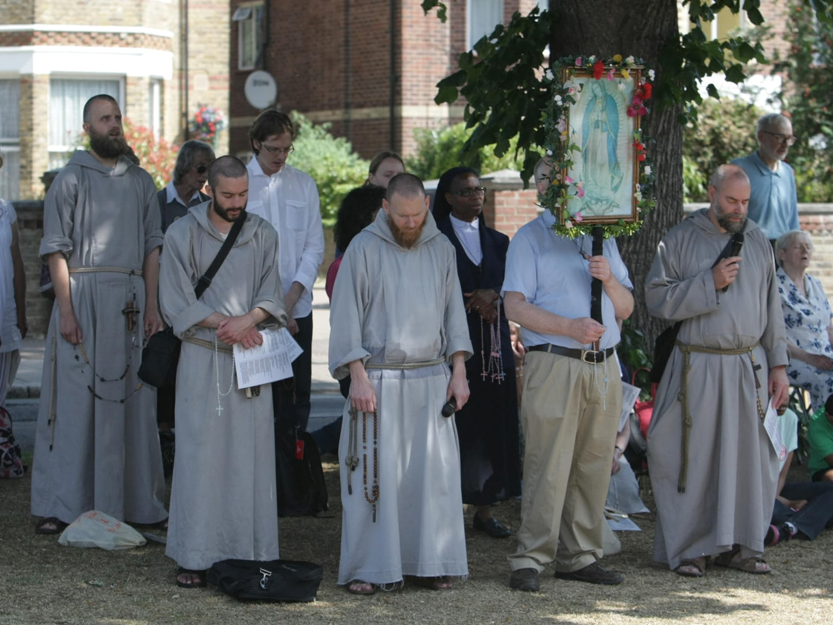
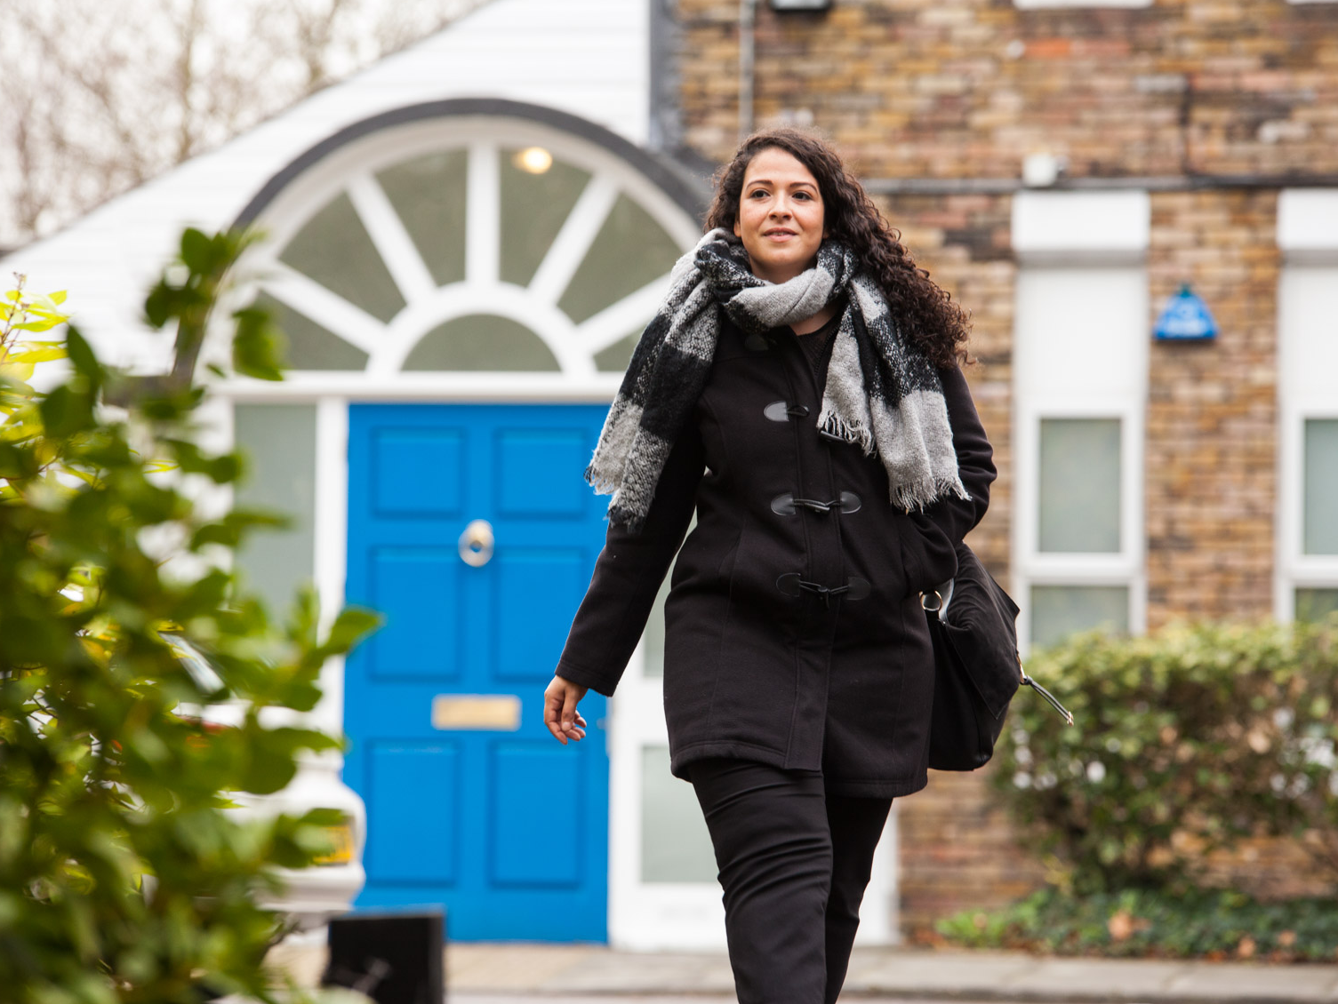
We are MSI Reproductive Choices MSIUK
Providing abortion services to
more than 62,000 women every year

Slide 3
Marie Stopes International working in:
Australia
Cambodia
China
Fiji / Pacific
Mongolia
Myanmar
PNG
Philippines
Timor Leste
Viet Nam
Albania
Austria
Belgium
Ireland
Romania
UK
Afghanistan
Bangladesh
India
Nepal
Pakistan
Sri Lanka
USA (Support Office)
Burkina Faso
Ethiopia
Ghana
Kenya
Madagascar
Malawi
Mali
Namibia
Nigeria
Sierra Leone
Yemen
Sudan
South Africa
Swaziland
Tanzania
Uganda
Zambia
Zimbabwe
Mexico
Bolivia
Notes:
3

Slide 4
What does this mean locally?
Community Treatment Centres (CTC)
Sheffield
Doncaster
Rotherham
Barnsley

Slide 5
What does this mean locally?
Surgical Centres
Leeds
Manchester
South Yorkshire Regional Treatment Centre

Slide 6
Abortion Services are Self Referral
Patients can call us directly on
0345 300 8090

Slide 7
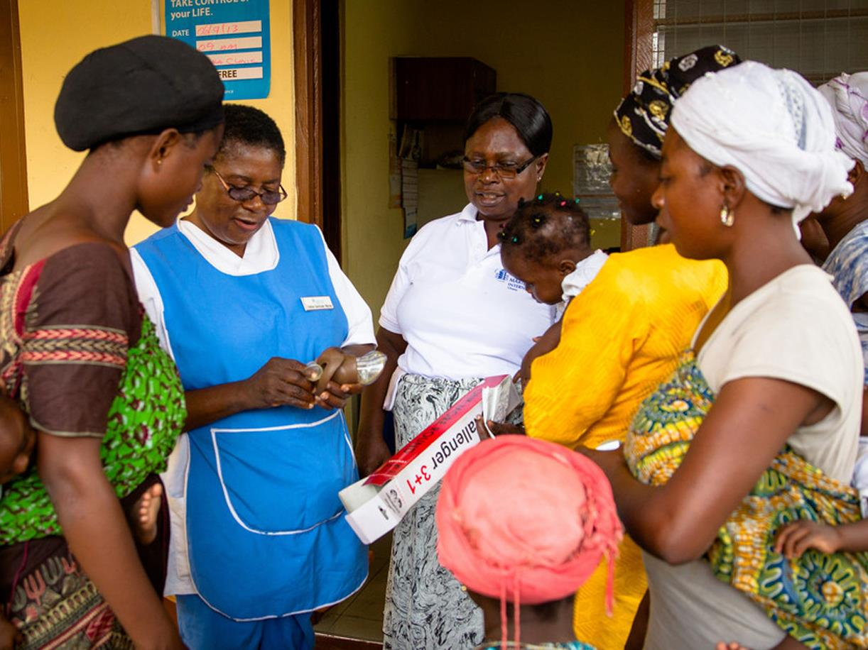
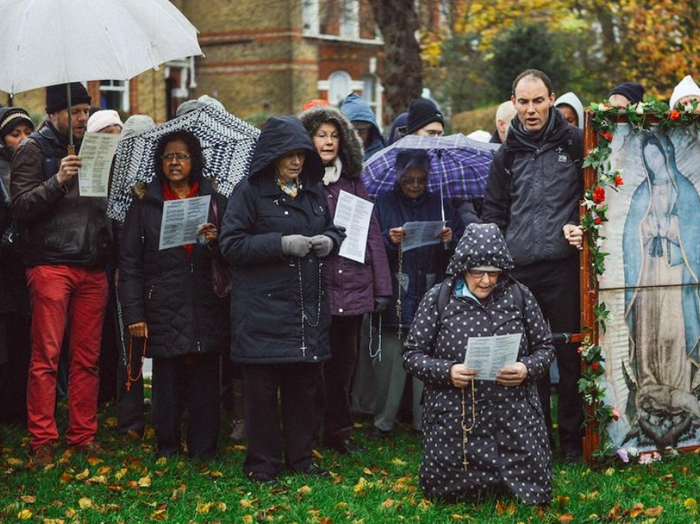
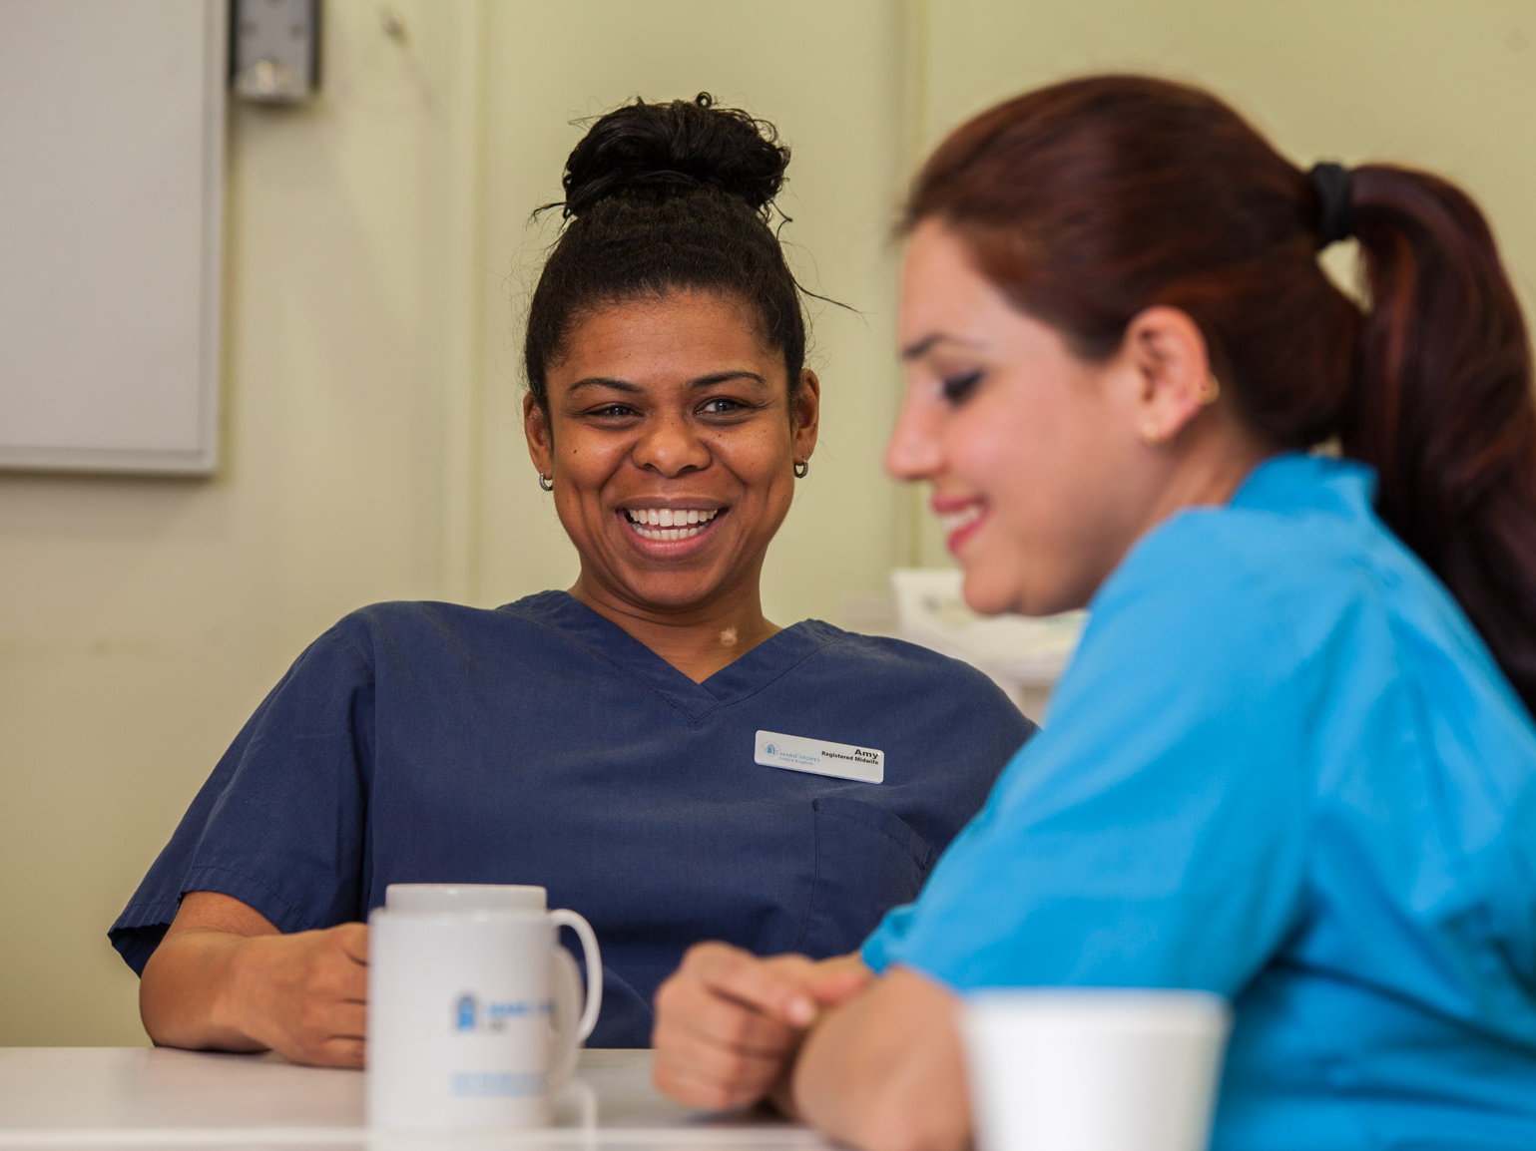
tele-medicine?
Safeguarding measures
Webchat and Video Consultations

Slide 8
Our service user standard pathway
Woman with unplanned pregnancy
Call Direct
All health Professionals
can refer by phone
Referral Letter/Form
Completed referral letters or forms with NHS number
Choose and Book
via usual appointment request including the unique ref number
Self-Referral
Clients are able to access advice, support and booking services 24/7
MSIUK One Call (Open 24hrs/7 days)
0345 300 8090
Webchat
Assessment and counselling
All health Professionals can refer by phone
Continues with pregnancy
Referred back to GP (with woman’s consent)
Client not pregnant
Contraception consultation, prescription and fitting
Miscarriage diagnosed
Client is booked in for treatment or referred to NHS service
STI Screening completed (Included in every consultation)
Early Medical Abortion (MA)
Up to 9 weeks + 6 days gestation
Scan to confirm gestation status
(Attends twice) Tablet - Same day 6hr service or 48 hours later
Miso at home now offered
Surgical Abortion (SA)
Up to 23 weeks + 6 days gestation (legal limit)
Scan to confirm gestation status
1 day procedure and recovery
Special Case
Other facility if treatment is complex
or
Referral to Early Pregnancy Unit at local hospital if Ectopic Pregnancy suspected
Other components
Contraception prescribed and fitted
Onward referral to CASH/GUM when required
Client discharged with access to 24hr aftercare and advice line
Post treatment counselling offered (Face to Face or Telephone appointments offered)

Slide 9
Contraception STI testing Counselling

Slide 10
What women say about our service
"From start to finish I was overwhelmed by the care and support I received. Every single person made me feel comfortable. I wouldn't change a thing. A huge thank you, especially as it was such a personal thing."
"I would just like to comment on the excellent service. I have been well looked after from my first phone call through to being in the recovery room. The staff have treated me as an individual, been friendly, smiley and very caring. They have made a very unpleasant and upsetting situation easier just by being the way they are. I couldn't have asked for more. Thank you to everyone."
“Excellent treatment
I was looked after by nurse Laxmi. Great service– thank you!”

