Slide 1
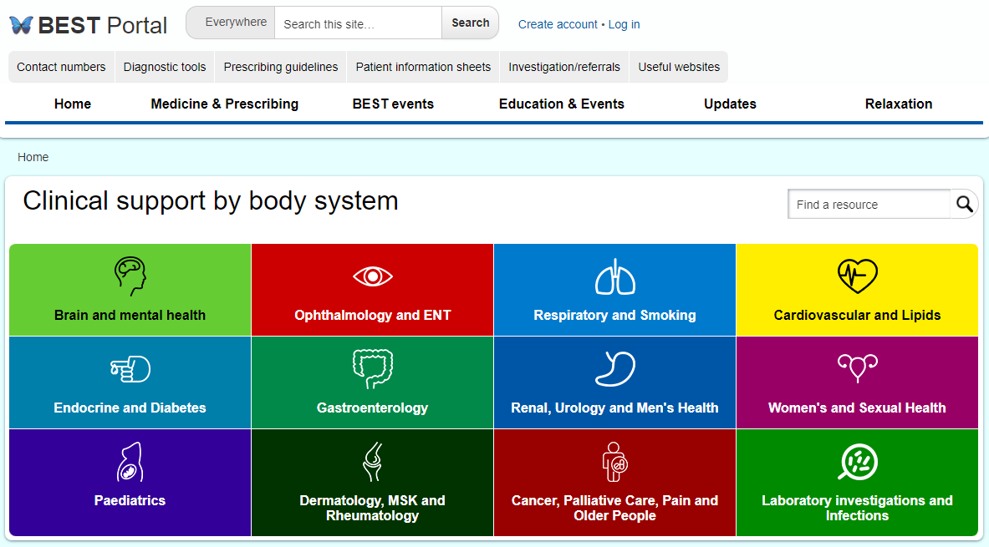
BEST Portal
best.barnsleyccg.nhs.uk
Notes:
I hope you’re all familiar with this screen.

Slide 2
Elements of the website
BEST Events – presentations and videos
Referral criteria and investigation forms - 197
eBMJ courses
- 413
Patient information sheets
- 436
Diagnostic tools
- 100
National guidelines and pathways
- 145
Local pathways and guidelines
- 221
Useful websites
- 128
Services
- 243
Contact numbers
Prescribing Guidelines
- 142
Education and Events
News and Updates
Practice Nurses
Relaxation
Commissioning
Practice Information
Primary Care, Secondary Care and Social Care
Working and Appraisal
Notes:
As you can see the website is full of useful information to assist you in practice.
Since the beginning of the year, Dr Atcha and Emma Smith have been working with the Site Kit Team develop a new editing platform to support the BEST Portal. I’m delighted to say this is now complete!
The content and functionality of the website is exactly the same for users. The main change is that each page has had to have a new IP address, which means any pages of the old website set as favourites of referenced elsewhere would need to be updated to the new site links.

Slide 3
Updates
BEST Events – presentations and videos
Referral criteria and investigation forms - 197
eBMJ courses
- 413
Patient information sheets
- 436
Diagnostic tools
- 100
National guidelines and pathways
- 145
Local pathways and guidelines
- 221
Useful websites
- 128
Services
- 243
Contact numbers
Prescribing Guidelines
- 142
Education and Events
News and Updates
Practice Nurses
Relaxation
Commissioning
Practice Information
Primary Care, Secondary Care and Social Care
Working and Appraisal
New Pathways
Asthma
Diabetes
Heart Failure
CKD
Notes:
Dr Atcha and Emma have reviewed the content and updated the areas in green. Relevant updates have been listed under the ‘News’ and ‘Updates’ sections so please do review these areas from next week.
The peach areas are what I’m currently working.
The Medicines Optimisation Team at the ICB manage the Medicines and Prescribing areas including Prescribing Guidelines, APC memos etc.

Slide 4
Practice Nurse Area
Primary Care Nursing
Communications Update
Newsletters
Nurse BEST
Presentations
Recordings
Health Professional Links and Clinical Awareness
RCN / GPNN Asthma resources
Infection Prevention & Control
Local IPC Advice
Cold Chain Audit Prescribing standards
IPC Bulletins
Patient Information Links
Diabetes Sexual Health
Screening and Immunisations
Screening – Barnsley Guidelines, Cervical Screening, Foreign Travel, NDPP, Orlistat px
Immunisations – Gov website, Health Publications website, Imms Update, The Green Book
Cervical Screening Bowel Cancer
Training and Education
SY Training Hub BMJ courses Support for Revalidation
HCA Training NA Training Nursing Competencies
Journals Cervical Screening Programme training Diabetes foot screening training
Notes:
Emma and I have reviewed and updated the Practice Nurse area with additional content as per the slide.
Please encourage suggestions.

Slide 5
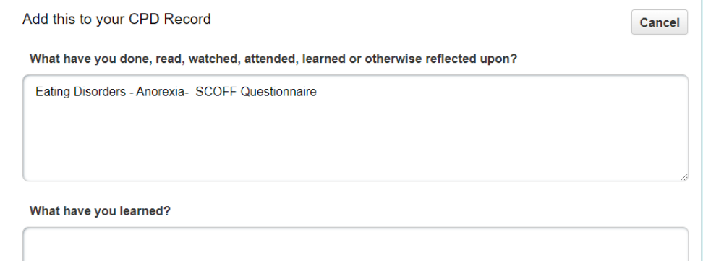
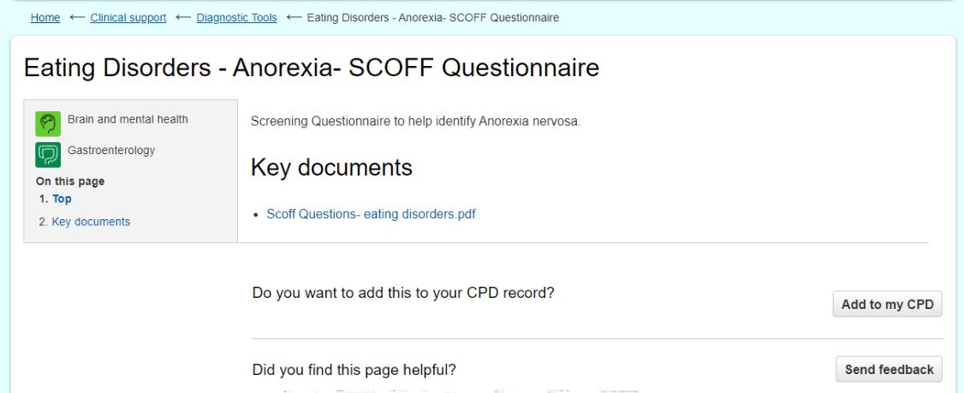
CPD
Notes:
As well as being used for clinical resources, the website can also be used to record your CPD – from accessing the clinical resources to logging external CPD.
Make sure the website is only open in one tab so it can record your CPD
Save – print save as PDF as per other Microsoft Office software

Slide 6
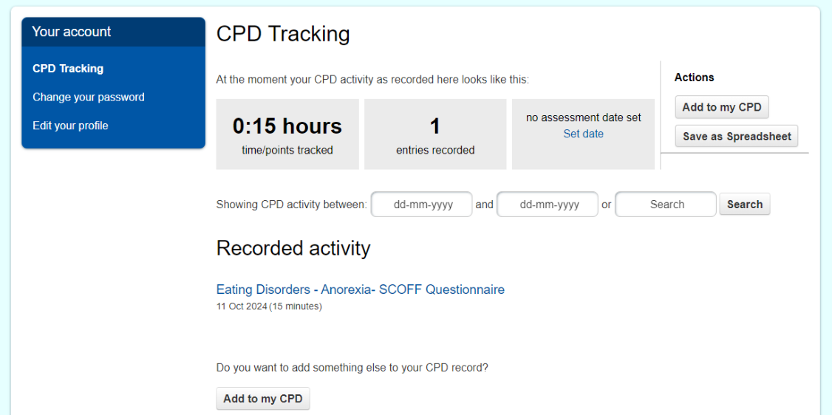
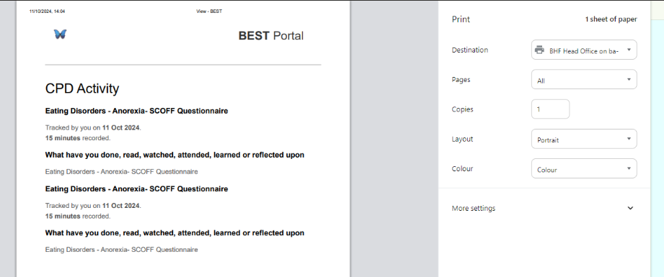
CPD
Notes:
Log in screen
This is where the list of your recorded CPD appears and you can select it my date, if required.
Click on the individual entry and it opens up like this
You can then edit, delete or print/save as appropriate

Slide 7
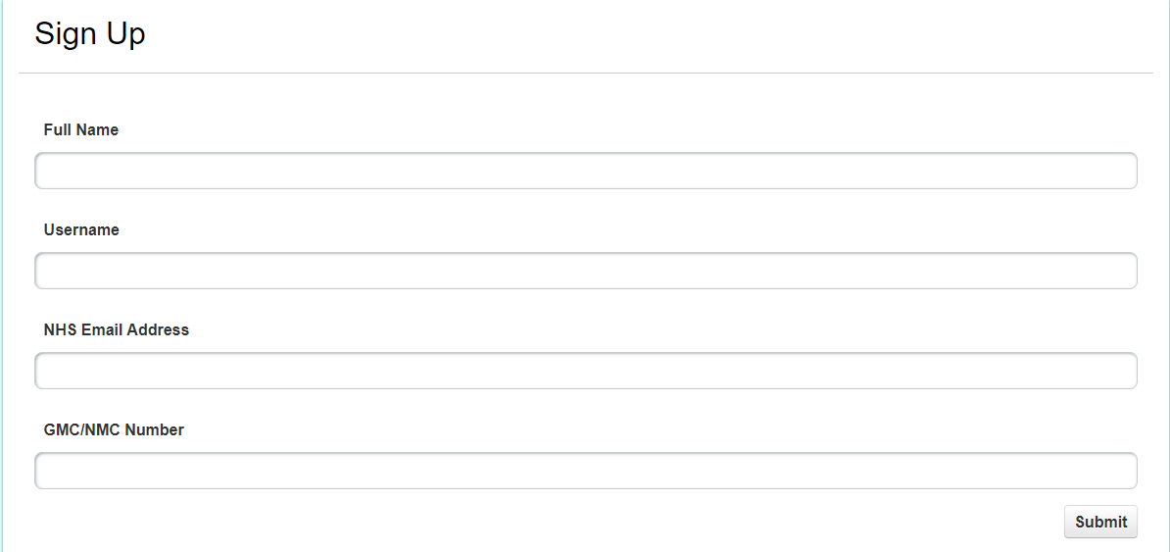
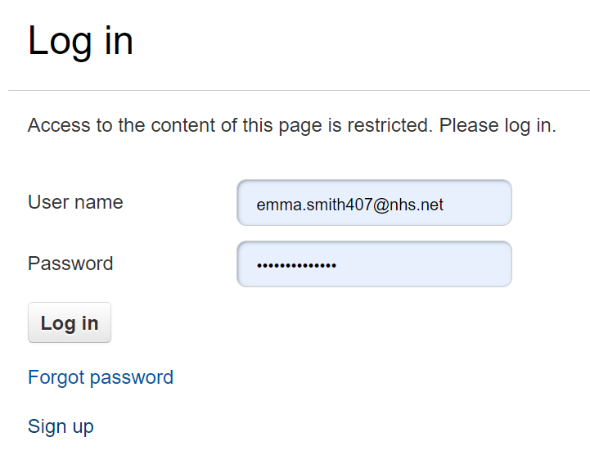
Creating an account
If already a member, select log in then ‘Forgot Password’
You will then receive an email with a new password
Notes:
If you already have an account, you will need to select ‘Forgot Password’. You’ll then receive an email with a new password. The site doesn’t store passwords so these weren’t able to be transferred over.
To create a new account, complete the requested fields. This will go to Emma for approval. She will set up a temporary password which she will email to you. When you first log on it will prompt you to change it.

Slide 8
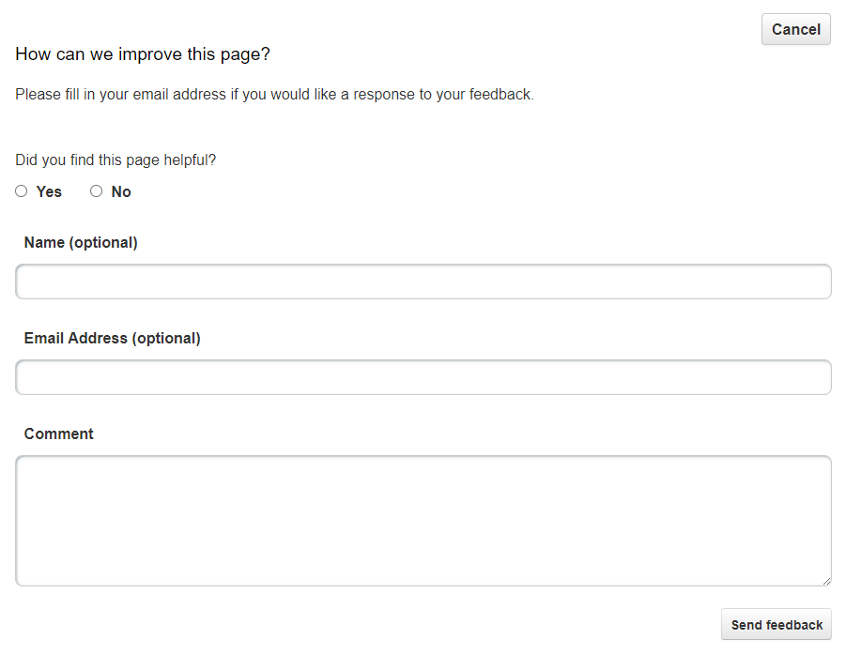
Support
Emma Smith Link to feedback form: here
BEST Lead Administrator
emma.smith407@nhs.net
07897735549
Link to new website:
Home - BEST (best-prod-uks-wpp-site.azurewebsites.net)
Notes:
If anyone requires any training, please do get in touch with Emma
We are always keen to receive feedback from staff on how you use the site and what we can do to approve it. Above is the link to a feedback form
Additionally, you will find ‘Send Feedback’ buttons throughout the site.

