Slide 1
Contraception Update Abigail Allison and Catherine Bateman
January 2024

Slide 2
Overview
Services we offer at Spectrum
How to access Services at Spectrum
Types of Contraception we offer
Emergency Contraception Scenarios
New Coil guidance
Contraception Following Childbirth
UKMEC
Contraception in the News
Questions

Slide 3
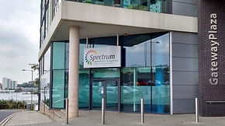
Services at Spectrum
Relationship and Sexual Education in Schools
HIV Services
Asymptomatic Screening (Test No Talk, Postal Kits, Walk In Testing)
Young People’s Drop In
Contraception (including Long-Acting Contraception Outreach)
Symptomatic Same Day/Next Day Appointments
Health Advisors (Treatment of STIs, Partner Notification)
Bookable Telephone Consultations
Face to Face Contraception and Follow Up Appointments

Slide 4
Services that are not offered at Spectrum
As a service, we are not commissioned to provide services such as:
HRT/Menopausal Care
Treatment for Heavy Menstrual Bleeding
Genital Skin Conditions

Slide 5
How To Access Services?
Phone
Direct Appointment
Telemedicine
Same Day Appointments for Urgent Care e.g. Symptoms
Walk In
Self-Testing
Young Peoples Drop In on Monday and Wednesday 3pm-6pm
Referral
GP Referral
TOP Referral
Online
Postal Kits for CT/GC Testing
Online Bookable Telephone Appointments

Slide 6
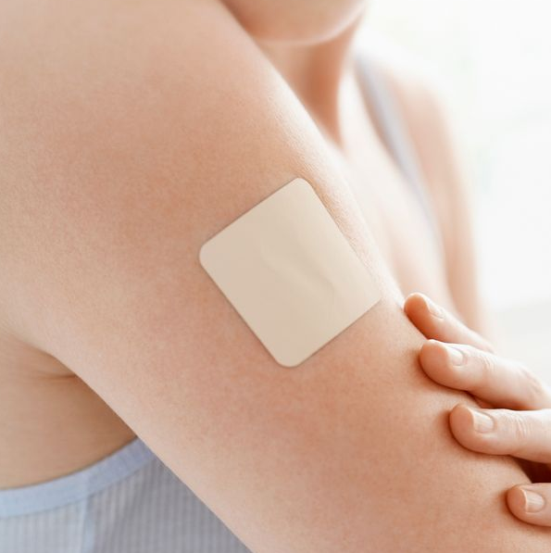
Types of Contraception Oral Methods
Combined Patch
(Potential alternative to Combined Pill if absorption issues) – change weekly
Vaginal Ring
(Potential alternative to Combined Pill also if absorption issues) – lasts 21 days
Progestogen Only Pill
Combined Pill

Slide 7
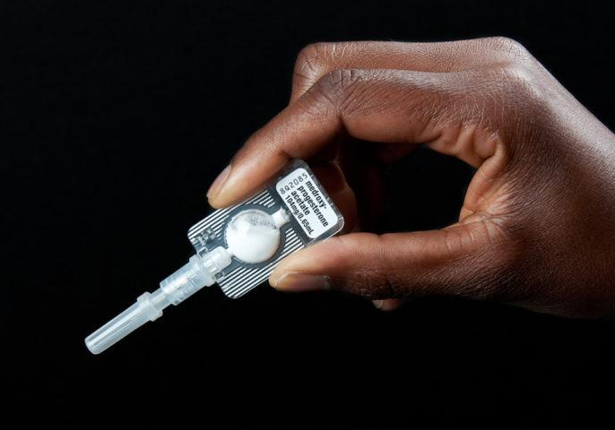
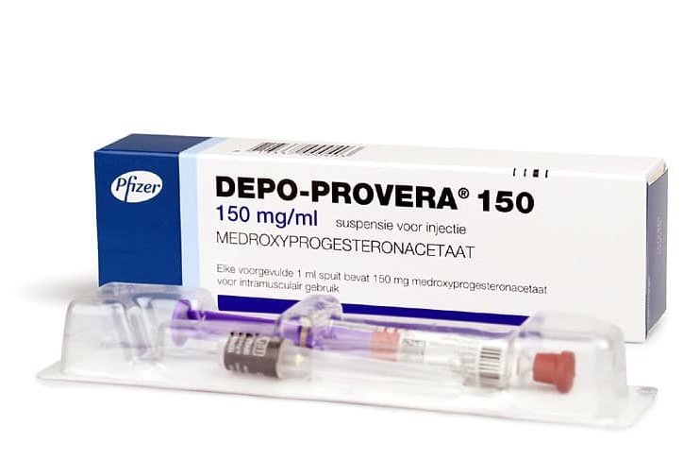
Types of Contraception Injectable Methods
Depo Provera
Sayana Press

Slide 8
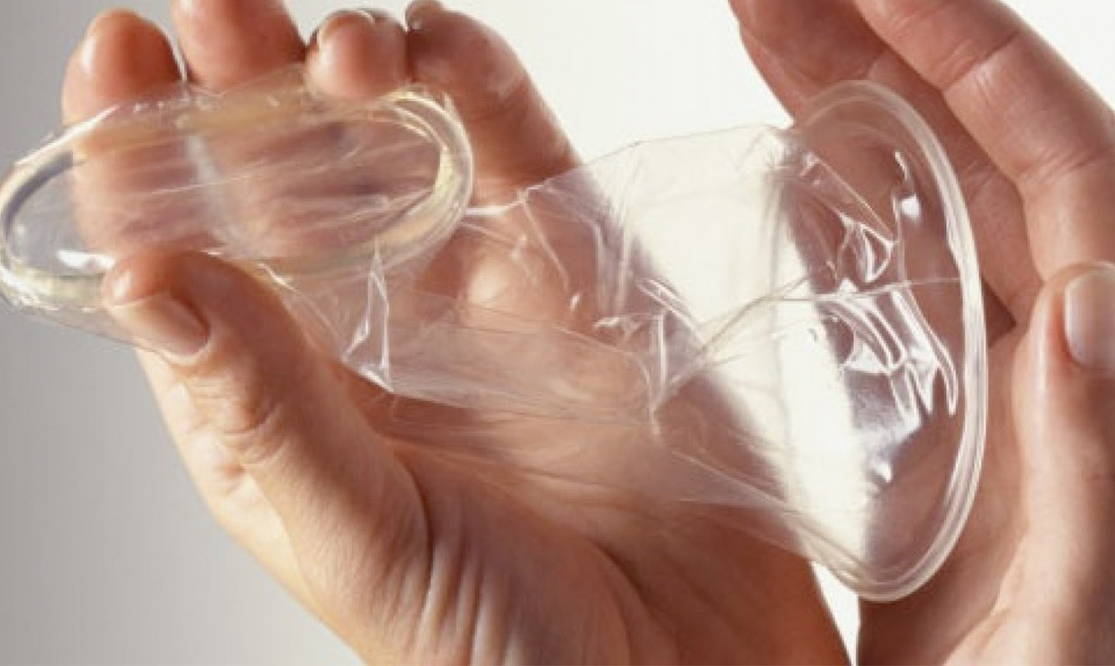
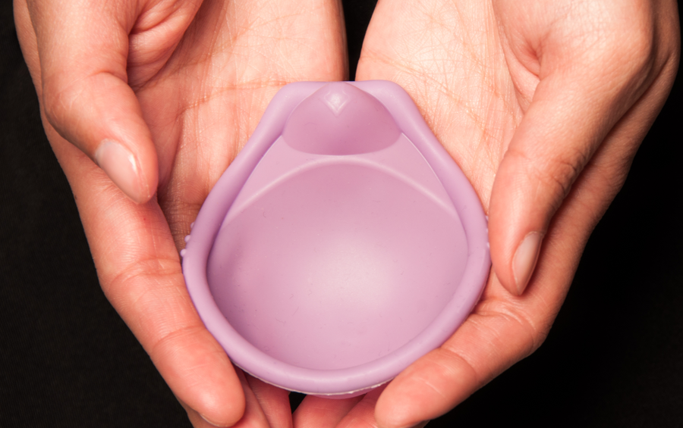
Types of Contraception Barrier Methods
If aged between 16 and 25 years, you can get free condoms online
If aged 13-15 you can still register with Barnsley C-Card and get free condoms, but you will need to go to one of the Barnsley C-Card Venues.

Slide 9
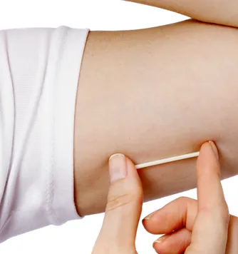
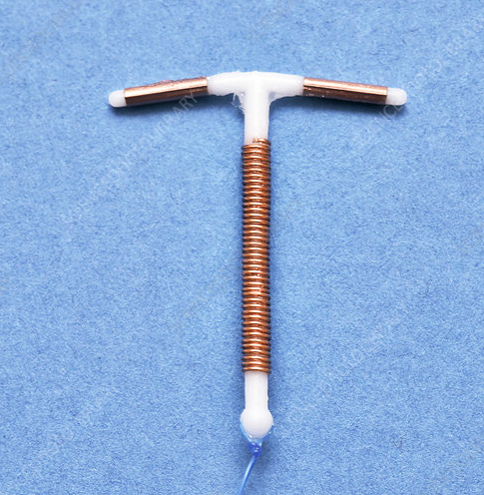
Types of Contraception Long-Acting Reversible Contraception
Most effective and reliable method of contraception available - >99% effective.
Implant
(3 years)
CU IUD
(Copper Coil)
(5-10 years)
LNG IUD (Hormonal Coil)
(3-8 years)

Slide 10
LARC Outreach Service
Geographical Outreach Areas
GP Practices contracted within Barnsley delivering LARC
5 Additional Regular Outreach Clinics
Areas of reduced LARC provision geographically
Public Health Fingertips and Ward Profiles as indicators of inequalities e.g. teenage pregnancy, life expectancy

Slide 11
Update on Mirena licence
FSRH statement published 11/01/2024
FSRH CEU Statement: Mirena® 52mg LNG-IUD extension of licence for contraception to 8 years - Faculty of Sexual and Reproductive Healthcare
Does not affect Levosert/Benilexa (still 6 years … for now)
Only for contraception – not heavy menstrual bleeding/HRT
Applies to all current users (device unchanged)

Slide 12
Emergency Contraception
Take a systematic history
Any hormonal contraception at the moment (or have they taken anything hormonal in the past week)?
Any potential drug interactions/medical conditions/GI tract issues/breastfeeding?
When did they have sex? Multiple episodes? Likely to have further UPSI?
LMP? Likely date of ovulation?
How much do they weigh?
Is a copper coil appropriate?
Is quickstarting a new method appropriate?
STI risk?
Ongoing contraception? When will new method be effective? When to do pregnancy test?

Slide 13
Emergency Contraception Case 1
16 year old girl
Phoned requesting emergency contraception
Takes COCP (Rigevidon)
What do we need to know?

Slide 14
Has she been taking the pill as prescribed?
Where is she in the packet?
When did she have sex?
Any other medication?
Any other medical problems?
Would she consider changing to a LARC method?
Does she know about continuous pill taking regimes and shorter breaks?
Any safeguarding concerns?

Slide 15
Further info
Established on COCP, likes method
Had sex without a condom yesterday – realised had forgotten pill that day and the previous day (so had missed 2 pills from middle of packet – thinks had already taken 7 pills after 7 day break)
BMI 18, 50kg, fit and well, no other medication
Regular male partner, aged 17, no others ever
Does she need EC? If so what would you offer? What would you advise re condoms?

Slide 16
Emergency Contraception Case 2
35 year old woman
Condomless sex previous day (25 hours before consultation)
What else do we need to know?

Slide 17
Condoms usually, every time
LMP 4 days ago, irregular cycle
Takes antidepressants, no enzyme inducers
No GI tract problems
Regular male partner
Undecided about future contraception
What would you offer?

Slide 18
Given options Cu-IUD/ulipristal acetate/levonelle
Opted for ulipristal
What other advice do you need to give?
When would a copper coil not be appropriate?

Slide 19
Learning Points
May be fertile for longer in cycle than normal (ovulation delayed)
If vomiting within 3 hours need repeat dose
Can still return for IUD if changes mind
Pregnancy test in 3 weeks
Don’t take any other hormonal contraception (or levonelle) for next 5 days
Offer information leaflets about contraception choices
Don’t forget STI screening

Slide 20
Starting Postnatal Contraception
Effective medical and drug history – i.e. nil contraindications
Eliminate pregnancy risk – if <21 days, no pregnancy risk. If >21 days, consider pregnancy risk
 | Under 48hrs | Day 2-21 | Day 22-28 | Day 29-42 | Day 42+
CU IUD | YES | NO | NO | YES | YES
LNG IUD | YES | NO | NO | YES | YES
Implant | YES | YES | YES | YES | YES
Depo/Sayana | YES | YES | YES | YES | YES
POP | YES | YES | YES | YES | YES
COC + BF | NO | NO | NO | NO | YES
COC + VTE Risks | NO | NO | NO | NO | YES
COC and not BF and no VTE risks | NO | NO | YES | YES | YES
VTE RISKS
Immobility
Transfusion at delivery
BMI ≥30
Postpartum haemorrhage
Post C Section
Pre-eclampsia
Smoking.
(This all applies to both women who are breastfeeding and not breastfeeding)
It is also important to be aware of Lactational Amenorrhoea. Up to 98% effective ONLY IF THESE THREE MEASURES ARE MET!
FULLY BREASTFEEDING (NO FORMULA FEEDING, TOP UPS)
NO PERIODS
LESS THAN 6 MONTHS POSTNATAL
(USE OF DUMMIES AND/OR NO NIGHT FEEDS MAY REDUCE EFFICACY)

Slide 21
UKMEC
Numbers do not add up
If any condition is a UKMEC 3 or 4 – use is not recommended
It may be beneficial for a member of the practice to be a member of the FSRH or finding out who is a member of the FSRH in your service to seek advice from.

Slide 22
Contraception in the News!
Anyone needing the POP or COC can access it through participating pharmacies without a referral from their GP, though they can be referred by their general practice or sexual health clinic.
Confidential consultation – for COC BP and BMI will be taken.
Research could see men given a non-hormonal gel/pill that would affect the sperm cell’s swimming action, effectively disabling its function.
Aiming to use as event based – works in hours and reversible in hours
Research trials will take years – watch this space

Slide 23
Contact
schcic.bishadmin@nhs.net for general enquiries
Please email Beverley.Lister@Spectrum-cic.nhs.uk if you would like to be added to the mailing list for our fitters’ forums meetings

Slide 24
Thank you for listening Any questions?

