Slide 1
Community Pharmacy Advance Services
Thomas Bisset
Pharmacy BEST
Clinical Lead

Slide 2
Contraception
The objectives of the service are to:
Provide a model for community pharmacy teams to initiate provision of OC, and to continue the provision of OC supplies initiated in primary care (including general practice and pharmacies) or sexual health clinics and equivalent. Both initiation and ongoing supply will be undertaken using PGDs to support the review and supply process; and
Establish an integrated pathway between existing services and community pharmacies that provides people with greater choice and access when considering continuing their current form of OC.
Notes:
The service aims to provide:
People greater choice from where people can access contraception services; and
Extra capacity in primary care and sexual health clinics (or equivalent) to support meeting the demand for more complex assessments.

Slide 3
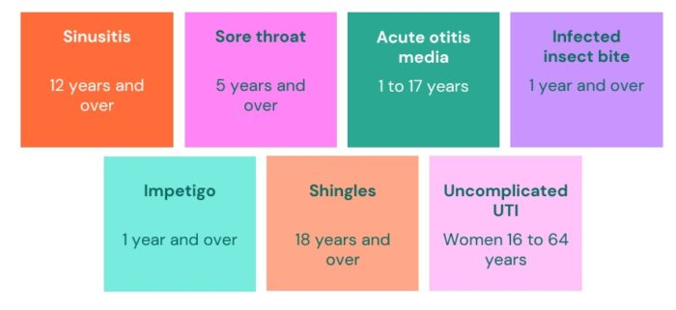
Pharmacy First
Involves pharmacists providing advice and NHS-funded treatment, where clinically appropriate, for seven common conditions (age restrictions apply):
Consultations for these seven clinical pathways can be provided to patients presenting to the pharmacy as well as those referred electronically by NHS 111, general practices and others.
The service also incorporates the elements of the Community Pharmacist Consultation Service, which are minor illness consultations with a pharmacist and the supply of urgent medicines (NHS 111 only), both following an electronic referral from NHS 111, general practices and other authorised healthcare providers
(i.e. patients are not able to present to the pharmacy without an electronic referral).
Notes:
The service aims to provide:
People greater choice from where people can access contraception services; and
Extra capacity in primary care and sexual health clinics (or equivalent) to support meeting the demand for more complex assessments.

Slide 4
Hypertension Case Finding
The service aims to:
Identify people aged 40 years or older, or at the discretion of pharmacy staff, people under the age of 40, with high blood pressure (who have previously not had a confirmed diagnosis of hypertension), and to refer them to general practice to confirm diagnosis and for appropriate management;
At the request of a general practice, undertake ad hoc clinic and ambulatory blood pressure measurements. These requests can be in relation to people either with or without a diagnosis of hypertension; and
Provide another opportunity to promote healthy behaviours to patients.

Slide 5
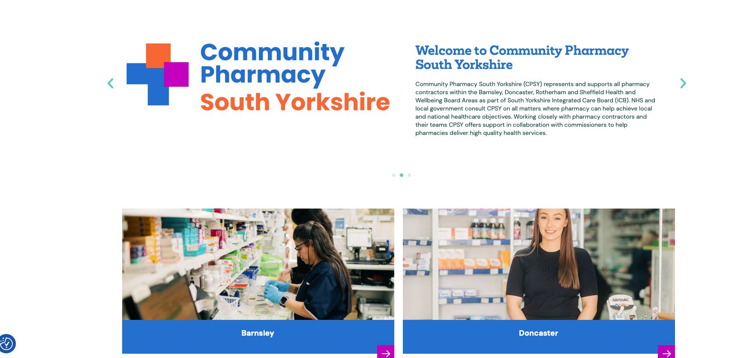
Resources: southyorkshire.communitypharmacy.org.uk

