Slide 1
Barnsley BEST meeting 16/10/24

Slide 2
Overview
Mix of information reflecting queries we get from you
Decision-making and communication issues in EOLC
Prescribing
  Prescribing for last days of life
  Routes of administration
  specific drugs
Discussion – please ask questions
Notes:
Note down queries as we go through – time for questions at the end.

Slide 3
Recognising approaching end of life
Weeks, months, years
https://www.spict.org.uk/spict-4all/

Slide 4
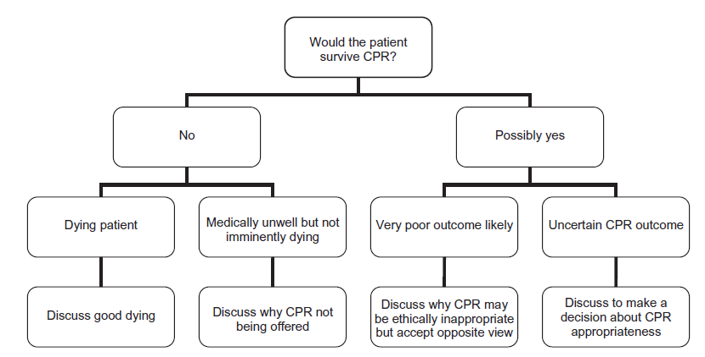
ReSPECT and DNACPR decisions
Notes:
Don’t ask ‘do you want to be resuscitated?’
Don’t ask family either

Slide 5
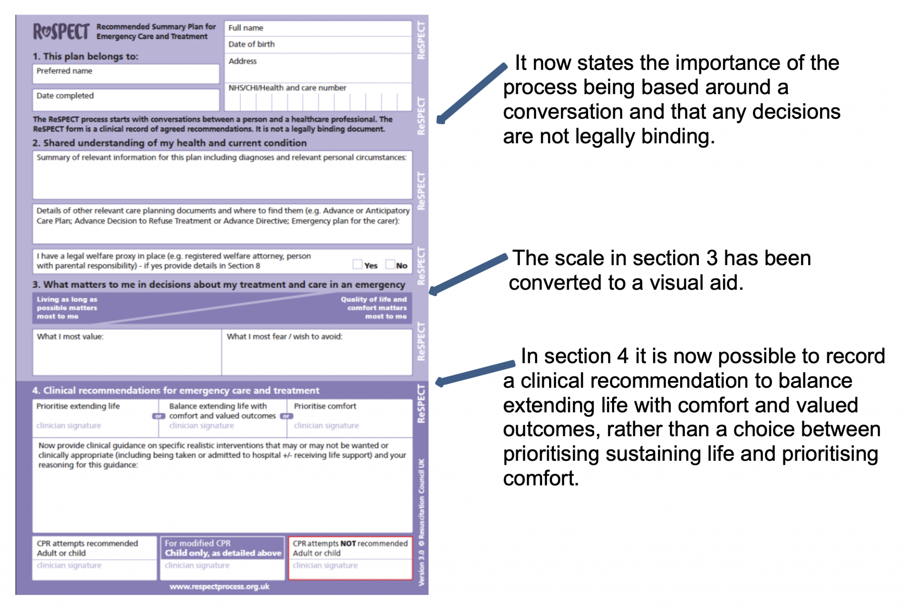
From GP Gateway Coventry and Warwick ICB – accessed 10.10.24

Slide 6
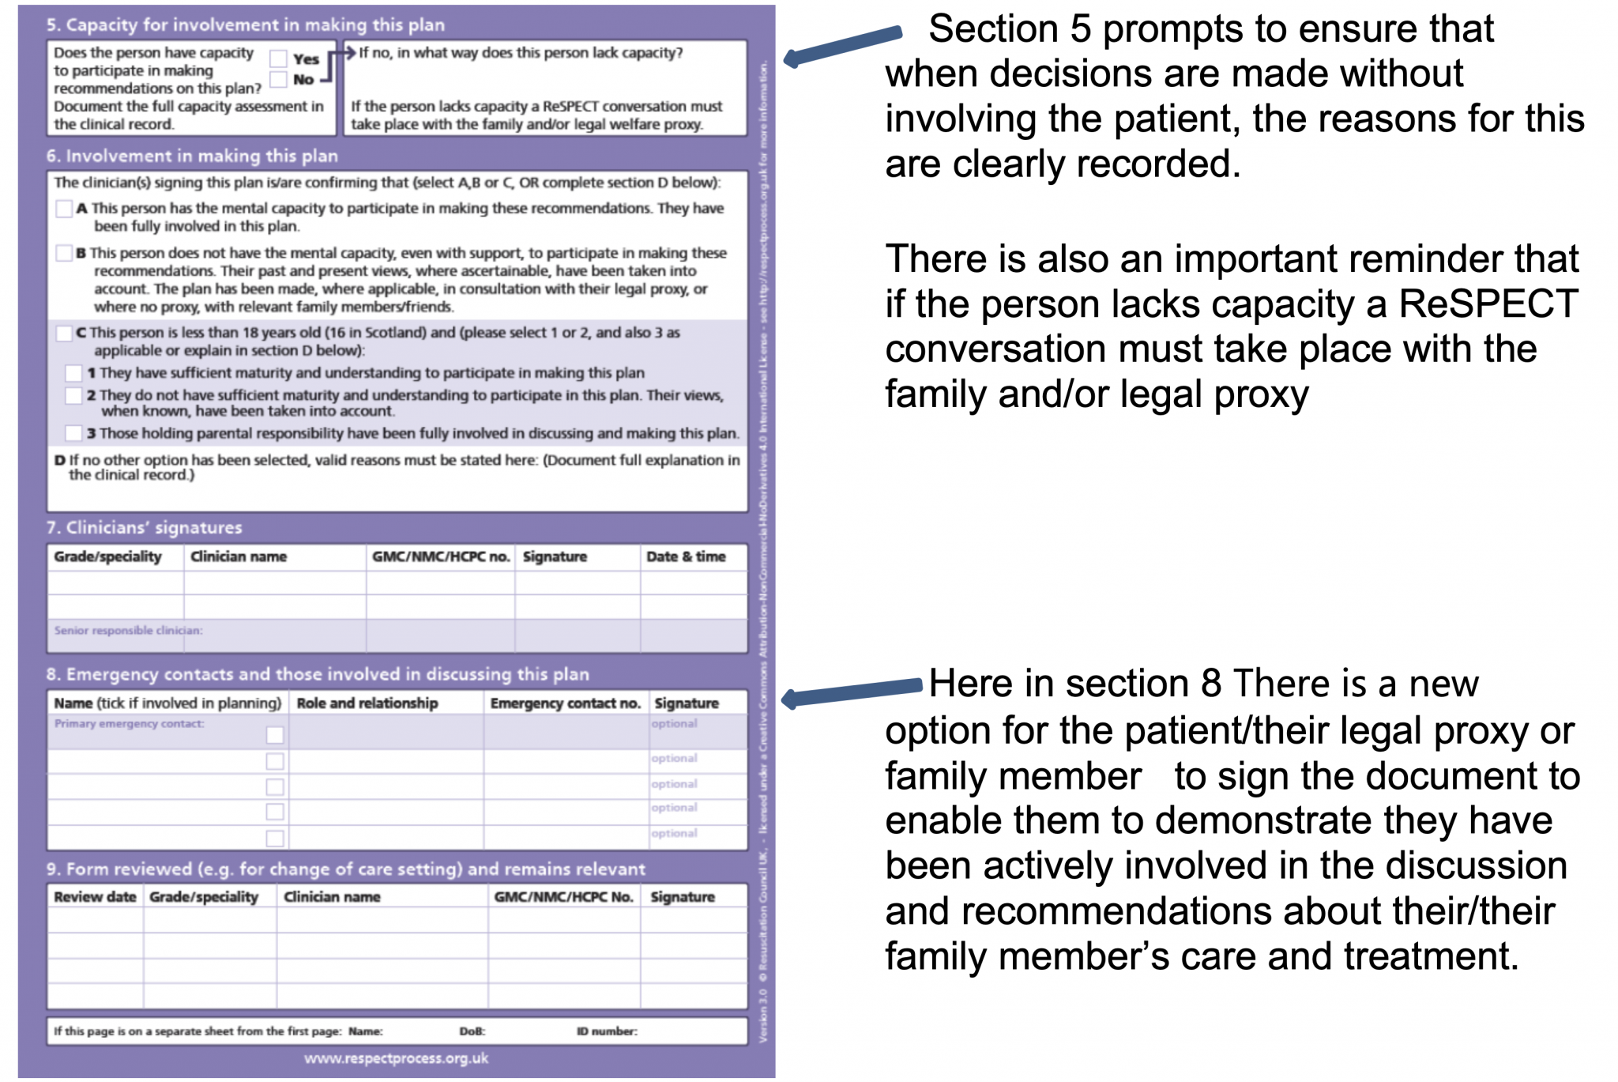
From GP Gateway Coventry and Warwick ICB – accessed 10.10.24

Slide 7
Notes:
Do not admit if dying of cancer
I don’t want to die in hospital

Slide 8
Recognising dying
In patients with advanced malignancy
  Gradual deterioration in functional status
  Becomes bedbound
  Is sleepy more of the time, may be semi-comatose
  Less aware or concerned with what is going on around them
  Able only to take sips of fluid
  No longer able to take oral drugs
In organ failure, advanced frailty, multimorbidity similar picture in final stage, may be longer period of gradual decline prior to this
Pain – may be same, less, more
Dyspnoea
Confusion/delirium – often, not always
Secretions, altered breathing patterns and peripheral shut-down

Slide 9
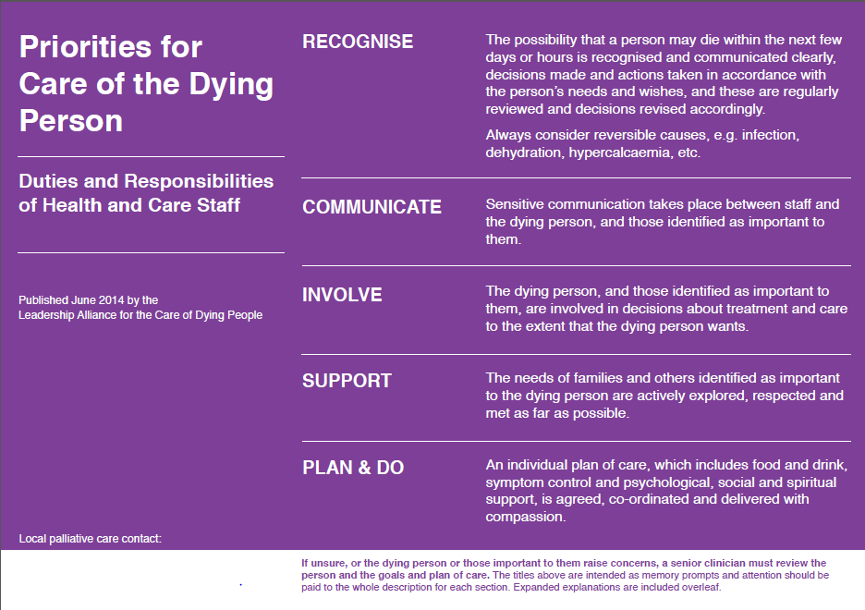

Slide 10
Caring for dying patients in community
https://www.bmj.com/content/386/bmj-2022-071661
Rethinking the UK’s approach to dying report
https://compassionindying.org.uk/resource/rethinking-uk-approach-dying/

Slide 11
Blood tests and fluids
If you are considering blood tests, be clear in advance what you will do with the results
What is the rationale for the test?
eg renal impairment
Decisions about parenteral fluids in the last days or weeks of life
We do not have evidence to inform one way or the other whether subcut fluids helps or harms in last days
Reducing intake is normal part of dying
If subcut fluids may be indicated consider possible harms including that of prolonging dying, and make a plan for time limited trial then re-assess
Notes:
Aim is patient comfort
Never ask a question to which you don’t want to know the answer
Thank about OOH, and continuity of results
Delirium, thirst
Consider other treatments also for these problems
Pulmonary and peripheral oedema, secretions,

Slide 12
Barnsley Palliative Care Formulary
https://best.barnsleyccg.nhs.uk/prescribing-guidelines/palliative-care-formulary/16288

Slide 13
Rationalising medication
Tablet burden
  Continue meds that are important for symptom management
  Discontinue others
Unable to swallow – alternative route of administration, usually subcut
  Regular oral opioid analgesia
  Other symptom management
  Steroids?
  Anti-epileptics

Slide 14
Steroids in palliative care
Dexamethasone
  Oral : subcut 1:1
  Subcut - Dexamethasone 3.8mg/ml, 3.3mg/ml
Indications
Steroid approximate equivalent oral doses
  Dex 0.75mg = Pred 5mg = Hydrocortisone 20mg
Side effects
Protecting bones
Titration
Adrenal suppression
  Doses > 7.5mg pred and 1mg dex
Notes:
Dexamethasone
Subcut - Dexamethasone 3.8mg/ml, 3.3mg/ml
Indications in cancer medicine
Brain tumours
Anti-emetic
SVCO
bronchial or tracheal obstruction
lymphangitis
MSCC, or radiculopathy / nerve compression
Appetite / wellbeing
Bowel obstruction, ureteric obstruction
Steroid equivalent doses
Side effects
Protecting bones
Titration
Adrenal suppression

Slide 15
Managing seizures
Risk of seizures MIDAZOLAM 20-30mg/24hrs sc infusion
PRN midazolam subcut / buccal (10mg/ml)
Levetiracetam (Keppra) can be given subcut up to 2g /24hrs in normal saline, often prescribed in an additional syringe driver but accumulating evidence of mixing
Dexamethasone in brain tumours
Notes:
Midaz – fits and anxiety, in last days, sleepy anyway
Keppra – difficult seizure management, already on Keppra nad other AEDs, maintain quality of alertness

Slide 16
Opioid analgesia
Switching opioid preparations and routes of administration
Opioid equivalencies – principles
  Conversion ratios are never more than an approximate guide
  When switching consider dose reduction 25-50%
MR preparations
Patches
Subcut infusions
Avoid inadvertently mixing opioids
Seek SPC advice if needed
Notes:
Conversion ratios are never more than an approximate guide and there will be inter-individual variation
Current advice in our formulary re morphine and oxycodone – see PCF
(note there has been some change in this, and in next review on it may look a little different BNF reads differently)
Make a calculation in morphine equivalent doses, use a chart
Dose lower to be safe
MR bd preparations Morphine / oxycodone – can start syringe driver 8 – 12 hours after last MR dose
If switching to a patch start patch with final dose of MR preparation
Avoid inadvertently mixing opioids – use same as background if oral MR preparation, if patch – fentanyl/buprenorphine then PRN opioid will be different – morphine or oxycodone
If on 2 different background opioids (unusal) seek advice

Slide 17
Transdermal patches not the easy option
Complex pharmacokinetics
eg Fentanyl 25 microg/hour patch
3-23 hours onset action
steady state >100hours
Conversion from morphine varies from 60mg-120mg/day
Plasma fentanyl concentrations up to ½ lower in cachectic patients
Serious adverse events including deaths
Inappropriate use for short term/acute pain
Lack of education re safety, storage and disposal
Lack of awareness impact of direct heat
Failure to remove old patches
Notes:
Lots of fentanyl left in the patch, importance of disposal

Slide 18
SYMPTOM CONTROL - PAIN
Around half of patients require an unchanged dose of analgesic in last days of life
Route may need to be changed to subcut if oral route no longer an option (morphine, oxycodone, alfentanil)
Do not remove opioid patches
  Buprenorphine, Fentanyl
Notes:
Several studies have shown that around half of patients do not require any more analgesia in the terminal phase. However, others may develop new pains related to progression of disease or to a preterminal event such as bowel perforation or stiffness from increasing mobility. As swallowing becomes more difficult, medication that has no direct effect on symptom control should be stopped. More common opioid switching now we have a range of opioids to switch to even via the sc route.

Slide 19
SYMPTOM CONTROL - PAIN
In a subcutaneous infusion of morphine use ½ the total daily dose of oral morphine
Principle of converting oxycodone is the same
Prescribe 1/10 – 1/6 of the daily dose PRN subcut
If >2 breakthrough doses needed per day consider titrating background
Titration ranges – d/w SPC team if unsure
Co-analgesics via sc route eg NSAID, benzodiazepine
Notes:
Subcut infusions – dose ranges for titration, small ranges, this facility is to allow for nursing teams to make changes on response to PRN use of analgesia in dying patients
Very wide ranges prescribed in advance are not appropriate (eg morphine/oxycodone titration 10 – 200mg /24)
Take into consideration previous background oral opioid dose, previous PRN use, presence of additional opioid patch
SEEK SPC ADVICE
Wide range – responsive to patient need
¼ - 1/3
Risk harm, litigation, coroner if range is too big

Slide 20
SYMPTOM CONTROL - BREATHLESSNESS
Treat what may be treatable to help symptoms
  Bronchspasm, infection, PE, pulmonary oedema, pleural effusion, lymphangitis, SVCO, anaemia
In cancer particularly look out for diaphragmatic splinting by abdominal disease and ascites
General supportive measures – explanation, position, fan or cool airflow, relaxation techniques
O₂ therapy (O₂ sats <92%)
Notes:
The scope for correcting reversible causes of breathlessness becomes limited but it may still be appropriate to give diuretics for breathlessness due to heart failure. In most cases the priority is to address the symptom of breathlessness and the fear and anxiety that go with it.
General supportive measures are important although these will depend on the conscious level of the patient as to how well they are able to participate in relaxation and breathing exercises for instance. Face masks may be uncomfortable and intrusive at this time – and this and nasal cannulae may be a barrier to relatives getting close to the patient – but oxygen therapy can help some patients. Opioids and benzodiazepines can be helpful. If the patient is already on an opioid for pain then this can be titrated for dyspoea and used PRN. If a patient is still able to take oral medication then lorazepam can be useful, otherwise midazolam can be given subcutaneously.

Slide 21
End stage respiratory disease
All drugs for relief of breathlessness are respiratory sedatives
  Monitor titration carefully
  In terminal stage of illness benefits usually outweigh risks
Opioids – steady state is better
  Morphine MR start at 5 or 10mg bd (also prescribe laxative)
  Up to 15mg bd good evidence for benefit over risk
  Care at doses above this monitor benefit and risks
Benzodiazepines
  Lorazepam 500mcg sublingual for rapid relief during panic attacks
Consider mirtazapine if anxiety is a significant driver of breathlessness
Notes:
Gabapentinoids also respiratory depressants

Slide 22
SYMPTOM CONTROL - SECRETIONS
Noisy breathing or ‘death rattle’ caused by turbulent air passing over secretions
Manage by:
  Explanation
  Nurse patient on their side and at 45 degrees
  Antimuscarinic drugs – HYOSCINE BUTYLBROMIDE (Buscopan)
    20mg subcut PRN 1 hourly
    60mg-300mg/24hrs via syringe driver
  Glycopyrronium
    200 - 400mcg sc PRN, 1200mcg/24hrs sc infusion
Notes:
Buscopan is not a respiratory depressant and it acts peripherally, stops secretions developing, so using a good dose early is more likely to be effective.
Inability to clear secretions from the oropharynx and trachea results in noisy breathing or death rattle as secretions move up and down in time with inspiration and expiration in a patient who is close to death and is unable to clear secretions by coughing or swallowing. This lack of coughing and coughing associated with being nursed lying down results in secretions pooling in the oropharynx and bronchi. Relatives and members of the team are often more distressed by this than the patient is often drowsy or comatose by this time. It is important to explain the symptoms to those close to the patient, and this along with changing the patients position so that they are on their side may be all that is needed.
Once secretions have formed they will not be diminished by antimuscarinic drugs and gentle suction may be required. Therefore these need to be started at the first sign of rattling. Hyposcine butyl bromide, a quaternary amine. Because it’s a big molecule it doesn’t cross the blood brain barrier and so doesn’t cause the central side effects of sedation and confusion like hyoscine hydrobromide. Sometimes I would quite like to be able to use something that was sedating at the same time but having said that you can get a paradoxical restlessness with hyoscine hydrobromide. The other option is glycopyrrhonium.
Refractory secretions may be due to pulmonary oedema (when opioids may be helpful) or infection.

Slide 23
SYMPTOM CONTROL – RESTLESSNESS AND CONFUSION
Causes
  Drugs – opioids, co-analgesics, corticosteroids
  Drug withdrawal – nicotine, alcohol, SSRIs, pregabalin/gabapentin
  Physical – unrelieved pain, distended bladder or bowel, cerebral lesions, infection
  Metabolic upset – urea, Ca, Na, glucose, hypoxia, jaundice
  Seizure activity
  Anxiety and distress
  Existential – unfinished business
Management
  Treat the acute state and address cause as much as is possible
  General supportive measures – light, reassurance, company
Notes:
In the terminal phase of illness, restlessness and delirium are often signs of impending death. Delirium is often associated with hallucinations and paranoid ideas and may occur in an agitated, hyper or hypo active form. The causes may be direct malignant involvement of the brain or a manifestation of a paraneoplastic syndrome, terminal multiorgan failure, dehydration, hypercalcaemia or drug side effects. However, it is important to look for reasons why a patient may be restless and/or confused as this may guide treatment. Many of the drugs we use frequently can cause symptoms. Symptoms of opioid toxicity can be alleviated with haloperidol while the dose is adjusted. Sudden opioid toxicity in a previously stable patient may herald the deterioration in renal function preceding death. What might you look out for to indicate opioid toxicity? However, unrelieved pain can be a potent cause of restlessness, and in a patient less able to vocalise problems this needs to be thought about, as do a full bowel or bladder. It’s sometimes a difficult decision, dealing with severe constipation at the end of life but usually popping a catheter in is a relatively easy thing to do. Depending on the estimated prognosis it may not be appropriate to go looking for a raised calcium for instance if the patient would not live long enough to benefit from an infusion of bisphosphonates. It might be reasonable be rehydrate a patient with subcutaneous fluids for 24 hours if it was thought that dehydration was a possible reversible cause but it should be reviewed critically after 24 hours or before if the patient is no better or deteriorating.
The company of people familiar ot the patient and a comfortable safe and quiet environment are important and reassuring. Remember that poor hearing and vision compounds confusion. Also, suffering from emotional and spiritual anguish can not be releived by drugs and if the patient is still able to talk through issues then this is much more appropriate than sedating them. Sadly, there may come a time when they do not have the physical strength or the cognitive ability to come to grips with this and then it may be necessary to recourse to drug treatment.

Slide 24
SYMPTOM CONTROL – NAUSEA + VOMITING
Consider cause and choose appropriate anti-emetic
  Delayed gastric emptying – metoclopramide 10mg sc PRN, 30mg/24hrs sc infusion
  Metabolic derangement – haloperidol – see below
  Bowel obstruction – haloperidol, cyclizine 50mg sc PRN, 150mg/24hrs sc infusion
Cause unknown or pre-emptive prescribing use HALOPERIDOL
  Dose: 0.5 – 1.5mg sc PRN or sc infusion 1.5-5mg/24h
  Can be used as single daily dose instead of via syringe driver
For resistant symptoms use levomepromazine
  Dose: sc bolus 5-12.5mg; sc infusion 12.5-25mg/24h

Slide 25
DRUG TREATMENT OF RESTLESSNESS AND CONFUSION
HALOPERIDOL
  Indications: delirium (drug toxicity, metabolic upset)
  Dose: 0.5 – 1.5mg sc PRN or sc infusion of up to 10mg/24h
MIDAZOLAM
  Indications: anxiety and restlessness, risk of seizure, dyspnoea
  Dose: 2.5 – 5mg sc bolus, sc infusion of 10mg/24hrs (may titrate up to 100mg/24hrs)
Notes:
Haloperidol is useful if the confusion is thought to be drug induced or due to metabolic upset. Midazolam can be given alone for anxiety and distress or combined with haloperidol if there is delirium too.

Slide 26
DRUG TREATMENT OF RESTLESSNESS AND CONFUSION
Levomepromazine
  Indications: need for alternative or additional treatment
  Dose: sc bolus 12.5-25mg; sc infusion of 25-50mg/24h (may titrate up to 250mg/24hrs)
Phenobarbitone – SPC prescribing

Slide 27
Pre-emptive prescribing
MORPHINE / OXYCODONE
HALOPERIDOL
MIDAZOLAM
HYOSCINE BUTYLBROMIDE
Link to PCF on BEST website, also has algorithms for symptom management in last days

Slide 28
Peripheral opioid antagonists for opioid-induced constipation
Contra-indications: known or suspected bowel obstruction, increased risk of GI perf, acute abdomen
Naldemidine, (naloxegol, methylnaltrexone [sc])
Naldemidine 200mcg po od
  5-18hrs to bowel action
  Abdo pain, diarrhoea are common side-effects
  Take care in frail patients
Notes:
Amber G

Slide 29
Questions / Discussion

Slide 30
Diabetes at the end of life
Link to Barnsley diabetes guidelines
https://best.barnsleyccg.nhs.uk/clinical-support/medicines-management/diabetes-guidelines.htm

