Slide 1
Pharmacy Best
6:30 Buffet & networking
7:00 Introductions
7:05 Emergency Hormonal Contraception Service (Under 25s)
Jane Partridge, Head of Service, Barnsley Integrated Sexual Health Service
7:35 Thinking Pharmacy First: Contraception Advance Service
Thomas Bisset, Pharmacy Clinical Lead
7:50 Refreshment Break
8:00 Local Care Pathway Development:
Respiratory
Opiates
Cardiovascular Disease
Chris Lawson, Head of Medicines Optimisation
8:35 Thinking Pharmacy First: Pharmacy First Service – Minor Ailments
Sore Throats
Acute Sinusitis
Thomas Bisset, Pharmacy Clinical Lead
8:55 Questions
Pharmacy BEST
2nd October 2024
Priory Campus

Slide 2
Housekeeping
Introductions
Fire Alarms
Telephone
Toilets
Questions

Slide 4
Pharmacy BEST: Aims & Objectives
Barnsley Education Support & Training
Best.barnsleyccg.nhs.uk
Help Pharmacies deliver quality services
Align with CCG plans
Help Barnsley patients access healthcare in the appropriate place, at the appropriate time from the appropriate person

Slide 5
BEST website
https://best.barnsleyccg.nhs.uk

Slide 6
Thinking Pharmacy First
Contraceptive Service
Pharmacy First
Sinusitis
Sore Throat

Slide 7
Contraceptive Service

Slide 8
Aims of the service
Provide greater choice of access to contraception services
Provide extra capacity in primary care & sexual health clinics to support more complex patients
Key points:
Initiation, review & ongoing supply of oral contraception
Consultation needs to be provided by pharmacist
Trained pharmacy staff can provide BP & BMI measurement
From April 2025 contractors will likely need to be providing PCS, Pharmacy First & Hypertension Service

Slide 9
Registration and Payment
READY TO DELIVER at point of registration
Deliver BOTH initiation and ongoing supply consultations
Use an IT solution which meets the minimum digital requirements of the service (as specified within the NHS technical toolkits)
i.e. Pharmoutcomes, Cegedim, Sonar or Positive Solutions
Pharmacy set up costs:
£400 paid on signing up via MYS
£250 paid after claiming first 5 consultations and
£250 paid after claiming a further 5 consultations

Slide 10
Training & Safeguarding
CPE website: Pharmacy Contraception Service - Community Pharmacy England (cpe.org.uk) which includes links to CPPE & FSRH training
Pharmacists delivering the service must have completed one of the recommended Safeguarding level 3 training materials or have direct access to professional advice from someone who can advise on Safeguarding at Level 3.
Safeguarding Level 3 – – Safeguarding Children and Adults Level 3 for Community Pharmacists – video on elfh
Or
Safeguarding Level 3 Learning for Healthcare Safeguarding Children and Young People (SGC) – Safeguarding Children Level 3

Slide 11
CPE Resources for Implementation
Briefing 032/23: Pharmacy owner implementation checklist
GP practices and local sexual health clinics service notification template
Briefing 034/23: Briefing for general practice teams and staff at sexual health clinics
Briefing 033/23: Briefing for pharmacy teams Whole pharmacy team approach to promotion and recruitment
Promoting the Service in the Pharmacy:
Posters, leaflets, digital media
Collecting a prescription
Accessing other services e.g. EHC requests

Slide 12
Providing the service
Patient Access:
Self-refer;
Referred by their general practice, from a sexual health clinic or from other NHS service providers, e.g., urgent treatment centres or NHS 111.
Consultation done face to face (in consultation room) or remotely via video/telephone conference
Eligibility Inclusion Criteria:
An individual seeking to be initiated on an OC, or seeking to obtain a further supply of their ongoing OC:
COC – age from menarche up to & including 49 years
POP – age from menarche up to & including 54 years
Exclusion Criteria:
Clinically unsuitable
Individuals under 16 years of age and assessed as not competent using Fraser Guidelines;
Individuals 16 years of age and over and assessed as lacking capacity to consent.
Additional exclusion criteria are listed in the PGDs

Slide 13
Consultation
Patient centred approach
Discuss alternative and more effective forms of contraception including Long-Acting Reversible Contraception (LARC)
Initiation – discuss options with individual
Online shared decision-making contraception consultation tools:
NHS.uk
Contraception choices
Brook - Brook & contraception choices have useful online questionnaires
Don’t forget safety netting advice! Consider safeguarding!

Slide 14
Outcomes
Criteria met - Supply can be made
✓ FSRH UK Medical Eligibility Criteria for Contraceptive Use (UKMEC) calculator available to support clinical decision on choice
✓ local SY ICB formularies should be referred to
✓ Quantity
➢ Initiation - quantity should not exceed 3 months
➢ Ongoing supplies of up to 12 months duration
Criteria not met - Supply deemed not clinically appropriate
✓ Explain
✓ Refer
✓ Document – reason for not supplying against a PGD – referral to an alternate service provider
Post event message to GP via NHS mail or GP Connect: Update Record if the patient consents.
If the patient does not consent this does not prevent a supply from being made.

Slide 15
Initiation: POP vs COC
POP:
POP option for people who cannot take combined pill
Irregular bleeding may bother some
Needs to be taken roughly the same time each day
(desogestrel 12 hrs, others 3 hr window)
POP average user 91% effective
COC:
Cycle control – can take back to back, bleeding is lighter & less painful
Risk of blood clots (clots in legs or lungs very rare side effect 5-12 in 10,000 users)
NICE 1st line option are monophasic preps containing 30mcg of oestrogen plus either norethisterone or levonorgestrel – lower risk of DVT

Slide 16
Tips for effective delivery
Ensure NHS Profile Manager reflects current status
Ensure members of the pharmacy team are trained & have access to update profile manager.
Do NOT make a supply of OC via PGD if a Rx has already been issued by GP practice
Implement a booking system
Consider online consultations
Consider sending the patient information ahead of the consultation
Make the most of EHC enquires/supplies to promote service
Work collaboratively with local GP practices – find out how the service offer could benefit them & maximise opportunity for referrals

Slide 17
Resources
SY ICB formularies: Contraceptive formularies – South Yorkshire LPC (communitypharmacy.org.uk)
Contraceptive choices: https://www.contraceptionchoices.org/
Brook contraception: https://www.brook.org.uk/topics/contraception/
Sexwise: https://www.sexwise.org.uk
Faculty of sexual and reproductive health care (FSRH), UK Medical Eligibility Criteria for Contraceptive Use (UKMEC) 2016 (amended September 2019): https://www.fsrh.org/standards-and-guidance/uk-medical-eligibility-criteria-for-contraceptive-use-ukmec/
FSRH Clinical Guideline: Combined Hormonal Contraception (January 2019, Amended October 2023): https://www.fsrh.org/documents/combined-hormonal-contraception/
NICE CKS: Scenario: Combined oral contraceptive | Management | Contraception - combined hormonal methods | CKS | NICE

Slide 18
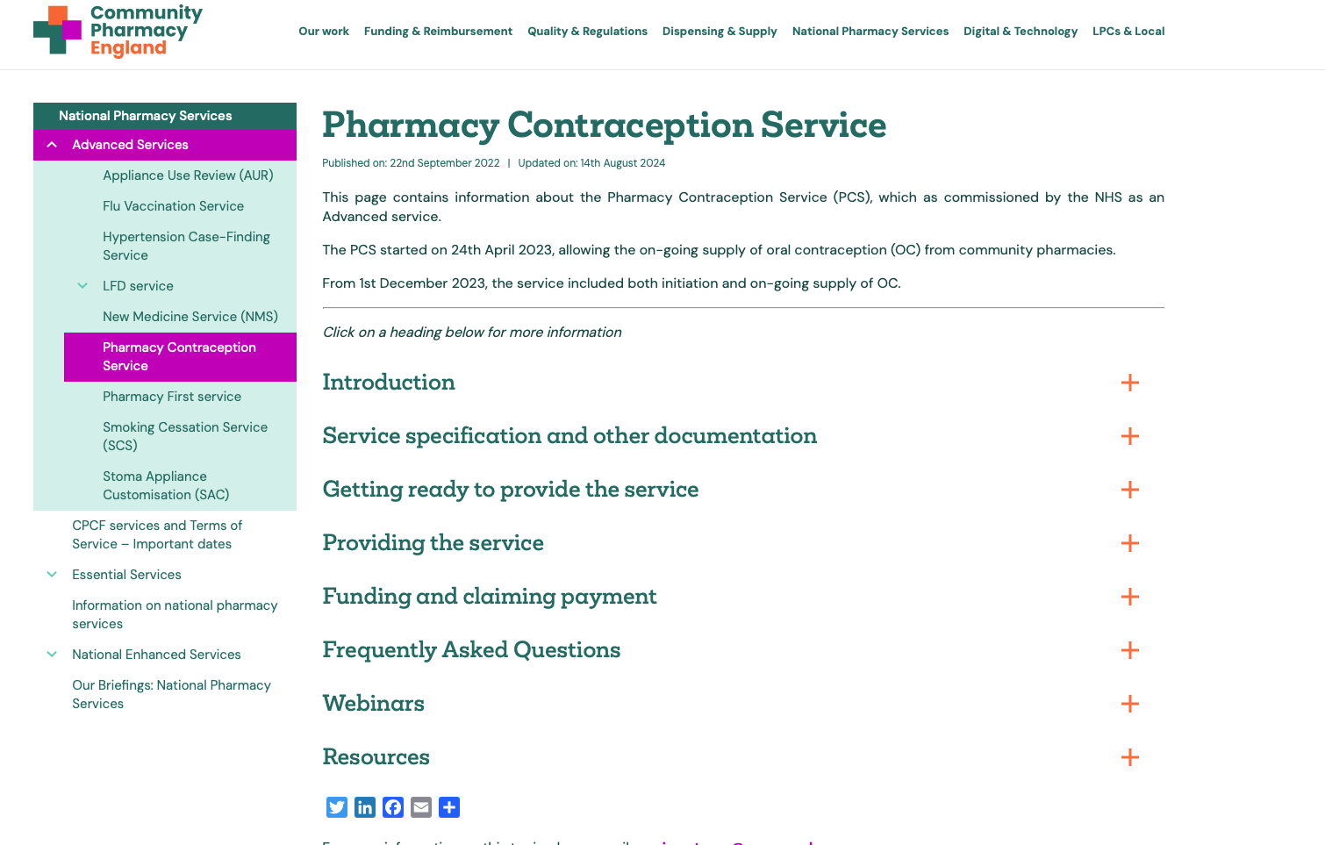
CPE Resources

Slide 19
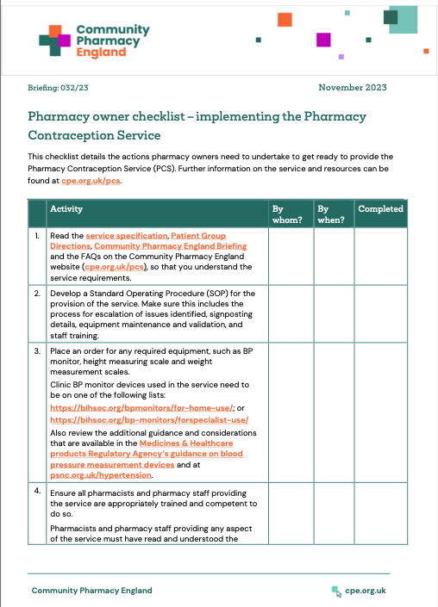
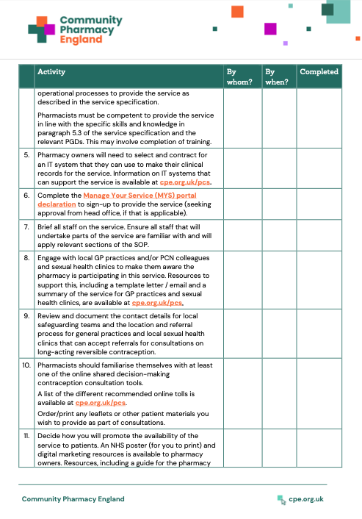
CPE Resources

Slide 20
Thinking Pharmacy First
Sinusitis
Sore Throat

Slide 21
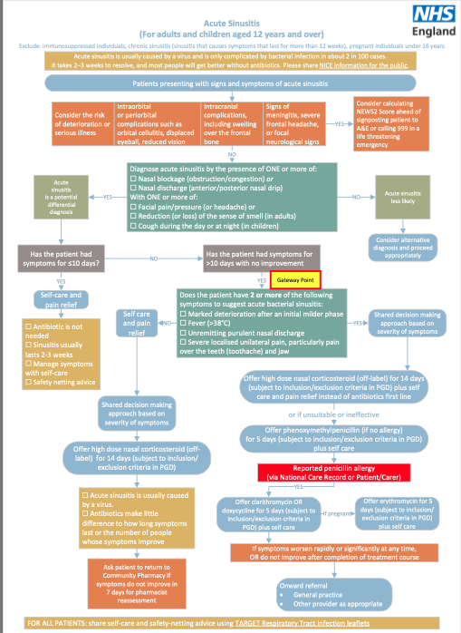
Acute Sinusitis: Key Points
Adults and children aged over 12
Consider the risk of deterioration or serious illness
Presence of ONE or more of
Nasal Blockage or
Nasal Discharge
With ONE or more of
Facial pain / pressure / headache
Reduction of sense of smell
Cough during day or at night
Has the patient had symptoms for > 10 days?

Slide 22
Acute Sinusitis: Key Points
Does the patient have 2 or more of the following:
Marked deterioration
Fever (>38C)
Unremitting purulent nasal discharge
Severe localised unilateral pain, particularly over the teeth and jaw

Slide 23
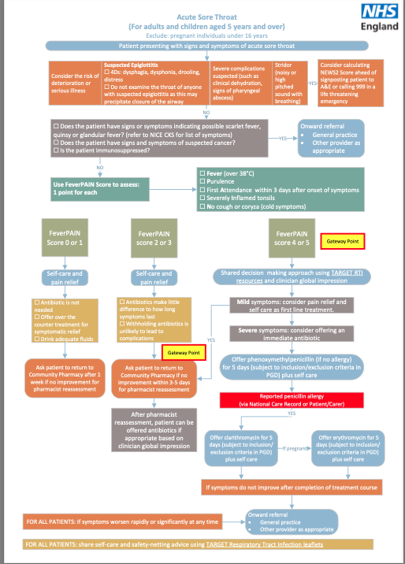
Acute Sore Throat: Key Points
Adults and children aged over 5
Consider the risk of deterioration or serious illness
User FeverPain score to assess
Fever (over 38C)
Purulence
First attendance within 3 days after onset of symptoms
Severely inflamed tonsils
No cough or coryza (cold symptoms)
Patient may reach Gateway point but doesn’t need antibiotics at that stage. Can be advised to return.
This can still be claimed as a Pharmacy First service.

Slide 24
Pharmacy First Referral
NHS 111 – Urgent Supply | NHS 111 – Minor Ailment / Clinical Pathway | GP – Minor Ailment / Clinical Pathway | Self-referral – Clinical Pathway
Via Pharmoutcomes, notification in NHS mail | Via Pharmoutcomes, notification in NHS mail | Via Pharmoutcomes, notification in NHS mail, or NHS mail or Accurx | Walk in, telephone call
Process via Pharmoutcomes or provider of choice
 |  | If via NHS mail or Accurx complete Patient Registration First | Complete Patient Registration
 | Choose Either Minor Illness or Clinical Pathway
If supply required, print Pharmacy First Urgent Supply Token, dispense, charge if appropriate and submit with month end scripts

Slide 25
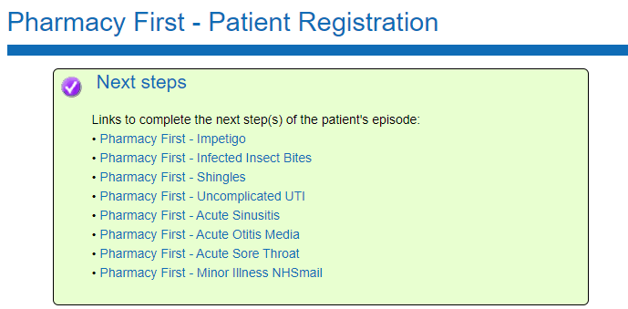
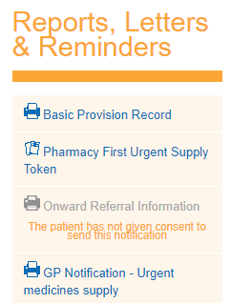

Slide 26
Accurx Referrals

Slide 27
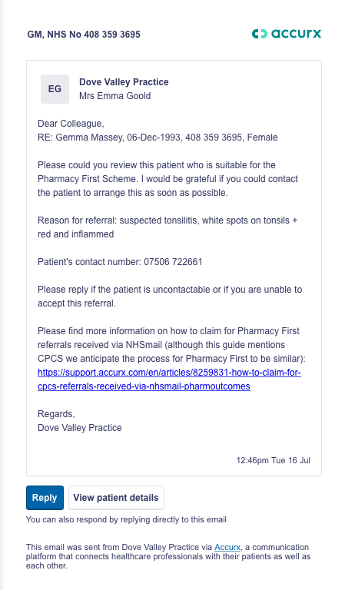
Accurx Referrals
Patient Name
Date of Birth
NHS Number
Contact Number

Slide 28
Patient Safety Issues
Clinical information on advance services not received in a timely manner
Pharmacy fail to send information to surgery
Surgery do not process information
This may apply to:
Hypertension
Contraception
Pharmacy First Urgent Supply
Pharmacy First Minor Ailments
Pharmacy First Clinical Pathway

Slide 29
Resources
southyorkshire.communitypharmacy.org.uk

Slide 30
Questions?

