Slide 1
Lung Cancer Services & Pathways
Catherine Patrick – Lung CNS
M Rahim Khan – Respiratory Consultant

Slide 2
Cancer Services
Trust Cancer Service Lead – Julia Dicks
Trust Cancer Service Manager – Rebecca Cook
Lead CNS – Sara Andrews
Cancer Informatics – Richard Broughton
CPIG – Lorraine Burnett
Lung Cancer Lead – Dr M J Malik, Catherine Patrick
Cancer Support Worker Lead – Sara Andrews

Slide 3
TLHC
USC
(2ww)
Lung Cancer
NOLCP
Internal
Referrals
Inpatient
Referrals
Incidental
Findings

Slide 4
TLHC
SRM
USC
(2ww)
Lung Cancer
NOLCP
CNS
+/- Cons
CNS Triage
CT Thorax
CT Thorax
Internal
Referrals
Inpatient
Referrals
Incidental
Findings
Discharge
Downgraded
Cons/Reg
Cons Triage
+/- CNS input

Slide 5
Usual Patient Journey
Referral
2ww clinic
Pre-MDT
Lung cancer MDT
Post-MDT
Clinic
Onward
Referral
Thoracic surgery
Oncology
Radiotherapy
Chemotherapy / immunotherapy
Palliative care team
Lung CNS Support

Slide 6
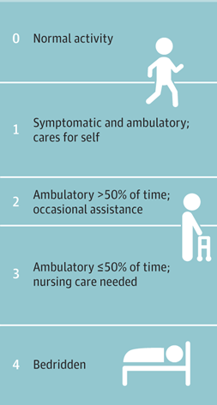
USC (2WW) Clinic
Consultant led
CNS support
Focused
Symptoms and signs
Risk factors
Co-morbidities
Medications
Functional status: Performance status (0-4)
Preferences
Investigations requested

Slide 7
Pre-MDT
Fri 1400
Respiratory Consultants >=2
Lung CNS
MDT coordinator
Radiologist!
Significant reduction in lung MDT numbers

Slide 8
Lung MDT
Tue AM 09:00 – 10:30
Face-to-face & virtual
MDT coordinator
Lung CNS
Respiratory consultants x 2
Radiology consultant
Histopathologist (STH)
Thoracic surgeon (STH)
Oncologist (WPH)
SPCT consultant
+/- Observer / Medical students / Managers

Slide 9
Lung MDT
Investigations Decisions
Least invasive, most informative
Location of cancer
Staging / tissue diagnosis
Patient's preferences

Slide 10
Lung MDT
Treatment Decisions
Fitness
Type of cancer
Location of cancer
Stage of the disease
Co-morbidities
PFTs
Patient's preferences

Slide 11
Investigations
CT
MRI
PET
Ultrasound
PFTs
CPEX
Biopsies – ultrasound-guided, CT-guided
Bronchoscopy / EBUS / EUS / Mini probe
Navigational bronchoscopy
Pleural aspiration / biopsy
Medical thoracoscopy
VATS
Mediastinocopy
Ct DNA (Liquid biopsy)

Slide 12
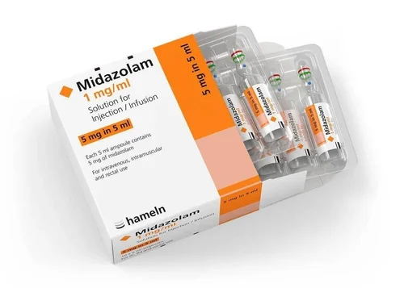
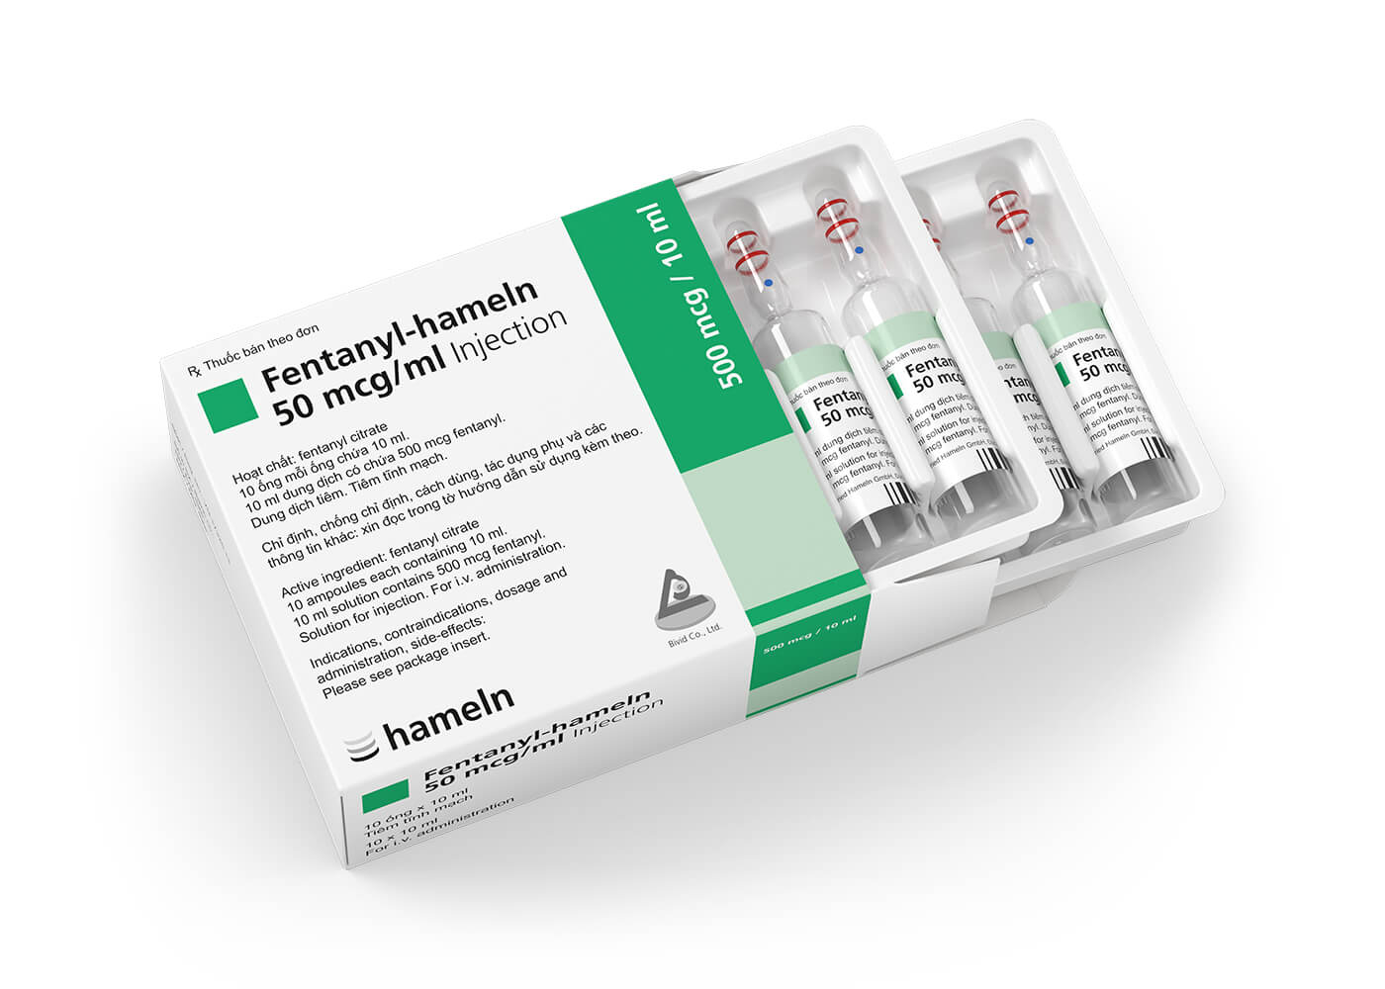
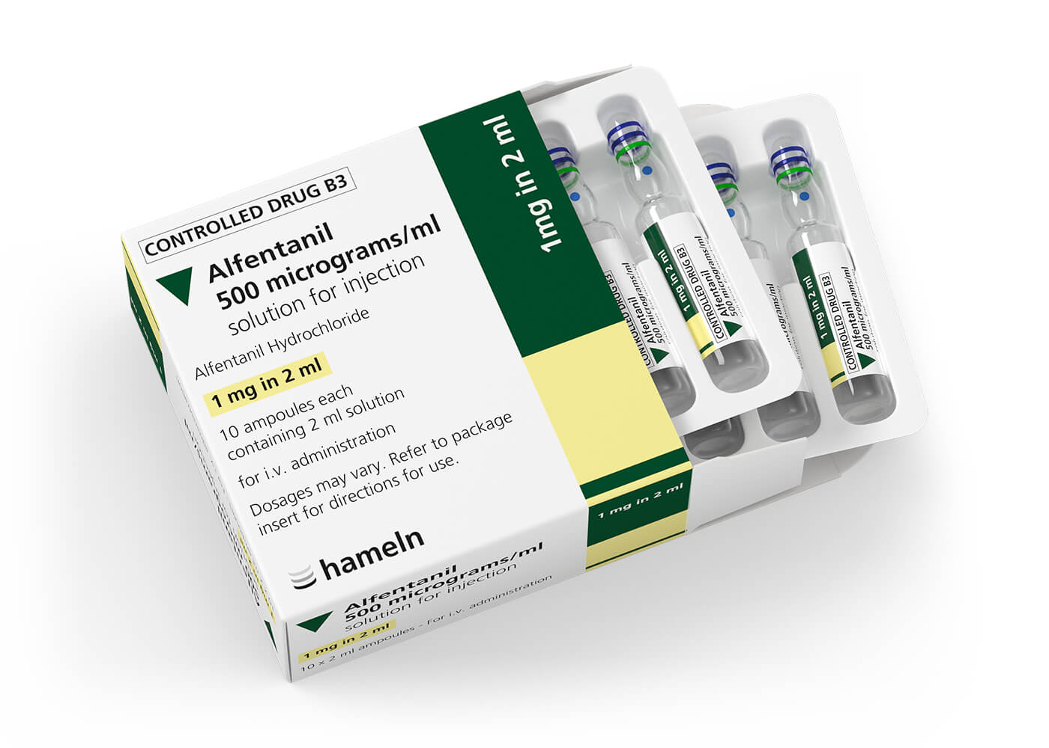
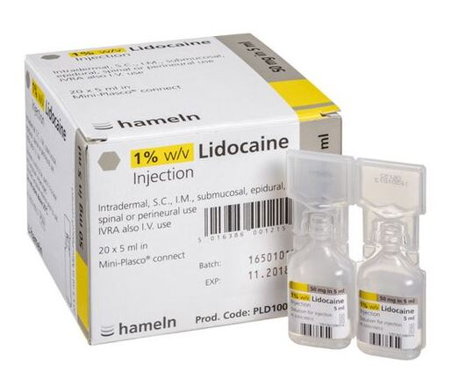
Bronchoscopy / EBUS / EUS
Day case
Respiratory x 4
Twice a week +/- ad hoc
Conscious sedation
Local anaesthetic

Slide 13
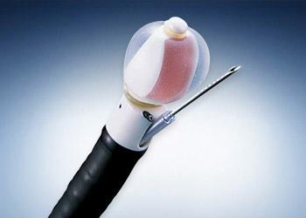
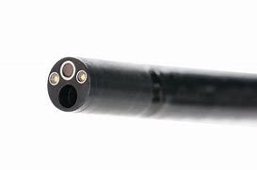
Bronchoscopy
EBUS

Slide 14
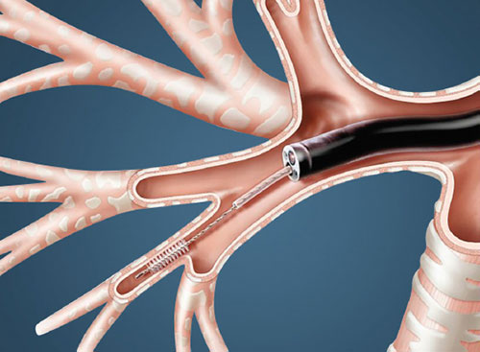
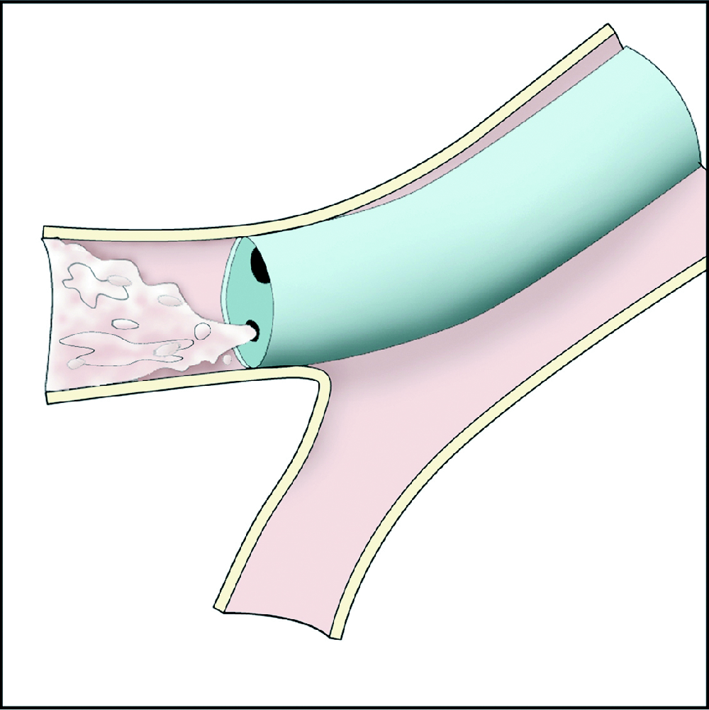

Slide 15
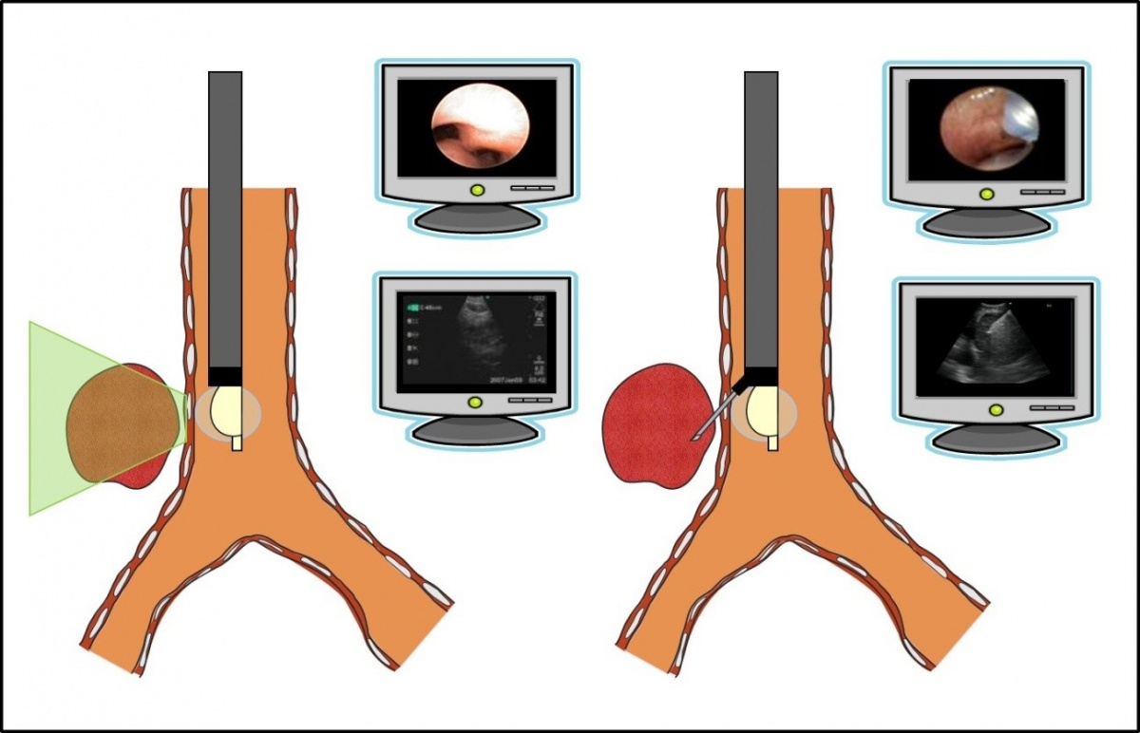

Slide 16
Pleural Procedures
Ultrasound-assisted/guided
Diagnostic aspiration
Therapeutic aspiration
Pleural biopsies
IPC
Lung biopsies
US-guided
CT-guided
Medical thoracoscopy
VATS
Mediastinoscopy

Slide 17
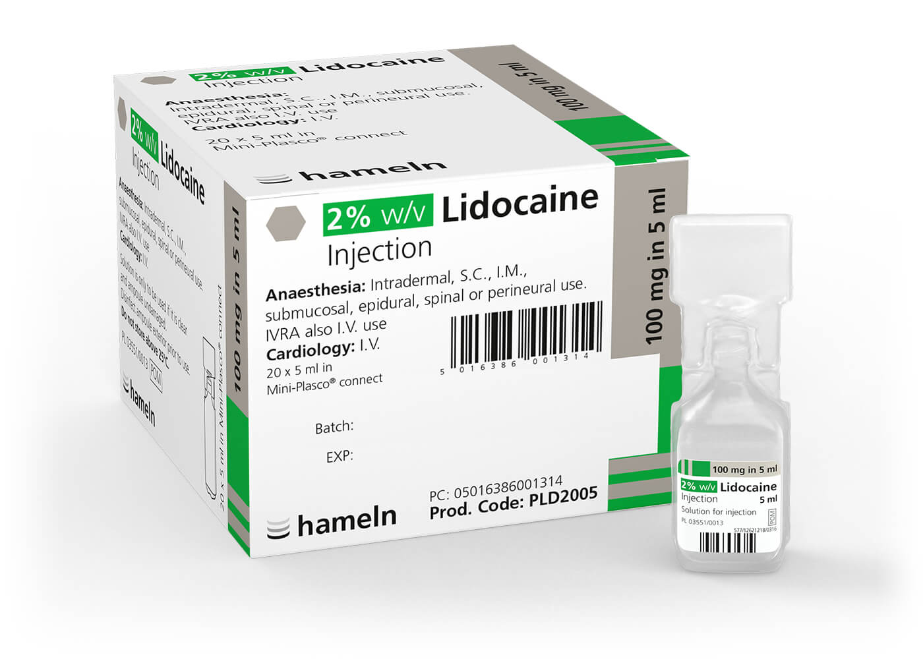
Pleural Procedures
Day case
Respiratory +/- Radiology
Local anaesthetics
Twice a week +/- ad hoc

Slide 18
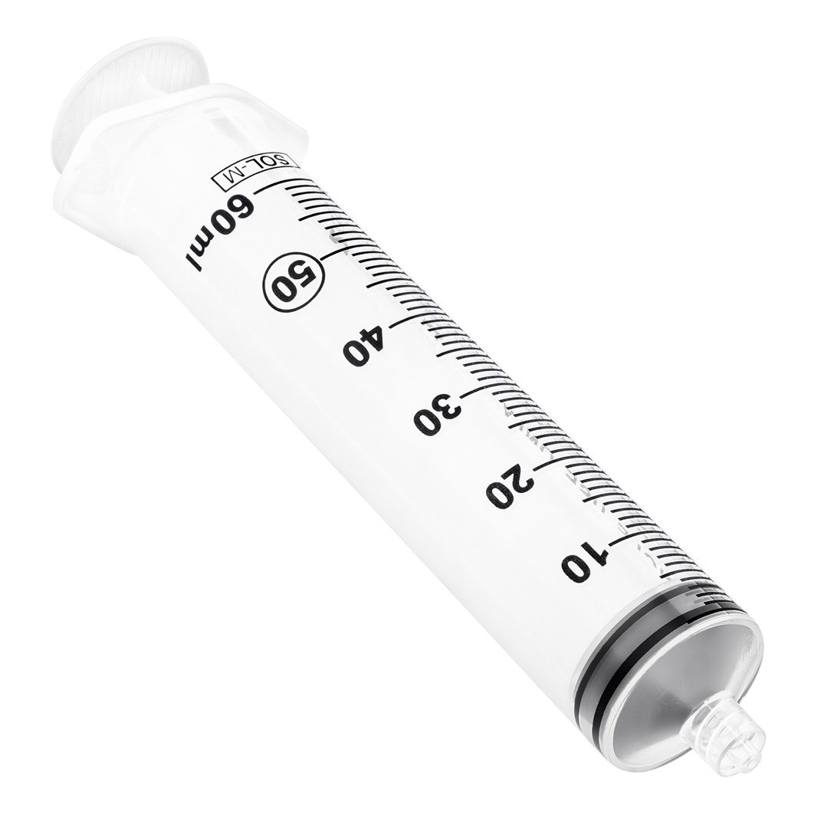
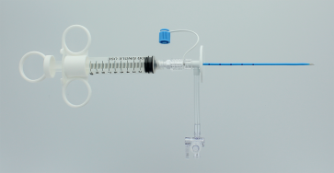
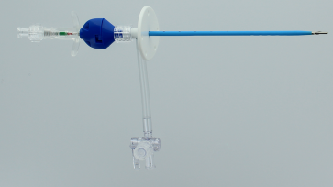
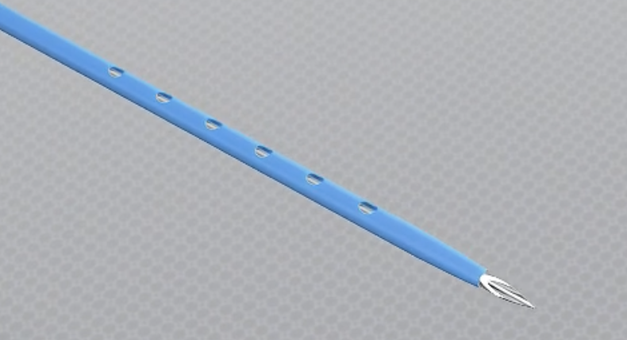

Slide 19
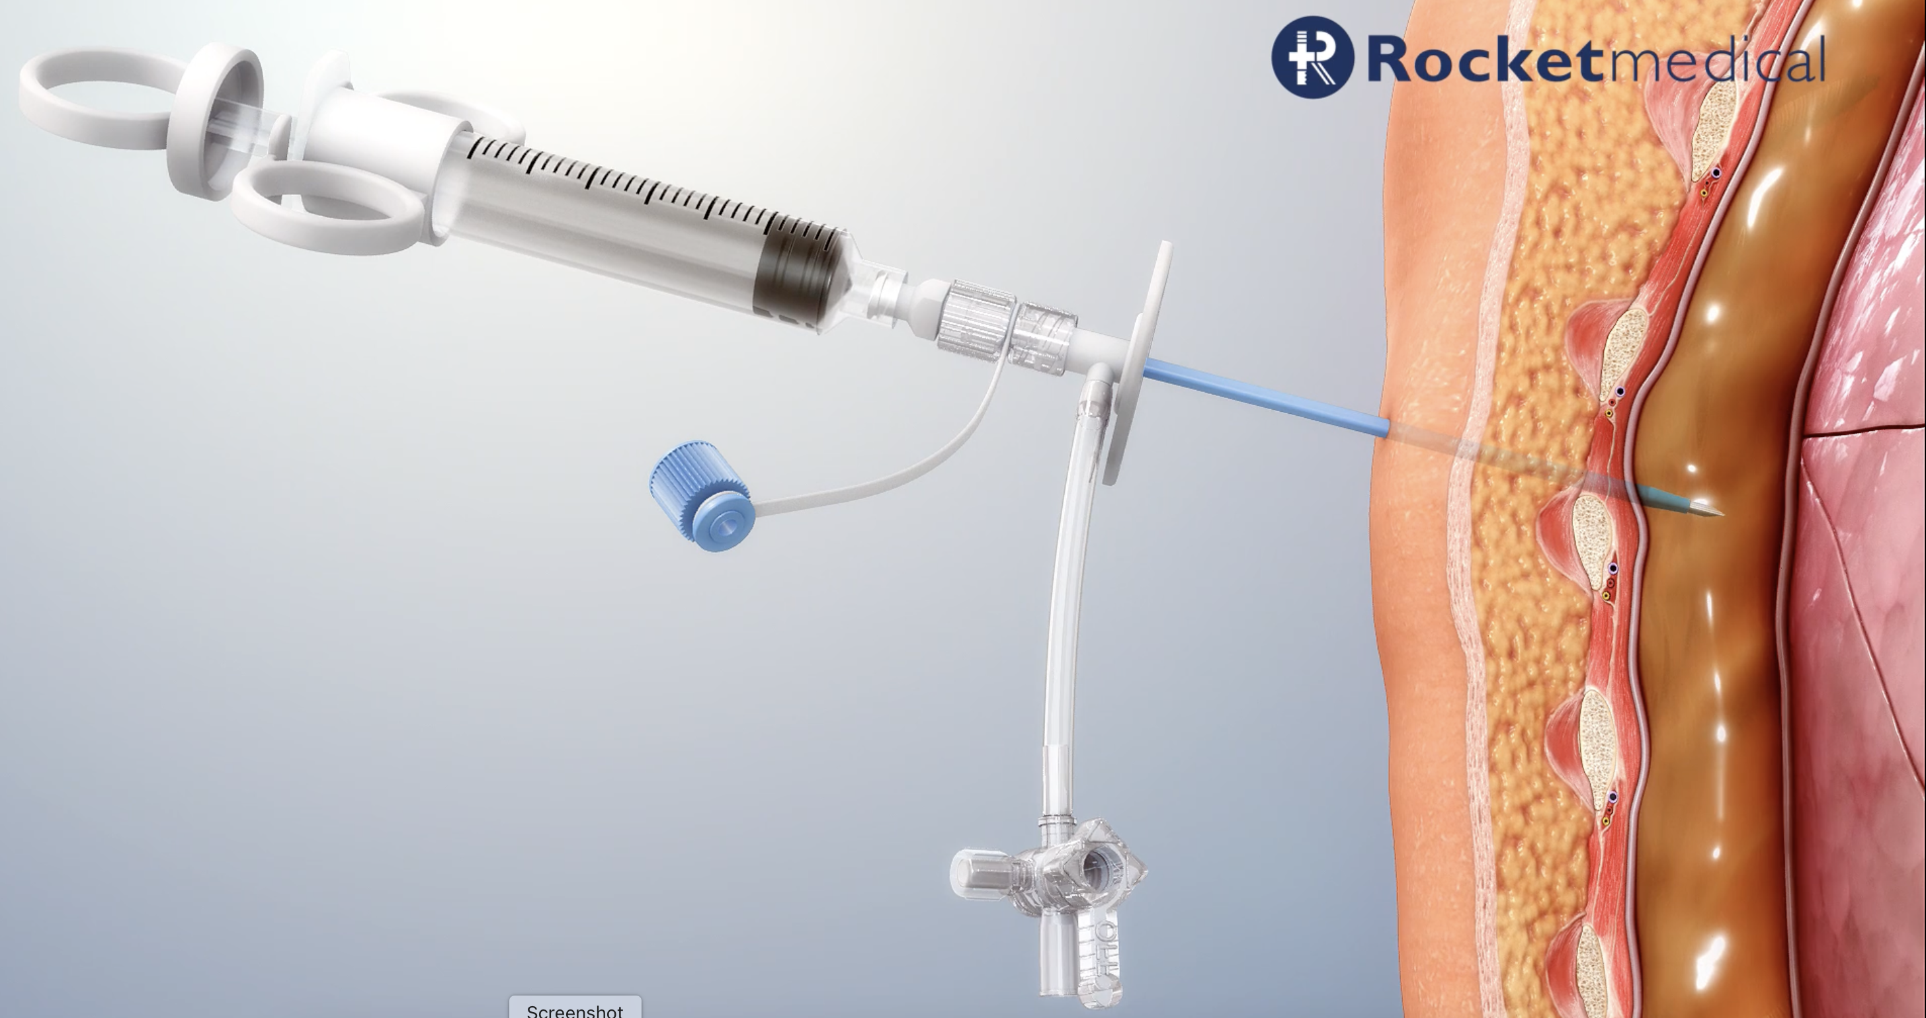

Slide 20
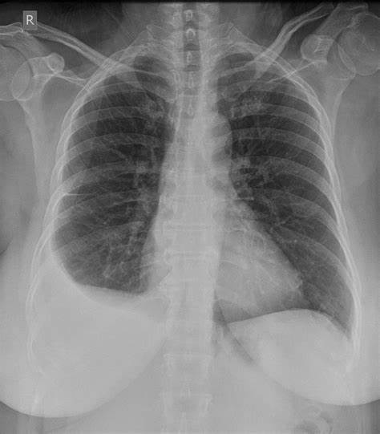

Slide 21
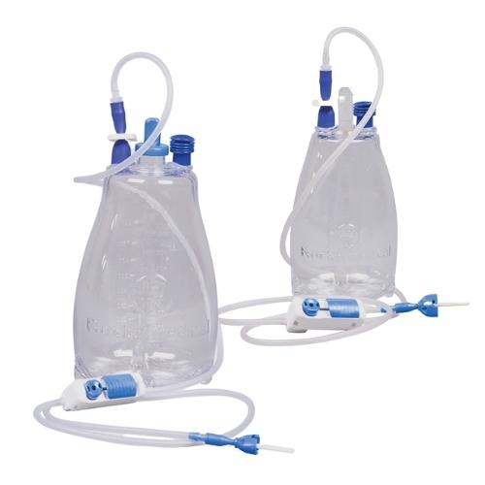
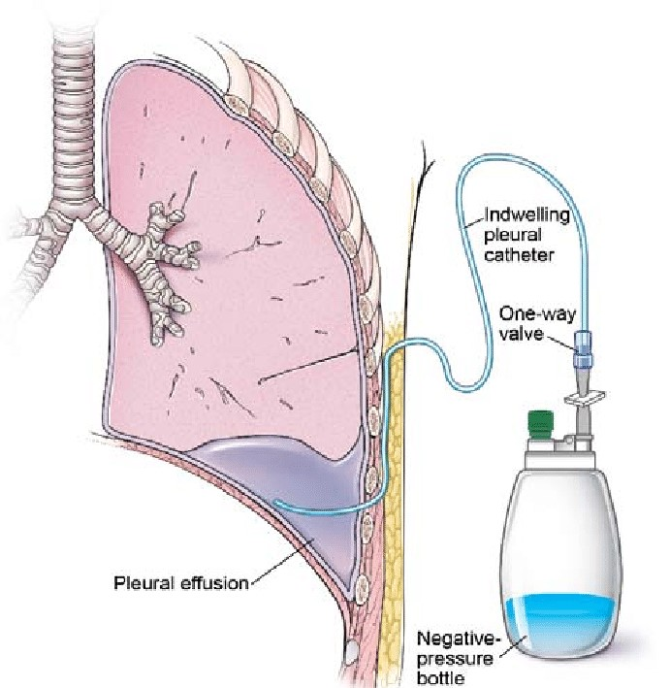
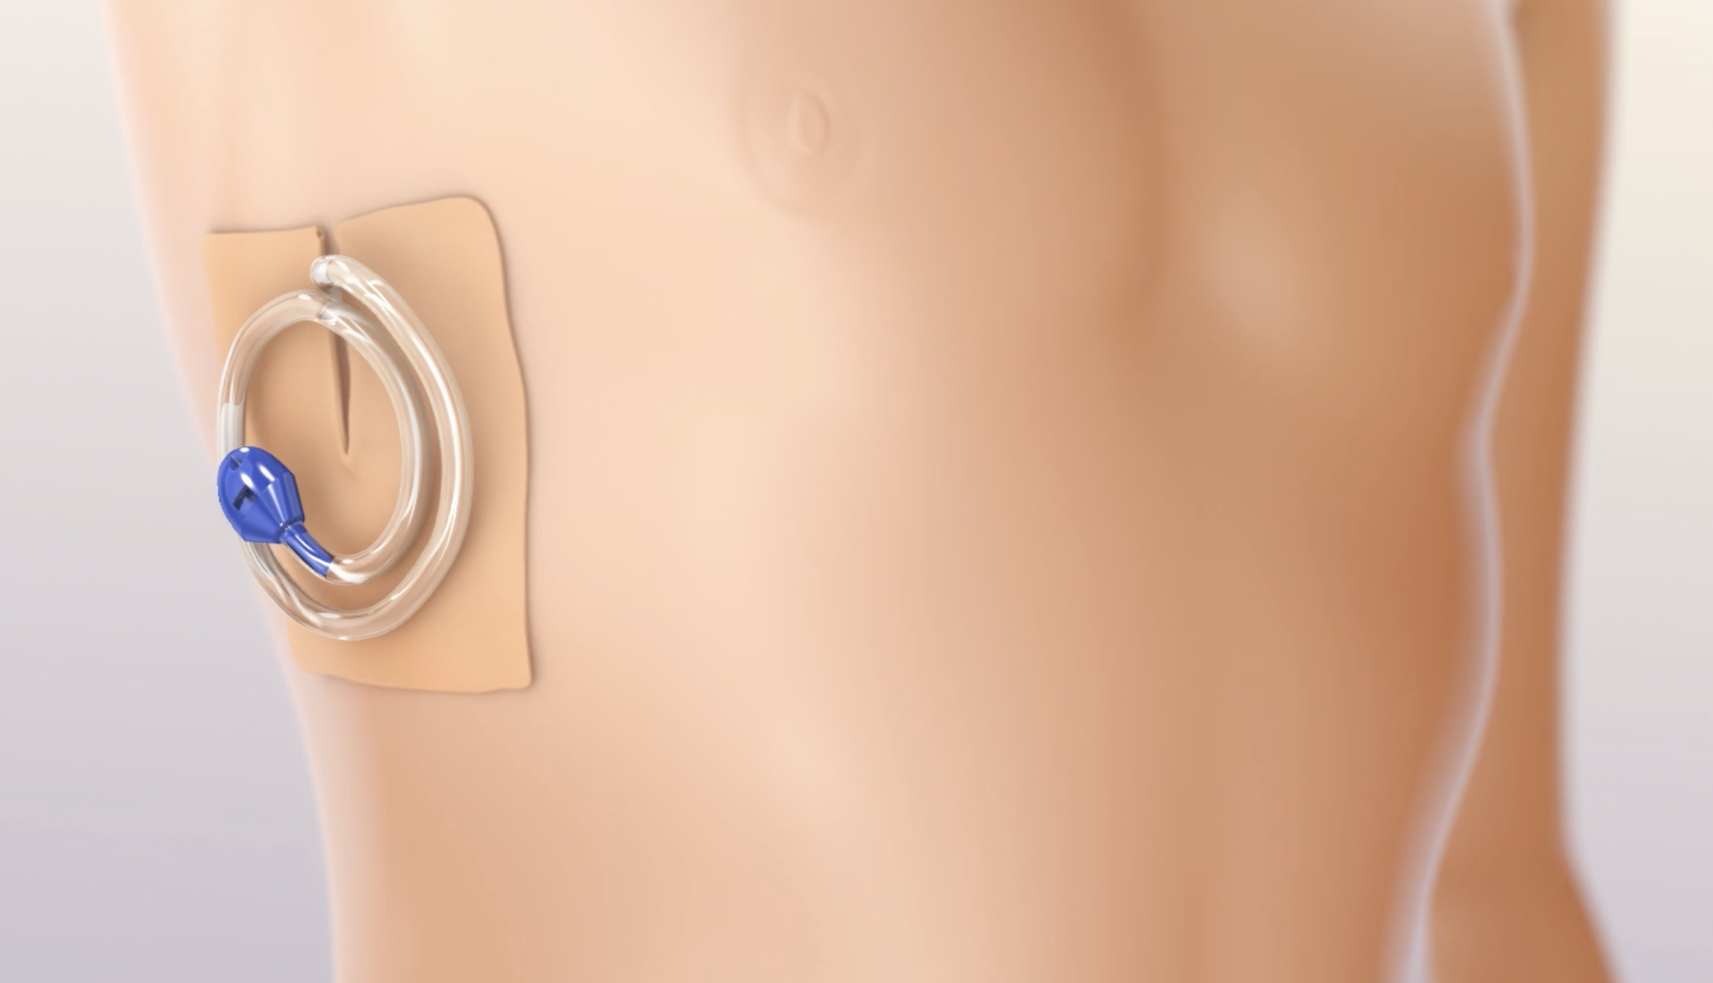

Slide 22
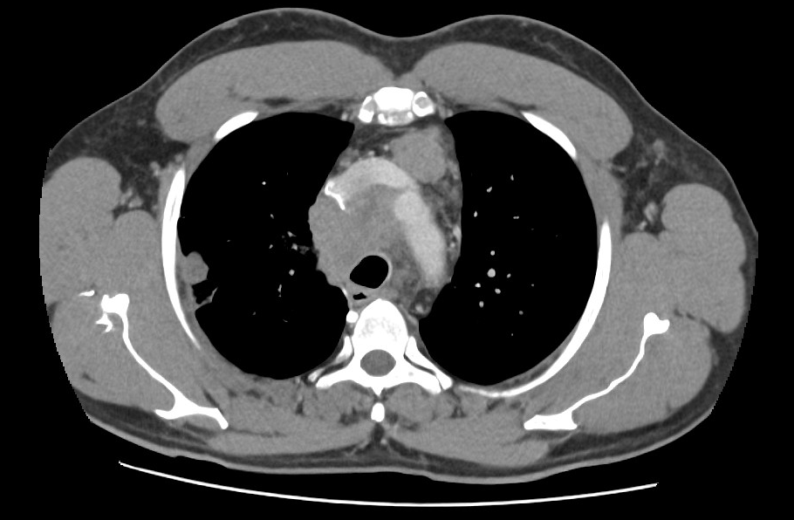
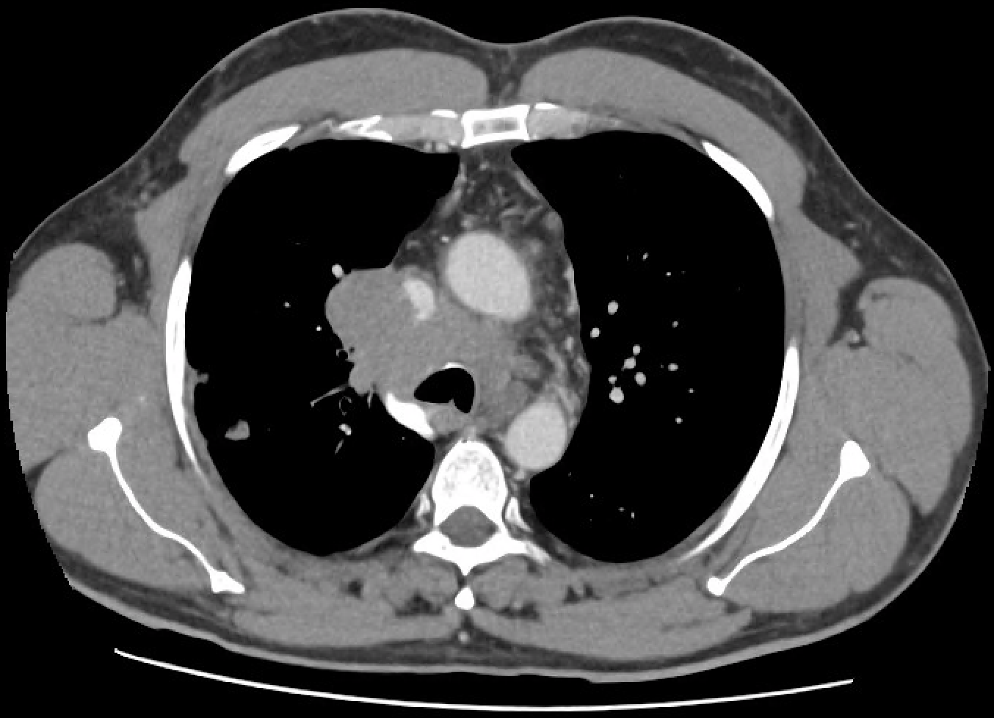

Slide 23
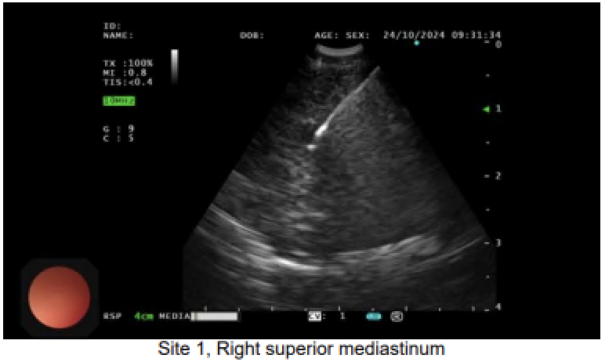
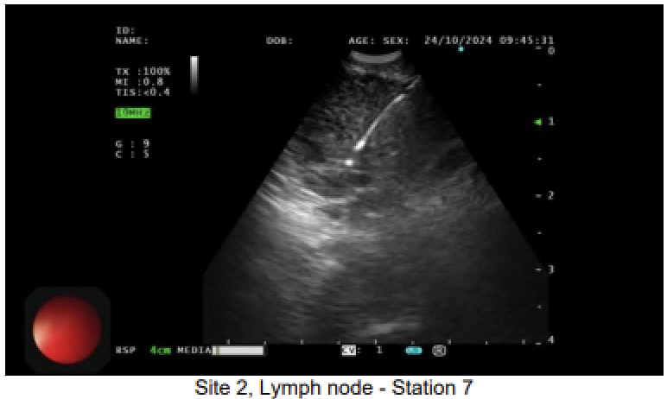

Slide 24
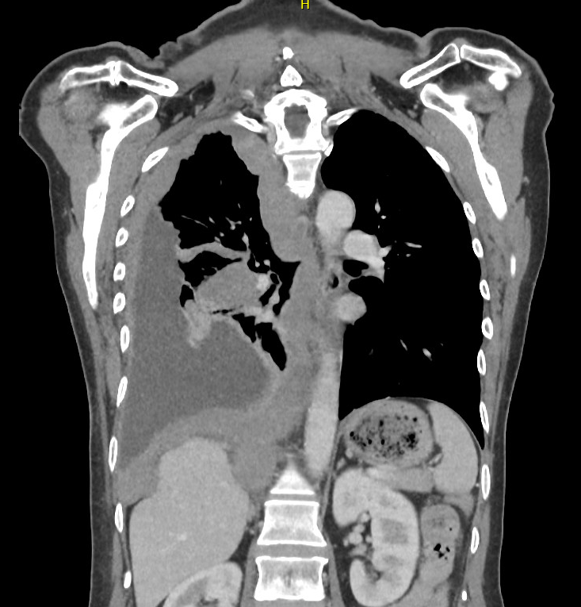
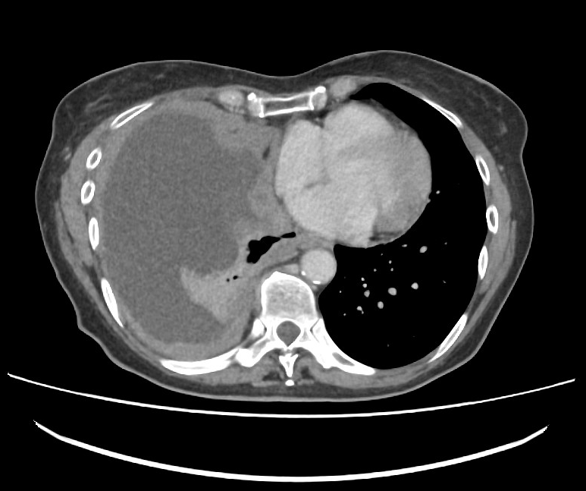

Slide 25
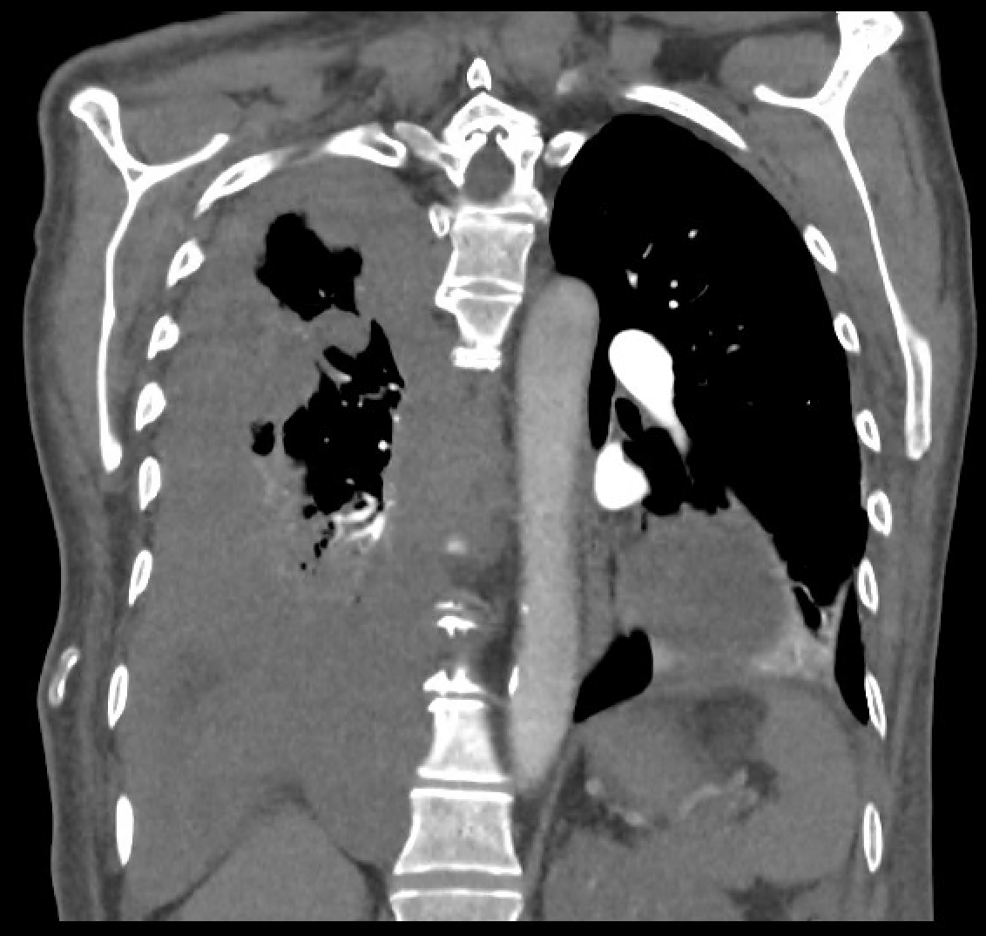
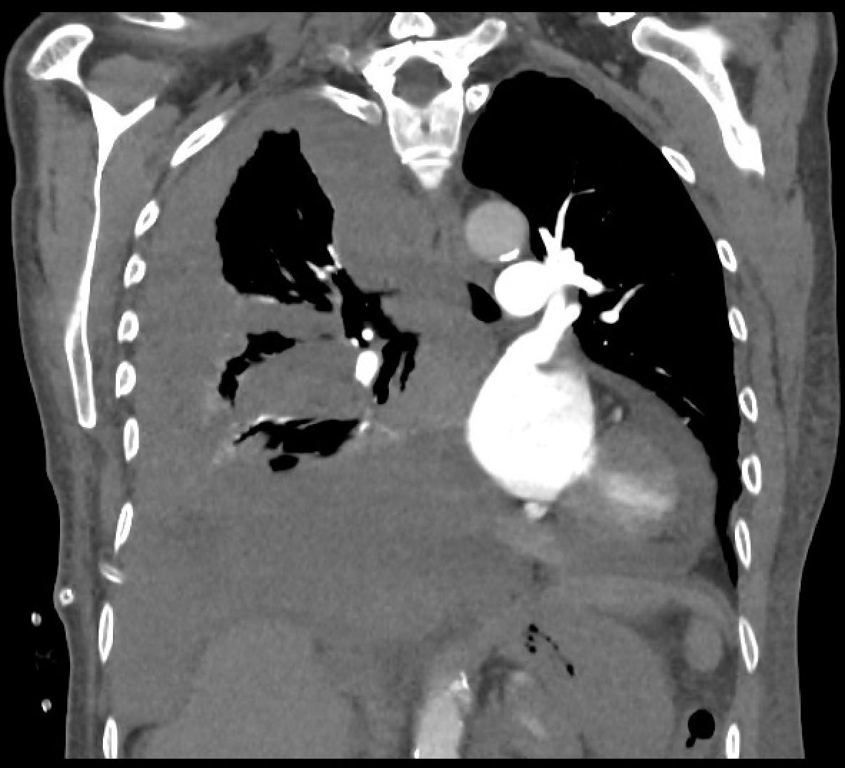
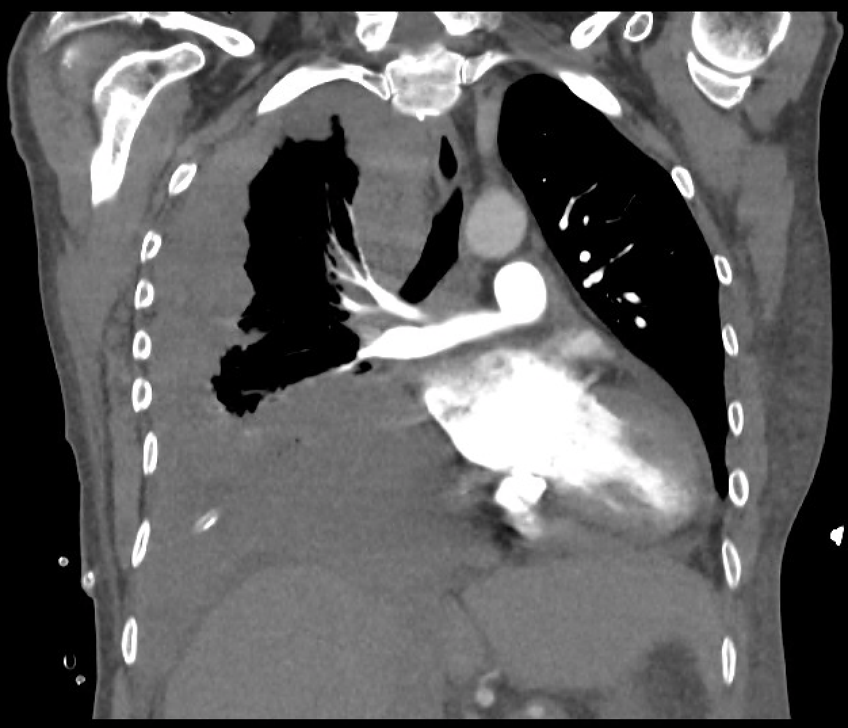

Slide 26
It’s not always cancer.

Slide 27
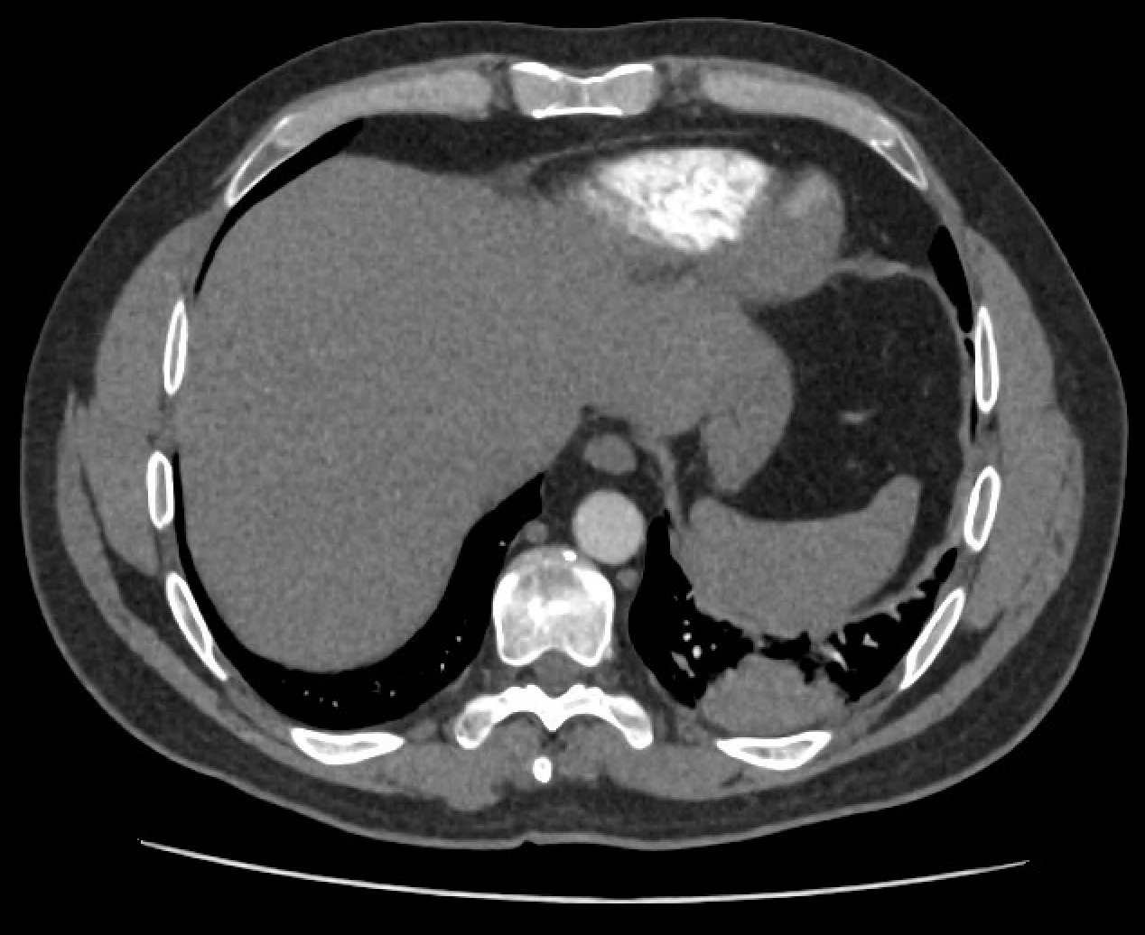
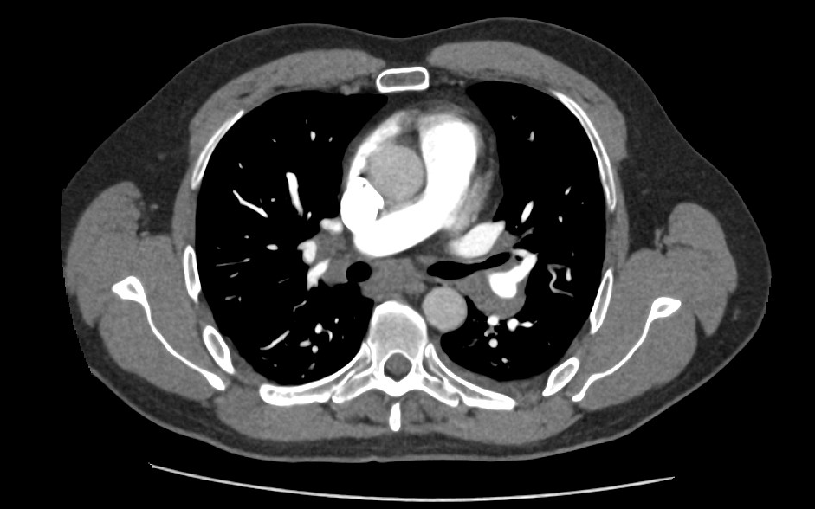
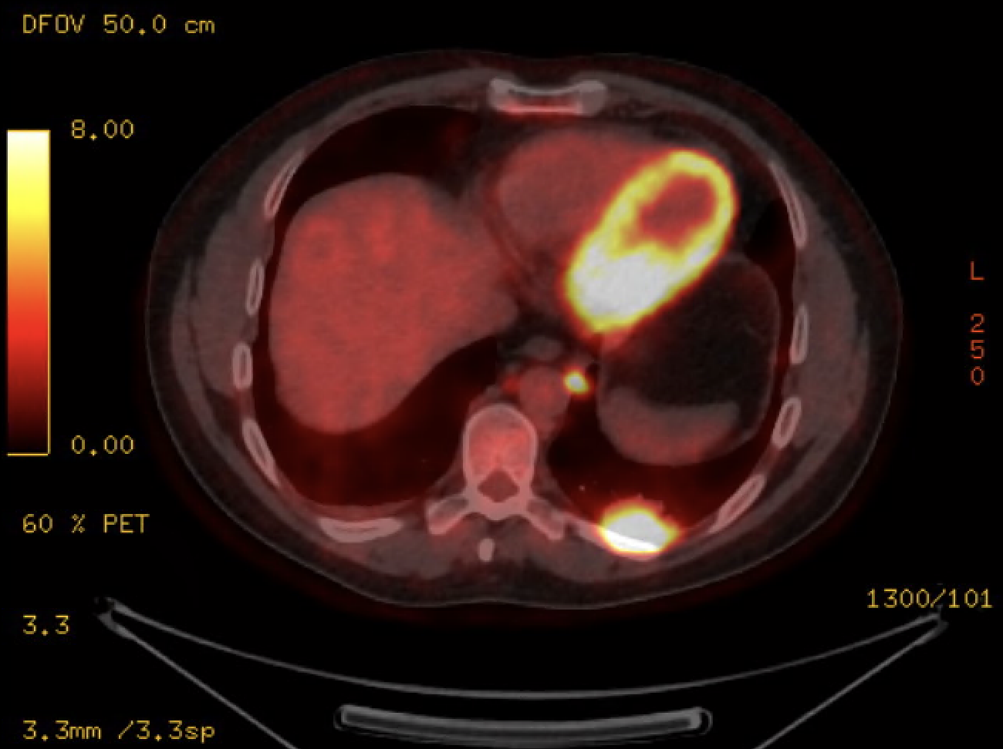

Slide 28
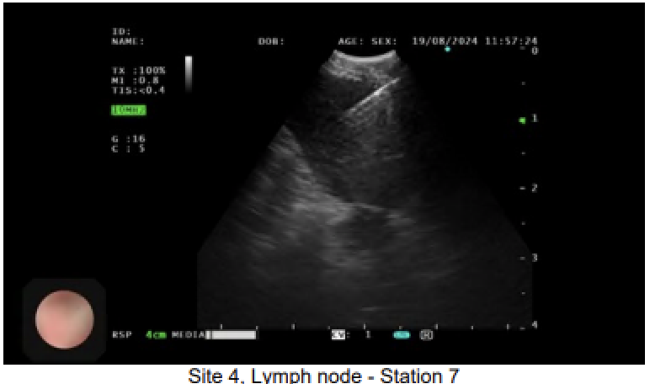
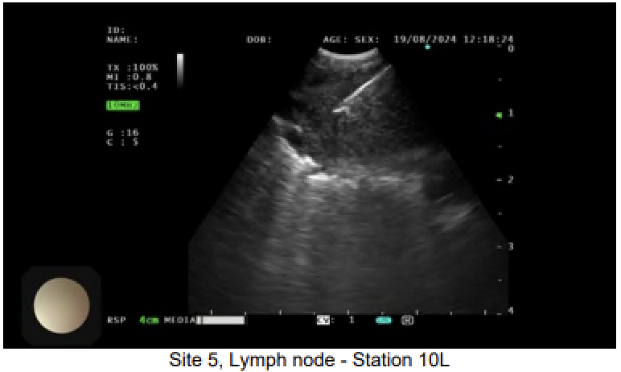
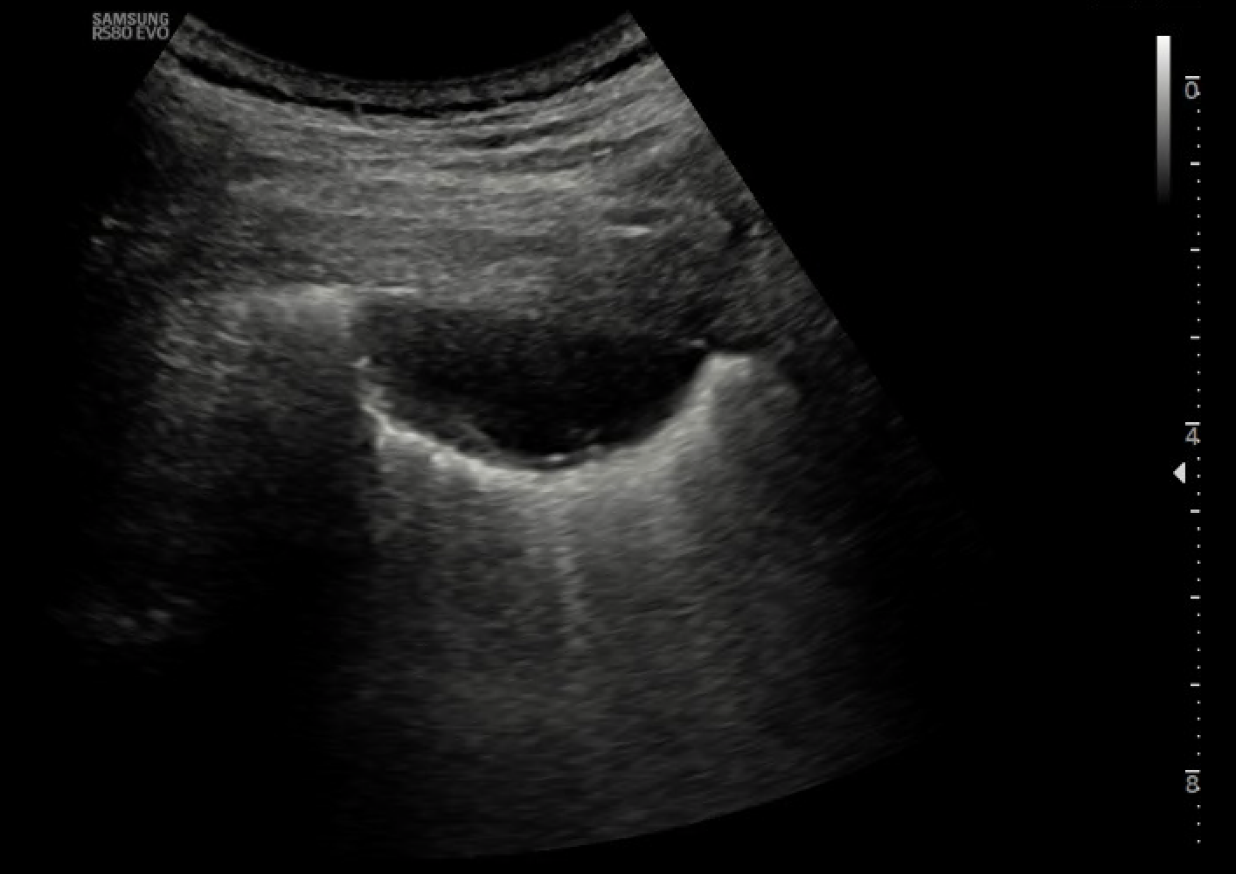

Slide 29
Targeted Lung Health Check
Targeted population
55 - 75yr
Smoking history
Calculated high risk
CT thorax
Incidental findings
SRM
Referral back to program
Referral to specialties
2-year cycle
Low dose
Unenhanced
Fri 1400

Slide 30
Targeted Lung Health Check
NOT JUST LUNG CANCER
Oesophageal
Breast
Renal
Adrenal / pheochromocytoma

Slide 31
Targeted Lung Health Check
NOT JUST CANCER
Coronary artery calcifications
Adrenal nodules
Emphysema
Pulmonary infections
Pulmonary fibrosis
Aortic aneurysms (thoracic, abdominal)
Osteoporotic bone fractures
etc.

Slide 32
TLHC Referrals From SRM

Slide 33
Targeted Lung Health Check
(31st Mar 2023 – 31st Oct 2024)
93 patients have been diagnosed with lung cancer
Stage I – 53 (57%)
Stage II – 12 (12.9%)
Stage III – 12 (12.9%)
Stage IV – 13 (14%)
Unstaged – 3 (3.2%)

Slide 34
Targeted Lung Health Check
24 patients have been diagnosed with another cancer
Urology
Upper GI
Breast

Slide 35
Thank you

