Slide 1

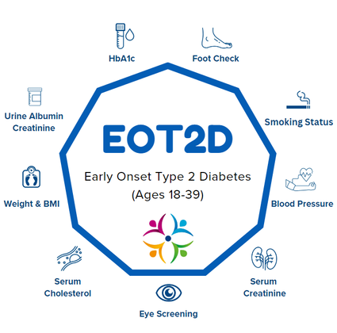

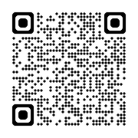






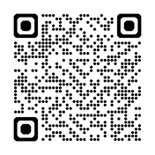

Cambridge Diabetes Education Programme (CDEP)
Your Diabetes
Your Journey
Early Onset Type 2 Diabetes
FREE for staff across South Yorkshire. ​
CDEP is an online diabetes training platform which can be accessed by all levels of staff, both registered and unregistered at any time.​
To register scan the QR code.
Under “Registration Key Code” enter “SOUTHYORKSHIRE”
This will provide you with free access for 12 months.​
Scan the QR code to access the Your Diabetes Your Journey Webpage and tool kit.
App
Improving care for adults
18-39 with
Type 2 Diabetes
Access a variety of essential films and resources for Type 2 diabetes, covering topics like sick day rules, healthy eating, exercise management, meal planning, healthy swaps, and motivation support for self-management.
This online course is tailored for healthcare professionals working with young adults (18-39) with early onset type 2 diabetes, helping them improve treatment outcomes and address specific care gaps.
Scan the QR code to download the DigiBete app and use Clinic Code: DVIKG
For more information and to access the course, scan the QR code

Slide 2

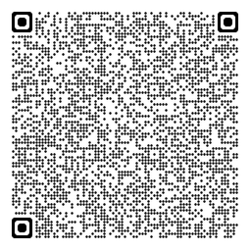
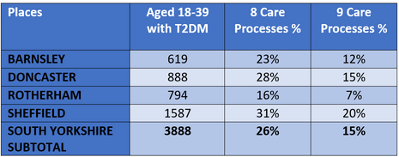

What?
How?
Prevent the Impending Tsunami of EOT2D
T2 Day is a nationally funded NHSE programme to improve the care of people with T2D aged 18-39yrs (EOT2D). SYICB has a team supporting this programme (see contacts).
We can improve the care of this cohort by:​​
  Identifying our patient population – clinical searches or ECLIPSE tool. ​
  Check their KCP completion in the last 12 months Recall/follow up outstanding KCPs.​​
  Ensure women with T2D have had preconception advice and are on contraception where needed.​ CODE CONVERSATIONS.​
  Check eligibility and offer referral to T2D Remission programme.​​
  Check if diagnosis fits clinical picture –if not, question/ask advice/refer.​
  Identify all eligible patients for National Diabetes Prevention Programme (NDPP)and offer referral. (£11.50 per referral)​​
  Identify women with h/o GDM – preconception advice and referral to NDPP.​​
  Utilise all educational programmes – DESMOND, Healthy Living with T2D, Digital Weight Management Programme, More Life, Carb Smart etc.​
Why?
EOT2D is associated with faster progression of disease, more complications and reduced life expectancy BUT worse uptake of Key Care Processes (KCPs) and lower achievement of HBA1c =/<48. Also higher risk of maternal and neonatal complications.​​
You can visit our SharePoint page for more information by scanning the QR code
Consider
South Yorkshire 12 months Data up to 21st January 2025
  Flexibility re appointments to family/work commitments.​​
  Tailored approach might be needed – phone calls, letters, texts.​​
  Utilize additional roles –care coordinator, health coach, admin, HCA, to engage patient.​​
  Consider language/literacy barriers in comms.​​
  Offer age appropriate resources e.g. “Your Diabetes Your Journey” website.​
Contact Details
syicb-sheffield.sydiabetes@nhs.net

